Slide 1
How to address common misconceptions about the Standard Days Method® (SDM)

Slide 2
Common misconceptions about SDM
“Because SDM is natural, it can’t be very effective.”
“SDM does not seem like a modern method.”
“SDM sounds just the same as the rhythm method.”
“Women will not have the power to decide when to have sex.”
“Men won’t like this method.”
“If we offer this method, clients using modern methods will switch to SDM.”
“There wouldn’t be much demand for SDM.”
“SDM counseling would take too much time, just like other natural methods.”
“It would be hard for illiterate women to use SDM.”
“More educated women would not be interested in using SDM.”

Slide 3
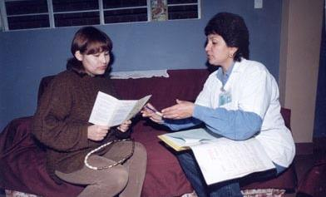
“Because SDM is natural, it can’t be very effective.”

Slide 4
Fact: SDM is a natural, effective method
Rigorously tested in a multi-site efficacy trial.
Found to be 95% effective with correct use.
Efficacy rate compares to other user-directed methods.
Successful use requires motivation by the couple to avoid unprotected sex during the fertile window.
97% of the couples in the efficacy study followed this rule.
Notes:
References:
Arévalo, M., V. Jennings, and I. Sinai. 2002. “Efficacy of a new method of family planning: The Standard Days Method.” Contraception 65(5):333-338.
Gribble, J., R. Lundgren, C. Velasquez, and E. Anastasi. 2008. “Being strategic about contraceptive introduction: the experience of the Standard Days Method®.” Contraception. 77(3): 147-154.

Slide 5
SDM efficacy study
Multi-site prospective study
Services provided in existing programs
Clients followed monthly for 13 cycles
478 women in the study, 43 became pregnant
Couples used the method correctly in 97% of cycles
With correct use, the failure rate is 4.8
With typical use the failure rate is 12.0

Slide 6
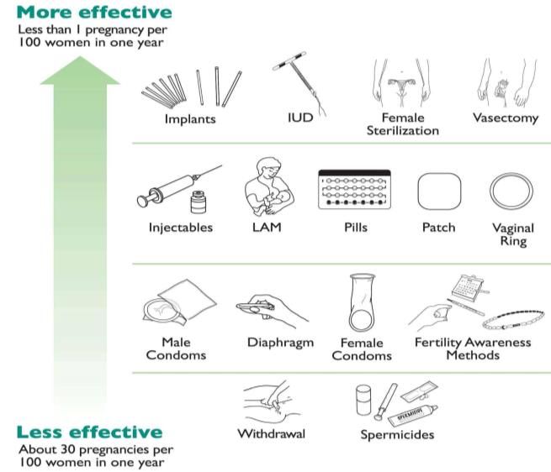
Comparing effectiveness of FP methods
Source: Family Planning: A Global Handbook for Providers 2007, WHO
Notes:
References:
WHO 4 cornerstone documents: Medical Eligibility Criteria for Contraceptive Use (2004) , Selected Practice Recommendations for Contraceptive Use (2005) , Decision-Making Tool for Family Planning Clients and Providers (2005), Family Planning: Global Handbook for Providers (2007)
Hatcher, R. et al. 2007. Contraceptive Technology 19th Revised Edition. New York: Ardent Media, Inc.

Slide 7
“SDM does not seem like a modern method.”

Slide 8
Fact: SDM is a modern FP method
Based on recent findings of research in reproductive biology.
Developed following the scientific model and using modern research tools, including computer modeling.
Clinically tested following universally accepted research methodology.
It is included in State of the Art (SOTA) guidelines published by WHO.
Notes:
References:
The Standard Days Method®: A Modern Family Planning Method
http://irh.org/resource-library/the-standard-days-method-a-modern-family-planning-method/

Slide 9
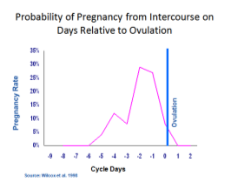
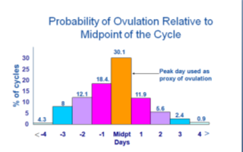
Standard Days Method is based on:
Probability of pregnancy relative to ovulation.
Viable sperm – up to 5 days
Viable egg – up to 24 hours
Timing of ovulation.
Menstrual Cycle mid-point ± 3 days
Notes:
With regard to the probability of pregnancy from intercourse on days relative to ovulation, ultrasound and hormonal studies have found that these are 6 days during the menstrual cycle when it is possible for a woman to become pregnant.
Data on the probability of pregnancy on different days around ovulation indicates that:
There is approximately a 4% probability of pregnancy from intercourse 5 days before ovulation.
This increases to 15%, 4 days before ovulation.
The highest probability of pregnancy – between 25 and 28% -- is on the 2 days before ovulation.
On the day of ovulation, there is an 8-10% probability.
Fertility then decreases – with a 0% probability of pregnancy by the day after ovulation.
These probabilities are due to the limited viable life span of the sperm after ejaculation (not more than 5 days) and to the very limited viable life span of the egg following ovulation (less than 24 hours).
Together these result in an actual fertile window of no more than 6 days during the woman’s cycle. On all the other days, the woman cannot become pregnant.
Putting this in practical terms, if a woman has sex on Saturday and ovulates the following Wednesday, she has a 10 – 12% chance of getting pregnant that cycle. But if she has sex on Saturday and doesn’t ovulate until the following Friday, she has a basically zero % chance of pregnancy.
But how do we know the moment ovulation occurs, and thus know the exact fertile window?
Again, consider probabilities. Data on when during the cycle ovulation occurs indicates that in the great majority of cycles, ovulation occurs very close to the middle of the cycle.
In approximately 30% of cycles, ovulation occurs at the mid point (for example, on or very close to day 14 in a 28 day cycle, or day 15 in a 30 day cycle).
In approximately 60% of cycles, ovulation occurs within 1 day before or after mid cycle.
And in approximately 78% of cycles, ovulation occurs within 2 days before or after the midpoint.
By 4 days before or after midpoint, 95% of ovulations have occurred.
References:
Arevalo M, Sinai I, Jennings V. A fixed formula to define the fertile window of the menstrual cycle as the basis of a simple method of Natural Family Planning. Contraception 1999;60:357–60.
Arévalo, M., V. Jennings, and I. Sinai. 2002. “Efficacy of a new method of family planning: The Standard Days Method.” Contraception 65(5):333-338. The method is currently offered in over 30 countries.

Slide 10
Probability of Pregnancy from Intercourse on Days Relative to Ovulation
Ovulation
Pregnancy Rate
Cycle Days
Source: Wilcox et al. 1998
Notes:
With regard to the probability of pregnancy from intercourse on days relative to ovulation, ultrasound and hormonal studies have found that these are 6 days during the menstrual cycle when it is possible for a woman to become pregnant.
Data on the probability of pregnancy on different days around ovulation indicates that:
There is approximately a 4% probability of pregnancy from intercourse 5 days before ovulation.
This increases to 15%, 4 days before ovulation.
The highest probability of pregnancy – between 25 and 28% -- is on the 2 days before ovulation.
On the day of ovulation, there is an 8-10% probability.
Fertility then decreases – with a 0% probability of pregnancy by the day after ovulation.
These probabilities are due to the limited viable life span of the sperm after ejaculation (not more than 5 days) and to the very limited viable life span of the egg following ovulation (less than 24 hours).
Together these result in an actual fertile window of no more than 6 days during the woman’s cycle. On all the other days, the woman cannot become pregnant.
Putting this in practical terms, if a woman has sex on Saturday and ovulates the following Wednesday, she has a 10 – 12% chance of getting pregnant that cycle. But if she has sex on Saturday and doesn’t ovulate until the following Friday, she has a basically zero % chance of pregnancy.
But how do we know the moment ovulation occurs, and thus know the exact fertile window?
References:
Wilcox AJ, Weinberg CR, Baird DD. Post-ovulatory aging of the human oocyte and embryo failure. Hum Reprod 1998;13:394–7.

Slide 11
Probability of ovulation relative to midpoint of the cycle
30.1
30
25
Peak day used as proxy of ovulation
20
18.4.
% of cycles
15
12.1
11.9
10
8
5.6
5
2.4
4.3
0.9
0
<
-4
-3
-2
-1
Midpt
1
2
3
>
4
Days
Source: IRH analysis of WHO 1981 data
Notes:
Again, consider probabilities. Data on when during the cycle ovulation occurs indicates that in the great majority of cycles, ovulation occurs very close to the middle of the cycle.
In approximately 30% of cycles, ovulation occurs at the mid point (for example, on or very close to day 14 in a 28 day cycle, or day 15 in a 30 day cycle).
In approximately 60% of cycles, ovulation occurs within 1 day before or after mid cycle.
And in approximately 78% of cycles, ovulation occurs within 2 days before or after the midpoint.
By 4 days before or after midpoint, 95% of ovulations have occurred.
References:
Arevalo M, Sinai I, Jennings V. A fixed formula to define the fertile window of the menstrual cycle as the basis of a simple method of Natural Family Planning. Contraception 1999;60:357–60.
Arévalo, M., V. Jennings, and I. Sinai. 2002. “Efficacy of a new method of family planning: The Standard Days Method.” Contraception 65(5):333-338. The method is currently offered in over 30 countries.

Slide 12
Determining the fertile window
Day 8
Day 19
Notes:
With a combination of these probabilities – the probability of pregnancy on different cycle days related to ovulation, and the probability of the timing of ovulation -- it was possible to identify the days when pregnancy is VERY LIKELY and the days when it is MOST UNLIKELY. In menstrual cycles between 26 and 32 days long (which accounts for more than 80% of all cycles), the days pregnancy is very likely are days 8 through 19. On all the other days, pregnancy is very unlikely.
Thus, researchers found that, in theory, the Standard Days Method was a very effective method of family planning.

Slide 13
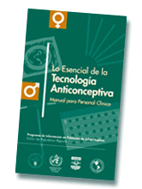
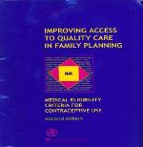
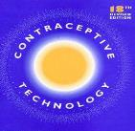
Included in SOTA documents
IPPF Medical Bulletin – 2000, 2003
IRH Reference Guide – 2002
WHO Medical Eligibility Criteria – 2002, 2004
WHO Selected Practice Recommendations – 2004
Contraceptive Technology – 2004, 2007
USAID Global Health Technical Briefs – 2004
Pocket Guide to Managing Contraception – 2004
Pop Report (New Contraceptive Methods) – 2005
WHO FP Decision-Making Tool – 2005
WHO Global Handbook for Family Planning – 2008
Pop Council Balanced Counseling Strategy – 2006
Ministries of Health norms and policies 2003 – 2010

Slide 14
“SDM sounds just the same as the rhythm method.”

Slide 15
How is the SDM different from the Rhythm Method?
Standard Days Method
Rhythm Method
SDM uses a fixed formula for the fertile phase
SDM clients use the same fertile window for all cycles
SDM has been tested in a well-designed clinical trial
Rhythm requires information about the previous 6 cycles
Rhythm users must make complex monthly calculations
Rhythm has never been tested in clinical trials
Notes:
The SDM uses a fixed formula for the fertile phase, while the Rhythm method requires information about the previous 6 cycles
The SDM clients use the same fertile window for all cycles. Rhythm users must make complex monthly calculations
The SDM has been tested in a well-designed trial. On the other hand, the Rhythm method has never been tested in a well-designed trial.

Slide 16
“Women will not have the power to decide when to have sex.”

Slide 17
Fact: SDM is best suited for couples that can communicate about sex
SDM is unlikely to succeed with couples whose relationship is characterized by gender inequity and gender-based violence
For correct SDM use, it is important:
That both the woman and man agree about whether or not they want a pregnancy
That both understand how SDM works
FP counselors encourage couples to decide how to manage the fertile days beforehand
Notes:
References:
Engaging men in family planning services delivery: Experiences introducing the Standard Days Method in four countries,World Health and Population Journal
Strengthening Services and Increasing Access to the Standard Days Method® in the Guatemala Highlands, Institute for Reproductive Health
Assessing the effect of introducing a new method into family planning programs in India, Peru,and Rwanda, Institute for Reproductive Health

Slide 18
Providers need to be trained on how to provide counseling support to the couple
 | Before (n=55) | After (n=57)
Offered to meet with partner | n/a | 77%
Considered role of partner | n/a | 70%
Discussed STI risk | 8% | 16%
Explored condom knowledge | n/a | 38%
Explained condom use | n/a | 19%
Honduras Simulated Client Study (Baseline and Endline Results)

Slide 19
Counseling should address options for managing the fertile phase
 | Admission | Exit
Rural India | 30% | 35%
Urban India | 87% | 98%
El Salvador | 25% | 34%
Philippines | 22% | 30%
Project reports, IRH

Slide 20
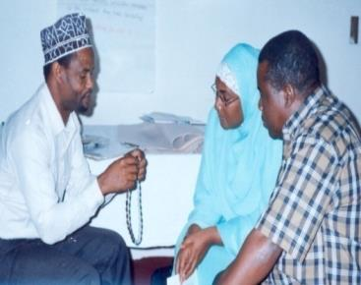
“Men won’t like this method…”

Slide 21
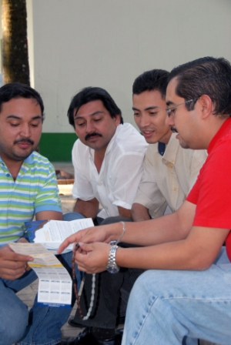
Fact: Men support SDM use
Results from efficacy trials and introduction studies show that men participate in SDM use in a number of ways:
Using a condom or abstaining during fertile days
Following wife’s instructions
Keeping track of fertile days
Purchasing CycleBeads and condoms
Notes:
Research shows that male partners of women who choose SDM are able and willing to use the method correctly. Only about 2% of women dropped out of the study that tested SDM efficacy because their partners did not want to use the method. According to data from 14 studies conducted in Latin America, Asia and Africa, very few women reported that their husbands insisted on sex during the fertile days. The results from these studies demonstrate that men are interested in SDM and participate in it in a number of ways: using condoms or abstaining during fertile days; supporting the woman’s use of the method; keeping track of fertile days; and purchasing CycleBeads and condoms. Other findings show CycleBeads are an effective communication tool and have helped women and men talk about family planning or facilitated discussion about sexuality, including what they need to do to avoid pregnancy on the fertile days. CycleBeads are a visual aid; the man can see when the beads indicate that the woman is fertile.
References:
Arévalo, M., V. Jennings, and I. Sinai. 2002. “Efficacy of a new method of family planning: The Standard Days Method.” Contraception 65(5):333-338.
Gribble, J., R. Lundgren, C. Velasquez, and E. Anastasi. 2008. “Being strategic about contraceptive introduction: the experience of the Standard Days Method®.” Contraception. 77(3): 147-154.
Lundgren R.I. et al. 2005. "Cultivating men's interest in family planning in rural El Salvador. " Studies in Family Planning: 36(3):173-188.

Slide 22
% of women who report that their partners track fertile days
(n=427)
(n=142)
Exit interviews with SDM users in El Salvador/India
Notes:
Does counseling increase male participation in method use? Here we see a comparison of the percentage of women who report that their husbands help them track their fertile days by whether or not their partner was counseled. The first set of bars presents data from India and the second from El Salvador. These results suggest that men who are counseled participate more in method use – either because they represent a more motivated group, or because of the information they receive.

Slide 23
Comparison of mean coital frequency
All sexually active women | 5.5 per cycle*
Withdrawal | 4.9 per cycle*
SDM users | 5.5 per cycle
*Stover et al, 2001
Notes:
From DHS data in 27 countries
Accordingly, we looked at coital frequency from the SDM efficacy trials. Results show that SDM users have intercourse as frequently as other method users, although almost all intercourse takes place on days 1-7 or on or after day 20 of the cycle. Great, we thought. SDM users are having sex just as often as other method users, so they must be equally satisfied. But then we started to look at the data coming in from SDM users, and saw that frequency of intercourse was not always the most salient issue for couples who chose the SDM. Comments such as, “We don’t have any problem, it’s not like sex is an every day thing”, were common.
Moreover, as we moved out of clinical trials into introduction of the SDM on a wider scale, couples were counseled to avoid unprotected intercourse during the fertile period in whatever way worked best for them. From 40-60% of users around the world opted for condom use during the fertile period – thus increasing the opportunity for intercourse.
References:
Sinai I. and M. Arevalo. 2006. "It's all in the timing: coital frequency and fertility awareness-based methods of family planning." Journal of Biosocial Science: 38(6):763-77.

Slide 24
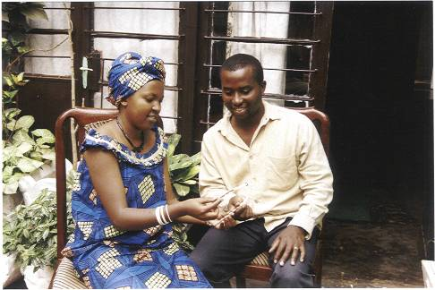
“If we offer this method, clients using modern methods will switch to SDM.”

Slide 25
Fact: SDM integration has no negative effects on FP use and method mix
Research shows that SDM brings new users to family planning
In fact, in the state of Jharkhand, India, 87% of new SDM users are new to family planning
Notes:
References:
Assessing the impact of scaling-up the Standard Days Method® in India, Peru and Rwanda. Institute for Reproductive Health Georgetown University Report. 2007.
Introducing the Standard Days Method® into Public Sector Services in Peru. Institute for Reproductive Health Georgetown University Report. Feb. 2008.
Long-term use of Standard Days Method: Experience of operations research study participants, Institute for Reproductive Health

Slide 26
CPR in study area before and 18 months after SDM introduction (rural villages, El Salvador)
 | Pre | Post SDM
Total prevalence | 45% | 58%
Permanent Methods (T.L. and Vasectomy) | 16% | 19%
Birth Spacing Methods | 28% | 39%
SDM | 0% | 4%
Source: Community survey, Project Concern International, 2002

Slide 27
CPR in study area before and 18 months after SDM introduction (urban slums, India)
 | Pre SDM | Post SDM
Total Prevalence | 49% | 58%
Tubal Ligation | 20% | 24%
DMPA | < 1% | 1%
Condom | 15% | 17%
IUD | 5% | 5%
SDM | 0% | 1%
Source: Community survey, TNS MODE, 2004

Slide 28
What method were clients using two months before adopting the SDM?
Government Statistics collected during SDM Impact Study
Notes:
References:
Assessing the impact of scaling-up the Standard Days Method® in India, Peru and Rwanda. Institute for Reproductive Health Georgetown University Report. 2007.

Slide 29
Effect on method mix and contraceptive prevalence
Percent of new family planning users accepting SDM
Countries/organizations | Percent of new users
Benin/ASPF | 7.1
India/CASP | 2.9
Ecuador/CEMOPLAF | 2.2
Honduras/ASHONPLAFA | 1.6

Slide 30
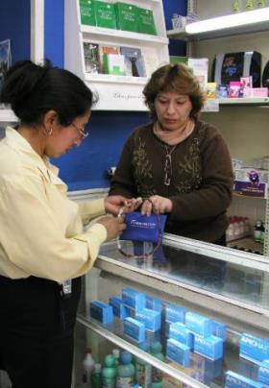
“There wouldn’t be much demand for SDM”

Slide 31
Fact: Demand exists for SDM and it is growing
2,617,695 sets of CycleBeads have been sold worldwide from 2004-2013
Notes:
References:
Cycle Technologies sales data

Slide 32
Family planning use worldwide
(Women in Union)
8%
Natural methods
8%
No methods
43%
42%
49%
Modern methods
50%
Levels and Trends of Contraceptive Use as Assessed in 1998. United Nations, Report ESA/P/WP.155 New York, 1999

Slide 33
New SDM Users (4136 users by Dec 05)
Source: DISA San Martín

Slide 34
“SDM counseling would take too much time, just like other natural methods.”

Slide 35
Fact: SDM is easy to teach in about the same amount of time as other methods
Can be taught in about 20 minutes, even in low-literacy settings
Continuation and correct use improved with 2nd visit but not necessary
Notes:
References:
Leon F., R. Lundgren, and V. Jennings. 2008. "Provider selection of evidence-based contraception guidelines in service provision: A study in India, Peru and Rwanda." Evaluation & the Health Professions 31(1): 3-21.
Assessing the impact of scaling-up the Standard Days Method® in India, Peru and Rwanda. Institute for Reproductive Health Report. February 2008.

Slide 36
Comparison of SDM, sterilization, and pill counseling at government clinics (Jharkhand, India)
 | SDM (n=59) | Pill (n=59) | Sterilization (n=59)
Interpersonal relations | 78% | 78% | 83%
Information exchange | 64% | 58% | 44%
Session length | 17 min. | 13 min. | 15 min.
Source: Simulated clients, endline
Notes:
Intervention clinics only
References:
Leon F., R. Lundgren, and V. Jennings. 2008. "Provider selection of evidence-based contraception guidelines in service provision: A study in India, Peru and Rwanda." Evaluation & the Health Professions 31(1): 3-21.
Assessing the impact of scaling-up the Standard Days Method® in India, Peru and Rwanda. Institute for Reproductive Health Report. February 2008.

Slide 37
Medical barriers in Peru and Rwanda
Rwanda
Peru
25% of eligible clients denied SDM because partner not present
5% requested to track cycles
46% of eligible clients denied SDM because partner not present or requested to track menstrual cycles
After reinforcement, virtually all eligible clients received the method.
Source: Simulated clients, endline
Notes:
References:
Leon F., R. Lundgren, and V. Jennings. 2008. "Provider selection of evidence-based contraception guidelines in service provision: A study in India, Peru and Rwanda." Evaluation & the Health Professions 31(1): 3-21.
Assessing the impact of scaling-up the Standard Days Method® in India, Peru and Rwanda. Institute for Reproductive Health Report. February 2008.

Slide 38
“It would be hard for illiterate women to use SDM.”

Slide 39
Fact: Low literacy or illiterate women can learn how to use SDM correctly
It is entirely possible for low literacy and illiterate women to use this method. There is no need for them to be able to read in order to use it.
CycleBeads serve as a helpful visual tool for women, regardless of whether or not they are literate
IRH has developed low-literacy inserts to support method use
Notes:
References:
Selected reports from SDM Operations Research studies, 2003, Institute for Reproductive Health
AWARENESS Project: Benin Country Report 2002-2007
AWARENESS Project: Philippines Country Report 2002-2007

Slide 40
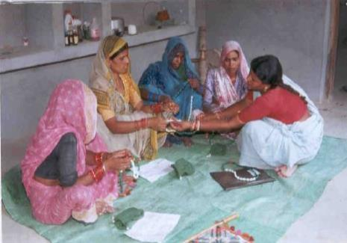
Among women and men who had heard of the SDM, 70-90% knew that the SDM…
defines the fertile days as 8-19
comes with a visual aid
and that it requires:
26-32 day cycles
partner cooperation
abstinence/condom use
keeping track daily
Analysis of household surveys
Notes:
References:
Selected reports from SDM Operations Research studies, 2003, Institute for Reproductive Health
AWARENESS Project: Benin Country Report 2002-2007
AWARENESS Project: Philippines Country Report 2002-2007

Slide 41
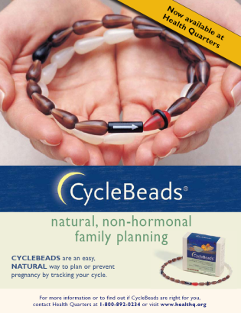
“More educated women would not be interested in using SDM.”

Slide 42
Fact: SDM appeals to women from a range of socio-economic backgrounds
SDM is offered in over thirty countries worldwide, including the United States, in both the public and private sectors
Women worldwide choose SDM because:
It is natural and free of health side effects
It teaches them about their fertility and helps them monitor their cycle lengths
CycleBeads help women negotiate & discuss sex with their partners

