Slide 1
Shifting Social Norms as Part of Social and Behavior Change
PRESENTER, ORGANIZATION
Notes:
NOTE TO FACILITATOR: Only use as starting slide if you are presenting all five modules or want to situate this module within the larger curriculum. If using this slide, make sure to reflect the presenter and organization name.

Slide 2
SHIFTING SOCIAL NORMS AS PART OF SOCIAL AND BEHAVIOR CHANGE
Overall Course Objectives
Discuss and explore advances in social norms programming, the relation of norms-shifting interventions to behavior change efforts, and the role of social norms in health and other sector programming.
Share design, implementation, and evaluation challenges and solutions for community-based social and behavior change (SBC) projects engaging in, expanding, or planning to expand normative change efforts.
Explore next steps to further collective learning about such promising interventions globally.
Notes:
NOTE TO FACILITATOR: These are the objectives for the social norms training, which comprises several modules. Only use as starting slide if you are presenting all five modules or want to situate this module within the larger curriculum.
SPEAKER NOTE: Read slide content.

Slide 3
Shifting Social Norms as Part of SBC
1
2
3
4
5
INTRODUCTION | ASSESSMENT | DESIGN | MEASUREMENT | SCALE-UP
Why Social Norms Matter | Assessing Social Norms to Inform Program Design and Implementation Strategies | Designing Norms-Shifting Interventions | Measuring Normative Shifts in Complex Environments | Scaling Up Norms-Shifting Interventions Effectively and Ethically
Notes:
NOTE TO FACILITATOR:. Only use as starting slide if you are presenting all five modules or want to situate this module within the larger curriculum.
SPEAKER NOTES: This training is part of a five-module course on norms-shifting interventions; as a note, when we say norms-shifting interventions, or NSIs, we mean those that are standalone or may be activities integrated into a larger SBC intervention. The following modules cover the introduction, assessment, design, measurement, and scale-up of norms-shifting interventions.

Slide 4


Measuring Normative Shifts in Complex Environments
MODULE FOUR
Mixed Method Monitoring, Evaluation, and Learning
Photo credit: RyanJLane/Getty Images
Notes:
SPEAKER NOTES: We have reached our fourth module on Measuring Normative Shifts in Complex Environments.

Slide 5
Learning Objectives
MIXED METHOD MONITORING, EVALUATION, AND LEARNING
During this session, participants will:
Identify core elements of monitoring and learning to gauge and address signs of norms shifting at the program level.
Distinguish among data gathering approaches, including types of indicators, for activity monitoring to track shifts in norms, diffusion effects, and the quality of implementation.
Review and examine types of measures to use in baseline and endline evaluations of social norms.
Use a case study to practice adapting a monitoring, evaluation, and learning (MEL) system of a norms-focused social and behavior change (SBC) project.
Notes:
NOTE TO FACILITATOR: After you’ve read through the notes for this slide when presenting, stop and allow time for questions or clarifications from the group.
SPEAKER NOTES: Read slide.

Slide 6
Contents
1
Overview of Monitoring and Evaluation
Section
2
Project Monitoring of Normative Shifts
Section
3
Evaluation and Measurement of Normative Shifts
Section
Notes:
SPEAKER NOTES: This section focuses on how the different elements of monitoring, evaluation, and learning support NSI.
NSIs operate within complex social systems and thus can lead to unexpected effects, including social opposition as projects begin and new social possibilities for communities to explore by the time a project ends. For example, after critical reflection on new ideas, communities may take off with a new normative idea, or they may strongly oppose it, or both reactions could occur simultaneously.
These kinds of dynamics define how monitoring, evaluation, and learning of NSIs differ from other projects. In this section…
We will provide an overview of monitoring and evaluation and examine strategies to gather and use information to improve NSI implementation in complex contexts.
Then, we will focus on project monitoring and rapid studies, which provide a basis for learning and adaptive management of NSI during implementation. We will discuss how monitoring in complex social context implies looking for signs of norms change and addressing social pushback, opposition, or other unanticipated outcomes as they emerge. We will consider how conducting rapid learning studies allows for real-time assessment of NSI strategies. Both provide data for decisionmaking that is organized at different points in project implementation.
Then, we will discuss the evaluation of normative shifts, moving to…
A discussion of measurement where we will examine quantitative and qualitative approaches to measure normative change resulting from NSI project implementation.

Slide 7



A Moving Survey
PLENARY ACTIVITY
What is your level of understanding of monitoring, evaluation, and learning?
Photo credit: Nina Robinson/Getty Images/Images of Empowerment
Notes:
NOTE TO FACILITATOR: This exercise is aimed helping the participants self-assess their level of understanding of MEL concepts. The results of the exercise can help the facilitator adjust “on the go” or decide to emphasize or de-emphasize points throughout depending on the participants’ level of experience with MEL.
Exercise
Moving survey: How much understanding you have in monitoring and evaluation and learning?
Preparation
Prepare a flip chart to note the results of the moving survey.
Process
Have participants line up on the same imaginary line. Tell them to gauge how much understanding of the three concepts they have.
MONITORING: Tell them that if they stand by the chair, it means that they have “very good understanding.” If they stand at the door, it means that they have “no understanding at all.” They can place themselves anywhere in between and must do so without talking to one another. Once they have placed themselves, ask a few participants why they are standing where they are standing. Choose participants from different parts of the line, asking various people to explain:
Why they feel they have “little to no understanding”
Why they have “some understanding” (ask, “What do you understand? What do you want to know more about?”)
Someone else to talk about why they have a lot of understanding of monitoring and evaluation.
On the flip chart note how many participants have “no understanding,” how many have “some understanding,” and how many have “very good understanding.”
Repeat this exercise for EVALUATION.
Repeat this exercise for LEARNING.
Discussion and Closing
Points to bring up in the discussion and wrap-up:
Monitoring and evaluation is a more systematic way to do what many of us already do in terms of tracking project implementation and assessing performance or impact. Many people underestimate the experience and understanding they have of these issues.
In this room, there is a lot of experience and understanding with monitoring and evaluation already. We will make sure to build on this as we discuss monitoring and evaluation of NSI. And we encourage you to make use of this knowledge and learn from each other.
We’ll also bring in throughout a focus on LEARNING from monitoring and evaluation and using information for decisionmaking throughout a project. As you’ll see, NSI in particular should build learning into their monitoring and evaluation systems.

Slide 8
Session I
Notes:
NOTE TO FACILITATOR: This slide is hidden and intended to help you plan this training.

Slide 9
Review of Concepts
Notes:
SPEAKER NOTES: Let's start our discussion with a refresher on basic social norms concepts from our curriculum.

Slide 10
What people in a group believe is a typical (what others do) and appropriate (what others expect me to do) behavior.
Often defined in relation to a reference group.
Social Norms
Notes:
SPEAKER NOTES:
Social norms are different from individual attitudes or beliefs—not what I believe, rather what I think that others believe.
Example: I believe it is good to use family planning. I believe that others believe family planning use is good/not good.
The second sentence represents what others expect or want me to do; this creates a norm of what is appropriate behavior.
The “others” form part of a person’s reference group (next slide).

Slide 11

Social Norms Are Passed On and Enforced by Reference Groups:
Those who matter to an individual in a specific situation.
PARTNER
CELEBRITY
HEALTH OFFICIAL
RELIGIOUS LEADER
FAMILY ELDER
Notes:
SPEAKER NOTES:
Social norms are context-specific and defined in relation to a reference group—those who matter to an individual in a specific situation. Reference groups are the influential people, individuals, or peer groups that sustain community beliefs around social norms. Some people define the reference group as a valued social group that can exert a considerable amount of influence on behavior. Reference groups:
Give information and advice.
Influence attitudes, behaviors, and decisions of a specific group.
Can reward or punish behavior.
Are considered community authorities or influential persons in a group.
Power holders within reference groups are those who have disproportionate influence on the behaviors and beliefs of a group—for example, they can enforce sanctions for deviation from norms.

Slide 12
Use an analysis of social norms.
Are intentionally designed to promote collective change by encouraging communities to reflect on, and question, social and cultural factors.
Result in positive new norms rooted within the values of that group.
-Learning Collaborative (2017)
Community-Based Norms-Shifting Interventions (NSI)
Notes:
SPEAKER NOTES: Read slide.

Slide 13
NORMATIVE-FOCUSED SBC
WHO | Individual and community as a locus of change.
WHAT | Uses mix of media channels and social spaces to foster critical reflection rooted in cultural values. Works at different levels of social ecology. Based on social norms assessment and identification of relevant norms; planned diffusion of new ideas.
HOW | Behavior change strategies address normative perceptions and expectations; new, alternative behaviors.
AIM | To redistribute power and social influence to support individuals’ health behaviors and service use.
Notes:
SPEAKER NOTES:
This slide shows the lens of SBC that is normatively focused.
WHO – Focus on community.
HOW – Normatively oriented.
WHAT – Safe spaces and critical reflection. Not focused only on the target group’s behavior but influencers of the target group.
AIM – Changing power dynamics is at the center of norms change—power over, power to, power within, power with.
DESIGN – Too often we assume which norms have the biggest influence, but better to ask the community. Diffusion—where a sufficient number of members adopt a new behavior, attitudes, or belief—is critical to achieve a tipping point of normative change.

Slide 14
Overview:
Monitoring and Evaluation
SECTION 1
Notes:
SPEAKER NOTES: Let's start our discussion with an overview of monitoring and evaluation. Before we start, from your experience, what are key differences between monitoring and evaluation (M&E)?

Slide 15
Monitoring
DEFINITIONS
Evaluation
Systematic and routine process of gathering information from different parts of a program.
Usually focused on short-term outcomes.
Generally conducted by people involved in the program.
Assessment of an entire program cycle.
Usually long-term.
Often conducted by impartial outsiders with M&E background.
Can also be participatory, with insiders having historical and contextual knowledge and implementation experience
Notes:
NOTE TO FACILITATOR: After the discussion on the earlier slide, present this slide with definitions.
SPEAKER NOTES:
Monitoring is…
Systematic and routine process of gathering information from different parts of a program.
Usually focused on short-term outcomes.
Generally conducted by people involved in the program.
Evaluation is…
Assessment of an entire program cycle.
Usually long-term.
Often conducted by impartial outsiders with M&E background.
Can also be participatory, with insiders having historical and contextual knowledge and implementation experience

Slide 16
Monitoring and Evaluation (M&E) of NSI
 | TYPICAL PROGRAM | FOR NSI OPERATING IN COMPLEX SOCIAL ENVIRONMENTS
Monitoring | Data and insights from monitoring may inform program evaluation and learning about the program. | Develop understanding of whether program elements are being implemented as designed, complementing each other, moving together to support change. Track expected and unexpected social change effects (individual change of early adapters, social opposers, and collective actions).
Evaluation | Data and insights from evaluation may inform how well an SBC program is working and future implementation of programs. | The extent to which normative shifts occur should be reflected in baseline and endline evaluations. Focus on which norms are being explicitly addressed and what level of normative change is expected by project end.
Notes:
SPEAKER NOTES:
Now let’s think about M&E of NSIs: How might classic M&E need to be adjusted for NSI?
As we have been discussing, NSI operate in complexity. There are additional elements to track or monitor.
[Read through key points in the slide.]
One of the important gaps in NSI evaluation is that norms are not often identified as projects begin, rather they are assumed.
[Read through key points in the slide.]
In addition, while activities may be designed to be norms-shifting, they are not articulated as such and so are lost or forgotten when evaluation occurs.

Slide 17
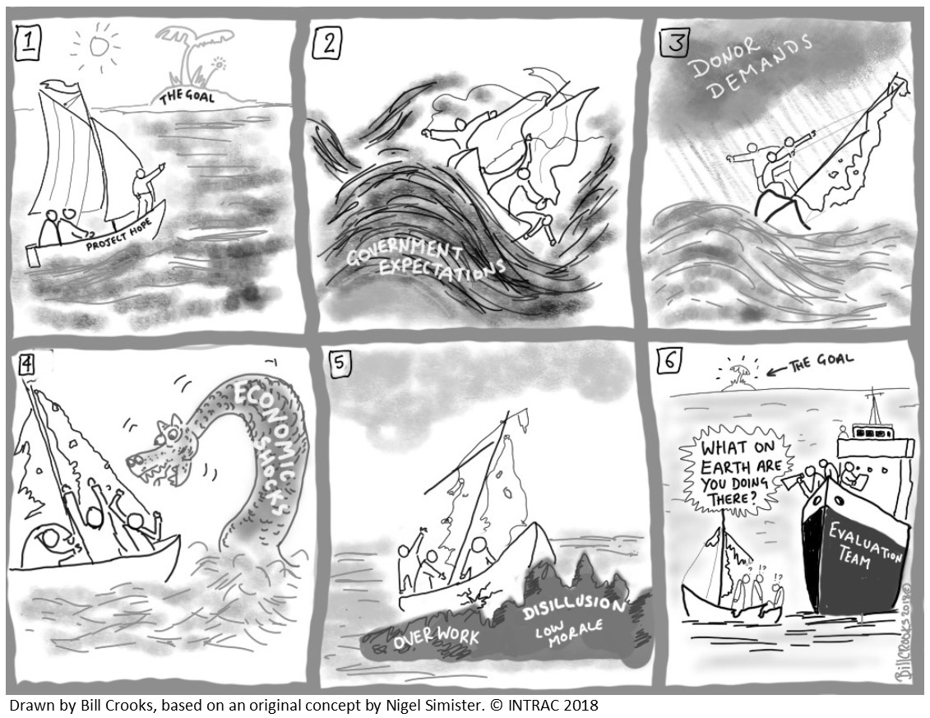
Projects Operate in Complex Environments!
Notes:
SPEAKER NOTES:
Let’s talk about the influence of complex environments. What does this cartoon tell you about project design, implementation, and evaluation?
Well-articulated design and goals (Panel 1).
Shifts in the environment that influence original plans (Panels 2,3,4,5).
When the moment for endline evaluation arrives,…. (Panel 6).

Slide 18

How to Prepare for Complex Environments
Expect the unexpected.
Some systems or parts of systems may move more quickly than others. Tailor your approach and pay attention to local context.
Use monitoring to track and react to norms change events as they unfold; see what emerges and how it impacts project implementation.
Be ready to adapt the NSI strategies when context shifts.
Notes:
SPEAKER NOTES:
The way that complex systems operate give us some clues to what to expect:
For one, expect the unexpected!
As various parts of the system interact, some or parts of systems may move more quickly than others, and unintended outcomes will present themselves. Tailor your approach to account for this, and pay attention to local context.
Frequent monitoring helps implementers to keep track of events as they unfold and to react to them.
Monitoring provides real-time information that allows not only tracking, but reacting, including adjusting strategies to ensure the NSI continues to move towards its end goals.
Example: We know to expect some community reactions, such as social pushback from communities when men take on a larger portion of the household chores. But the form in which pushback will manifest are not always predictable. While a man’s parents may protest to those promoting new ideas and say it is “unmanly” to help his wife, there may be other reactions, such as his work colleagues telling him it’s a positive thing. These competing views help programmers further norms discussions. Unless you are actively looking at how communities react, you many never identify new opportunities to move the NSI project agenda forward.
This also goes for adapting NSI. If there are possibilities to engage new allies such as teachers in norms-shifting work, then small adaptations might make the project more effective. A project could initiate work in schools to gain leader support and then move to working with parents.
As project activities deepen in communities, the complex environment may shift over time, and a new round of activities may be possible, e.g., bringing parents, teachers, and students together.

Slide 19
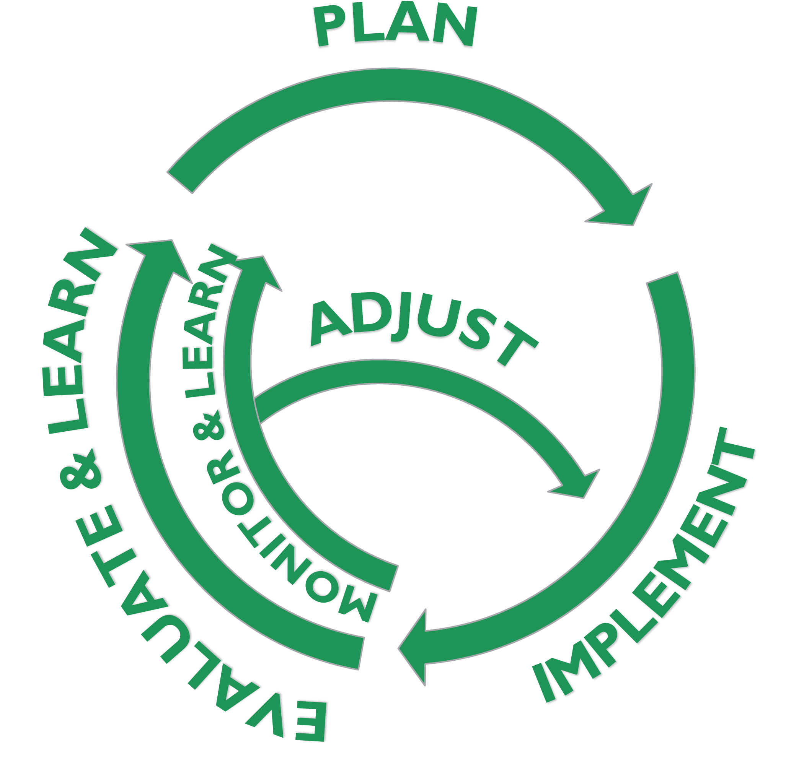
Learning as Part of M&E
Flexible, exploratory, iterative way to integrate observations and emerging knowledge into a program on an ongoing basis.
Regular cycles of learning.
Recognizes that staff close to a program have the best knowledge of circumstances.
Uses monitoring and learning to adjust programs as they are being implemented to put learning into program action.
Notes:
SPEAKER NOTES:
In recent years M&E has evolved into MEL.
Focus on learning is incredibly important when working in complex environments—looking actively for changes in the environment that influence implementation.
This also makes learning important when working in the normative space, particularly regarding how communities receive and react to NSI implementation.
[Read slide.]

Slide 20
Added NSI Measurement Moments
STAGE | LEARNING AIMS | METHODS
Formative assessment | Identify possible social norms, sanctions, reference groups. | Literature review, community discussions.
Monitoring | Observe signs of norms change, monitor backlash. | Activity monitoring, direct/indirect observation, rapid studies to test strategies.
Evaluation of impact | Baseline: verify social norms, norm strength, identify “cracks” in norms and opportunities for intervention. Endline: changes in social norms; correlates with attitudes and behaviors. | Quantitative surveys and qualitative interviews and discussions using vignettes and norms-oriented questions.
Notes:
SPEAKER NOTES:
We’ve identified “moments” when MEL comes into play in the NSI project cycle from design, to monitoring, to assessing impact. The moments are in addition to monitoring done as a matter of course for SBC programs.
During formative assessment, we will want to identify specific norms, assess their strengths, and identify opportunities for intervention.
During monitoring, we want to monitor activities, observe signs of norms change, and observe backlash.
For evaluation of impact, at baseline, we’ll measure and verify social norms and look for intervention opportunities. At endline, we will assess shifts in norms and how norms correlate with attitudes and behaviors.
During this session we’ll provide guidance on how to measure norms both qualitatively and quantitatively.

Slide 21
Project Monitoring of Normative Shifts
SECTION 2
It’s Not Just About Activity Tracking!
Notes:
SPEAKER NOTES: Project monitoring is not just about activity tracking.
Optional: Ask the audience what comes to mind when they think about project monitoring. Their answers can be single words or concepts.

Slide 22


Monitoring Shifts in Norms Tells Programs…
PLENARY DISCUSSION
How project activities were implemented; what bottlenecks emerged and how programs addressed them.
What signs of social change are being observed at the community level.
Which signs of social change are supportive/not supportive of project aims.
How program participants, frontline workers, staff, and broader communities have reacted to these shifts.
How programs are affecting people and stakeholders, things, systems, and practices.
Photo credit: Yagazie Emezi/Getty Images/Images of Empowerment
Notes:
NOTE TO FACILITATOR:
This slide is animated—show the title and ask the group: “what do you think a focus on monitoring shifts in norms allows programs to capture?” After some discussion among participants, animate the points on the screen one by one to share with the group. At the end, after sharing the points, you can engage the group again by asking: “In your own project experiences, which of these are typically tracked in project monitoring systems?”
SPEAKER NOTES:
First, monitoring broadly allows programs to learn about how program activities are implemented, if it is going as planned, and what issues arose and how they were dealt with. Given the NSI objective of catalyzing social changes in communities and broader social systems, NSI monitoring goes beyond the first question. For monitoring norms at a high level, you want to look for signs of norms shifts, signs of changes in social support (or backlash), and how this is impacting programs and their participants and actors.
REFERENCE:
Mercy Corps, Managing Complexity: Adaptive Management at Mercy Corps, 2020, https://www.mercycorps.org/sites/default/files/2020-01/Adaptive%20management%20paper_external.pdf.

Slide 23
Signs of Norms Shifts to Monitor
INITIAL SIGNS OF CHANGE | EXPLANATION
A norm is no longer common. | When a practice is a social norm, people believe that most other people follow the norm. If people start to believe that it’s become common not to follow the norm, this change can indicate the norm is shifting.
A norm is no longer approved of. | When a practice is a social norm, people believe that others will disapprove if they do not follow the norm. Changes in these perceptions can indicate a norm is shifting.
There is no longer consensus around a norm. | Social norms are shared beliefs about which behaviors are common and appropriate within a group. If individuals’ beliefs start to differ from one another—there is no longer consensus about a norm—it can indicate a norm is shifting.
Notes:
SPEAKER NOTES:
Here we provide a framework for what to monitor about norms in programs, referred to as signs of shift in norms.
The first is perceived change in the prevalence of a norm or when it’s no longer common (typical) to do something. So, if people start to believe that it’s become common not to follow the norm, this change can indicate the norm is shifting.
The second is perceived change in the social support (or backlash) for behaving outside a norm and by whom. Changes in these perceptions of approval or disapproval can indicate a norm is shifting.
And finally, disagreement about a norm. Social norms are shared beliefs about which behaviors are common and appropriate within a group. If individuals’ beliefs start to differ from one another so that there is no longer consensus around a norm, it can indicate a norm is shifting.
REFERENCE:
The Learning Collaborative to Advance Normative Change, Approaches & Insights for Monitoring of Shifts in Social Norms (Washington, DC: Institute for Reproductive Health, Georgetown University, 2020).

Slide 24
Example for Norms Around Child Marriage
INITIAL SIGNS OF CHANGE | SAMPLE QUESTIONS
A norm is no longer common. | Do you think that most girls in your community marry before age 15? Has this changed over time? Why/why not? Is this change the same across different groups of people?
A norm is no longer approved of. | If girls marry before age 15, would your community speak negatively about them or act negatively towards them? Is this the same reaction across different groups of people? Has this negative response changed over time? From which groups/people? Are there any changes in people’s willingness to talk openly about girls’ delaying marriage?
There is no longer consensus around a norm. | Is the community less in agreement than before about: 1) whether girls marry before age 15 and 2) whether girls would face social pressure if they delayed marriage until they are older?
Notes:
SPEAKER NOTES:
For this same framework, presenting initial signs of norm change, we provide some sample questions.
The first is perceived change in the prevalence of a norm or when it’s no longer common (typical) to do something. So, for example of child marriage, a sample question might be: Do you think that most girls [population of interest for this intervention] in your community marry before age 15? Has this changed over time? Why/why not?
The second is perceived change in the social support (or backlash) for behaving outside a norm and by whom. For this example, a question could be: Would girls be spoken about negatively in your community if they did not marry by age 15? By whom?
And finally, a sign of change is that there is no longer consensus around a norm. For this example, a sample question could be: Do people disagree about whether most girls marry before age 15 or whether girls would face social backlash if they delayed marriage until they are older than 15?
REFERENCE:
The Learning Collaborative to Advance Normative Change, Approaches & Insights for Monitoring of Shifts in Social Norms (Washington, DC: Institute for Reproductive Health, Georgetown University, 2020).

Slide 25
Monitoring Methods and Approaches
METHODS | TOOLS & APPROACHES
Activity monitoring. Observation by frontline workers and field supervisors. Qualitative methods (e.g., interviews, focus groups). Community-led surveillance of signs of norms change (e.g., program feedback). | Monitoring systems with norms change indicators. Rapid studies to test new strategies. Periodic guided-learning reflections with staff. Periodic check-ins with community monitors.
Notes:
SPEAKER NOTES: Shifting norms is a process that takes time. As it is unlikely to see complete norm transformation within short project timelines, it is useful to design monitoring systems to better understand the change process. Compared with quantitative data, qualitative data provides more nuanced insights into how norms change, sticking points, and what is working well. Both quantitative indicators and systems and qualitative data can yield helpful insights for monitoring norms shifts.

Slide 26
EXAMPLE INDICATOR
Quantitative Indicators
EXAMPLE SIGN OF NORM SHIFT | EXAMPLE INDICATOR | EXAMPLE METHODS TO COLLECT INFORMATION
A norm is no longer approved of. | % of people in this community who report that most of the people who are important to them would approve delaying marriage for their young daughters. | Intermediate outcome indicator for program in monitoring plan. Pre- and mid-program surveys Exit interviews for program activities.
Notes:
SPEAKER NOTES: Read slide.

Slide 27
EXAMPLE INDICATOR
Qualitative Indicators
EXAMPLE SIGN OF NORM SHIFT | EXAMPLE INDICATOR | EXAMPLE METHODS TO COLLECT INFORMATION
A norm is no longer approved of. | The social norm of [disapproval of early marriage] is shifting in the desired direction. | Programmatic interviews. Activity observation. Staff anecdotes and impressions.
Notes:
SPEAKER NOTES:

Slide 28
Monitoring Diffusion in Norms-Shifting Programs
NSIs can have planned diffusion strategies, and diffusion also happens outside of project outputs, in unpredictable ways, especially for social change.
Hence, diffusion of norms change is complex and difficult to track through routine program monitoring.
Programs with organized diffusion as a strategy can monitor the ways they expect those changes to unfurl, which can help teams understand norms shifting over time when combined with evaluation research.
Notes:
SPEAKER NOTES:
Organized diffusion is a process for how an innovation (in idea or practice) spreads widely within a group of people. Diffusion is used to understand how changes are spreading through the population—beyond those directly participating to enough others to bring about widespread collective-level change. Projects can have planned diffusion strategies, and diffusion also happens outside of project outputs and in unpredictable ways, especially for social change. Hence, diffusion of norms change is complex and difficult to track through routine program monitoring. Programs with organized diffusion as a strategy can, however, monitor some of the ways they expect those changes to unfurl, which can help teams to understand norms shifting over time when combined with evaluation research.

Slide 29
Developing or Adjusting Your Monitoring Plan to Capture Shifts in Norms
Assess how you are currently capturing shifts in norms, if at all.
Consider where you are in your program’s implementation (design, mid-implementation, nearly complete) and what is feasible to adjust and learn about.
Develop indicators that reflect your existing program’s logic model/theory of change to support capturing shifts in norms.
Integrate the indicators into your program’s MEL plan. Consider the type of indicator and shifts in norms you seek to monitor.
Reflect on the best methods for your program to collect information on each indicator and make a plan.
Notes:
SPEAKER NOTES:
Depending on where you are in your program, you can embark on integrating indicators to track shifts in norms in different ways, considering what’s possible for you. We suggest you:
Assess how you are currently capturing shifts in norms, if at all.
Consider where you are in your program’s implementation (design, mid-implementation, nearly complete) and what’s feasible to adjust and learn about.
Develop indicators that reflect your existing program’s logic model/theory of change to support capturing shifts in norms.
Integrate the indicators in your program’s MEL plan. Consider the type of indicator and shifts in norms you seek to monitor.
Reflect on the best methods for your program to collect information on each indicator and make a plan.
REFERENCE:
The Learning Collaborative to Advance Normative Change and Breakthrough ACTION, Getting Practical Integrating Social Norms into Social and Behavior Change Programs, 2021, https://www.alignplatform.org/sites/default/files/2021-01/getting_practical_tool_january_2021_english.pdf.

Slide 30
Matrix to Guide Quarterly LEARNING REFLECTION MEETINGS with Staff of Growing Up Great! (Adapted from Mercy Corps and Save the Children- DRC)
Growing Up Great! components | What is working? (successes) What is not working? (challenges) | How is our work affecting people and stakeholders, things, systems, and practices? | What signs of social change have you seen in past 3 months? Which are supportive/not supportive of project aims? | How have frontline workers reacted to such changes? How have staff reacted? | If not working well: Can you imagine doing the activity in a completely different way? What might the value be? | Proposed changes and next steps.
Parent video discussion session | Poor participation, especially dads. | Key strategy to reach parents and model gender-equitable homes. | No changes seen in the past quarter. | Nothing to report. | Merge this into community game day to see if better participation. | Test adding videos to daily community game day.
VYA clubs
Club leaders
Teacher integration of GUG! in classes
…and more
Notes:
NOTE TO FACILITATOR: This is an optional slide.
SPEAKER NOTES:
Here is a nice example of how to collect information from learning reflection meetings with staff.
Left-hand column reflects key strategies of the Growing Up Great! approach.
Top row guides reflections for different strategies.
While it is the combination of strategies that makes the approach work, it is often more practical to reflect on different strategies separ, as their contexts may differ. In this example, some activities are implemented in school settings, others in community and health center settings.
Here is an example of reflecting on a project issue in one area and testing a new way to implement it.

Slide 31
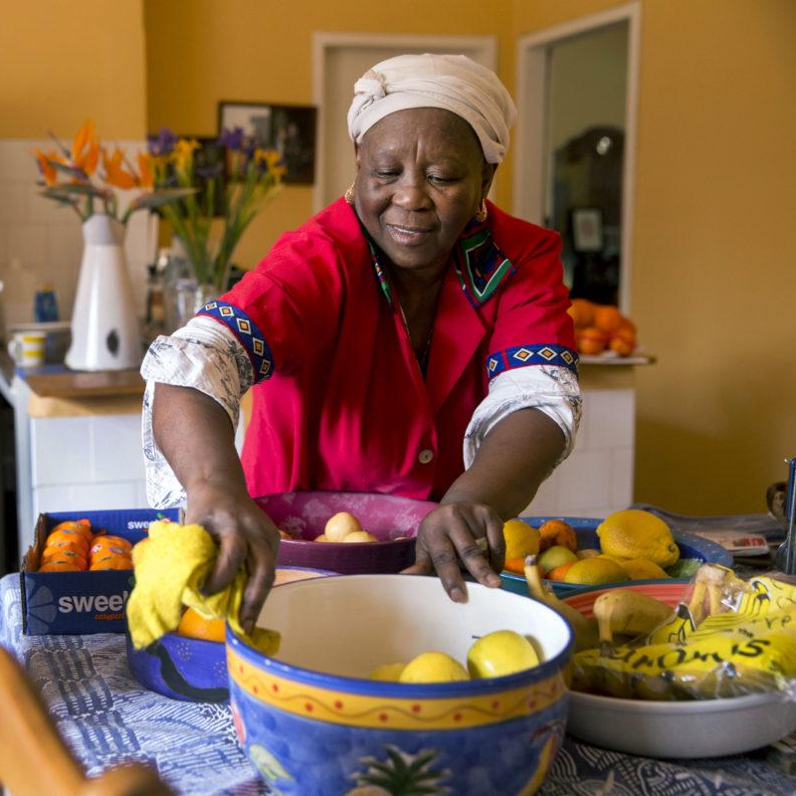
Applying Learning Agendas
Learning agendas guide monitoring and rapid studies, which answer questions about specific implementation issues.
Photo credit: Jonathan Torgovnik/Getty Images/Images of Empowerment
Notes:
SPEAKER NOTES:
In this next section, we’ll be talking about applying learning agendas. Learning agendas, in essence, are a set of questions directly related to project work that practitioners aim to answer through the course of the work. Answered, they enable projects to work more effectively. Learning agenda questions tend to focus on understanding the "how" and "why" beyond the basic outcomes and results so that you can learn, adapt, and be more effective in your work.

Slide 32
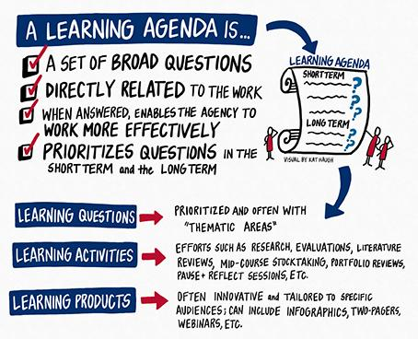
What’s a Learning Agenda?
Visual by Kat Haugh, from the USAID Learning Lab
Notes:
SPEAKER NOTES:
Let's move on to another learning approach during implementation: learning studies.
A learning agenda is:
A set of broad questions.
Directly related to the work.
Which, when answered, enables the project to work more effectively.
Prioritizing questions in the short term and the long term.
Learning questions 🡺 Prioritized and often with “thematic areas.”
Learning activities 🡺 Efforts such as rapid monitoring and assessment studies, targeted strategy evaluation, data parties (to make sense of data), learning reflection sessions.
Learning products 🡺 Often interpretive and tailored to specific questions; can include slide decks showing monitoring and other data in visual ways (data visualization); rapid reports/briefs, webinars to share results and discuss.

Slide 33
Strategy Testing Using Learning Agendas
Learning agendas can help guide learning on a range of implementation issues and needed adjustments:
Testing of existing or new strategies.
Strategies’ ease of implementation.
How beneficiaries appreciate (or not) the NSI strategy.
Whether activities are leading to expected social, behavioral, structural, or other shifts.
Notes:
SPEAKER NOTES:
In IRH projects we often establish learning agendas to provide a focus for small studies that answer critical issues, such as those shown on the slide:
Testing of existing or new strategies.
Strategies’ ease of implementation.
How beneficiaries appreciate (or not) the NSI strategy.
Whether activities are leading to expected social, behavioral, structural, or other shifts.
Strategy testing can be done using rapid studies, which are small and fast.
For example, in one rapid study in Benin we wanted to learn how volunteers were doing facilitating stories and games that engaged groups in reflective activities. We asked field staff to collect information from frontline workers (volunteer-facilitator self-assessments of their capacity to facilitate stories and games used by the NSI to engage groups in reflective activities) as they made supervision visits.
In another rapid study in Benin, we wanted to test a project strategy to use radio call-ins to discuss women’s and men’s roles in planning their families. We asked field supervisors to listen to weekly call-in shows over three months to monitor questions and answers and tone of the callers (to learn if women and men were participating equally and to assess if callers were moving toward gender equality or not).

Slide 34

Learning Agendas
GROUP DISCUSSION
Have you ever used learning agendas to focus information-gathering efforts while monitor project implementation and social change? What were benefits and challenges?
Given the intangible nature of social change (that is, social change is not easily countable), what kinds of monitoring and rapid studies were or could be done? And by whom? What might be challenges?
Photo credit: Oliver Rossi/Getty Images
Notes:
NOTE TO FACILITATOR: This exercise is aimed at discussing the use of learning agendas and rapid studies in participants’ past experiences.
Process
Organize the participants into small groups of four to give for a reflection on and discussion of the two questions on the slide.
Invite volunteers to share the answers in plenary.
Discussion and Closing
Learning agendas can help focus project resources used to build understanding of what is going on in communities receiving the NSI.
Rapid studies don’t have to be elegant, just systematic enough to allow you to draw conclusions and answer critical questions that you might have.
In the end, they can greatly improve the performance of a project, as they can lead to strategy adjustments that can influence impact.

Slide 35
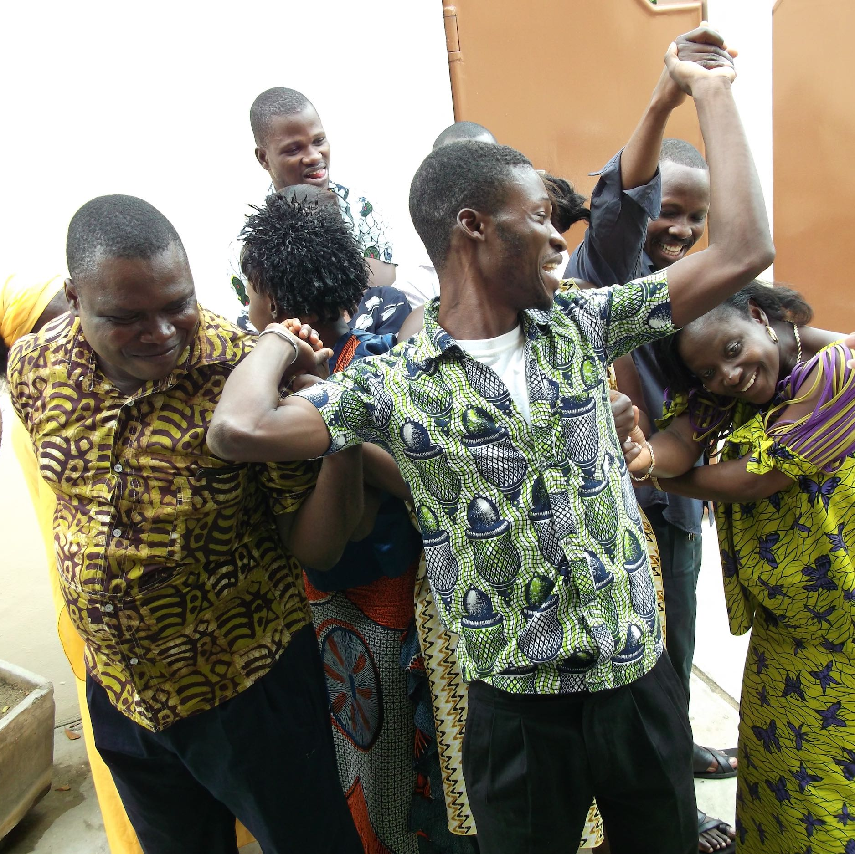
TÉKPONON JIKUAGOU
LEARNING AGENDA CASE STUDY
Photo credit: Institute for Reproductive Health
Notes:
SPEAKER NOTES: Here’s a quick introduction to TJ, a norms-shifting intervention to address low modern family planning uptake in Benin. TJ used a learning agenda to inform its scale-up phase.

Slide 36
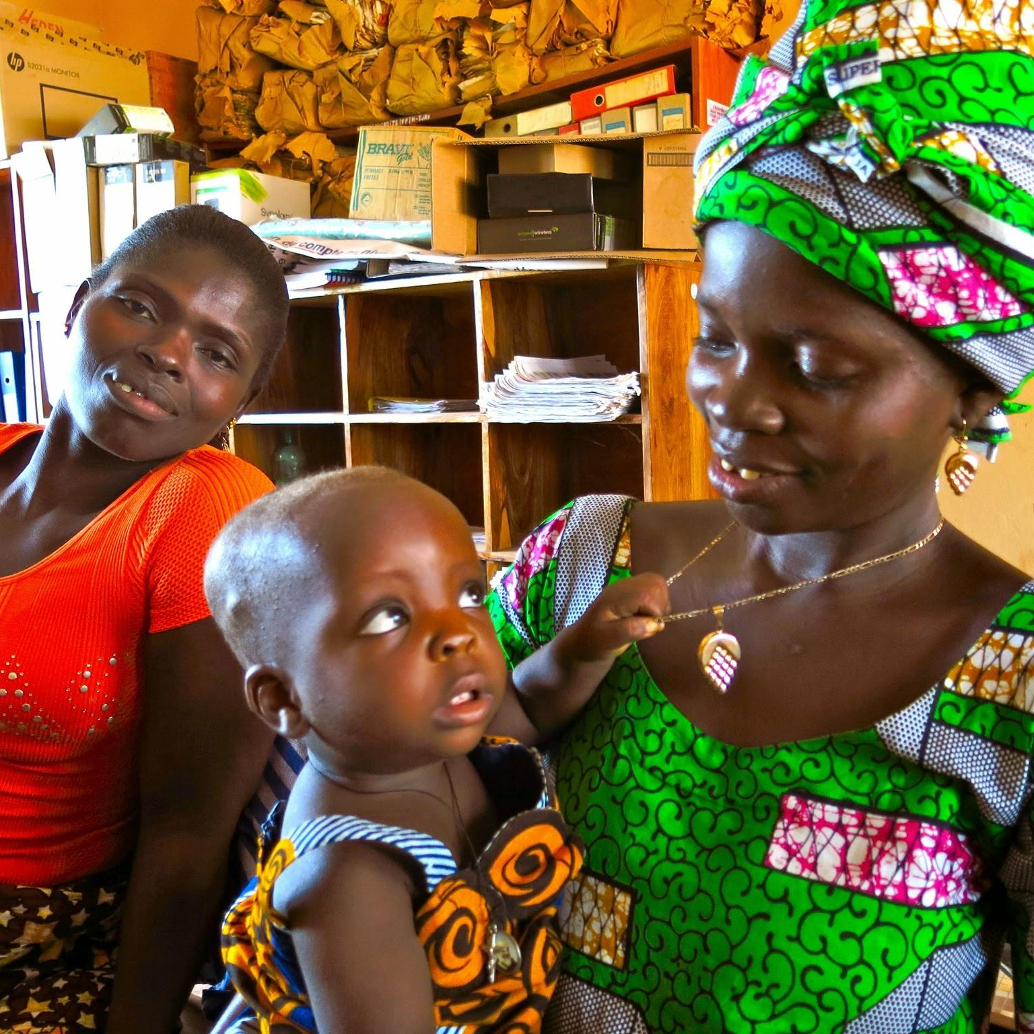
Project Overview
TÉKPONON JIKUAGOU
Location: Benin.
Aim: Address low rates of uptake of modern family planning methods.
Norms focus: Reduce normative barriers related to reproductive health seeking.
Value added: TJ’s integration into non-family planning projects (e.g., nutrition) had cross-sectoral benefits.
Photo credit: Institute for Reproductive Health
Notes:
SPEAKER NOTES: Read slide.
TJ is a social norms intervention that aimed to address low uptake of modern FP methods. To do so, TJ sought to shift:
Norms concerning family size.
Norms concerning family decisionmaking for seeking health care, including communication taboos for couples and gender roles related to seeking reproductive health care.
Norms concerning community approval of family planning use.
TJ was integrated into projects in other sectors, which offered cross-sectoral benefits, as some of the norms addressed underlaid behaviors in more than one sector.

Slide 37






Social Network Package
CASE STUDY
Tékponon Jikuagou
Engage communities in social mapping
Support influential groups in reflective dialogue
Encourage influential individuals to act
Use radio to create an enabling environment
Link family planning providers with influential groups
Notes:
SPEAKER NOTES:
This slide provides an overview of the five components of the social network package of TJ. It portrays the components of the package we developed.
Communities identify socially influential groups and individuals through mapping and ranking exercise.
Groups, including these influential individuals, engage in reflective dialogue. Ideas from this reflective dialogue are then encouraged to be shared outside the group, allowing them to be diffused.
Influential people engage their communities to address unmet need for FP, by identifying actions they can take to help others in the community identify and overcome barriers.
Radio expands exposure to stories and discussions through broadcasts, supporting the social acceptability of discussing and using family planning
Family planning providers, who participated in the community mapping exercise, link with influential groups to answer questions about family planning. Influencers may also link community members with these providers for FP services.
Each of these components have accompanying How to Guidelines, which provide instructions and guidance for implementation.

Slide 38

TÉKPONEN JIKUAGOU
A Learning Agenda for TJ
OUR KEY QUESTION:
Could TJ be scaled by a new set of NGOs and still have similar social change effects as originally observed?
Selected Learning Questions
How can expanded implementation maintain gender-synchronized approaches?
New partners are using gender-synchronized approaches for the first time: What are their key challenges, advantages, and lessons learned in using gender-synchronized approaches?
What social and other changes are occurring in receiving communities as a result of TJ implementation?
Photo credit: Institute for Reproductive Health
Notes:
SPEAKER NOTES:
Here is an example of selected questions from a learning agenda for the TJ project, used during an 18-month scale-up/expansion phase.
TJ is a social network diffusion approach designed to break social barriers that stop men and women who want to space births from doing so, often for fear of social disapproval and sanctions within their couple, family, and peers.
The approach worked very well in its pilot phase. In the scale-up phase there were concerns that the NGOs who wanted to try TJ did not actually work in health, but rather in literacy, WASH, and nutrition at the community level. And none had worked with men. So, our key question was could the approach work and have the same effects when scaled up by a new set of NGOs?
These selected critical learning questions looked at:
How implementing organizations could maintain gender-synchronized approaches and what challenges and lessons were learned while using such approaches.
What social and other changes happened in the communities where TJ was implemented.
Using these questions, along with others, we could plan different rapid studies over two years to answer them.

Slide 39
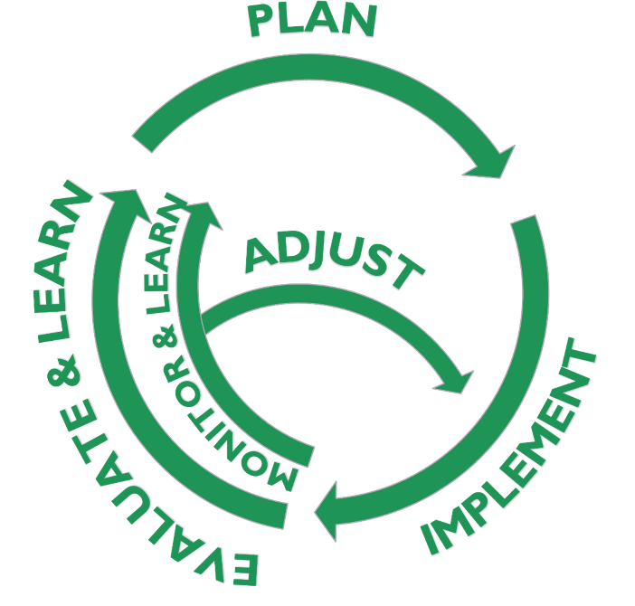
TEKPONON JIKUAGO
How Might Monitoring and Rapid Studies Answer TJ’s Learning Questions?
Given our program and MEL roles:
What are potential methods for collecting information?
Who would be responsible for conducting studies?
Who would be responsible for making program adjustments?
Notes:
SPEAKER NOTES:
Using TJ as our case study, we’ll start thinking about how monitoring and rapid studies might answer TJ’s learning questions. We’ll think about the following:
What are potential methods for collecting information?
Who would be responsible for conducting studies?
Who would be responsible for making program adjustments?

Slide 40

How Might Monitoring and Rapid Studies Answer TJ’s Learning Questions?
GROUP ACTIVITY
Group discussion: 15 minutes
Debrief in plenary: 5 minutes
Discuss in your small group.
Record your responses on a flip chart sheet.
Assign a notetaker and reporter to share in plenary.
Photo credit: Yagazie Emezi/Getty Images/Images of Empowerment
Notes:
FACILITATOR NOTES: Divide participants into small groups of four to eight people (depending on the size of the full group) and ask them to consider the three questions below, with an eye to how they can answer TJ’s four learning questions (participants can refer to handouts to find both the questions they’re answering and the TJ learning questions).
What are potential methods of collecting information?
Who would be responsible for conducting studies?
Who would be responsible for making program adjustments?

Slide 41
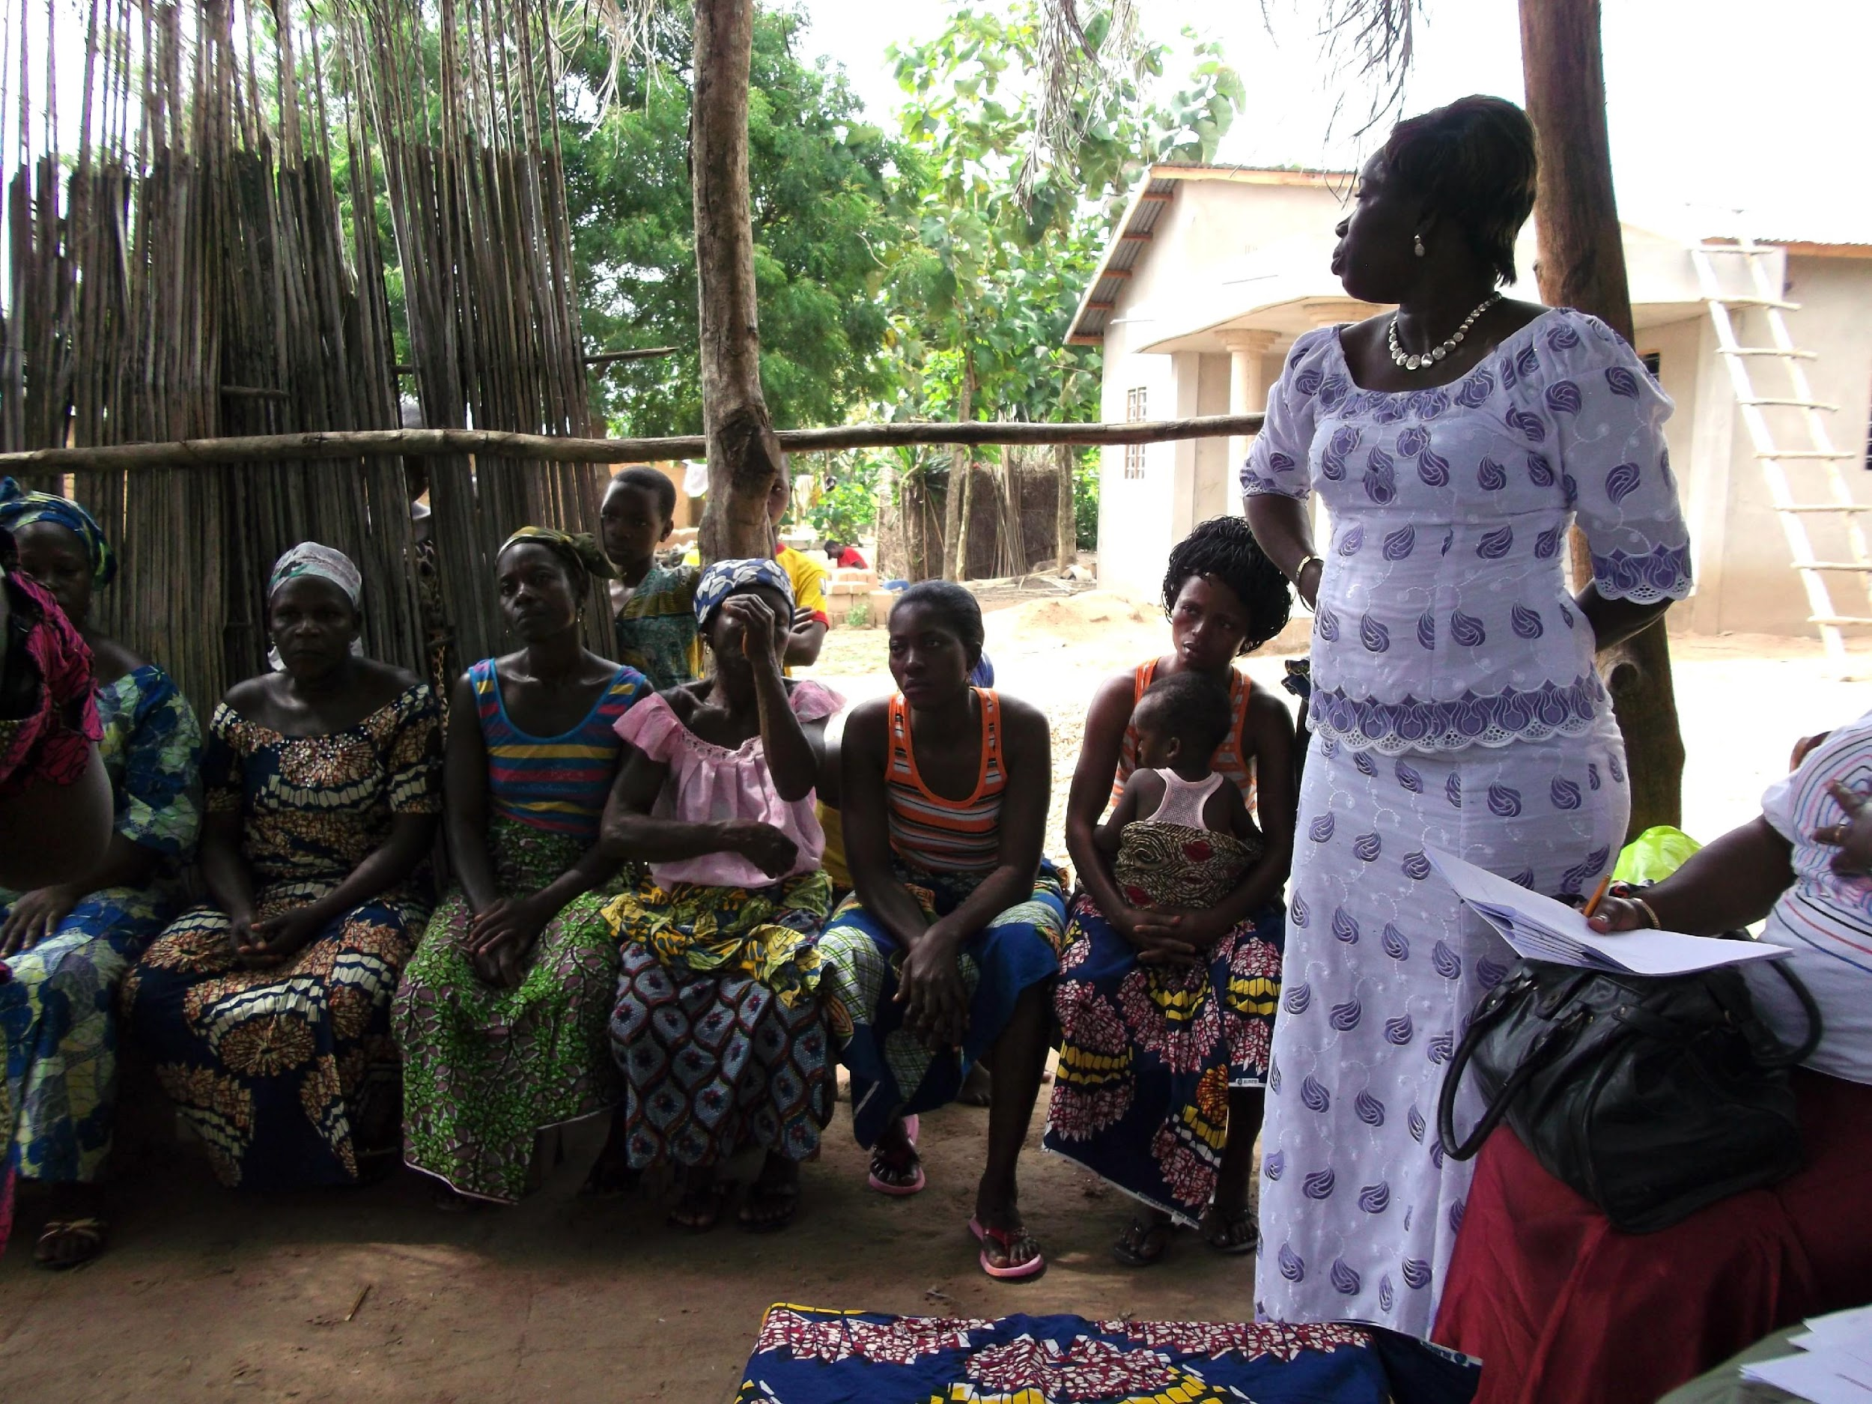
LEARNING QUESTION:
How do we maintain the quality of TJ implementation, especially gender-synchronized approaches?
Method
Capacity Self-Assessment tool
Rapid quantitative study at project midpoint in which:
Facilitators self-rated their capacity (Likert scale) to offer different TJ activities. Coupled with supervisor assessments (Likert scale) of facilitator capacities.
Key learning
New users of the TJ approach, even if they are not versed in family planning work, could offer the approach with high quality.
How it was used
Refresher trainings were conducted on gender synchronized approaches, which facilitators felt less capable of doing well.
Photo credit: Institute for Reproductive Health
Notes:
SPEAKER NOTES:
For the TJ learning agenda, we wanted to know if the TJ approach could be implemented by new NGOs. This is an example of how the learning study looked at this question, namely by implementers assessing their ability to offer TJ activities, including gender synchronized approaches. This is an example of the questions you just answered in our activity.
Q: What are potential methods for collecting information? A: A rapid quantitative survey.
Q: Who would be responsible for conducting studies? A: The NGOs asked facilitators to complete this study.
Q: Who would be responsible for making program adjustments? A: NGOs used this information to offer refresher trainings on gender synchronized approaches, which facilitators reporting being less comfortable delivering.
This is just to give you a flavor of how learning can be organized to occur throughout a project cycle. These rapid studies provide real-time information to address problems and improve performance.

Slide 42
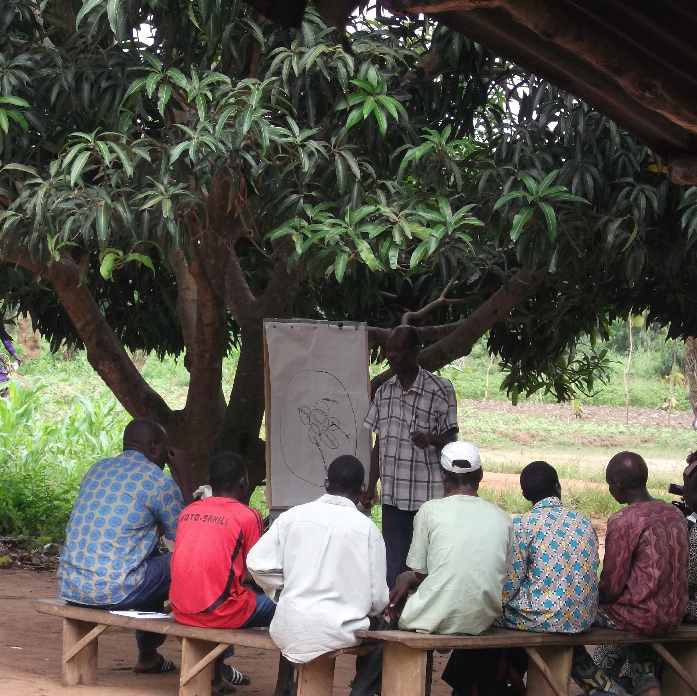
LEARNING QUESTION: What social and other changes are occurring?
Method
Group discussions with staff.
During semi-annual staff meetings we held guided reflection sessions to collecting staff observations and analyses of change.
Key learning
In one meeting we learned that female and male volunteers were being criticized by peers, with some pressured to stop TJ discussions on family planning.
How it was used
We held a series of discussions with frontline workers to talk about how to manage opposition.
Photo credit: Institute for Reproductive Health
Notes:
SPEAKER NOTES:
For the TJ learning agenda, we wanted to know about social and other changes emerging as the scale-up of TJ was implemented by new NGOs. This is an example of how the learning study looked at this question using guided reflections
Q: What are potential methods for collecting information? A: Guided staff reflections, where it was found volunteers were being criticized by peers.
Q: Who would be responsible for conducting studies? A: NGOs implementing TJ conducted these guided reflections.
Q: Who would be responsible for making program adjustments? A: NGOs used this information to offer discussion sessions with frontline workers on how to manage opposition. These solutions included:
Having supervisors talk with groups and community leaders about the important service that volunteers freely offer.
Having frontline workers role play with their supervisors to practice responding to negative reactions.
This is just to give you a flavor of how learning can be organized to occur throughout a project cycle. These rapid studies provide real-time information to address problems and improve performance.

Slide 43
MONITORING NSIs
What Are Your Key Takeaways About Using Learning Agenda for NSIs?
TO SUM UP
Taking a “learning-reflecting-acting” approach to project monitoring…
Creates flexibility in thinking that encourages real-time and evidence-informed reflection.
Encourages strategy and other program adjustments along the way.
Allows for better targeting of monitoring resources to focus on key implementation questions.
Notes:
SPEAKER NOTES:
Before we move to the next section, on evaluation, what are some key takeaways on learning and use of learning agendas?
[Allow participants to answer either in person or in the chat box before clicking through bullet points on screen.]

Slide 44
Session II
Notes:
FACILITATOR NOTE: This slide is hidden and intended to help you plan this training.

Slide 45
Evaluation of Normative Shifts
SECTION 3
Baseline and Endline Measurement
Notes:
NOTE TO FACILITATOR: If this presentation will be delivered in two parts, this is where the second part will begin. Based on your audience and first session, decide which of the “overview of social norms slides” section you will repeat here to remind participants of basic concepts.
SPEAKER NOTES:
Now that we’ve discussed monitoring norms-shifting interventions and using the information we gather to improve program implementation, let’s shift our focus to evaluation.
Evaluation will often encompass baseline and endline surveys. In order to generate useful information about NSIs, we need good measures (i.e., ones that are valid and reliable) for social norms.

Slide 46
NSI Measurement Moments
STAGE | LEARNING AIMS | METHODS
Formative assessment | Identify possible social norms, sanctions, reference groups. | Literature review; community discussions.
Monitoring | Observe signs of norms change; monitor backlash. | Activity monitoring; direct/indirect observation; rapid studies to test strategies.
Evaluation of impact | Baseline: verify social norms and norm strength; identify “cracks” in norms and opportunities for intervention. Endline: changes in social norms; correlates with attitudes and behaviors. | Quantitative surveys; qualitative interviews and discussions using vignettes and norms-oriented questions.
Notes:
SPEAKER NOTES:
As we discussed earlier, we’ve grouped “moments” when MEL comes into play in the project cycle, from design to monitoring to assessing impact.
For evaluation of impact, at baseline we’ll measure and verify social norms and look for intervention opportunities. At endline we will assess shifts in norms, and how norms correlate with attitudes and behaviors.
Let’s review how to assess shifts in norms and measure norms both qualitatively and quantitatively.

Slide 47

How Do We Measure Social Norms?
Photo credit: Jovanmandic/Getty Images

Slide 48
Individual vs. Social Norm Measures
TYPE OF MEASURE | MEASURING | EXAMPLE QUESTION
Individual measures | Attitude | Should people your age wear face masks In public?
Social norm measures | Descriptive norm | Is wearing face masks in public typical among adults in your community?
 | Injunctive norm | Is wearing face masks in public approved of among adults in your community?
Notes:
SPEAKER NOTES: Something that is often confused: individual attitudes versus social norms. Here you see that the first example question assesses an attitude, while the other two measure norms.

Slide 49
Key Norms Components to Measure
Norms are beliefs about others:
What others do.
What others dis/approve of doing.
Norms occur within a reference group.
Norms are maintained by social regulation.
Behavior
Attitude
What respondent does.
What respondent believes she should do.
Individual
What respondent believes others do.
What respondent believes others think she should do.
Group
Descriptive Norm
Injunctive Norm
Notes:
SPEAKER NOTES: A norms measure should….
Assess beliefs about what others do and what others approve of (what is typical and appropriate)
Take into account the reference group, those who influence one’s compliance with the social norm
Consider what sanctions maintain a norm, or the social regulation of anticipated approval or disapproval by others.

Slide 50
Characteristics of a Promising Social Norms Measure
Is specific about a concrete scenario and expected outcome.
Refers to specific behaviors.
Refers to a reference group. If not, it’s an individual attitude.
Measures both injunctive and descriptive norms.
Determines whether sanctions exist and how much they matter.
May take different forms.
May measure collective norms (aggregated attitudes rather than perceived norms).
Notes:
NOTE TO FACILITATOR: Animated slide
SPEAKER NOTES: This slide presents a summary of characteristics of a promising social norms measure.
1. A promising measure refers to a specific scenario and expected outcome. (CLICK for animation)
2. It is specific about the behavior. (CLICK for animation)
3. And about the reference group for that behavior. (CLICK for animation)
4. It may measure both injunctive and descriptive norms. (CLICK for animation)
5. And will sometimes consider sanctions, or rewards or punishments associated with adherence to the norm. (CLICK for animation)
6. The measure may take different forms, such as single item, scales or indices, or vignettes. (CLICK for animation)
7. Sometimes collective norms are measured. With this method researchers aggregate attitudes (or behaviors) at a group level (such as a community) and develop a variable that represents the combined attitudes or behavior to use as a norms measure.
REFERENCE:
Learning Collaborative to Advance Normative Change, Resources for Measuring Social Norms: A Practical Guide for Program Implementers (Washington, DC: Institute for Reproductive Health, Georgetown University, 2019).

Slide 51

Techniques for Measuring Norms
Norms can be measured with…
Single-item questions.
Scales.
Vignettes.
Focus group discussions, in-depth interviews, and participatory methods.
Using direct and indirect approaches.
Taking into account their key components.
Notes:
SPEAKER NOTES:
Norms can be measured:
Using different formats, which include single-item questions, scales, vignettes, focus group discussions, in-depth interviews, and participatory methods
Directly or indirectly.
And by taking into account their key components (injunctive or descriptive norm, reference group, sanctions, strength, and sensitivity).
We’ll talk about each of these in more detail, starting with different techniques. The combination of measurement techniques will be dependent on how the MEL is designed.

Slide 52

Types of Measures
Photo credit: Yagazie Emezi/Getty Images/Images of Empowerment
Notes:
SPEAKER NOTES: Now that we’ve discussed monitoring norms-shifting interventions and using the information we gather to improve program implementation, let’s shift our focus to evaluation.
Evaluation will often encompass baseline and endline surveys. In order to generate useful information about NSIs, we need good measures (i.e., ones that are valid and reliable) for social norms.

Slide 53
TECHNIQUES
Single Item
Now I would like to know what people in your congregation actually do. Think about what is normal or typical behavior when you respond to these statements. Do you think that these statements are true for most, many, some, or none of the newly married couples or first-time parents in this congregation?
A husband beats his wife. | None…….…………………… 1 Some…………………………. 2 Many……………………..…….3 Most……………………………4
Notes:
SPEAKER NOTES:
One commonly used technique for measuring social norms is the single item measure, which asks respondents about one construct. Here is an example of a single item measure of a social norm and how common it is in the surveyed population. [READ SLIDE.]

Slide 54
TECHNIQUES
Scales
 | PERCENT OF THE COMMUNITY
Item | None | Some | Most/all
A husband who helps his wife with the household chores will not be respected by his family. | 32 | 37 | 31
A man who makes important decisions jointly with his wife will be considered a weak man by his family. | 31 | 42 | 28
A man’s family will think he is a disloyal son if he takes his wife’s opinion over his mother’s opinion. | 18 | 43 | 39
A woman who openly expresses her sexual desires to her husband is perceived to be vulgar. | 34 | 38 | 28
Notes:
SPEAKER NOTES:
Scales measure levels of intensity, like how much a person agrees or disagrees with a particular statement.
Here you see an example of a scale. Statements reflecting gender norms are read and respondents asked to say how common is the belief within their community.
[READ one item/ statement in the table. And the percent of the community that agreed with the statement.]
This is from work in Nepal by Cari Jo Clark and colleagues.
REFERENCES:
Cari Jo Clark et al., “Social Norms and Women’s Risk of Intimate Partner Violence in Nepal,” Social Science and Medicine 202 (2018):162-169, https://doi.org/10.1016/j.socscimed.2018.02.017.

Slide 55
TECHNIQUES
Vignettes
Desired Target Behavior: Parents talk to their very young adolescents (VYA) about puberty.
What are the factors that support this behavior? Which ones are socio-cultural? Identified social norm behavior: Normative behavior you would like to shift, e.g., parents not talking about puberty to VYAs.
Descriptive norms: Perceptions about what is common behavior.
In your opinion, how many people practice this behavior? [ few | some | many | most ] What are the advantages of practicing this behavior? What are the disadvantages? a. How many see this as advantageous? [ few | some | many | most ] b. Are these advantages/disadvantages stronger for some community groups than other groups?
Injunctive norms: Perceptions about what other people think is approved behavior.
How many people in your community approve of this behavior? [ few | some | many | most ] What happens if you do not practice this behavior? a. How many in your community would sanction people if they did not practice the behavior? b. Are these sanctions stronger for some community groups than other groups?
Notes:
NOTE TO FACILITATOR:
SPEAKER NOTES:
Vignettes are a popular way of measuring social norms because they allow you to capture social context and nuance. They can be used in both qualitative and quantitative data collection. Vignettes present a short, hypothetical scenario and then ask respondents questions about the scenario.
Tips for vignettes include making sure you:
Develop one vignette for each behavior.
Develop a group discussion guide.
Include common situations and characters that cannot be linked with real individuals.
Include reference groups.
Study participants like them, but they take some effort to develop to make sure they are accurate for the context, and they take more time to analyze.
On the right is a formula example to create a vignette

Slide 56
VIGNETTE EXAMPLE
Child Marriage
“Rehima is a 16-year-old student who lives with her parents. She attends school and helps her mother with household chores. One day Hindiya, Rehima’s cousin comes over to visit Rehima’s family. They are about the same age. Hindiya announces that she is engaged and getting married in a month’s time. She also strongly suggests to Rehima that she should also marry soon, as she is getting old for marriage. Hindiya reveals that she also knows someone from their village who is interested in marrying Rehima.”
What would most adolescent girls in Rehima’s position do in this situation?
What would Hindiya and most other girls expect Rehima to do in this situation?
"But Rehima doesn’t want to marry young. She announces that she does not want marry at this age.”
What would Hindiya and most other girls say about Rehima’s decision?
Would the opinions and reactions of her peers make Rehima change her mind about refusing the marriage?
Are there any circumstances where it would be considered more or less acceptable for Rehima not to get married at her age?
Addis Continental Institute of Public Health and CARE Ethiopia, Abdiboru Project: The Context and Social Norms on Girls’ Marriage, Education and Nutrition – a Qualitative Study (Addis Ababa, Ethiopia: CARE Ethiopia, 2016).
Notes:
SPEAKER NOTES: Here is an example of a vignette from CARE’s work in Ethiopia on child marriage.
[READ THROUGH THE EXAMPLE]
[Click for animation]
Rehima is a 16-year-old student who lives with her parents. She attends school and helps her mother with household chores. One day Rehima’s cousin Hindiya comes over to visit Rehima’s family. Hindiya and Rehima are about the same age. Hindiya announces that she is engaged and getting married in a month’s time. She also strongly suggests to Rehima that she should also marry soon, as she is getting old for marriage. Hindiya reveals that she also knows someone from their village who is interested in marrying Rehima.
In a vignette, you would now ask the following questions to respondents:
[Click for animation]
What would most adolescent girls in Rehima’s position do in this situation?
[Click for animation]
2. What would Hindiya and most other girls expect Rehima to do in this situation?
[Click for animation]
But Rehima doesn’t want to marry young. She announces that she does not want marry at this age. Additional questions to be asked include:
[Click for animation]
3. What would Hindiya and most other girls say about Rehima’s decision?
[Click for animation]
Would the opinions and reactions of her peers make Rehima change her mind about refusing the marriage?
[Click for animation]
5. Are there any circumstances where it would be considered more or less acceptable for Rehima not to get married at her age?

Slide 57
VIGNETTES RESPONSES
Child Marriage
“Father and mother make every decision about marriage. It is not acceptable that one should marry on her own wish.” (descriptive norm)
“Parents make the decision in order to avoid any bad rumor in the society concerning the girl.” (injunctive norm)
“Her mother tells [her] that if she does that (follows her own wishes), the neighbors would backbite about her and would laugh at [her].” (sanctions on the girl)
“Although a girl has grown enough and is eligible for marriage and she says that she does not want to marry, then we order her to stay inside the house and also order her to not move anywhere outside.” (severity of sanctions)
“Some girls do reject marriage proposals. For example, if the groom side come to see the girl and the girl doesn’t like him, she can reject the proposal.” (exceptions)
Addis Continental Institute of Public Health and CARE Ethiopia, Abdiboru Project: The Context and Social Norms on Girls’ Marriage, Education and Nutrition – a Qualitative Study (Addis Ababa, Ethiopia: CARE Ethiopia, 2016).
Notes:
NOTE TO FACILITATOR: Each response is animated. Click for each one to show up so that you can easily read through the examples on the screen.
SPEAKER NOTES: These are some of the responses the previous vignette example could generate.
[Read through responses.]
As you can see, this technique yields rich information on descriptive and injunctive norms, sanctions, and exceptions.

Slide 58
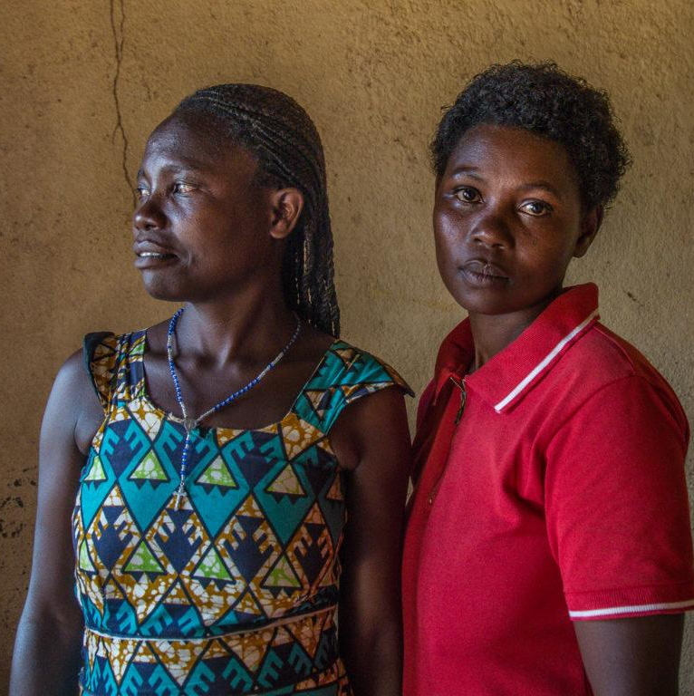
Indirect and Direct Measures
Photo credit: Yagazie Emezi/Getty Images/Images of Empowerment
Notes:
SPEAKER NOTES: Now let’s look at measures from a different angle—indirect and direct measures.

Slide 59
Indirect Measures
DEFINITIONS
Direct Measures
Typically focus on changes in:
Attitudes.
Intentions.
Behavior/practices.
Typically focus on expectations of what others do:
Descriptive norms (what others do).
Injunctive norms (what others should do).
Notes:
SPEAKER NOTES
A useful way to think of norms measures is whether they are indirect (proxy) or direct approaches.
Indirect measures or proxies assess attitudes, intentions, and behaviors or practices.
Direct measures assess social expectations of what others do. They measure descriptive norms, or respondent perceptions of what others do, and injunctive norms, or respondent perceptions of what others should do.
Next, we’ll show you some examples of direct and indirect measures for two behaviors: child immunization and health care utilization.

Slide 60
Examples of Direct Indicators of Norms Change
BEHAVIORS
CHILD IMMUNIZATION
HEALTH CARE UTILIZATION
DESCRIPTIVE NORM:
Perception that most children are not vaccinated.
INJUNCTIVE NORM:
Religious leaders oppose vaccination.
DESCRIPTIVE NORM:
Mothers in my town take their children to clinic.
INJUNCTIVE NORM:
Fathers who take their children to the clinic are seen as weak.
Notes:
SPEAKER NOTES
Behavior: child immunization
Descriptive norm that can be measured by the percentage of respondents believing most children in the community are not vaccinated.
Injunctive norm that can be measured by the percentage of respondents believing religious leaders oppose vaccination.
Behavior: Healthcare Utilization
Descriptive norm that can be measured by the percentage of respondents believing that mothers in town take their children to the clinic.
Injunctive norm that can be measured by the percentage of respondents believing fathers who take their children to clinic are “weak.”

Slide 61
Indirect Indicators of Norm Change
APPROACH | SAMPLE INDICATOR
Attitudes | Percentage of respondents who agree that children 6 to 23 months should eat an animal-source food daily.
Intentions/ hypothetical situation | Percentage of respondents agreeing with statement: I will get a goat for milk when I have a child.
Practices | Percentage of children (by age) consuming animal-source food in the past 24 hours.
Collective Norms | Aggregate attitudes/behaviors within a bounded social space.
Notes:
SPEAKER NOTES
And here you see the type of indirect indicators used to assess norm change. These are often collected in knowledge, attitudes, and behavior surveys, or KAB surveys, and the collected information is used to create a composite measure or index representing collective norms.
The concept of bounded social space is important for measurement and will be project dependent. A social space is a physical or virtual space whose boundaries are defined by the evaluator, such as a social center, online social media, or other gathering place where people gather and interact
An index is a composite measure that summarizes responses from statements/questions based on their empirical relationship to norms.
Here’s an example.
[read through table]
(Bounded social space: Define a physical or virtual space where people gather and interact.)

Slide 62

Measuring Descriptive and Injunctive Norms
Photo credit: Ezra Bailey/Getty Images
Notes:
SPEAKER NOTES:
We started our discussion comparing descriptive and injunctive norms and the differences between them. Let's return to them and focus on indicators of each to close out this part of the presentation.
It is good to distinguish between these two norm types because 1) they may have different influences on a behavior and 2) programmatically, an SBC intervention might treat differently normative beliefs that are descriptive (what others do) versus injunctive (what others think you should do and if not…).

Slide 63
Descriptive Norms
FORMULAS
Injunctive Norms
(What you think others do.)
(What you think others approve or disapprove of.)
What proportion of [relevant group] do you think [engages in behavior]?
What proportion of [others in your church congregation] do you think [have been tested for HIV/use condoms]?
To what extent do [those in a relevant group] approve of/encourage you to [engage in behavior]?
To what extent do [elders in your congregation] approve of/encourage you to [get tested for HIV/use condoms]?
Notes:
SPEAKER NOTES:
Here you can see one formula for crafting questions to measure descriptive and injunctive norms and an example for each. Direct measures include questions about descriptive norms (what you think others do) and injunctive norms (what you think others approve of).
[READ SLIDE]

Slide 64
Measuring Descriptive Norms
TYPE OF NORM | WHAT DO YOU WANT TO KNOW? | SAMPLE INDICATOR (CHANGE IN % RESPONDENTS AGREEING BETWEEN BASELINE AND ENDLINE)
Descriptive norm | What people perceive to be common behavior in their community/reference group. | Most people in my community practice cutting. Most of my friends practice cutting. Most women here would not work as drivers or builders.
Notes:
SPEAKER NOTES: Here is an example of a measure of a descriptive norm related to female genital mutilation/cutting (FGM/C).
[READ SLIDE]

Slide 65
Measuring Injunctive Norms
TYPE OF NORM | WHAT DO YOU WANT TO KNOW? | SAMPLE INDICATOR (CHANGE IN % RESPONDENTS AGREEING BETWEEN BASELINE AND ENDLINE)
Injunctive norm | What people perceive to be appropriate behavior in their community/reference group. | It is appropriate for families in my community to practice cutting. Market trading, hairdressing, and selling food are suitable work for women; driving or being a builder are not suitable.
Notes:
SPEAKER NOTES: And now an example of an injunctive norm related to FGM/C.
[READ SLIDE]

Slide 66
Fix my measure breakout group notetaking form
1 | Original measure | Do you think most pregnant women eat last?
 | Your revised measure
2 | Original measure | How many of your friends and your religious leaders would you say feed their children eggs every day?
 | Your revised measure
3 | Original measure | Among girls you look up to, do you think most wear face masks?
 | Your revised measure
4 | Original measure | Do your community members approve of breastfeeding until the child is 2 years?
 | Your revised measure
5 | Original measure | My family members would disapprove if I ate before my husband or saved seed grain.
 | Your revised measure
6 | Original measure | A woman should not argue with her husband, even if she does not share his view.
 | Your revised measure

Slide 67

Fix My Measure
PLENARY ACTIVITY
How can we improve these normative measures?
Do you think most pregnant women eat last?
How many of your friends and your religious leaders would you say feed their children eggs every day?
Among girls you look up to, do you think most wear face masks?
Do your community members approve of breastfeeding until the child is 2 years?
My family members would disapprove if I eat before my husband or saved seed grain.
A woman should not argue with her husband, even if she does not share his view.
Photo credit: Yagazie Emezi/Getty Images/Images of Empowerment
Notes:
NOTE TO FACILITATOR: The aim of this slide is for the participants to discern and consider practical ways of measuring descriptive and injunctive norms. The measures presented are have common errors, and you’ll ask the participants to fix them.
Display one question at a time and ask participants:
How would you improve it?
Which are direct and indirect measures?
ANSWER KEY
Revised measure: Do most pregnant women in your community eat last? OR Do you think most/some/no pregnant women in your community eat last?
Revised measure: Do most/some/no religious leaders in your community feed their children eggs? AND Do most/some/no friends in your community feed their children eggs every day?
Revised measure: Of the upper-form girls in your school, would you say none/a few/most/all wear face masks?
Revised measure: Do all/most/some/none of your mother support group members/grandmothers in your community/mothers-in-law in your community approve of breastfeeding until the child is 2 years?
Revised measure: Would all/most/some/none of your family members disapprove if you ate before your husband? AND Would all/most/some/none of your family members disapprove if you saved seed grain?
Revised measure: Do all/most/some/none of people in your group expect that a woman not argue with her husband, even if she does not share his view?

Slide 68

Measuring Sanctions
Photo credit: Jonathan Torgovnik/Getty Images/Images of Empowerment
Notes:
SPEAKER NOTES:
Some programs like to measure sanctions as a way of identifying the existence of a norm and tracking change.

Slide 69
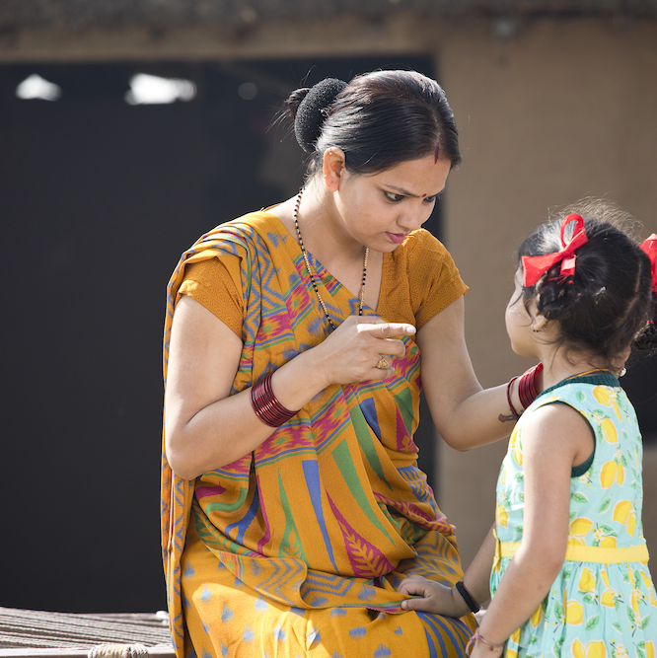
Sanctions
DIRECT MEASURES
If you don’t comply with norms, you face negative sanctions or punishments—or anticipate you will face them.
If you do comply with social norms, you receive some positive sanctions or rewards—or anticipate you will face them.
Photo credit: Triloks/Getty Images
Notes:
SPEAKER NOTES:
You’ll recall from earlier sessions that norms are enforced by sanctions (which can be positive or negative) that individuals expect as a result of complying—or not complying—with norms.

Slide 70
EXAMPLE
Measuring Sanctions in ICRW’s Parivartan Project
If you are given more freedom to move about in public spaces and play sport, how likely is it that the following consequences might occur? There is no right or wrong answer.
Responses:
Very Likely: 1, Somewhat Likely: 2, Not Likely: 3.
You will be harassed by local boys or men.
You may encounter more arguments/conflicts with your parents.
You may find it more difficult to get married.
You may be considered uppity and disobedient.
Notes:
SPEAKER NOTES: Here is an example of how to measure sanctions. The Parivartan project in India sought to increase acceptability of girl’s mobility, including freedom to move around in public spaces and to play group sports.
[READ SLIDE]
REFERENCES:
Learning Collaborative to Advance Normative Change, Resources for Measuring Social Norms: A Practical Guide for Program Implementers (Washington, DC: Institute for Reproductive Health, Georgetown University, 2019).

Slide 71

Strength, Prevalence, and Sensitivity
Photo credit: Tim Robberts/Getty Images
Notes:
SPEAKER NOTES: Not all norms are created equal. It is also important to understand how strong a norm is, how widespread it is, and whether people care about the sanctions (sensitivity). If an individual doesn’t really care about the sanction (such as being laughed at by other students), this sanction will not be an effective norms enforcer.

Slide 72
Measuring Strength and Prevalence
APPROACH | SAMPLE QUESTIONS
Measuring strength of norm | How strongly do people agree that a parent should hit a misbehaving child? [don’t support, support it in certain circumstances, strongly support it]
Measuring prevalence of norm | I am going to read out some views that many people in our society agree with. Could you please tell me to what extent such attitudes exist among the people in your neighborhood? A man who beats his wife has no place in his neighborhood. [don’t support, support it in certain circumstances, strongly support it] During an argument, a man who listens to his wife’s point of view is considered “not manly enough” by his neighbors and relatives. [don’t support, support it in certain circumstances, strongly support it] A woman who talks back to her husband earns a bad reputation among relatives. [don’t support, support it in certain circumstances, strongly support it]
Notes:
SPEAKER NOTES: Here are examples of the questions you might ask to ascertain the strength and prevalence of a norm.
[READ SLIDE.]
These can be asked in a quantitative survey or used in a focus group or individual interview.

Slide 73
EXAMPLE ITEM—VIGNETTE AND QUESTIONS
Measuring Sensitivity in CARE’s Abdiboru Project
Halima [age 15] is a grade 8 student. After completing grade 8, her parents indicate that Halima has no need to continue school as she has enough education for a girl to lead a life. They say that she must help the family and that she can find some job with her current educational level. Her father orders that she is not going to school anymore. (background)
Halima decides to go against her parents’ wishes and continues going to school. (non-compliance with norm)
        What would Halima’s parents do/say to their daughter in this situation? Would the reaction of the father and mother be different? (sanctions)
        Would Halima continue to go to school if it was not for the reaction of her parents? (sensitivity to sanctions)
        Under what conditions would Halima be able to continue school? (exceptions)
Notes:
SPEAKER NOTES:
Not everyone will be similarly influenced by the rewards or sanctions linked to complying or not complying with a particular norm. We refer to this as sensitivity. If a person is very sensitive to the rewards or sanctions, their behavior is more likely to be influenced by—or is more sensitive to—the norm.
Vignettes are an excellent way to measure sensitivity to sanctions. This vignette, used to measure sanctions for girl’s education, was used in CARE’s Abidboru Project in Ethiopia.
[READ SLIDE]
REFERENCES:
Learning Collaborative to Advance Normative Change, Resources for Measuring Social Norms: A Practical Guide for Program Implementers (Washington, DC: Institute for Reproductive Health, Georgetown University, 2019).

Slide 74

Measuring Reference Groups and Power Holders
Photo credit: Jonathan Torgovnik/Getty Images/Images of Empowerment
Notes:
SPEAKER NOTES:
We are now going to discuss one last set of concepts that often need to be measured in the evaluation of NSIs. These are reference groups and power holders.

Slide 75

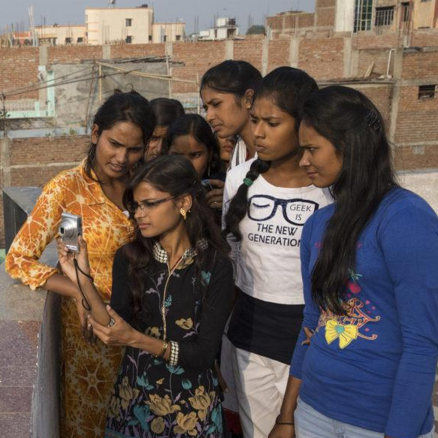

Reference Groups
Reference group members influence an individual’s likelihood of complying with norms through modeling and enforcement.
1-Photo credit: FilippoBacci/Getty Images
2-Photo credit: Paula Bronstein/Getty Images/Images of Empowerment
3-Photo credit: Triloks/Getty Images
4-Photo credit: Filadendron/Getty Images
Notes:
SPEAKER NOTES:
Earlier this session we learned that reference groups influence norms compliance through social modeling and enforcement.

Slide 76
All Reference Groups May Not Be Created Equal
Modeler
What proportion of girls in your school do you think use contraception?
Enforcer/power holder
Does your mother approve of you using contraception?
Likelihood of compliance
How much does your mother’s opinion matter to you?
Notes:
SPEAKER NOTES:
Remember that not all reference groups have equal influence. Let’s discuss questions that explore different paths of influence—modeling, enforcement, and sensitivity. As we just discussed, sensitivity is the degree to which someone’s opinion matters enough to encourage norm compliance.

Slide 77
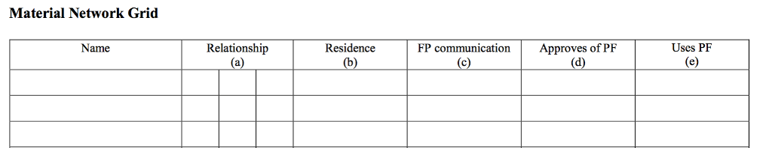
Reference Group Elicitation
SOCIAL NETWORK MAPPING CENSUS
“Now we are going to talk about the people in your network—people who you interact with, people you receive support from, people you consider to be part of your world. People you mention can live in this village or elsewhere.”
MATERIAL/PRACTICAL/EMOTIONAL NETWORK GRID
Notes:
SPEAKER NOTES:
This is an example of reference group elicitation through a social network mapping census. As reference groups are key to upholding the behavior of interest, identifying them makes for better intervention design. This example from a family planning project uses this grid elicit the names of members of a reference group for social network analysis.
As the respondent names each person in their network, the interviewer will ask the following questions:
“What is your relationship with (first name of the person)? You can mention more than one kind of relationship. For example, this person can be your aunt and your health care provider at the same time.”
“Is (first name of the person) a member of your household? If s/he is not, does this person live elsewhere?”
If the answer is “elsewhere,” ask “What town does (the first name of the person) live in?”
“In the last three months, have you spoken with (first name of person) about birth spacing or a method that would allow you to delay or avoid pregnancy?”
“In your opinion, would you say that (first name of person) approves of people who use a method of family planning to space their births?”
“In your opinion, would you say that (first name of person) uses a method of family planning to space their births?”

Slide 78
Reference Groups Measurement in the Masculinite, Famille, et Foi project
EXAMPLE ITEMS
In matters related to family planning, whose opinion is important to you? Do not read options. Check all options that apply. Husband 1, Friends 2, Mother 3, Father 4, Mother-in-law 5, Father-in-law 6, Faith leader 7, Sister 8, Brother 9, Other female relative 10, Other male relative 11, Other 88, specify___
Notes:
SPEAKER NOTES:
This is an example of another way to elicit a reference group, as a single survey question. The example is from the Masculinite, Famille, et Foi project implemented by the Passages Project in the Democratic Republic of Congo.

Slide 79
Measuring Power Holders in the Nigeria Urban Reproductive Health Initiative
EXAMPLE ITEM
If you wanted to use a method of family planning, would you need anyone’s permission?
Notes:
SPEAKER NOTES:
Power holders are the people who have direct or indirect influence of a person’s ability to engage in a behavior. This question from an evaluation in Nigeria was designed to detect the influence of power holders on contraceptive use.

Slide 80
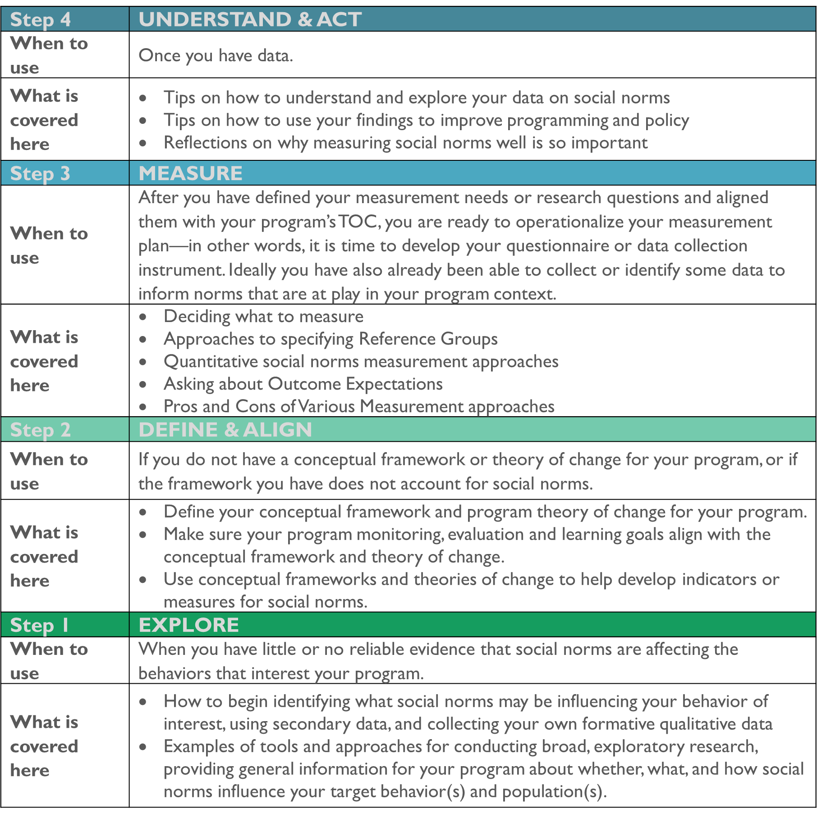
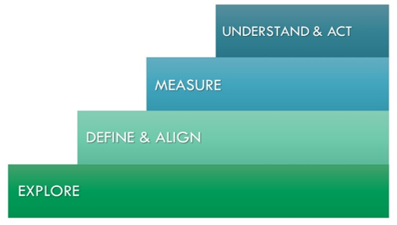
Resources for Measuring Social Norms: A Practical Guide for Program Implementers
ALIGN Resource
Notes:
SPEAKER NOTES:
The Social Norms Measurement Guide produced by the Learning Collaborative provides tips and examples of measures for each step of the program measurement cycle: explore, define and align, measure, and understand and act.
REFERENCE:
The Learning Collaborative to Advance Normative Change, Resources for Measuring Social Norms: A Practical Guide for Programme Implementers (Washington, DC: Institute for Reproductive Health, Georgetown University, 2019),
https://www.alignplatform.org/resources/resources-measuring-social-norms-practical-guide-programme-implementers.

Slide 81
Key Takeaways
MEASURING NORMATIVE SHIFTS IN COMPLEX ENVIRONMENTS
Measure either the descriptive norm (perceptions of typical behavior) or injunctive norm (perceptions of what is appropriate)… or ideally both.
Refer to a reference group. If not, it’s an individual attitude.
Use an approach best-suited to respondents (i.e., single item, scales or indices, vignettes, other participatory methods).
Social change is complex; monitoring and evaluation methods need to address complexity.
Collect and use data in real time to guide implementation.
Strengthen adaptive capacity and build a culture of adaptive management to foster norms change.
Notes:
SPEAKER NOTES:
We’ve covered a lot of measurement ground today. Here are the points I’d like you to keep in mind as you evaluate norms-shifting interventions.
[READ SLIDE]

Slide 82
Resources
“Map of social norms-focused projects and their measurement approaches: Who is doing what
and where.” ALiGN: Advancing Learning and Innovation on Gender Norms. Overseas Development Institute (ODI), 2002. https://www.alignplatform.org/learning-collaborative/case-studies
Passages Project and the Social Norms Learning Collaborative. Social Norms Exploration Tool. Washington, DC: Institute for Reproductive Health, Georgetown University, 2020. https://irh.org/social-norms-exploration/
Passages Project. Costing of Norms-Shifting Interventions: A Primer from the Passages Project. Washington, D.C.: Institute for Reproductive Health, Georgetown University for the U.S. Agency for International Development (USAID), 2020. https://www.alignplatform.org/resources/costing-norms-shifting-interventions-primer-passages-project
The Social Norms Learning Collaborative. Resources for Measuring Social Norms: A Practical Guide for Program Implementers. Washington, DC: Institute for Reproductive Health, Georgetown University, 2019. https://www.alignplatform.org/resources/resources-measuring-social-norms-practical-guide-programme-implementers
Center on Gender Equity and Health. Evidence-based Measures of Empowerment for Research on Gender Equality (EMERGE). University of California, San Diego, 2020. https://emerge.ucsd.edu/
The Social Norms Learning Collaborative. Monitoring Shifts in Social Norms: A Guidance Note for Program Implementers. Washington, DC: 2021. https://www.alignplatform.org/resources/monitoring-shifts-social-norms-guidance-note-program-implementers
Notes:
SPEAKER NOTES: I’d like to draw your attention to some useful resources for norms measurement. You can go to the Learning Collaborative page on the ALIGN website and find:
A map of social norms projects and their measurement approaches (you can search by country and type of program).
The Social Norms Exploration Tool (discussed in an earlier session) is a useful resource for formative research.
A report on the costing of NSIs from Passages
A practical guide for measuring social norms developed by Learning Collaborative members. Much of the content I shared with you today comes from the compiled experiences and best practices of Learning Collaborative members documented in this guide.
REFERENCES:
Advancing Learning and Innovation on Gender Norms (ALIGN), https://www.alignplatform.org/.
Evidence-Based Measures of Empowerment for Research on Gender Equality (EMERGE), University of California San Diego, http://emerge.ucsd.edu/.

