Slide 1
Shifting Social Norms as Part of Social and Behavior Change
Presenter, Organization

Slide 2
SHIFTING SOCIAL NORMS AS PART OF SOCIAL AND BEHAVIOR CHANGE
Overall Course Objectives
Discuss and explore advances in social norms programming, the relation of NSI to behavior change efforts, and their role in health and other-sector programming.
Share challenges and solutions in the design, implementation, and evaluation of community-based SBC projects engaging in, expanding, or planning to expand normative change efforts.
Explore next steps to further collective learning about such promising interventions globally.
Notes:
SPEAKER NOTES: In this training, when we talk about “community-based norms-shifting intervention,” we mean an intervention focused on improving behavioral outcomes at least in part by shifting social norms.

Slide 3
Shifting Social Norms as Part of SBC
1
2
3
4
5
INTRODUCTION | ASSESSMENT | DESIGN | MEASUREMENT | SCALE-UP
Why Social Norms Matter | Assessing Social Norms to Inform Program Design and Implementation Strategies | Designing Norms-Shifting Interventions | Measuring Normative Shifts in Complex Environments | Scaling Up Norms-Shifting Interventions Effectively and Ethically
Notes:
SPEAKER NOTES: This training is part of a five-module course on norms-shifting interventions; this module is covering designing norms shifting interventions. As a note, when we refer to norms-shifting interventions, these may be standalone, or may be activities integrated into a broader SBC intervention.

Slide 4
Welcome & Introductions
PASSAGES SOCIAL NORMS TRAINING

Slide 5
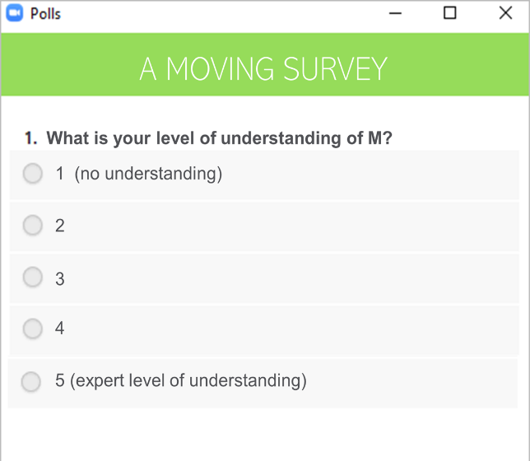


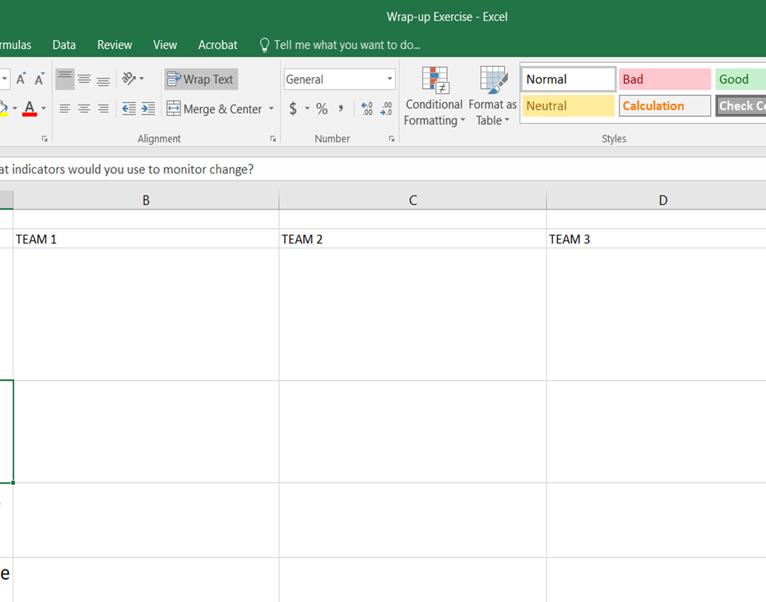

Virtual Tools
POLLS
BREAKOUT ROOMS
WHITEBOARD
GOOGLE SHEETS
CHAT
Notes:
NOTE TO FACILITATOR: Recap the tools you will be using.

Slide 6
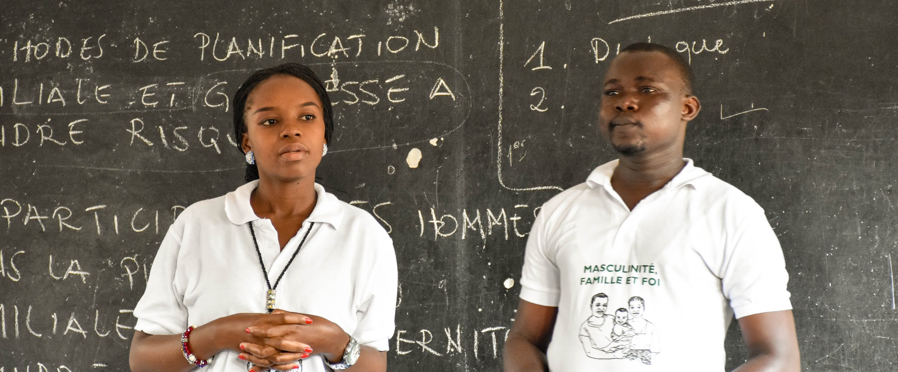

Designing Norms-Shifting Interventions
MODULE THREE
Photo credit: Institute for Reproductive Health

Slide 7
Session One
Notes:
NOTE TO FACILITATOR: If you are conducting your virtual session in two parts, the first one starts here. Note that you may have repeat virtual tools slides, and basic overview slides, at the beginning of your second session.

Slide 8
1
Shifting norms through community-based programming.
Section
2
Shifting gender and other social norms.
Section
Overview
Designing
Norms-Shifting Interventions
3
Program design for shifting
social norms.
Section
4
Common missteps in designing norms-shifting approaches.
Section
5
Ethical thinking for norms-shifting interventions.
Section
Notes:
SPEAKER NOTES: This section takes the key concepts and learning from formative research to focus on norms program design. The section will cover:
­ Approaches and issues to consider in the design of norms-shifting interventions (or NSIs) through case studies, group work, and experience sharing.
­ The strategies that community NSIs have used to shift norms in health and across sectors.
­ The importance of ethical grounding to norms program design and implementation.

Slide 9
DESIGNING NORMS-SHIFTING INTERVENTIONS
Learning Objectives
During this session, participants will:
Identify the differences between norms-shifting interventions (NSI) and other social behavior change interventions.
Recognize common characteristics of a community-based NSI.
Be aware of ethical considerations for NSI design and implementation.
Discuss strategies to integrate social norms shifting into project design.
Notes:
NOTE TO FACILITATOR: Read slide.

Slide 10
Overview of Social Norms and Their Relation to Behavior
WHY SOCIAL NORMS MATTER
Notes:
NOTE TO FACILITATOR: The following slides are an overview of social norms from Module 1 of this curriculum. If the participants have recently gone through Module 1, you may choose to go through these slides at a quicker pace.

Slide 11
DEFINITION
Social Norms
Social norms are the often implicit, informal rules that most people accept and abide by. They are influenced by belief systems, perceptions of what others expect and do, and sometimes by perceived rewards and sanctions.
Norms are embedded in formal and informal institutions and produced and reproduced through social interaction.
- ALIGN, Overseas Development Institute
Notes:
NOTE TO FACILITATOR: This slide is animated.
SPEAKER NOTES: This is a more formal definition of social norms.
[Click for Animation 1- Read Paragraph]: Often not consciously obeyed, norms are tacit rules of behavior.
[Click for Animation 2- Read Paragraph] It’s of note that norms can be embedded in formal institutions by codification into law as well as institutional policies.
[Read examples, if time permits]
Some examples include:
1) Some school policies do not allow unmarried girls who become pregnant and give birth to return to finish studies. The boys who got the girls pregnant are permitted to continue their educations. What norms are operating here? Which are institutionalized?
2) Some health care settings require spousal permission for contraceptive services. What norms may be operating here? How have they been institutionalized?

Slide 12

DEFINITION
Gender Norms
Social norms that govern attributes and behaviors that are valued and considered acceptable for people of a gender within a given culture or social group.
Are learned and reinforced from childhood to adulthood through observation, instruction, positive and negative sanctions, media, religion, and other social institutions.
Can be so pervasive that people mistakenly assume they are “natural” or “ordained” and thus immutable.
Photo credit: Yagazie Emezi/Getty Images/Images of Empowerment
Notes:
NOTE TO FACILITATOR: Read slide.

Slide 13
DEFINITION
Social Norms Are…
What people in a group believe is typical (what others do) and appropriate (what others expect me to do) behavior.
Often defined in relation to a reference group.
Notes:
SPEAKER NOTES: Social norms are different from individual attitudes or beliefs—not what I believe, but what I think that others believe.
Example: I believe it is good to use family planning. I believe that others believe FP use is good/not good.
The second sentence represents what others expect or want me to do; this creates a norm of what is appropriate behavior.
The ”others” form part of my reference group (defined on coming slide).

Slide 14


Types of Social Norms
DESCRIPTIVE NORMS
INJUNCTIVE NORMS
Perceptions of what others do.
Perceptions of what others expect me to do.
Photo credit: Getty Images/AfricaImages
Notes:
SPEAKER NOTES: This is an overview of the two types of social norms we focus on while discussing norms assessments.
This slide discusses the norm of always washing your hands before eating and two types of norms in action around this norm.
[Ask participants] What do you see in each photo?
Descriptive norms are what others do: the many children seeing others washing hands.
Injunctive norms are what is appropriate behavior: being told by your teacher or parent to leave the table and wash hands before rejoining.
Think of yourself as a child. How did descriptive and injunctive norms about handwashing before eating influence your behavior or the behavior of others in this room?

Slide 15
DEFINITION
Reference Groups Are…
Those who pass on and enforce social norms.
A group of people whose behaviors and beliefs influence my behaviors and beliefs.
Notes:
SPEAKER NOTES: With these definitions of social norms, we will turn to enforcement of norms. Social norms are passed on and enforced by reference groups- a reference group is a group of people, a community—from a village to a broad religious community—for which these behaviors are relevant. Some define the reference group as a valued social group.
The important thing is that reference groups can exert a considerable amount of influence on behavior, and we might not be particularly influenced by behavior of individuals that we do not interact with or value their approval or disapproval.

Slide 16
TERM |  | DEFINITION
Behavior |  | What I do.
Attitude or belief |  | What I prefer and what I know.
Social and gender norms | Descriptive norm | What I think others do.
 | Injunctive norm | What I think others will approve/disapprove of me doing.
Reference group |  | People whose opinions matter to me (for a particular behavior or context). People who reward or sanction me for my behavior.
Adapted from the Social Norms Learning Collaborative, Social Norms and AYSRH: Building a Bridge from Theory to Program Design, May 2019
Notes:
SPEAKER NOTES: This slide brings together the definitions of some of the key terms we will reference throughout the module. As you can see, all these terms can influence behavior, whether they are independent (such as beliefs and attitudes) or interdependent (such as social and gender norms).

Slide 17
Shifting Norms Through Community-Based Programming
SECTION 1
Notes:
SPEAKER NOTES: Now that we’ve reviewed what social norms are, let’s talk about norms change. In the next few slides, we’ll ask you: can norms really be shifted by community programs?

Slide 18

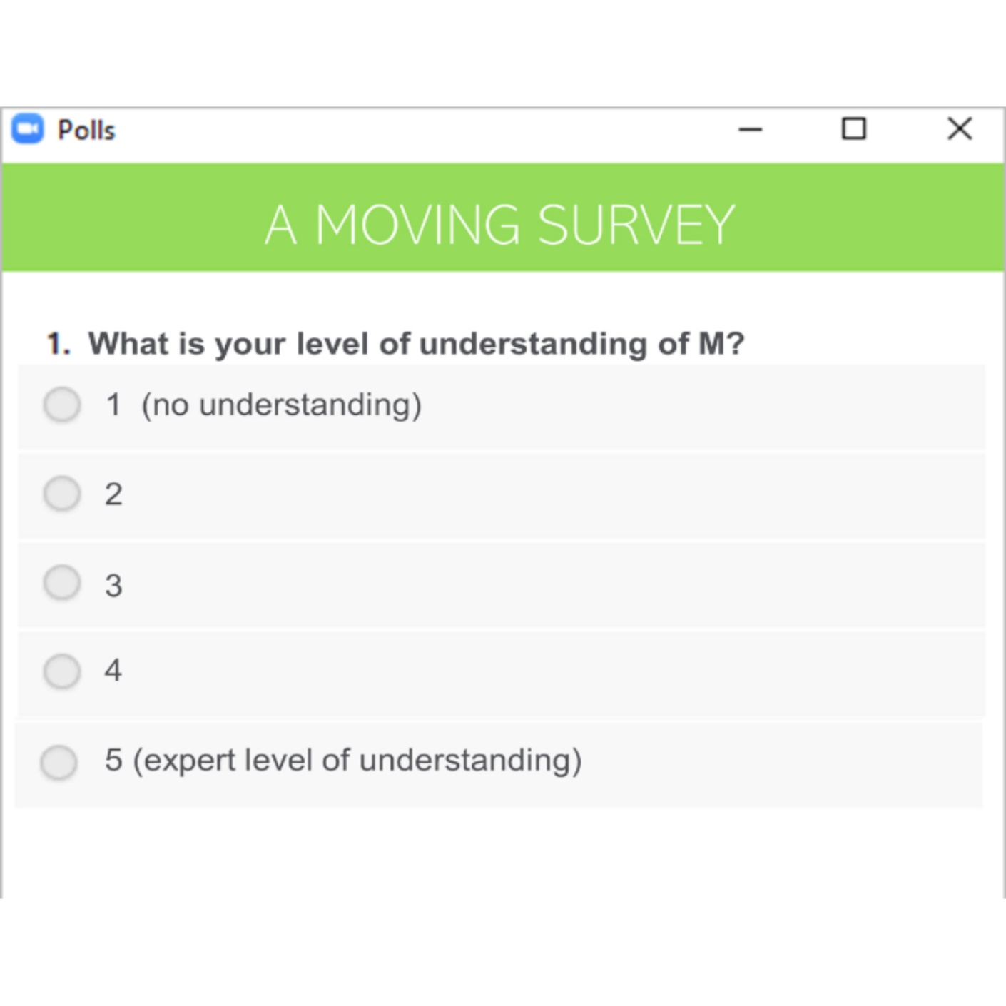
Social Norms in Real Time!
PLENARY ACTIVITY
Spend 30 seconds thinking about this question:
On a scale of 1 to 5, do you think social norms can be shifted by community programs?
POLL
5 | 4 | 3 | 2 | 1
Definitely | It’s possible | Not sure | I doubt it | It’s impossible
Notes:
NOTE TO FACILITATOR: This reflection activity aims to reveal whether participants believe that norms can be shifted.
Advance preparation: Program this poll in your virtual conference platform. Alternatively, participants can simply use the chat function to report back.
The activity. Ask everyone in the session to spend 30 seconds thinking about this question and keep in their mind what they think on a scale of 1 to 5. Then ask them to share their answer, either through a poll or through chat. Ask or call on people to report on why they chose the number they did. [10 minutes]

Slide 19

What Have You Observed in Shifting Norms Within a Project?
PLENARY DISCUSSION
CHAT
BOX
Notes:
NOTE TO FACILITATOR: Ask participants to list some challenges they have observed in shifting norms over a project time frame of three to five years. Norms change can take longer. How do you design a project that can lead to incremental shifts over time? Depending on the size of the group, you can either use the chat function or ask participants to unmute and share thoughts.
You can make note of these challenges to come back to later in the session. This should be a quick activity to collect ideas and observations that can be engaged with throughout the presentation.

Slide 20
Shifting Gender and Other Social Norms
SECTION 2
Notes:
SPEAKER NOTES: Now we are going to discuss how social and gender norms shift through programs, drawing from learnings coming out of programs and research.

Slide 21
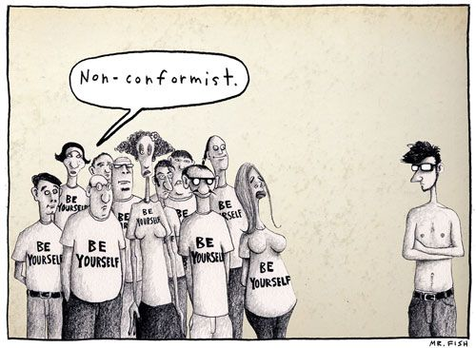
Why Do People Comply With Norms?
PLENARY DISCUSSION
CHAT
BOX
Notes:
FACILITATOR NOTES: You can start by asking participants to describe what they see in the comic—why do they think people comply with norms? Depending on the size of the group, they can share using the chat function or unmute and contribute.
SPEAKER NOTES:
There are a few reasons people comply with social norms.
One reason is that people do not know they are doing it. All the people wearing “be yourself” t-shirts may believe that they are expressing themselves and their individuality without realizing that they are adhering to social expectations.
Someone may be sanctioned (called names, pushed out of a group) for behaving differently. We see the person standing alone is not wearing the same clothes as others. As a result, he is separated from the group; they stare at him and call him names.
One’s identity as an individual and group member may be validated by adhering to the norm—even when the norm acts in opposition to what one thinks of oneself. Here we see people are wearing “be yourself” t-shirts while conforming to the norm of wearing a shirt and this particular shirt. This is another reason people comply with norms—they want to be part of a group.

Slide 22

Why Do People Comply With Norms?
PLENARY DISCUSSION
Norms’ often hidden and unexamined nature.
Powerholders’ desire to maintain power and privilege.
Insufficient power to resist the norms.
Fear of negative sanctions or desire for benefits or rewards.
Desire to conform to a sense of social identity.
To organize themselves for a common purpose.
Photo credit: Blend Images - JGI/Jamie Grill/Getty Images
Notes:
NOTES TO FACILITATOR: This slide and the previous one cover similar concepts in different ways. The facilitator can pick one or present both. This one may be a good option for audiences that wouldn’t connect with the cartoon.
SPEAKER NOTES: People comply with norms for many different reasons.
Norms are often hidden and unexamined. People may follow norms without realizing they are doing so. Often people have trouble identifying norms because they develop and are enforced in a social space, instead of being explicitly discussed and identified.
Powerholders wish to maintain power and privilege and may enforce norms. In any setting, and in all relationships, there are people that benefit from the power status quo. Their power may be specific to a situation or historic. When norms or behavior change, it can increase people’s voice and opportunity and lead to changes that powerholders feel uncomfortable with even when it is more equitable. In seeking to maintain their positions, powerholders may enforce sanctions, provide benefits or demonstrate their strength and resistance to norms change.
People may have insufficient power to resist the norms. Those people who have less power and who are abiding by norms that they would rather not follow or don’t agree with may lack the opportunity or strength to behave differently than the norm. This lack of power can lead to people abiding by norms they disagree with or secretly not following the norm.
People may fear of negative sanctions or seek benefits or rewards. People may abide by norms because they do not want to experience negative sanctions or because they want or need the benefits associated with adhering to the norm. Sanctions can be social (e.g., stigma, discipline, social pressure, reprimands, loss of privileges or opportunities) or operate at other levels. Rewards include access to services, social spaces, relationships, employment, material resources, etc.
The desire to conform to a sense of social identity is strong. As we saw in the comic, people may abide by norms in order to fit with a certain social identity that is important to them. This can include “being a good spouse” or adhering to a norm to be socially accepted by others in your peer, family, or community groups. A person may want to be considered good and adhering to the principles of their religion.
People may want to organize themselves for a common purpose. People also abide by norms in order to achieve common goals. They may choose not to deviate from a norm, even when they disagree with it, because of the other benefits, opportunities, or objectives that are achieved. For example, with coronavirus, people were asked to physically distance and wear masks in many settings. There was an individual and social benefit to this—and many people may have followed it, even when it was uncomfortable, in order to help stop or limit the spread of illness.

Slide 23
4 Common Reasons That Norms Influence Behavior
Reason | DESCRIPTION | Example
Uncertainty | Looking at others’ behavior when unsure about the best course of action. | Witnessing a parent hit their children and not saying anything because others are also silent.
Identity | Compliance to demonstrate group membership. | Adolescent drinking alcohol with peers to be a part of the group.
Reward | Anticipation of rewards for compliance. | A woman being praised and well regarded in a community because of how well she takes care of her home.
Enforcement | Group and individual actions force compliance. | Others won’t buy a family’s produce because husband and wife farm together in a setting where only women farm.
David C. Bell and Mary L. Cox, “Social Norms: Do We Love Norms Too Much?” Journal of Family Theory & Review 7, no. 1 (2015): 28-46.
Sophie Legros and Beniamino Cislaghi, “Mapping the Social-Norms Literature: An Overview of Reviews,” Perspectives on Psychological Science 15, no. 1 (2020), 62–80.
Notes:
SPEAKER NOTES: There are different reasons norms influence behavior. We are still learning what works for different norms, behaviors, and groups. A literature review (Bell & Cox, 2015) identified four reasons norms influence behavior that may work separately or together to shift norms.
Uncertainty describes a situation where a person follows what others do because they are unsure of which action to take. In this case, an individual may not know their own preference. For example, someone might witness a parent hit their children and not say anything because others are not.
Identity describes a situation where people recognize a norm as valid, important, or of value to them and others. These norms shape beliefs about how one should act and can lead to people adhering to the norm even when others do not. Norms compliance related to identity is related to these factors: (1) the norm is connected to individual values, (2) compliance validates self-identity, and (3) a lack of alternatives—where individuals comply because they cannot imagine or access alternatives. For example, adolescent might drink alcohol with peers to be a part of the group, because being part of the group is important to their identity.
Reward describes a situation in which people’s behavior is influenced by the rewards that are associated with (non) compliance. Consequences can come in different forms—reputational, economic, emotional, membership in a group, etc. This influence creates expectation of rewards in different ways including: (1) role modeling; (2) social pressure, subtle encouragement, or active enforcement; or (3) anticipation of rewards. For example, a woman may be praised and well-regarded in her community because of how well she takes care of her home, which is associated with female gender roles.
Enforcement describes a situation where a person’s behavior is influenced by the sanctions that are associated with (non)compliance. Again, consequences can be in different forms—reputational, economic, emotional, membership in a group—and influence creates obligation in different ways including: (1) role modeling; (2) social pressure, subtle encouragement, or active enforcement; or (3) anticipation of sanctions. For example, a couple may find that others won’t buy their produce because the husband and wife farm together in a setting where only women farm.

Slide 24
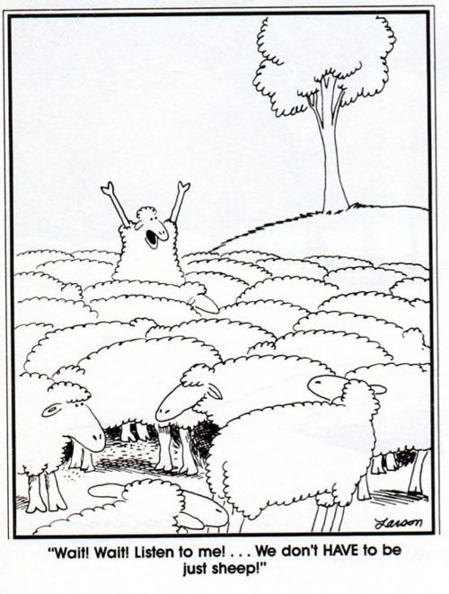
People Might Violate Norms If Their Knowledge, Attitude, Self-Efficacy, or Personal Agency Is Strong
Notes:
NOTE TO FACILITATOR: Before moving to the next slide, the facilitator can ask the group “Can you think of a time when you have done something that deviated from a norm?” Have a few people share before moving to the next section.
SPEAKER NOTES:
Can you think of a time when you have done something that deviated from a norm?
[Pause for discussion]
We know that people are able act against norms. Here in the comic, we see a sheep standing up saying there are other ways of being—that they can think about and decide who they want to be rather than following the group.
So, we have seen that with knowledge, attitudes, and strong self-efficacy and personal agency, people might choose to violate norms. They can do this individually or in groups, where their self and collective efficacy can support change. People also can violate norms when they are supported, knowing that support will continue even when they breach a norm.

Slide 25
Program Design for Shifting Social Norms
SECTION 3
Notes:
SPEAKER NOTES: Now we are going to focus on our design challenge: How can we design programs to shift norms?
Our goal in norms programing is to form new norms, shift or transform existing norms, and change behaviors. The end point of norms programming is to change both norms and behaviors, with the long-term goal of sustaining change for improved outcomes.

Slide 26
What Makes Interventions NORMS SHIFTING?
PLENARY ACTIVITY
Think about the SBC projects that you know.
Do they address the social factors that influence behavior? How?
How do they decrease socio-normative barriers to behavior change?
CHAT
BOX
Notes:
NOTE TO FACILITATOR: Ask participants each question, and allow them to discuss the answers in plenary, either by unmuting or in chat.
SPEAKER NOTES: Think about the SBC projects that you know.
1) Do they address the social factors that influence behavior?
2) How do they decrease socio-normative barriers to behavior change? How do positive social factors facilitate behavior change?
We want to have a discussion here on classic SBC interventions and whether and how these include strategies to shift norms. The value of this conversation is that people often know but have not verbalized how norms programming is different; this fact can make it challenging to design norms programming. It is important to understand that norms programming is part of SBC work, not separate from it.
Social and behavior change programs that take an individual approach, without focusing on the social aspect, often:
Focus on knowledge, quality, coverage, or access.
Address individual attitudes and behaviors, even if in group settings, without exploring the social factors that restrict behavior change.
Base measurement is largely on the individual (attitude, belief, behavior) rather than the way the environment enforces and upholds behaviors and norms.
Omit norms from the intervention/project’s pathway of change, even when people understand that norms are important.
Norms programming is a part of SBC and it is an explicit effort to include strategies to shift social norms.

Slide 27

Norms-Shifting Interventions Seeking to Influence Behavior
My friends think that having many children makes them valued by society.
My father and uncles think I should have many children.
Promote examination of existing norms in relation to new ideas and new desired behaviors by:
Correcting incorrect information.
Catalyzing different norms.
Supporting collective action as it emerges.
All my friends have many children, and even if I want only two children, I may have more because everyone else does.
My father and uncles think I should have many children and contribute to our family legacy and society.
BELIEFS, ATTITUDES, AND BEHAVIORS
Notes:
SPEAKER NOTES:
NSI seek to influence behavior by promoting the examination of existing norms in relation to new ideas and new desired behaviors. The man you see to the right has many normative influences on his behavior of deciding how many children he’ll have.
A program that seeks to shift norms and influence behavior often engages with the following ideas, which we’ve discussed in earlier slides. These are:
Social norms influence how people think, how they perceive, and how they behave.
People conform to a norm if they believe others follow it, or if they believe others expect or prefer them to do so.
An individual attitude may differ from the social norm, thus interventions that focus on individual attitudes exclusively may not be sufficient to change behaviors.
Behavior can be changed by:
Correcting incorrect normative perceptions—either descriptive or injunctive.
Catalyzing different norms.
Supporting collective action as it emerges.

Slide 28
Defining Community-Based NSI
Who | Individual and community as a locus of change.
What | Uses mix of media channels and social spaces to foster critical reflection rooted in cultural values. Works at different levels of social ecology. Based on social norms assessment and identification of relevant norms, planned diffusion of new ideas.
How | Behavior change strategies address normative perceptions and expectations; new, alternative behaviors.
Aim | Seeks to redistribute power and social influence that support individuals’ health behaviors and service use.
Notes:
SPEAKER NOTES:
Here is another way of understanding community-based norms-shifting interventions. We are focused here on community-based interventions but there are also other approaches to shifting norms which we will speak about briefly later.
Who are the participants in an NSI? Individuals and the community.
What are the strategies of an NSI?
Use a mix of media channels and social spaces to foster critical reflection rooted in cultural values.
Work at different levels of social ecology.
Base efforts on social norms assessment and identification of relevant norms and planned diffusion of new ideas.
How does an NSI work to change behavior? Behavior change strategies address normative perceptions and expectations; new, alternative behaviors.
What is the broad aim of an NSI: Ultimately, NSIs seek to redistribute power and social influence that support individuals’ health behaviors and service use.
NOTE TO FACILITATOR: The following text is an optional deeper explanation of community-based interventions, and community-based NSIs.
Many community-based programs work to influence behaviors but do not do so by shifting social norms. For instance:
Programs that focus on other contributing factors of normative change, such as policy reform or macro/environmental realities (e.g., poverty). Example: A program may advocate for strengthened legislation around intimate partner violence but does not address norms that condone such behavior as a private or family matter, thereby undermining enforcement of the law. Yet changes in policy and law can set norms-shifting processes in motion—the lines are not crisp.
Programs that target individuals’ attitudes and behaviors but do not address community-held social norms that shape that behavior. Example: A program may engage families in discussions of the harmful effects of female genital cutting (FGC) on girls, but not tackle social norms that promote FGC as a prerequisite for marriage. In such instances, a family’s personal attitudes about FGC may change while their behavior continues to be influenced by the prevailing community norm.
Programs that have a high level of community participation but do not engage communities in critical reflection or generate critical mass. Example: A workshop or training may raise knowledge of HIV transmission and prevention but does not include time for debate and reflection on why the situation exists, which would allow communities to establish new norms around sexual behavior.
While it is important to understand what makes norms-shifting interventions distinct, practitioners should keep in mind that many types of community-based programs are needed to facilitate social change. The aim is not to turn every community-based program into a social norms program, but to see how social norms influence behavior and to incorporate a norms-shifting approach as needed.

Slide 29

What Makes an Intervention Norms-Shifting?
Resources Included Meta-reviews: what works and lessons learned from evaluated projects. SBC landscaping report (Johns Hopkins University Center for Communication Programs). Meeting reports of international consultations deliberating on norms programming.
2017 desk review of the literature
Collected primarily from members of the Scale Up Learning Community, as well as additional sources.
29 articles selected with a low- and middle-income country focus (not a systematic review).
Thematic Areas Adolescent sexual and reproductive health. HIV prevention. Violence prevention for female genital cutting, violence against women, and violence. Gender transformative approaches for health, male engagement. Social marketing. Participation and community mobilization around HIV.
Notes:
NOTES TO FACILITATOR: This slide is animated.
SPEAKER NOTES: Here we describe the methodology for the literature review that led to the attributes of NSI, which we’ll talk about next.
Conducted in 2017 through the Learning Collaborative.
Included 29 articles, focused on interventions in low- and middle-income countries, mostly grey literature.
Thematic areas included: adolescent and youth reproductive health, HIV prevention, violence prevention for female genital mutilation, preventing violence against women, gender transformative approaches for health, male engagement, social marketing, and participation and community mobilization around HIV.

Slide 30











Common Attributes of Community NSI
x
=
Corrects misperceptions around harmful behavior
Confronts power imbalances, particularly related to gender
Seeks community-level change
Engages people at multiple levels
+
Creates safe spaces for critical reflection by community members
Roots the issue within the community’s own value systems
Accurately assesses norms
Uses “organized diffusion”
Creates positive new norms
Notes:
SPEAKER NOTES:
We are going to explore some common attributes of community-based norms-shifting interventions identified through the literature review we just talked about. Your handouts also have this information. Note that we are not saying that all nine of these are needed for an intervention to be a successful NSI; we also do not know yet whether some are more important than others or if one alone is sufficient to shift norms.

Slide 31
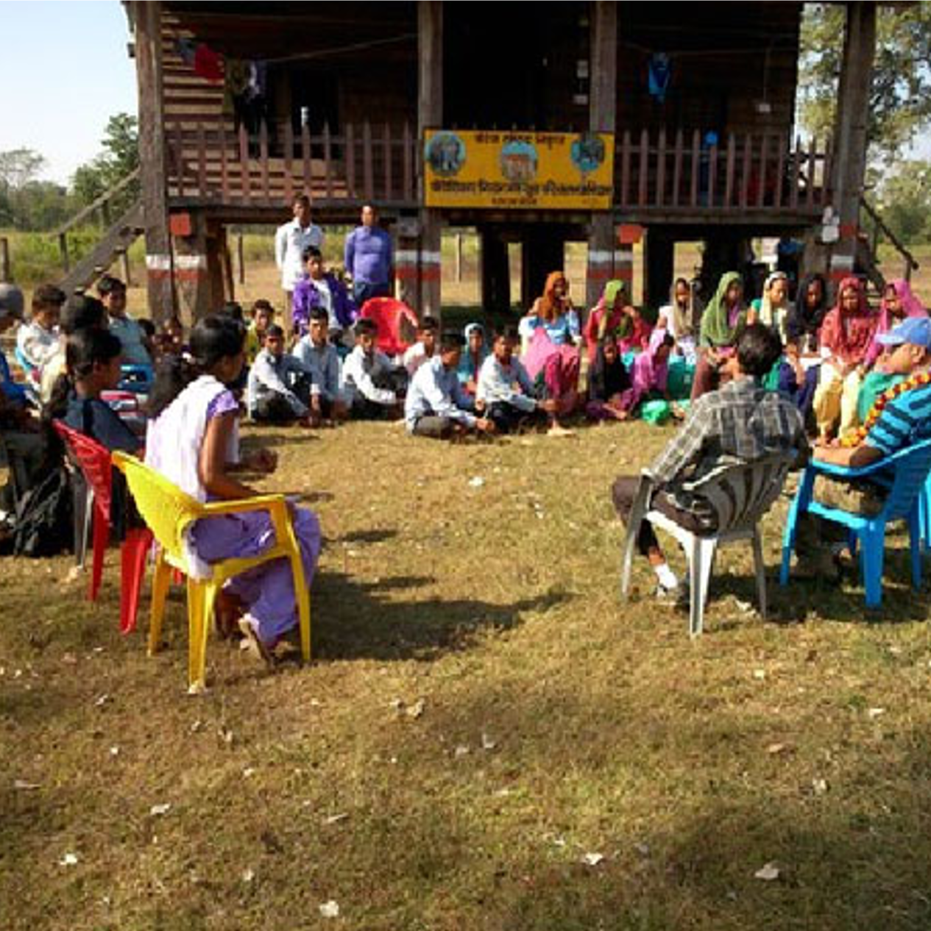
Seeks Community-Level Change
ATTRIBUTES OF COMMUNITY NSI
Targets social expectations, not just individual attitudes and behaviors.
Clearly articulates social change outcomes at the community level.
Photo credit: Institute for Reproductive Health
Notes:
NOTE TO FACILITATOR: Read the slide. If needed, below is additional information to craft your speaker notes and respond to participants’ inquiries.
SPEAKER NOTES:
The attribute that emerged most often as part of a norms-shifting intervention is that it seeks to achieve change at the community, rather than individual level. While this may seem obvious, in practice, programs sometimes:
Conflate individual outcomes with community-level outcomes.
Fail to articulate or measure the community-level outcomes they seek.
Use individual-level approaches to seek community-level change. In many cases, purported norms-shifting interventions may be deemed “successful” because they get positive results in changing individual attitudes and perceptions, but it is not clear whether the related community-level norms and behaviors change as a result.

Slide 32
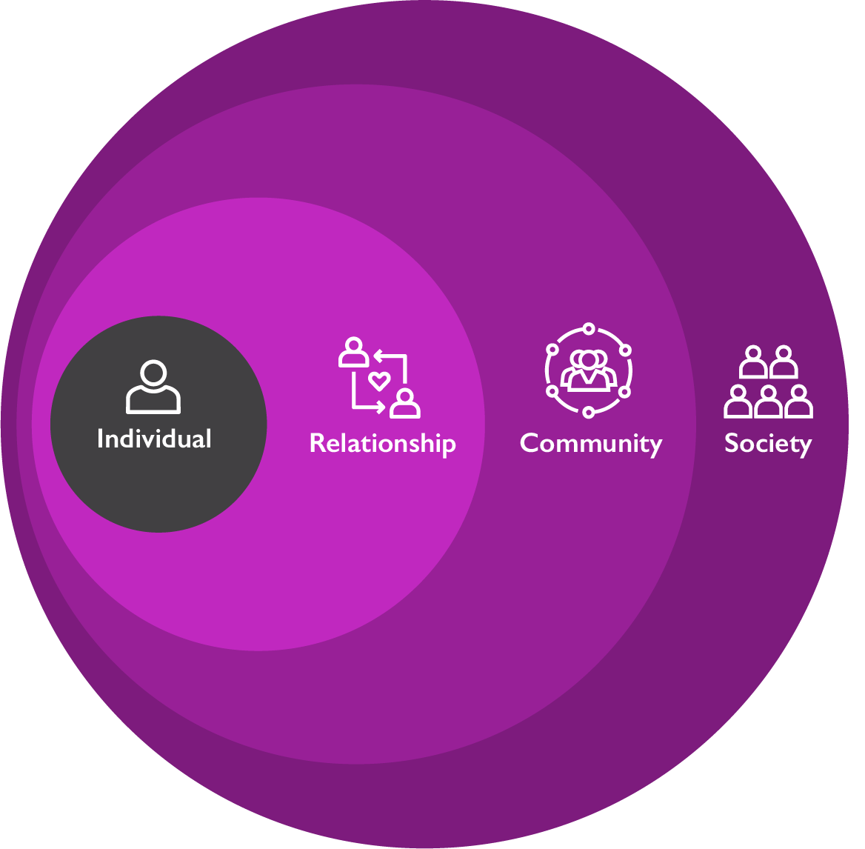
Engages People at Multiple Levels
ATTRIBUTES OF COMMUNITY NSI
Uses multiple strategies to engage people at different levels: individual, family, community, and policy/legal. (Ecological Model)
Notes:
NOTE TO FACILITATOR: Read the slide. If needed, below is additional information to craft your speaker notes and respond to participants’ inquiries.
SPEAKER NOTES:
Another common attribute is that norms-shifting interventions work with multiple types of people at different levels of the ecological system. They use multiple strategies for engaging different groups in critical reflection—which is important, as there is mounting evidence that harmful behaviors such as violence against women persist even when legal and political action has been taken to address the issue.

Slide 33
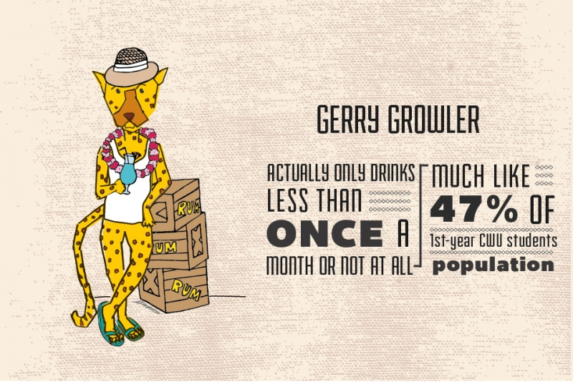
Corrects Misperceptions Around Harmful Behaviors
ATTRIBUTES OF COMMUNITY NSI
Sometimes individuals engage in a harmful behavior because they mistakenly think these behaviors are common—that “everyone does it”—when in reality they don’t.
In such instances, correcting misperceptions by revealing the actual, healthier norm can be effective.
Notes:
NOTE TO FACILITATOR: Read the slide. If needed, below is additional information to craft your speaker notes and respond to participants’ inquiries.
SPEAKER NOTES:
This attribute ties to much of the earlier work and literature on social norms, which involves situations where there is a difference between the perceived descriptive norm (what we think others believe/do) and the actual norm or behavior (what others actually believe/do), which is healthier than perceived. In these cases, the approach is to increase the visibility of the actual behavior norm. A common example of this is college drinking interventions where students believe much of their community drinks heavily and the program corrects this perception with the actual numbers, which are lower than believed.

Slide 34

Confronts Power Imbalances, Particularly Related to Gender and Other Sources of Marginalization
ATTRIBUTES OF COMMUNITY NSI
Addressing power imbalances and inequality, particularly related to gender and marginalized groups, has been found to be key to creating long-term social change.
Photo credit: LaylaBird/Getty Images
Notes:
NOTE TO FACILITATOR: Read the slide. If needed, below is additional information to craft your speaker notes and respond to participants’ inquiries.
SPEAKER NOTES:
Addressing power imbalances and inequality, particularly related to gender and marginalized groups, has been found to be key to creating long-term social change, particularly for women and girls. Within sexual and reproductive health and within programs focused on adolescent and youth development this is usually an important attribute of norms-change programming.
Not all norms-shifting interventions must have this attribute to be effective, but it should not be overlooked when working towards improved and equitable outcomes.

Slide 35

Creates Safe Spaces for Critical Reflection by Community Members
ATTRIBUTES OF COMMUNITY NSI
Deliberately promotes sustained, critical reflection that goes beyond trainings, one-off campaigns, or ad hoc outreach.
Often conducted in small group settings.
Photo credit: Adene Sanchez/ Getty Images
Notes:
NOTE TO FACILITATOR: Read the slide. If needed, below is additional information to craft your speaker notes and respond to participants’ inquiries.
SPEAKER NOTES:
It was found that many norms-shifting interventions have the attribute of providing community/group members space to think critically about their own ideas and behaviors and to reflect upon both old and new norms. This goes beyond trainings, one-off campaigns, or ad hoc outreach work. Such spaces promote reflection in creative, dynamic, and engaging ways and are important to dismantling old norms and creating new ones. This also helps group change within the community/group as a means of creating more meaningful, lasting change.

Slide 36

Roots the Issue Within Community’s Own Value Systems
ATTRIBUTES OF COMMUNITY NSI
Identifies how a norm serves or contradicts a community’s own values.
Avoids labeling a practice within a given community as bad.
Photo credit: Oliver Rossi/ Getty Images
Notes:
NOTE TO FACILITATOR: Read the slide. If needed, below is additional information to craft your speaker notes and respond to participants’ inquiries.
SPEAKER NOTES:
There is sometimes a misconception that dismantling norms and creating new ones means transferring someone else’s beliefs onto a community, labeling a community/group’s practices as “negative.” While discussion of new ideas may prompt some resistance at first, it is possible and in fact preferable to root new norms within communities’ own value systems, particularly if critical reflection is led by those who are trusted, credible sources. For example, a community that values strong families may be tolerant of intimate partner violence as a behavior that upholds this value. Critical reflection can help to dismantle norms around intimate partner violence by rooting the exploration of new, non-violent norms within this same value of strong families.
Reflection helps people to identify which values their norms and behaviors are serving and which they are not, as well as how they might better live their values if things changed.

Slide 37

Accurately Assesses Norms
ATTRIBUTES OF COMMUNITY NSI
Identifies which norms shape a given behavior and which groups uphold the norm.
Social norms exist within reference groups—the group of people that are important to an individual when they are making a decision.
Engaging the proper reference group is critical for effectively changing a social norm.
Photo credit: Maskot/Getty Images
Notes:
NOTE TO FACILITATOR: Read the slide. If needed, below is additional information to craft your speaker notes and respond to participants’ inquiries.
SPEAKER NOTES:
This attribute comes from programs that used a diagnosis process to identify the norms that prop up behaviors of interest. We may make assumptions about the norms that drive certain behaviors, and diagnosis may find that multiple norms drive the same behavior or that a behavior is driven by different norms than we assumed. We also may assume that the behaviors themselves are the norms, though social norms refer to the behavioral rules, not the behavior itself. Social norms assessment can clarify these points and allow us to identify whose behaviors a program intends to shift and who represents the relevant reference groups.

Slide 38
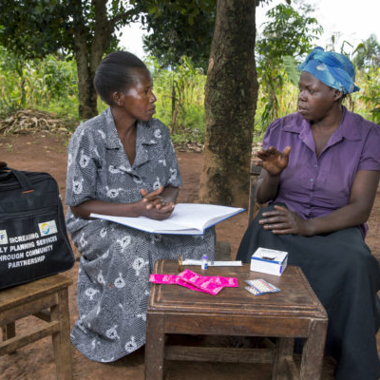
Uses “Organized Diffusion”
ATTRIBUTES OF COMMUNITY NSI
Sparks critical reflection to change norms within a core group who then engage others to have community-level impact.
Diffusion can take place in different ways and through different channels but seeks to shift norms beyond those directly engaged in program activities.
Photo credit: Jonathan Torgovnik/Getty Images/Images of Empowerment
Notes:
NOTE TO FACILITATOR: Read the slide. If needed, below is additional information to craft your speaker notes and respond to participants’ inquiries.
SPEAKER NOTES:
The attribute of organized diffusion is a popular technique for sparking social norm shifts. It means that change begins with a core group, who then engage others. Such diffusion can take place in different ways and through different channels but seeks to shift norms beyond those directly engaged in program activities. This is a technique to generate and diffuse social norms that has successfully been used by Tostan around FGC and by Raising Voices and others with SASA!, an approach to reduce violence against women and prevent HIV. This is distinct from spontaneous diffusion, which is unplanned.

Slide 39

Creates Positive New Norms
ATTRIBUTES OF COMMUNITY NSI
Creates new, shared beliefs when harmful norms have strong support within groups.
While it is common to focus on negative consequences of a behavior, this can unintentionally reinforce that behavior by making it seem widespread.
Photo credit PeopleImages/Getty Images
Notes:
NOTE TO FACILITATOR: Read the slide. If needed, below is additional information to craft your speaker notes and respond to participants’ inquiries.
NOTES TO FACILITATOR:
This characteristic can be key to understanding norms-shifting programming. For a long time, programs were designed based on the simple assumption that in order to change a problem, you highlight what the problem is and try to work through it.
While it is certainly important to explore the consequences of negative behaviors, social norms theory shows us that focusing on the negative behavior can actually reinforce and strengthen that behavior by increasing its visibility and making it appear to community members that the negative behavior is widely practiced by others. For example, if a program raises awareness that a large portion of a community thinks that hitting your wife is acceptable, this may increase acceptance of GBV. As part of this, and for other reasons, it is beneficial for communities to discuss and explore the new norms that they would like to work towards and highlight the positive practices that are already taking place in the community.

Slide 40
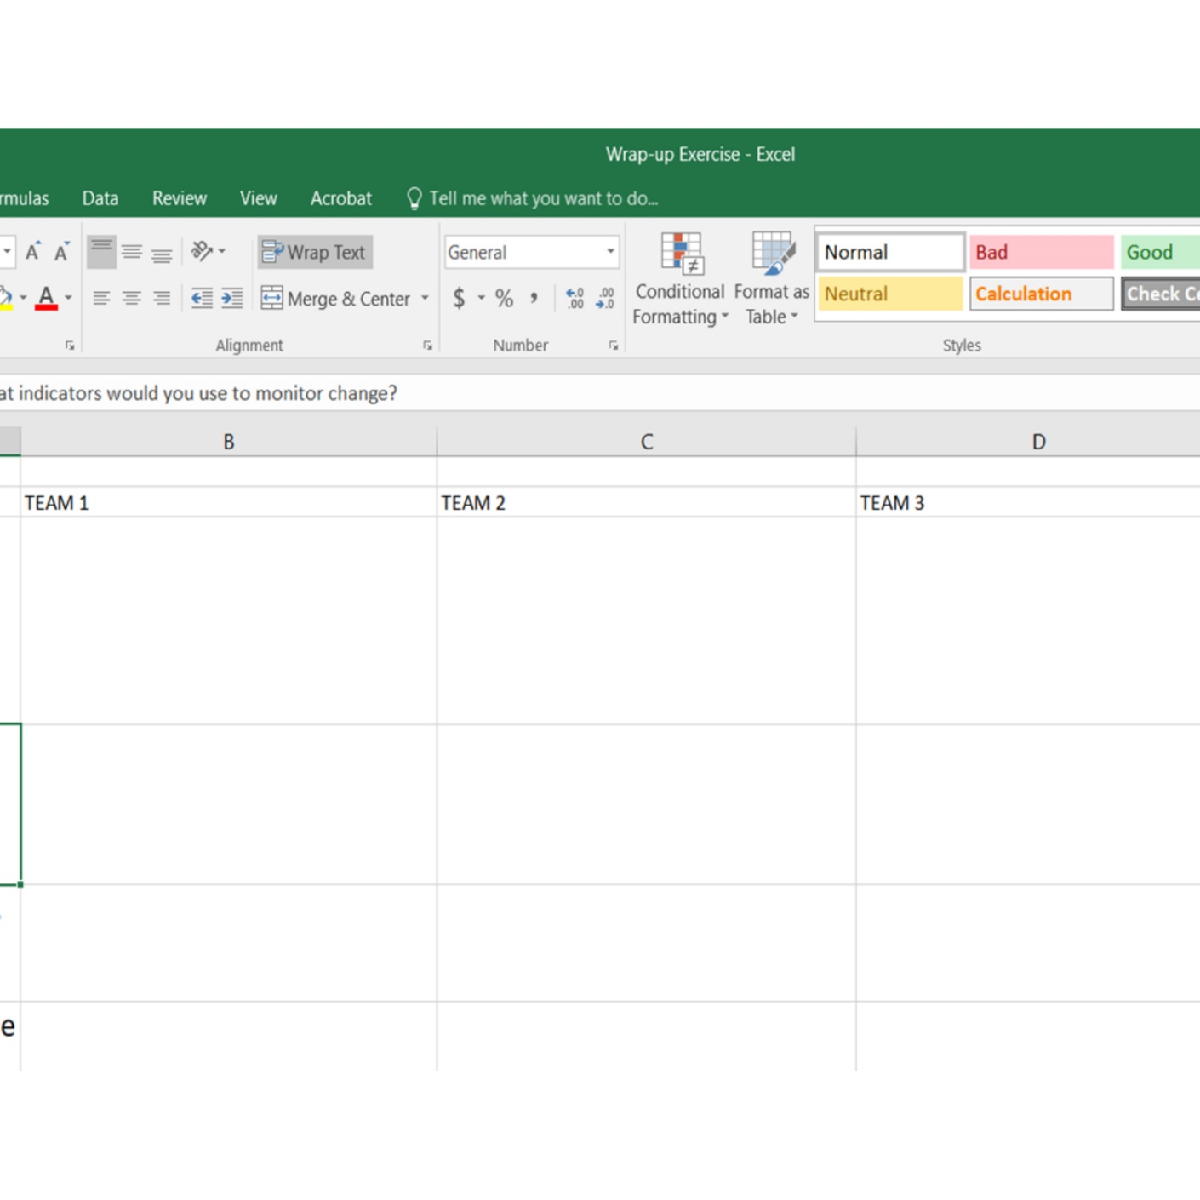
What Are Attributes of NSI?
GROUP ACTIVITY
10 MINUTES
In your group share a community-based social and behavior change program that you are currently implementing or have implemented.
From the examples shared, select one to discuss:
  Did your program design include any of these attributes in program activities and how well are they working?
  Did you include the attributes in design or in concept but only partially “comply” with conditions?
  Did you not include the attribute?
GOOGLE
SHEET
Notes:
NOTE TO FACILITATOR:
This activity gives participants an opportunity to engage with and think about the attributes as it relates to their own work.
Advance preparation.
The facilitator may want to include as a handout the Attributes Brief as reference for this work. Set up a Google sheet as shown on the hidden slide, following. In their small groups, participants will reflect on the different attributes in a program they work on. Drawing from that example, they will check the box of the attribute to indicate how the project they are thinking of matches the attribute.
Debrief questions follow on the next visible slide.
If the participants don’t have a common project, have them discuss in their group and pick one example.

Slide 41
BREAKOUT ROOM GOOGLE SHEET
Attributes of NSI group work
Attributes | Attribute was included | Attribute was partially included | Attribute was not included
1
2
3
4
5
6
7
8
9
Notes:
VIRTUAL NOTE TO FACILITATOR – HIDDEN SLIDE

Slide 42

Debrief
PLENARY DISCUSSION
Verbally provide an overview of the program/key elements.
What attributes did we find across programs?
Are any difficult to implement in practice? Why?
What attributes might be missing, based on your experience?
MICROPHONE
Notes:
NOTE TO FACILITATOR: After participants have finished populating their sheet, call the groups back and reveal the consolidated tab to observe the patterns with participants. Which attributes are common, and which are not?
Ask participants to share their experiences using the above questions as a guide to learn more about what people are doing, where there are challenges, and where there may be gaps.

Slide 43
Structural change.
Social mobilization.
Social protection.
Aspirational processes for equality across societal institutions.
Social movements and leadership.
Social and mass media.
Strategies for Norm Change: Structural and Social Change
Notes:
We have so far talked about norms change from a community-based perspective. This is not the only way to change norms. As you may remember from previous sessions, we discussed the flower framework for norms, which builds on the socio-ecological model to show how norms operate at different levels and strategies to shift norms and behavior should exist at different levels.
There is a lot of important work taking place to address social and structural change through other mechanisms, separate from or complementary to community-based efforts. It’s important to note again that policy and structural changes CAN change norms, but do not always. Optional example: laws banning FGC may make people more intent to practice it; laws mandating seat belt use have changed norms around their use.
Some examples of different approaches to norms change:
STRUCTURAL CHANGE APPROACHES, including change in laws and policies, enforcement of laws and polices. Includes economic opportunity, wealth distribution, quality, and inclusive education.
SOCIAL MOBILISATION, including increasing voice, accountability, and representation.
SOCIAL PROTECTION.
ASPIRATIONAL PROCESSES FOR EQUALITY ACROSS SOCIETAL INSTITUTIONS. An aspirational norms-shifting approach “provides the inspiration that generates motivation, resources, and a new sense of what is possible.” An example of Martin Luther King’s ‘I have a dream’ speech, which is all about aspirations and outlined a bold goal and possible new social, structural realities that fostered a social change movement in the US.
SOCIAL MOVEMENTS AND LEADERSHIP.
SOCIAL AND MASS MEDIA APPROACHES.
We won’t go in detail on these strategies, but it would be good to hear from participants if you have worked on any of these types of norms programming. What was the program and your experience with it?

Slide 44
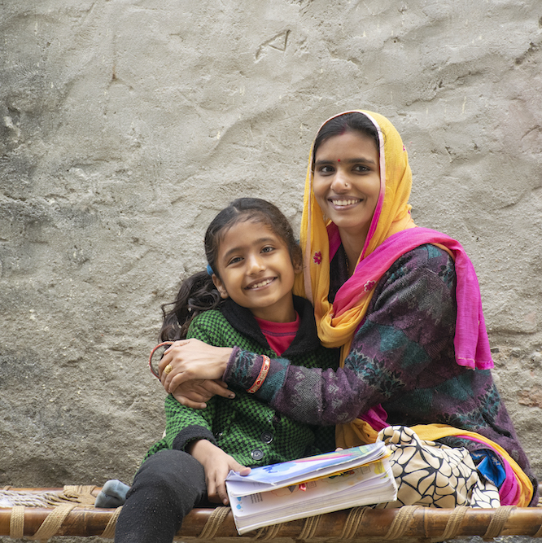
Parivartan for Girls:
A Sports and Mentoring Program
CASE STUDY
Photo credit: Suman Kumar / EyeEm / Getty Images
Notes:
NOTE TO FACILITATOR: Remind participants that the case study information presented can be found in the handouts, along with additional information.
SPEAKER NOTES: Now we want to apply what we’ve learned about social norms and program design to a real program example. We have a one-page handout summarizing this project. Let’s start by exploring the project together before breaking into groups to discuss it in more detail.
Parivartan for Girls is a project developed and implemented by STRIVE at the London School of Hygiene and Tropical Medicine, ICRW, and Apnalaya in India. The project is a sports and mentoring program in a community where people live with economic insecurity and in close spaces.

Slide 45
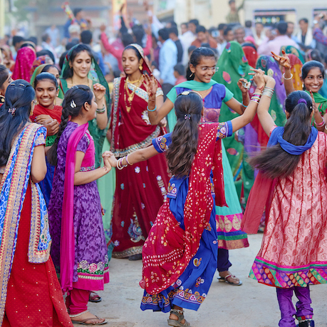
Program Foundation
PARIVARTAN FOR GIRLS
Restrictions on girls’ liberty in public spaces contributes to school dropout, early marriage, and negative health and well-being.
Norms enforced through self-surveillance and policing of women’s actions through observing their adherence to norms in day-to-day social interactions.
Photo credit: Tuul & Bruno Morandi/Getty Images
Notes:
SPEAKER NOTES: The project started because of concerns about how structural and social barriers were limiting the health, development, and opportunities of adolescent girls.
Restrictions on girls’ liberty to move freely in public spaces contributes to school dropout, early marriage, and negative health and well-being from adolescence to adulthood. These restrictions include not allowing adolescent girls to socialize in public spaces, participate in certain activities including sports, or socialize with boys. Girls typically have more responsibility in the home, so even when they go to school, they are expected to return home directly to stay safe and complete their responsibilities.
In this setting, popular discourse associates women’s safety with the modesty of their clothing.
Family honor is often seen as being housed in girls and women’s bodies. This means that they are socialized to fear not only potential violence in public spaces but also the threat of public censure that will impact their “reputation.”
The fear of sexual harassment maintains male privilege, diminishes women’s feelings of safety and belonging in public places, and restricts their freedom of movement.
Fear and social control significantly limit girls’ individual agency to access public spaces, a structural barrier in any intervention aiming to increase female education and participation as citizens in society.
These norms that restrict a girl to ensure she is safe, respected, and well-behaved also limit her opportunity. They are enforced through self-surveillance, meaning that it is ingrained in her from a young age to be obedient and respectful and that she is expected to be at home, especially after a certain age. It is also enforced through policing of her actions by people in the community, including by her family and extended family, friends of the family, neighbors, community leaders, and anyone else who knows her or the family. They may see her doing things that are not socially acceptable and will report to her parents who discipline her or directly speak to her about her behavior.

Slide 46
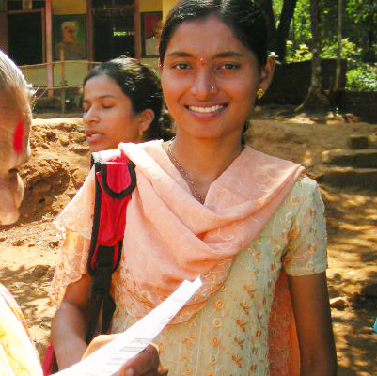
Project Objectives
PARIVARTAN FOR GIRLS
Can a sports-based program for adolescent girls ages 12 to 16 years in a low economic community in Mumbai, India:
  Shift norms that restrict girls’ liberty to move freely in public spaces?
  Increase girls’ self-esteem, self-confidence, and educational aspirations?
Photo credit: Parivatan for Girls
Notes:
SPEAKER NOTES:
Parivartan is a sports-based program that reaches girls between the ages of 12 and 16 years. It is based in a community living in very low-income neighborhood in Mumbai. When the program started, the team wanted to answer two questions:
Can the program shift norms that restrict girls’ liberty to move freely in public spaces?
And can it increase girls’ self-esteem, self-confidence, and educational aspirations?
The information on the case study that we have just reviewed is in your handouts. Please pull out or pull up the handout for the Parivartan case as we move on to a group exercise.

Slide 47




Project Strategies
PARIVARTAN FOR GIRLS
MENTOR
GENDER CURRICULUM
KABADDI
PARENTS & COMMUNITY
Relatively progressive young women from slums served as mentors to younger girls.
Lead reflection sessions on gender.
Coach kabaddi.
Once a week for 1.5 hours over 15 months.
Alternating sessions: prepared cards and group reflection.
Topics: dealing with emotions, goal-setting, gender equality, puberty, responding to violence.
Weekly 2-hour game/coaching.
Public tournament.
Parents groups with monthly reflection sessions.
Topics: communication skills, value of girls and girls’ education, benefits of delayed marriage, issues around sexual harassment.
Community Advisory Board.
Notes:
SPEAKER NOTES:
Let’s look at the intervention. Parivartan included four main components. [Read these as listed and described on the slide]
Mentors:
Relatively progressive young women from slums served as mentors to younger girls.
Lead reflection sessions on gender.
Coach kabaddi.
GENDER CURRICULUM
Intentionally did not engage boys and men.
Once a week for 1.5 hours over 15 months.
Alternating sessions: prepared cards and group reflection.
Topics: dealing with emotions, goal-setting, gender equality, puberty, responding to violence.
KABBADDI
Sports sessions in schools with a boundary wall, security guard.
Weekly 2-hour game/coaching.
Public tournament.
PARENTS & COMMUNITY
Parents groups with monthly reflection sessions.
Topics include communication skills, value of girls and girls’ education, benefits of delayed marriage, issues around sexual harassment.
Community Advisory Board provides guidance on program approach and implementation and community engagement.

Slide 48

Parivartan Case
GROUP ACTIVITY
30 MINUTES
Using the Parivartan case example, identify:
The behavior(s) the project seeks to influence.
The norm(s) the project seeks to shift.
The reference groups for these norms/behaviors and the powerholders.
Which strategies address norms and how they do this.
Share your discussions with the large group. (10 minutes)
BREAKOUT
ROOMS
Notes:
NOTE TO FACILITATOR: Think about how you want to structure feedback from participants. We recommend you form breakout groups of five to eight people, with a facilitator in each. Below are notes for these facilitators. If it is helpful, project a Google sheet (using the template on the following hidden slide) with a row for each question to take notes.
POSSIBLE ANSWERS TO THE GROUP ACTIVITY
1. Name the behavior(s) the project seeks to influence.
Girls’ behavior/practices: mobility; increase girls’ self-esteem, self-confidence, and educational aspirations.
2. Name the norm(s) the project seeks to shift.
The norms are summarized in your handout, including sanctions for breaking each norm.
Girls and boys should not interact post-menarche.
Public spaces are for men.
Post-puberty, girls should be at home and do domestic chores.
Sports are for boys.
Good girls (good families) do not (allow their girls to) socialize in public spaces (with boys/men).
3. Name the reference groups for these norms/behaviors. Name the powerholders.
Reference groups: fathers, mothers, close neighbors/friends, extended family.
Powerholders: fathers, community leadership.
The project is engaging these reference groups in different ways; how did they design the program to address norms and behavior? We will get into that at the end of the sharing.
4. Name the activities that address norms. How do they do this?
Norms are addressed in different ways:
Establishing role models and creating new reference groups by recruiting and training older adolescent girls who demonstrate the qualities the project seeks to build to be mentors. Giving them skills, status, and an advisory role to the younger adolescent girls both builds the mentors’ skills and influences how girls’ and their parents envision their futures.
Recruiting girls for the program from families that were not the strictest with their girls, thus working within existing norms. They selected families that would likely see the program as a benefit or of value to girls, even if they were not able to practice or support girls’ independence on their own. The project allowed parents and girls to decide whether to participate, and mothers were able to choose to participate and support their girls secretly when fathers did not yet support them. These mothers were aware of the potential risk and made the decisions independently, bringing along their husbands slowly when they could demonstrate their daughters were balancing work, maintaining respect, and doing well.
Using sports as a strategy to build girls confidence, play, and network. AND to challenge community ideas of girls as ill-suited for sports and of girls being in social spaces as being bad or high risk. To work within the community structure, the program held the sports program on school grounds, enclosed by walls, so the public could not see the girls practice. This allowed girls to play and build comradery, without the judgement of the community.
Having girls travel to the school in groups, with their mentor. This ensured their safety and didn’t allow people to spread rumors about girls traveling alone, using the time to get into mischief, etc. Further, it indirectly shifted the norm of girls not being in public spaces as community members got used to seeing groups of girls go back and forth to the school to play sports. It became acceptable.
Holding a community sports event: where parents and the community were invited to watch kabaddi matches to celebrate the girls. This challenged community members indirectly to see girls playing sports differently than they previously had, to get excited to cheer, and to support girls and their transformation.
Using a gender-transformative curriculum to deliberate on, reflect on, and discuss existing norms and expectations of girls; to develop new values and ideals; and to encourage girls to bring their learning home to their siblings and parents. This also built networks within groups of girls.
We can see the creativity and norms-shifting work of the program as it:
Engaged with people where they were (not reaching the strictest families).
Considered social safety structures and expectations, while building in strategies to shift and support girls and their reference groups’ and powerholders’ transformations.
Worked with older adolescent girls as mentors, allowing younger girls to have a realistic vision of their future.
Allowed mothers/parents to decide whether to enroll the girls, how to support them, and how public to make their support for the program. Parents/mothers did this based on their own priorities and experiences and developed their own safety and support strategies for the girls, as they slowly brought their husbands along if they didn’t support it at first.
Kept safety as a priority while seeking visible change.
Worked at the individual, family, community levels.

Slide 49
BREAKOUT ROOMS FOR Parivartan EXERCISE
Using the Parivartan case example, identify: | TEAM 1 | TEAM 2 | TEAM 3
The behavior(s) the project seeks to influence.
The norm(s) the project seeks to shift.
The reference groups and powerholders for these norms/behaviors.
Which strategies address norms and how they do this.

Slide 50
Key Learning From Project Evaluation on Norms Programming
PARIVARTAN FOR GIRLS
Sports with reflective sessions for girls and parents can be transformative.
Build and implement with a trusted, local, community-embedded partner.
Invest in those in the community most ready to change.
Foster collective agency as a basis to cultivate individual agency.
Ensure that program strategies are culturally appropriate.
Make change visible in day-to-day interactions.
Notes:
SPEAKER NOTES:
The Parivartan program evaluation has several lessons for how to design and implement a norms-shifting program that can act as a guide. These lessons are also supported by similar learning in other community-based norms programs.
1. Sports with reflective sessions for girls and parents can be transformative.
There has been debate about whether sports can serve this function. In Parivatan we see that when sports are implemented in a way that builds comradery and confidence and are conducted in a way that is acceptable while also building parent and community support, it can lead to transformative change (or be a part of it).
2. Build and implement programs with trusted, local, and community-embedded partners.
Parivartan was a partnership between international non-governmental organizations (INGO) and local non-governmental organizations (NGO) partners. They designed the program collaboratively, respecting community structures and expectations while being strategic about how to facilitate norms shifts for girls’ opportunity and well-being.
3. Invest in those in the community most ready for change.
The program engaged girls and families that were more likely to be supportive, who wanted to participate, and who were excited or interested in the program. They did not reach the most conservative families that would not have favored this. The idea was not to leave those girls out, but instead to reach those likely to change first, leading to shifting expectations from fathers and mothers and behaviors from girls—showing support for their opportunity and education and confidence while indirectly demonstrating that girls could participate and still be respected in the community.
4. Foster collective agency in order to cultivate individual agency.
Girls developed networks, worked together on teams and in discussion, and built relationships with mentors rather than working with each girl individually. Parents and community also participated in discussion groups so they could bring each other along.
5. Ensure that program strategies are culturally appropriate.
The strategies were structured to be acceptable while still providing quite different spaces for girls to interact. They built in activities for parents and community to bring them along with the program. A community advisory board guided the structure. Girls played sports and participated in the curriculum in the school, which was a safe and acceptable private space, with a guard rather than a public space.
6. Make change visible in day-to-day interactions.
The program structured change so that it was visible. The team wanted to bring the community along with them and reveal over time that girls could participate in the program, challenge social expectations, and still maintain safety and respect. They did this by having mentors and girls walk together to the school where they participated in sports and the curriculum and by having a public sports day where community and family could celebrate the girls. When walking to school, they avoided spaces with groups of men. The mentors also provided role models to the girls and community, showing them what was possible. Seeing the girls move around became normal over time. Mentors gained in their reputation by working with a trusted NGO, modeling good behavior, and acting as mentors to young girls. Parents formed relationships with the mentors, which allowed them to trust the program.

Slide 51
PARIVARTAN FOR GIRLS
Norms Enforcement Through Fear and Social Control
Norms support community fears about…
Risk/fear of violence in public spaces.
Reputational risk and risk of public censure.
Girls as custodians of family honor.
Sexual harassment, safety, and belonging.
Gender Norms
Communities believe…
Girls and boys should not interact post-menarche.
Public spaces are for men.
Post-puberty, girls should be at home and do domestic chores.
Sports are for boys. STRIVE Tackling the structural drivers of HIV
Public spaces are dangerous for girls.
Notes:
SPEAKER NOTES: [This slide is optional, if time allows.]
This slide summarizes some of the gender norms that Parivartan sought to address.
The slide also shows the different strategies for enforcing norms, largely through fear and social control. As you’ll see, many of the sanctions are associated with physical, sexual, and social harm/violence to girls’ and their families’ well-being. These are harsh punishments for deviation and the program had to work within the community’s and powerholders’ structures and develop strategies that would allow the program to advance while keeping girls safe.

Slide 52
PARIVARTAN FOR GIRLS
ATTRIBUTES OF NSI | PROGRAM APPLICATION
Engage people at multiple levels. | Younger/older girls, parents, community.
Root the issue within the community’s own value systems. | Adjust strategies, co-design, mentoring.
Use organized diffusion. | Visibility of girls in groups, normalizing behaviors.
Create safe spaces for critical reflection by community members. | Parent reflection sessions; girls’ sessions.
Create positive new norms. | Through sports and visibility.
+
Notes:
SPEAKER NOTES: [This slide is optional if time allows.]
This slide demonstrates how the attributes of community-based norms-shifting interventions are revealed in Parivartan program strategies. This slide might be helpful if you want to show how the attributes are actually realized in a program.

Slide 53
Session Two
Notes:
NOTE TO FACILIATOR: If this presentation will be delivered in two parts, this is where the second part will begin. Based on your audience and first session, decide which of the “overview of social norms" slides—if any—you will repeat here to remind participants of basic concepts.

Slide 54
Common Missteps in Designing Norms-Shifting Approaches
SECTION 4
Design Pitfalls to Watch Out For
Notes:
SPEAKER NOTES: Now we’re going to engage with some common pitfalls to designing norms-shifting strategies. These pitfalls describe common errors in norms programs that can help us think more deeply about what might work or not in our settings for the behaviors and norms of interest.

Slide 55
Common Design Pitfalls
Conflating social norms and personal attitudes.
Focusing only on discordant norms and attitudes; overlooking protective norms.
Confusing how common is a norm with how important it is for behavior change.
Publicizing the wide prevalence of a harmful social norm.
Notes:
SPEAKER NOTES:
This is a list of common pitfalls that are adapted by an article by Cislaghi and Heise on eight common pitfalls of NSIs. We’ll go over them briefly in the next few slides and then divide into small groups to discuss in more detail.
REFERENCES:
Beniamino Cislaghi and Lori Heise, “Theory and Practice of Social Norms Interventions: Eight Common Pitfalls,” Global Health 14, no. 1 (2018): 83.

Slide 56
COMMON PITFALLS
1
Conflating Social Norms and Personal Attitudes
“I believe girls should marry after age 18.”
“People around me marry daughters at puberty and expect me to do so.”
Sometimes the two align, other times not.
Misalignment can influence actions of many in a group.
Phenomenon known as “pluralistic ignorance.”
Notes:
NOTE TO FACILITATOR: Read slide. Animate slides with example first, then the explanation of the pitfall.
SPEAKER NOTES:
On this slide, the top quote is a personal attitude, and the second reflects a norm. Why could conflating the two could be a problem in SBC design?
[allow for brief discussion]
EXPLANATION:
The difference between the two is important: The misalignment between attitude and norm can influence the actions of multiple people in a group, to the point that everyone in the group might hold a protective personal attitude (“I believe that girls should be at least 18 before they marry”) but think that everyone else holds a different position (“The people around me marry their daughters as soon as they reach puberty and expect me to do likewise.”).
This phenomenon is commonly referred to as pluralistic ignorance.
Programmatically: When most people in a group hold contrasting attitudes and norms, an intervention might achieve change by revealing the misperception that keeps people bound to the harmful norm. That is, by showing that most people in the group hold the same personal attitudes, interventions might contribute to dismantling the harmful norm. The difference between attitudes and norms also has implications for social norms measurement.

Slide 57
COMMON PITFALLS
2
Focusing Only on Discordant Norms and Attitudes; Overlooking Protective Norms
“My community expects me to not take drugs.”
“I believe that taking drugs is a sign of weakness.”
“If my community finds out that I have experimented with drugs, I will be shamed.”
Norms and attitudes may or may not be aligned.
Our tendency is to focus on “problems,” yet in any cultural context both potentially harmful and protective norms likely exist.
Notes:
NOTE TO FACILITATOR: Slides are animated with an example first, then the explanation of the pitfall.
SPEAKER NOTES:
The top and bottom quotes reflect norms. The middle one is a personal attitude. All are “good” as they relate to health behaviors. And all are protective, whether an attitude or a norm. Do you think that program designers come with implicit biases, that they are looking for problems in communities, rather than protective factors?
[allow for short discussion].
EXPLANATION:
A tendency exists in the social norms literature, particularly in social psychology, economics, and implementation science, to focus largely on discordance between attitudes and norms. Norms and attitudes, however, can be aligned: not only can people believe that compliance with a harmful practice is expected of them, they can also have a positive personal attitude towards that practice.
Take the example of female genital cutting, for instance. In some places, people might think that “cutting their daughter” is both what’s expected of them and a good thing to do independent of what others do. Uncovering the relation between people’s attitudes and norms is critical to intervention design. While correcting misperceptions (as in the campus drinking example) might be an appropriate strategy when norms and attitudes are discordant, it will not serve when people’s attitudes align with the norm. In this latter case, practitioners may first need to work with communities to shift the attitudes of a core group of individuals and then help them become local change agents, reaching out to the larger group. This might be done, for instance, by providing the group with information on the harmful consequences of a given practice and inviting them to reflect critically on the reasons for the practice. Next, practitioners could help participants devise strategies to motivate others in their settings to join their movement for change (a process that has been referred to as “organized diffusion”).
Another implicit bias in development is to see “culture” only as a source of problems rather than as a space for possible solutions. But in any given cultural context both potentially harmful and potentially protective norms likely exist. As practitioners design their interventions, they would benefit from understanding the protective and harmful roles of existing social norms. Effective interventions might work with local populations in devising strategies to strengthen protective norms, building on existing cultural values and worldviews.

Slide 58
COMMON PITFALLS
3
Confusing How Common a Norm Is With How Important It Is for Behavior Change
Many program link the prevalence of a norm (how many people in a population hold normative belief X) to its influence (how many people do Y because of the belief X).
  It’s important to understand the influence of one or multiple norms over a given practice in order to improve program design.
Notes:
NOTE TO FACILITATOR: Not animated like other pitfall slides.
SPEAKER NOTES:
EXPLANATION:
Most studies to date have invested more time, thought, and resources in measuring the prevalence of a norm (i.e., how many people in a specific group hold normative belief X), than measuring its influence (i.e., how many people do Y because of the social norm). For example, there are norms in many cultures that pre-marital sex is not acceptable. But in many communities, adherence to this norm does not have much importance for adolescents engaging in the behavior of premarital sex—but it DOES have strong importance for adolescents’ likelihood to engage in the behavior of seeking sexual health information.
Measuring the strength of a norm is also important, just more complicated to do. It’s important in two ways:
If norms lead to private behaviors, many won’t discuss or admit to. An example: Everyone believes that washing hands is important for stopping cholera outbreaks. But in a home, washing hands may only be practiced with small children and not adults, because people believe that adults are “stronger” and not prone to disease.
People focus more on direct effects of norms rather than indirect effects. An example: It is common to look only for a norm that people are expected to do (e.g., marry their daughters young) versus norms operating upstream to influence behaviors (e.g., maintaining family honor with other families or the importance of accepting important suitors at any time, even when the girl is still a child). We call situations where the norm and the behavior are matched a “direct relation” between the practice and the norm. Practically, SBC interventions should be informed by exploratory formative research, specifically tailored to develop an in-depth understanding of the relations between various constellations of norms and their direct and/or indirect effects over the practices of interest.

Slide 59
COMMON PITFALLS
4
Publicizing the Wide Prevalence of a Harmful Social Norm
“In this area, eight out of 10 girls ages 10 to 14 were married this past year.”
Since descriptive norms (beliefs about what others do) can influence behavior, media and other SBC efforts can unwittingly reinforce a behavior that is harmful.
How to find an SBC message balance is the challenge.
Notes:
NOTE TO FACILITATOR: Slides are animated with an example first, then the explanation of the pitfall.
SPEAKER NOTES:
This quote reflects a finding from a barrier analysis. What might be some advantages of incorporating such a fact into an SBC campaign? What might be the disadvantage, normatively speaking?
[allow for short discussion].
EXPLANATION:
it is quite common to accidentally publicize the prevalence of a harmful norm; the challenge is to find a messaging balance. While formative assessments may provide important information on actual behaviors and expectations of what others do, how an SBC campaign uses the information requires some thinking. It might be risky to design campaign messages that highlight the great number of people complying with a harmful practice because it might unwittingly reinforce the practice. Social norms theory can help recognize the risks in designing campaigns that highlight the great number of people complying with a harmful practice. Those concerned about an issue frequently attempt to motivate change by publicizing the size of the problem: “One in three women globally are abused by their partner” or “The average American consumes 44.7 gallons of sugary soda each year.” Because descriptive norms (beliefs about what others do) can influence people’s behavior, such campaigns can unwittingly reinforce a practice. At a community level, we don’t know who is most likely to be influenced by such messages. While such messages might sway those who already hold personal attitudes in favor of the harmful practice, a concrete risk exists that similar messages might backfire, pushing new people to comply with the harmful norm. This is another reason for careful monitoring during implementation of NSIs.

Slide 60
Digging Deeper: Identifying Pitfall Moments in Parivartan Assessment and Design Phases
GROUP ACTIVITY
30 MINUTES
Review the Parivartan case with the common pitfalls in mind.
  Discuss where the four pitfalls might occur during formative assessment and design phases.
  Then take a few minutes to reflect on:
How you might avoid the pitfalls in your SBC program designs.
How a program could go wrong if we don’t keep these pitfalls in mind.
BREAKOUT
ROOMS
Notes:
NOTE TO FACILITATOR:
Divide the participants into groups of five to eight, with a facilitator. Ask for a volunteer to report out high-level discussion points.
Using the following hidden slide, set up a Google sheet note-taking template that allows participants to answer the prompts on the slide for each of the four pitfalls we’ve discussed. The facilitator can take notes or assign a notetaker from the group.
Participants will answer these questions individually in their worksheet and share in their groups to record on the group sheet.
Discuss for 15 to 20 minutes. Share in plenary, allotting three minutes per group with some summing-up by facilitator. Optional slide 69 provides prompts for a deeper discussion.
SPEAKER NOTES:
To process the pitfalls, we are going to reflect on the Parivartan case study in small groups. We’ll be answering the questions:
How is this pitfall important to norms design?
How might a program go wrong if we don’t keep this pitfall in mind? For this second question, offer suggestions about what a design team can do to be sure they don’t miss this in their planning efforts.

Slide 61
Digging Deeper Into the Pitfalls
Pitfall | How you might avoid the pitfall in your SBC program designs. | How a program could go wrong if you don’t keep this pitfall in mind.
Conflating social norms and personal attitudes.
Focusing only on discordant norms and attitudes; overlooking protective norms.
Confusing how common a norm is with how important it is for behavior change.
Publicizing the wide prevalence of a harmful social norm.
Notes:
[HIDDEN VIRTUAL SLIDE]
NOTE TO FACILITATOR: Use this hidden slide to set up a Google sheet for note-taking in small groups.

Slide 62
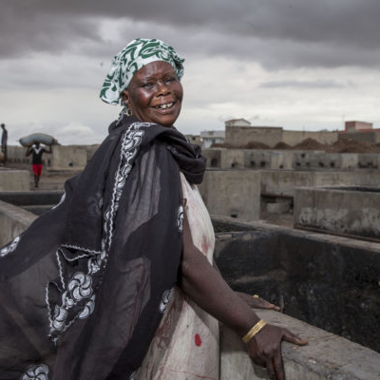
How Do You Avoid or At Least Recognize Pitfalls in…
PLENARY DISCUSSION
Conducting formative assessments?
Designing strategies?
Photo credit: Jonathan Torgovnik/Getty Images/Images of Empowerment
Notes:
NOTE TO FACILITATOR: For this report out, ask participants share their findings. Then ask them to think about these questions. This is a good spot to talk about backlash. This slide is optional if there is not time for an extended report out.

Slide 63
COMMON PITFALLS
5
A Proposed Fifth Pitfall
You’ve done the best design with solid norms-focused information and therefore assume that the intervention will work as planned!
Notes:
SPEAKER NOTES:
We’re also proposing a fifth pitfall here: assuming that, because you’ve done the best-practice design with solid norms-focused information, that the intervention will work as planned!
All interventions operate in open systems, and you can never know how a community will react to an intervention in advance. That is why including in designs a way to monitor community reactions to interventions is so critical. It gives you an understanding of reactions to interventions and a way to mitigate/manage any negative issues that might arise before they become big issues.

Slide 64

Let’s Talk About Ethical Thinking in NSI Design
DESIGNING NORMS-SHIFTING INTERVENTIONS
Photo credit: Mdphoto16/Getty Images
Notes:
SPEAKER NOTES:
We are going to discuss ethics in the context of design and implementation of norms-shifting interventions. This section could and should be a much fuller section, with more reflection and deliberation. Unfortunately, we will not get into the nuances, but we want to touch on ethics and why it matters and reflect on what this means for us as a frame for you to engage with moving forward.
An example: An NSI designed by an international NGO aims to shift a widely-held norm relating to child marriage, a child rights-focused behavior change of interest to the central government and funding agency but not necessarily an interest of local government administrators, community leaders, and families, including young girls, who value early marriage as a way to maintain family legitimacy and protect the girl child from illegitimate encounters with men in their communities. In such realities, whose voices and values, and at which levels, should programmers take into account when designing interventions? Who should decide which norms to promote and which strategies to employ? Who should be accountable for managing the resistance and backlash that often arise? As implementation occurs, should an organization implement an NSI knowing that there exists a risk of participants perceiving change as externally driven or moving too fast or too soon, resulting in change agents or early adopters suffering? We’ll start to try and answer these question in our next slides.

Slide 65
An Ethical Conundrum
PLENARY DISCUSSION
Families, community leaders, and local governments in “Risva” place great importance on the time and celebration of marriage. Marriage solidifies family and community ties. Girls typically marry between 14 and 16 years old; therefore, marriage protects a girl from sexual encounters with men and boys in the community who consider her mature.
International NGOs, the Risva central government, and funders agree that marriage before 18 years is a violation of child rights. Together, they have designed a project to shift norms that allow for child marriage and plan to work in this region.
CHAT
BOX
Notes:
NOTE TO FACILITATOR: After the case study, there are questions to get the discussion started. Ask participants a few questions at a time about the case study, allowing them time to reflect and share their opinions on what should happen or what they see as problematic. The purpose is to stimulate thinking and demonstrate that the path forward is not clear.
SPEAKER NOTES:
We’ll give an example of an ethical conundrum in a hypothetical issue in a made-up country.
Families, community leaders, and local governments in “Risva” place great importance on the time and celebration of marriage. Marriage solidifies family and community ties. Girls typically marry between 14 and 16 years old; therefore, marriage protects a girl from sexual encounters with men and boys in the community who consider her mature.
International NGOs, the Risva central government, and funders agree that marriage before18 years is a violation of child rights. Together, they have designed a project to shift norms that allow for child marriage and plan to work in this region.
Now, let’s talk about this case study. Here are some questions we’ll consider:
In this context, where there are different views on whether child marriage is acceptable, valuable, or important, whose voice should programmers take into account when designing the intervention?
Who should be involved and decide which norms to promote and which norms to change?
Who should be involved in and decide about designing program strategies to change norms?
Who is responsible for any resistance that arises when the program is implemented? For example, resistance to program staff? Girls? Family members?
Should the implementing organization continue with implementation even if there is a risk of participants being upset, perceiving change as coming from outsiders?
What obligations do the INGO, central government, and funders have to local culture, tradition, and desires?
[After discussion]
This discussion raises some of the challenges that we face in norms-shifting intervention design and implementation. These are not easy issues to tackle and there are not always clear, predetermined answers.
We will spend the rest of the session discussing ethical thinking in the context of norms-shifting intervention design and implementation. This section could be longer, with more reflection and deliberation. This part of the training is a start, to stimulate thinking and learn from how you’re engaging with ethical thinking in your work. We also want to share some our learnings from implementing norms-shifting interventions, working with partners and colleagues who have are thinking about this, and share examples of what this means and why it is important.

Slide 66
Ethical Thinking Is…
“the process of analyzing and understanding multiple connected variables in a changing context AND applying ethical values to make responsible choices. It requires doing the work to understand issues clearly before making decisions or taking actions that are ethical.”
– Thornton, 2019
Linda Fisher Thornton, “The Complexity of Ethical Thinking and Decision Making (Part 1),” Aug. 1, 2019, https://www.linkedin.com/pulse/complexity-ethical-thinking-decision-making-part-1-thornton.
Notes:
SPEAKER NOTES:
Ethical thinking is “the process of analyzing and understanding multiple connected variables in a changing context AND applying ethical values to make responsible choices. It requires doing the work to understand issues clearly before making decisions or taking actions that are ethical.”
Ethical thinking is a both process of understanding all the factors at play in an intervention and an application of this understanding. Are there any reflections on this definition? In the context of our discussion on child marriage, could this definition help us to think about how to tackle ethical conundrums?

Slide 67
Using Ethical Thinking to Design NSIs
Expand formative assessment frameworks.
Vet alternative strategies to influence normative factors with communities.
Include a range of important voices, including more marginalized groups.
Conduct internal design checks.
Notes:
SPEAKER NOTES:
Here are some that ethical thinking can be applied to our programs; it’s not a comprehensive list.
Expand formative assessment frameworks.
Explore not only technical gaps and individual needs but also value systems and social and power configurations across the socio-ecological levels.
Use participatory approaches to engage communities in analyzing their health issues and norms that negatively impact health.
Vet alternative strategies to influence normative factors with communities.
Include a range of important voices, including more marginalized groups.
Conduct internal design checks.
Who is included as a participant and who is not?
Which power structures are most affected?

Slide 68
Values
RECIPROCITY
SOLIDARITY
DO GOOD; MINIMIZE HARM
RESPONSIBLENESS
REASONABLENESS
INCLUSIVENESS
RESPECT
RESPONSIVENESS
FAIRNESS
OPENNESS
Notes:
NOTE TO FACILITATOR: Slide is animated.
SPEAKER NOTES:
[With only “Values” on the slide, state:]
It might help for us to have some values tied to ethical thinking as we engage with both the process and application of ethical thinking to norms-shifting interventions. Can you think of values that you use in your own work or within your organization?
[Give people time to share, perhaps define the value, say what it means in their work or why they think it’s important.]
[Now click to show all 10 values.]
Here is a list of common values that we see in ethical thinking in other domains, for example in human rights work, public health, or social justice. They are applied differently but may be valuable to our work. We won’t spend time defining these values, but you can reflect further on them by referring to the resources at the end of this presentation and experiences in other sectors.

Slide 69

Ethical Thinking in NSI Design
CASE STUDY
Photo credit: Paula Bronstein/Getty Images/Images of Empowerment
Notes:
SPEAKER NOTES: Now let’s look at ethical thinking in a real norms-shifting intervention.

Slide 70

Bell Bajao!
ETHICS CASE STUDY
Goal: To prevent domestic violence by making domestic violence unacceptable in communities and encourage men and boys to take action (ring a bell) when they suspect domestic violence.
Organization: Breakthrough India.
Pilot: 2008 to 2010 (2 years) in India.
Adapted and scaled in Bangladesh, Malaysia, Nepal, Pakistan, and South Africa.
Breakthrough India, Bell Bajao!, https://inbreakthrough.org/campaign/bellbajao/.
Notes:
SPEAKER NOTES:
In many parts of the world, domestic and other forms of violence are accepted, unquestioned behaviors and are viewed normatively as a mechanism of discipline and control.
Bell Bajao! is a project developed and implemented by Breakthrough India between 2008 and 2011. Ethical thinking was important to how the program made decisions while designing their approach to shift norms. The program was so successful it expanded to many new countries, with some adaptation.
Bell Bajao! sought to make domestic violence unacceptable and aimed to include men as part of the solution. To disrupt the prevalent binary of men as perpetrators of violence and women as victims, Bell Bajao! asked men to play a role in challenging violence, moving away from dominant frameworks of masculinity and machismo. So how did they approach this challenging problem?

Slide 71
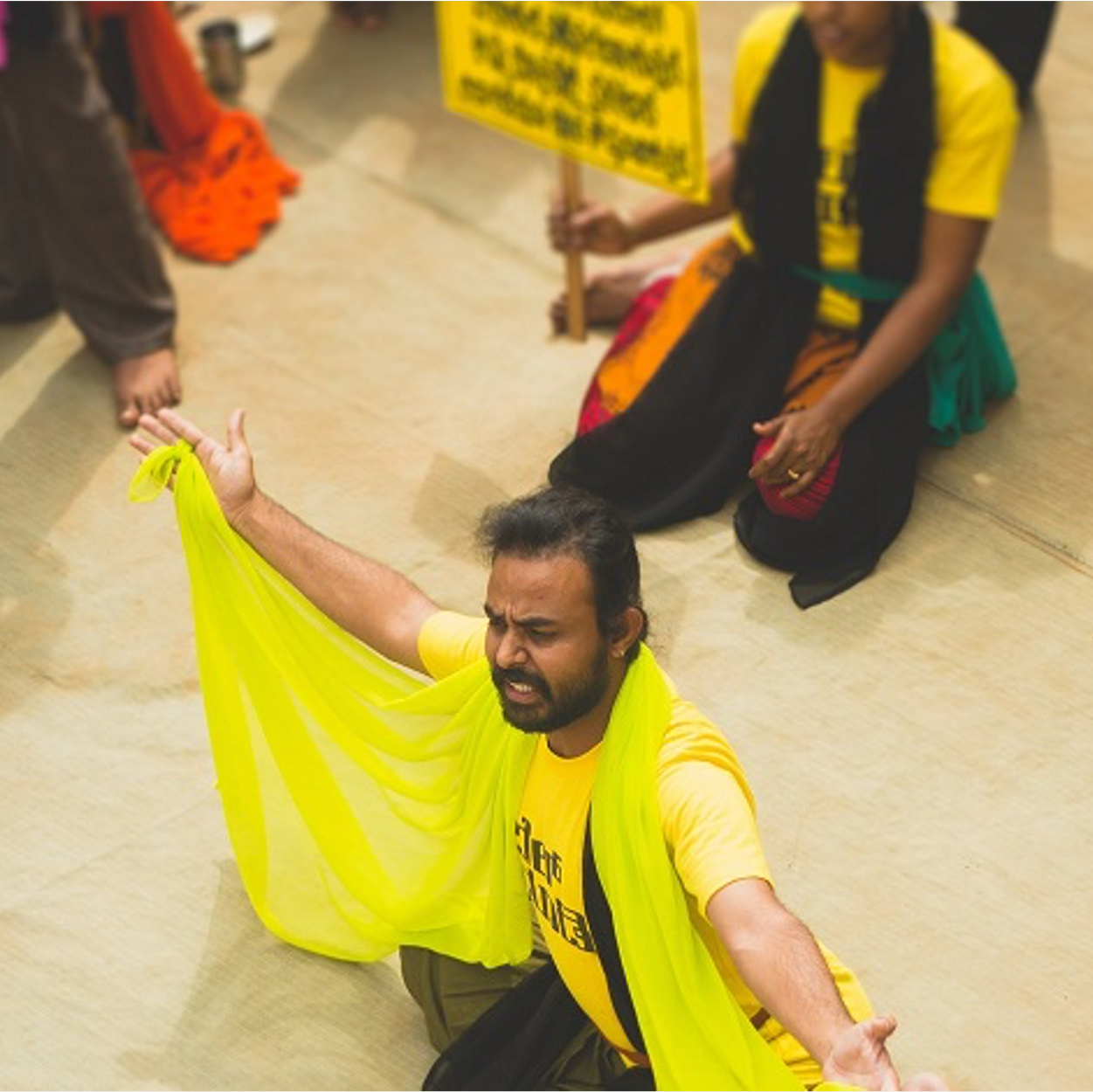
Findings From a Formative Assessment to Identify Norms Related to Domestic Violence
ETHICS CASE STUDY
People had a surface-level understanding of what constitutes domestic violence.
Men had power over their spouses and were heads of their families.
Men were expected to be macho.
Domestic violence was considered a private matter.
Intervening in domestic violence would create new problems and result in personal harm.
Photo credit: https://inbreakthrough.org/campaign/bellbajao/
Breakthrough India, Bell Bajao!, https://inbreakthrough.org/campaign/bellbajao/.
Notes:
SPEAKER NOTES:
Bell Bajao!’s design drew on existing action research, which by definition engages communities. They wanted to understand more about domestic violence, how people defined it, whether they believed it was important, and what typical expectations were of men, women, families, and communities in relation to domestic violence. Formative research for this project found that:
People had a surface-level understanding of what constitutes domestic violence. The scope of domestic violence was not fully understood.
Men had power over their spouses and were heads of their families. This was important to how domestic violence happened in households.
Men were expected to be macho. This norm influenced the way men performed their masculinity, which included through violence.
Domestic violence was considered a private matter. In these communities, this determined whether members of families and communities would intervene—or not.
Intervening in domestic violence would create new problems and result in personal harm. This community norm served as a barrier to intervention in domestic violence cases.

Slide 72
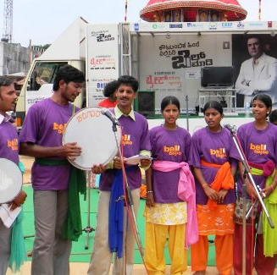
Bell Bajao!
ETHICS CASE STUDY
Approach: Cultural, organizing, and media campaign.
Messages: Reach whole communities with a focus on changing men’s and boys’ behavior.
Strategies:
  Interactive website.
  Online presence.
  Mass media campaign.
  Community mobilization.
  Celebrity support.
Photo credit: https://archive.informationactivism.org/en/case_BellBajao.html
Breakthrough India, Bell Bajao!, https://inbreakthrough.org/campaign/bellbajao/.
Notes:
SPEAKER NOTES:
The Bell Bajao approach was a cultural, organizing, and media campaign grounded in community norms, beliefs, attitudes, and behaviors related to domestic violence and intervention in domestic violence
Their messages were crafted to reach whole communities with a focus on changing men’s and boys’ behavior.
Bell Bajao strategies included:
An interactive website.
Online presence, including on Facebook, Twitter, YouTube. Their videos are easy to find on YouTube and are very interesting to watch.
A mass media campaign that included television, radio and print public service announcements inspired by true stories.
Community mobilization activities, which include leadership training, mass outreach, video vans, face-to-face educational and conversational events.
Celebrity supporters of Bell Bajao messages.

Slide 73
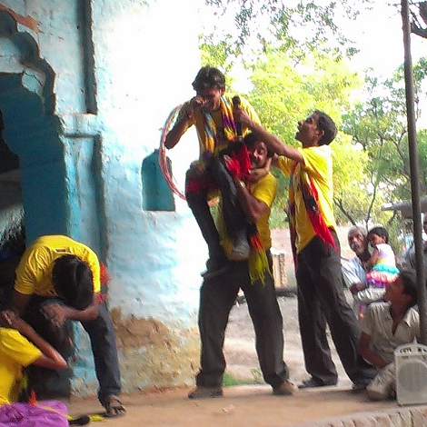
Bell Bajao! Achievements
ETHICS CASE STUDY
  Public service announcements reached more than 130 million people over two years.
  Increased knowledge about domestic violence.
  Changed individual and community attitudes towards domestic violence.
  Conversations about domestic violence were normalized.
  Policy supports effective laws and women seeking justice.
Breakthrough India considers their grounding in ethics to be essential to the successful program design and implementation.
Photo credit: https://inbreakthrough.org/campaign/bellbajao/
Breakthrough India, Bell Bajao!, https://inbreakthrough.org/campaign/bellbajao/.
Notes:
SPEAKER NOTES:
As we review Bell Bajao’s achievements, keep in mind that Breakthrough India considers their grounding in ethics as essential to the successful program design and implementation.
The program’s achievements include:
Public service announcements reached more than 130 million people over two years.
Increased knowledge about domestic violence.
Changed individual and community attitudes towards domestic violence.
Conversations about domestic violence—and intervening in domestic violence—were normalized.
Policy supports effective laws and women seeking justice.

Slide 74
Case Study: Group Work
GROUP ACTIVITY
Read the case study.
Make note of the values Breakthrough India applied.
Reflect and discuss:
  What values were considered in program design?
  How did the values influence program design?
  Do you think ethical thinking made a difference in program design decisions? Why or why not?
Report out highlights with a focus on question 3.
BREAKOUT
ROOMS
Notes:
NOTE TO FACILITATOR: This is a breakout group activity for 30 minutes. We want participants to reflect on the case study and reflect on which ethical values Breakthrough India considered in the program design, how they did this, and whether this made a difference. Steps are described below. Divide participants into breakout groups of five to eight people, each with a facilitator.
Step 1: Give participants four to five minutes to read the case study. Ask them to highlight the values that Breakthrough/Bell Bajao! considered when they designed the program and how those values influenced program design.
Step 2: Discussion: Share your screen to share the questions in your small group, and facilitate a discussion asking people to share their answers to the above questions. (approx. 10 minutes)
Step 3: Now move the discussion to whether participants think the values made a difference to decisions that were made during program design. Why or why not? Do they think Bell Bajao! would have made the same decisions without ethical values?

Slide 75
Case Study: Discussion in Plenary
PLENARY DISCUSSION
Share reflections from group work.
Make note of the values Breakthrough India applied.
Reflect and discuss your group’s takeaways.
CHAT
BOX
Notes:
NOTE TO FACILITATOR: Step 4: Ask for a volunteer to share high-level thoughts and reflections from small-group discussion.

Slide 76
Why Are We Using Ethical Thinking When Designing NSIs?
NSIs are complex and engage with and address power differentials between organizations, communities, and groups.
Notes:
SPEAKER NOTES:
So why are we discussing ethics when thinking about NSIs?
NSIs are complex and they engage with and address power differentials between organizations, communities, and groups. In the design and implementation of NSIs, there are many different participants from outsider and insider organizations, community members, and others.
People often question whether it is ethical or acceptable for organizations, especially outsider or Western organizations, to engage with norms, think about shifting norms, or design strategies to do this.
It is a challenging space and one that engages with justice, rights, culture, community, and collaboration.
NSIs engage directly with different power differentials including outsider organizations, insider organizations, and participants of different types, and there is a risk of local voices losing out or being dominated.
It is also important to remember that even when we do not intend to, we may be affecting norms and relationships in communities. This is inherent in interaction. What NSIs are doing is making this intentional and strategic for improved outcomes.
We still need to think about who gets to identify which norms and behaviors to change, how to change them, what new values or behaviors to push for, what risk of harm are we willing to accept, etc. None of these are easy topics but they ground the work we do. Being explicit allows us to be sure that in the organization, within collaborations, and in our work with communities, we are accountable to our values and ethics in addition to the project itself.

Slide 77
“
[T]he flow of history in a developing society is too often regarded as ‘the problem,’ the embodiment of the inertia, the traditional ways, as something which needs to be changed or transformed... More intelligent and realistic policies would start from the premise that the receiving society and its historical momentum are much more powerful and important than the applied policies, and the latter only really have a chance to succeed if they can work with the flow and the momentum of the society’s history to encourage the desired kinds of selective adaptations.”
Michael Woolcock, Simon Szreter, and Vijayendra Rao, How and Why Does History Matter for Development Policy? BWPI Working Paper 68 (Manchester: Brooks World Poverty Institute, 2009).
Notes:
SPEAKER NOTES:
This quote comes from an essay titled “How and why does history matter for development policy?”
“The flow of history in a developing society is too often regarded as ‘the problem,’ the embodiment of the inertia, the traditional ways, as something which needs to be changed or transformed... More intelligent and realistic policies would start from the premise that the receiving society and its historical momentum are much more powerful and important than the applied policies, and the latter [policies] only really have a chance to succeed if they can work with the flow and the momentum of the society’s history to encourage the desired kinds of selective adaptations.”
Does this resonate with you?

Slide 78
Norms Exist in a Historical and Social Context
Social and gender norms are rooted in belief systems.
Norms may outlive their function.
Early adopters change behaviors in a social and structural environment.
Norms change can be exciting, vulnerable, and risky.
Caroline Harper, Why Look Back? It's Not Where We Are Going: The Value of History in Understanding Gender and Development (London: ALIGN, 2020).
Notes:
SPEAKER NOTES:
Gender and social norms and equality reflect attitudes and behaviors that are rooted in belief systems that have a long history and deep roots. As a result, people may identify with them and consider them a fundamental part of their relationships and community. Therefore, it is often hard to quickly “nudge” behaviors towards gender equity. This fact creates some complexity in working to address inequities and shift norms, which further necessitates collaboration and close partnership with communities to define the focus and strategies to shift norms.
Norms and behaviors can outlive their functions, continuing even when they no longer reflect the values and desires of the community. This can happen because norms are not always identified, spoken, or visible. People may operate on and take them for granted, never questioning their existence. In these cases, people may want to change the norms or behavior themselves once given the change to reflect and discuss together.
Early adopters change their behaviors earlier than the rest of the community. When they do this, they are operating in a social and structural environment that is not aligned with these changes. It can place early adopters at risk, necessitating support from the organization and community.
Norms change can be exciting for communities if they are actively leading the reflections on and discussions about the future they want for their communities and themselves. Norms change can also be a vulnerable process, requiring people to engage with inequities and harm. There is a risk of fracturing social relations. Norms change can also be healing and hopeful. And it can be risky, possibly leading to a backlash, resistance, or efforts to stop change or enforce or create sanctions.

Slide 79
…some of the most crucial drivers of [norms] change have been perseverance and bravery from individuals, support from immediate family and community…and role models and leadership from those with power.”
“
ALiGN, “History and Change,” https://www.alignplatform.org/historyandchange#continue.
Notes:
SPEAKER NOTES:
Norms change relies on the “crucial drivers of … perseverance and bravery from individuals, support from immediate family and community…and role models and leadership from those with power.”
This quote comes from the Align platform, which published a piece on history and change as related to gender norms. It is included here because it describes well what it takes for norms to change and for individuals and groups of individuals to lead change, especially as early adopters and others pushing for change that may not yet be widely accepted.
REFERENCE: ALiGN, “History and Change,” https://www.alignplatform.org/historyandchange#continue.

Slide 80
Additional Reflections or Questions?

Slide 81
Key Takeaways
DESIGNING NORMS-SHIFTING INTERVENTIONS
Social norms shifting can be complex.
Design processes led by data and co-design will help identify strategies.
Watch out for common pitfalls that can mislead program design.
Ground your work in values and ethics.
Plan for, monitor, and respond to pushback.
Build in flexibility to allow for positive change as it emerges.
Know that one program alone cannot do everything.
Notes:
SPEAKER NOTES:
These different areas need resources and a package of policies, interventions, and support to function effectively. For example, gender norms can only shift in one domain (e.g., education) if economic opportunities are present and political voice and leadership support educational aspirations for decent work and gender equality. Schools alone cannot overcome these barriers. We’ve paraphrased this from an ALiGN platform piece on “History and Change” of social norms (https://www.alignplatform.org/historyandchange#continue).
Design processes led by data and co-design will help identify strategies.
Watch out for common pitfalls that can mislead program design.
Ground your work in values and ethics. Remember that values and ethics may be different between contexts, and practitioners should be aware of this.
Plan for, monitor, and respond to pushback.
Build in flexibility to allow for positive change as it emerges: iterative monitoring and evaluation and adaptive management is important.
Know that one program alone cannot do everything.
REFERENCE: ALiGN, “History and Change,” https://www.alignplatform.org/historyandchange#continue.

Slide 82
DESIGNING NORMS-SHIFTING INTERVENTIONS
Resources
Passages Project. Social Norms Key to Development Programming: Landscaping Finds Their Influence on Behaviors across Sectors. Washington, DC: Institute for Reproductive Health, Georgetown University, 2020.
The Social Norms Learning Collaborative. Social Norms and AYSRH: Building a Bridge from Theory to Program Design. Washington, D.C.: IRH, Georgetown University, 2019. https://
The Social Norms Learning Collaborative. Community-Based, Norms-Shifting Interventions: Definitions and Attributes. Washington, DC: Institute for Reproductive Health, Georgetown University, 2019.
The Social Norms Learning Collaborative. Identifying and Describing Approaches and Attributes of Norms-Shifting Interventions. Washington, DC: Institute for Reproductive Health, Georgetown University, 2017.

Slide 83
FIVE VALUES THAT CAN GUIDE ETHICAL DECISIONMAKING DURING NSI PROGRAM DESIGN
Inclusiveness | • Including those who will be affected by the decision. • Including people representing all cultures and communities. • Taking everyone’s contributions seriously.
Openness | • Letting others know what decisions need to be made, how they will be made, and on what basis they will be made. • Letting others know what decisions have been made and why. • Letting others know what will come next.
Reasonableness | • Systematically considering alternative options and ways of thinking. • Being conscious to reﬂect cultural diversity. • Using a fair process to make decisions. • Basing decisions on shared values and best evidence.
Responsiveness | • Being willing to make changes and be innovative. • Changing when relevant information or the context changes. • Enabling others to contribute whenever we (and they) can. • Enabling others to challenge our decisions and actions.
Responsibleness | • Acting on our responsibility to others for our decisions and actions. • Helping others to take responsibility for their decisions and actions.
Source: Adapted from New Zealand National Ethics Advisory Committee, Getting Through Together: Ethical Values for a Pandemic (Wellington, New Zealand: Ministry of Health, 2007).
Notes:
NOTE TO FACILITATOR: To include for trainings with a focus on making ethical programming decisions.
REFERENCES: New Zealand National Ethics Advisory Committee, Getting Through Together: Ethical Values for a Pandemic (Wellington, New Zealand: Ministry of Health, 2007), https://neac.health.govt.nz/system/files/documents/publications/getting-through-together-jul07.pdf.

Slide 84
FIVE VALUES GUIDING ETHICAL DECISIONMAKING DURING NSI IMPLEMENTATION
Do good; Minimize harm | • Helping individuals and communities attain good health, minimizing risks and potential harm. • Not harming other individuals or groups. • Protecting one another from harm.
Respect | • Recognizing that every person matters and treating people accordingly. • Supporting others to make their own decisions whenever possible.
Fairness | • Ensuring everyone gets a fair go. • Prioritizing fairly when there are not enough resources for all to get the services they need. • Supporting others to get what they are entitled to. • Minimizing inequalities.
Reciprocity | • Helping one another. • Acting on any special responsibilities we may have, such as those associated with professionalism or outsider project status (power of holding resources). • Agreeing to extra support for those who have extra responsibilities in catalyzing social change.
Solidarity | • Working together when there is a need to be met. • Showing our commitment to strengthening individuals and communities. • Helping and caring for our neighbors and friends. • Helping and caring for our family and relations.
Source: Adapted from New Zealand National Ethics Advisory Committee, Getting Through Together: Ethical Values for a Pandemic (Wellington, New Zealand: Ministry of Health, 2007).
Notes:
NOTE TO FACILITATOR: To include for trainings with a focus on making ethical programming decisions.
REFERENCES: New Zealand National Ethics Advisory Committee, Getting Through Together: Ethical Values for a Pandemic (Wellington, New Zealand: Ministry of Health, 2007), https://neac.health.govt.nz/system/files/documents/publications/getting-through-together-jul07.pdf.

