Slide 1
Shifting Social Norms as Part of Social and Behavior Change
PRESENTER, ORGANIZATION
Notes:
NOTE TO FACILIATOR: This is the title slide for the five-module course, “Shifting Social Norms as Part of Social and Behavior Change” and is not specific to Module 2. Only use as starting slide if you are presenting all five modules or want to situate this module within the larger curriculum. If using this slide, make sure to reflect the presenter and organization. If not, start at slide 6.

Slide 2
Overall Course Objectives
SHIFTING SOCIAL NORMS AS PART OF SOCIAL AND BEHAVIOR CHANGE
Discuss and explore advances in social norms programming, the relation of norms-shifting interventions to behavior change efforts, and the role of social norms in health and other sector programming.
Share design, implementation, and evaluation challenges and solutions for community-based social and behavior change (SBC) projects engaging in, expanding, or planning to expand normative change efforts.
Explore next steps to further collective learning about such promising interventions globally.
Notes:
NOTE TO FACILITATOR: These are the objectives for the social norms training that comprises several modules. Only use as starting slide if you are presenting all five modules or want to situate this module within the larger curriculum.
SPEAKER NOTES: Read slide content.

Slide 3
Shifting Social Norms as Part of SBC
1
2
3
4
5
INTRODUCTION | ASSESSMENT | DESIGN | MEASUREMENT | SCALE-UP
Why Social Norms Matter | Assessing Social Norms to Inform Program Design and Implementation Strategies | Designing Norms-Shifting Interventions | Measuring Normative Shifts in Complex Environments | Scaling Up Norms-Shifting Interventions Effectively and Ethically
Notes:
NOTE TO FACILITATOR: Only use as starting slide if you are presenting all five modules or want to situate this module within the larger curriculum.
SPEAKER NOTES: This training is part of a five-module course on norms-shifting interventions; as a note, when we say norms-shifting interventions, or NSIs, we mean those that may be standalone or may be activities integrated into a larger SBC intervention. The following modules cover the introduction, assessment, design, measurement, and scale-up of norms-shifting interventions.
Now, let’s get started on our introduction to social norms and why they matter for SBC efforts.

Slide 4
Welcome & Introductions
Notes:
NOTE TO FACILITATOR: After your welcome and introductions, lead participants into an icebreaker/activity to jump start the session. Examples of short activities on social norms include:
Take a quick poll (either out loud or through the poll function in a virtual training) to see where participants feel they are on scale of one to four.
Ask participants to shares one thing they know and one thing they would like to know about [social norms].
Match words and definitions related to the topic of social norms.

Slide 5
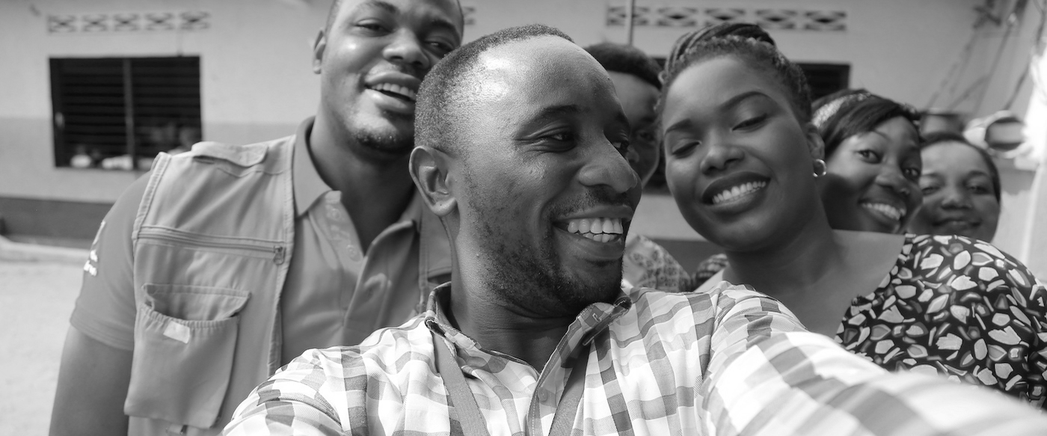

Assessing Social Norms to Inform Program Design and Implementation Strategies
MODULE TWO
Understanding, Exploring, & Acting on Findings
Photo credit: Institute for Reproductive Health
Notes:
NOTES TO FACILITATOR: This module is structured in four parts: an opening section, the introduction of an approach to assess norms (the Social Norms Exploration Tool), dedicated time for group work, and a wrap up section after the report out from the groups. Some slides in the opening and closing have interactive components where prompts are included to engage participants in dialogue.
SPEAKER NOTES: This is Module 2 in the training curriculum, covering the value of understanding and exploring the norms that underlie the behaviors of interest in your program and context.

Slide 6
1
Introduction to norms assessments.
Section
2
Norms assessments: How-To’s.
Section
Overview
Assessing Social Norms
3
Social Norms Exploration Tool.
Section
4
Applying the Social Norms Exploration Tool.
Section
5
Using assessment findings to take action.
Section
Notes:
NOTES TO FACILITATOR: N/A
SPEAKER NOTES: This section is a review of social norms concepts and provides opportunities to put these concepts into practice. We start with a review of the value of conducting norms assessments and how to understand, identify, and explore norms. We follow that with approaches and resources to assess norms for programs. Finally, we use examples and participatory exercises to practice conducting rapid norms assessments to maximize the use of findings in program design, monitoring, and evaluations.
This section is outlined by:
Agreeing on the value of a norms assessment: Providing an initial framing of why it’s important to assess norms from the outset—what you need to know before moving on to further steps (design, measurement, etc.).
Exploring norms assessment methods (participatory activities)
Taking action. Reflect on how to integrate learnings into programs

Slide 7
ASSESSING SOCIAL NORMS
Learning Objectives
During this session, participants will:
Identify the value of norms assessments for informing program design and implementation strategies.
Strengthen their understanding of the extent to which norms influence behaviors in key populations and reference groups in their settings and context.
Practice using participatory methods for gathering community-level information to identify reference groups and assess norms that influence behaviors.
Reflect briefly on how to integrate norms assessment findings into new or ongoing projects.
Notes:
NOTES TO FACILITATOR: After you’ve read through the notes for this slide when presenting, stop and allow time for questions or clarifications from the group.
SPEAKER NOTES: Four objectives are included in this section to clarify our goal. They will guide us—from understanding norms assessments to first-hand applying assessment approaches to learning how to apply findings within projects/contexts. The objectives are for participants to:
Identify the value of norms assessment for informing program design and implementation strategies.
Strengthen their understanding of to what extent norms influence behaviors in key populations and reference groups in their settings and context.
Practice using participatory methods for gathering community-level information to identify reference groups and assess norms that influence behaviors.
Reflect briefly on how to integrate norms assessment findings into new or ongoing projects.

Slide 8
Overview of Social Norms and Their Relation to Behavior
WHY SOCIAL NORMS MATTER
Notes:
NOTE TO FACILITATOR: The following slides are an overview of social norms from Module 1 of this curriculum. If the participants have recently gone through Module 1, you may choose to go through these slides at a quicker pace.

Slide 9
DEFINITION
Social Norms
Social norms are the often implicit, informal rules that most people accept and abide by. They are influenced by belief systems, perceptions of what others expect and do, and sometimes by perceived rewards and sanctions.
Norms are embedded in formal and informal institutions and produced and reproduced through social interaction.
- ALIGN, Overseas Development Institute
Notes:
NOTE TO FACILITATOR: This slide is animated.
SPEAKER NOTES: This is a more formal definition of social norms.
[Click for Animation 1- Read Paragraph]: Often not consciously obeyed, norms are tacit rules of behavior.
[Click for Animation 2- Read Paragraph] It’s of note that norms can be embedded in formal institutions by codification into law as well as institutional policies.
[Read examples, if time permits]
Some examples include:
1) Some school policies do not allow unmarried girls who become pregnant and give birth to return to finish studies. The boys who got the girls pregnant are permitted to continue their educations. What norms are operating here? Which are institutionalized?
2) Some health care settings require spousal permission for contraceptive services. What norms may be operating here? How have they been institutionalized?

Slide 10
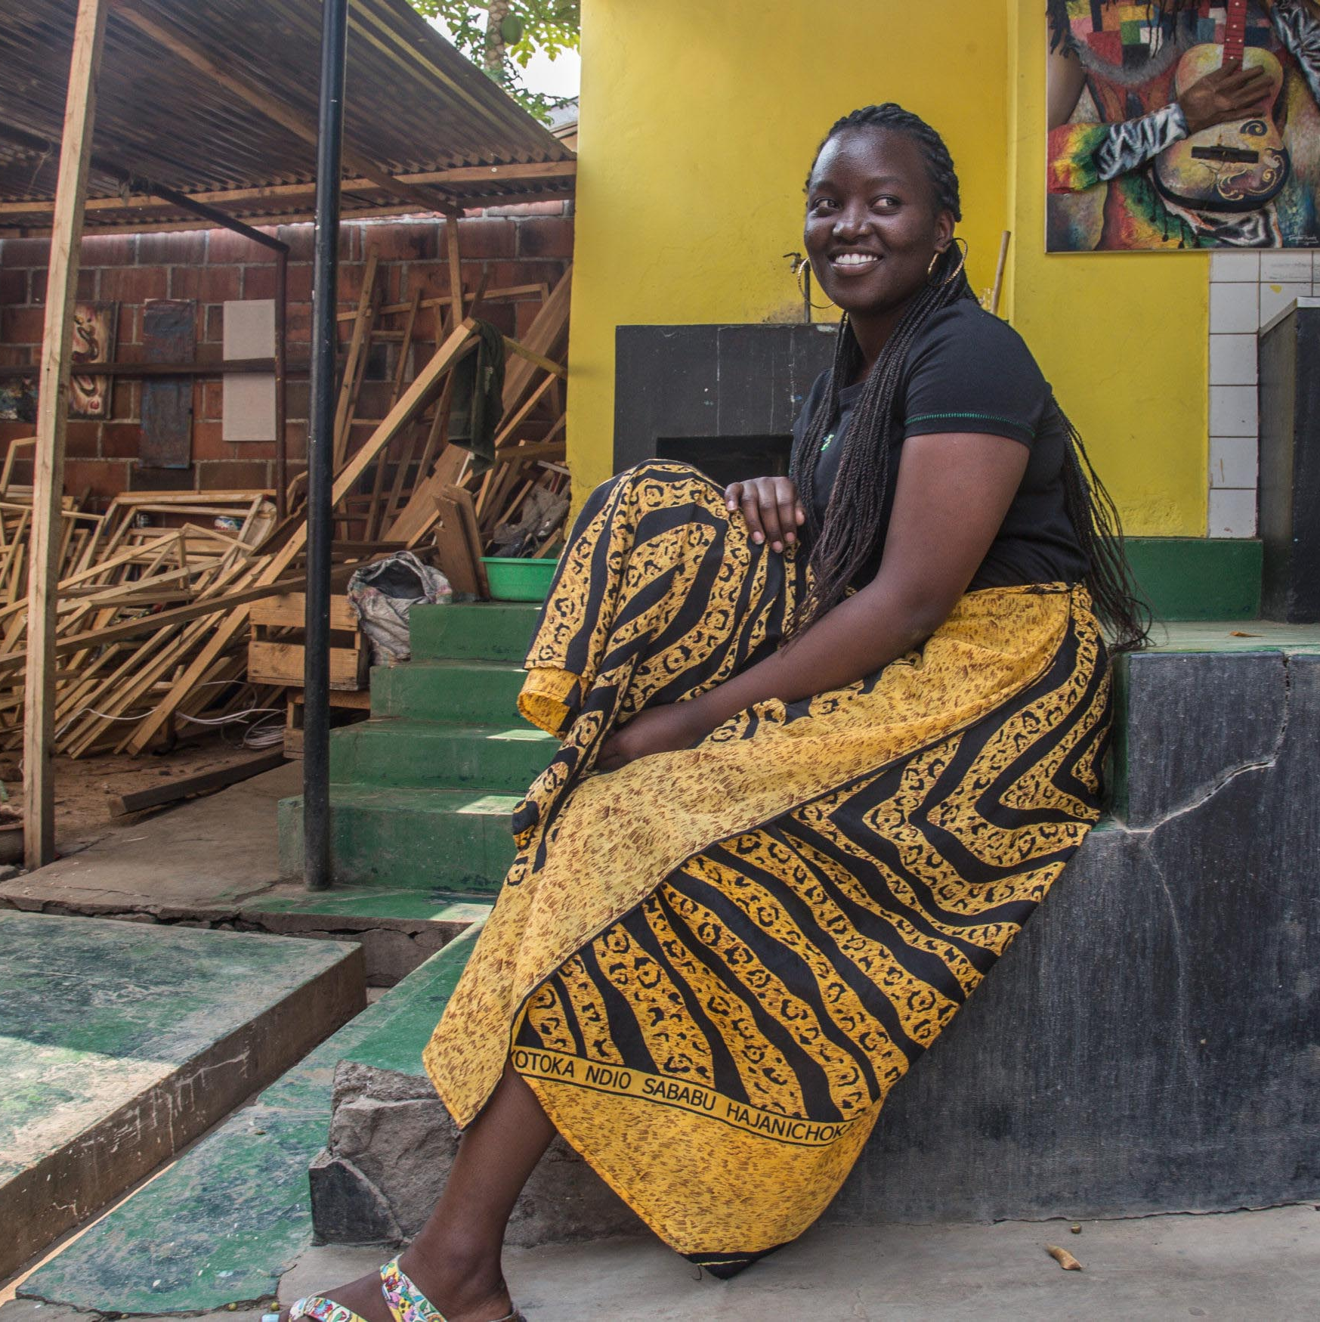
DEFINITION
Gender Norms
Social norms that govern attributes and behaviors that are valued and considered acceptable for people of a gender within a given culture or social group.
Learned and reinforced from childhood to adulthood through observation, instruction, positive and negative sanctions, media, religion, and other social institutions.
Can be so pervasive that people mistakenly assume they are “natural” or “ordained” and thus immutable.
Photo credit: Yagazie Emezi/Getty Images/Images of Empowerment
Notes:
NOTE TO FACILITATOR: Read slide.

Slide 11
DEFINITION
Social Norms Are…
What people in a group believe is typical (what others do) and appropriate (what others expect me to do) behavior.
Often defined in relation to a reference group.
Notes:
SPEAKER NOTES: Social norms are different from individual attitudes or beliefs—not what I believe, but what I think that others believe.
Example: I believe it is good to use family planning. I believe that others believe FP use is good/not good.
The second sentence represents what others expect or want me to do; this creates a norm of what is appropriate behavior.
The ”others” form part of my reference group (defined on next slide).

Slide 12


Types of Social Norms
DESCRIPTIVE NORMS
INJUNCTIVE NORMS
Perceptions of what others do.
Perceptions of what others expect me to do.
Photo credit: Getty Images/AfricaImages
Notes:
SPEAKER NOTES: This is an overview of the two types of social norms we focus on while discussing norms assessments.
This slide discusses the norm of always washing your hands before eating and two types of norms in action around this norm.
[Ask participants] What do you see in each photo?
Descriptive norms are what others do: the many children seeing others washing hands.
Injunctive norms are what is appropriate behavior: being told by your teacher or parent to leave the table and wash hands before rejoining.
Think of yourself as a child. How did descriptive and injunctive norms about handwashing before eating influence your behavior or the behavior of others in this room?

Slide 13
DEFINITION
Reference Groups Are…
Those who pass on and enforce social norms
A group of people whose behaviors and beliefs influence my behaviors and beliefs.
Notes:
SPEAKER NOTES: With these definitions of social norms, we will turn to enforcement of norms. Social norms are passed on and enforced by reference groups- a reference group is a group of people, a community—from a village to a broad religious community—for which these behaviors are relevant. Some define the reference group as a valued social group.
The important thing is that reference groups can exert a considerable amount of influence on behavior, and we might not be particularly influenced by behavior of individuals that we do not interact with or value their approval or disapproval.

Slide 14
TERM |  | DEFINITION
Behavior |  | What I do.
Attitude or belief |  | What I prefer and what I know.
Social and gender norms | Descriptive norm | What I think others do.
 | Injunctive norm | What I think others will approve/disapprove of me doing.
Reference group |  | People whose opinions matter to me (for a particular behavior or context). People who reward or sanction me for my behavior.
Adapted from CARE, 2017 & Chung & Rimal, 2016
Notes:
SPEAKER NOTES: This slide brings together the definitions of some of the key terms we will reference throughout the module. As you can see, all these terms can influence behavior, whether they are independent (such as beliefs and attitudes) or interdependent (such as social and gender norms).

Slide 15
Introduction to Norms Assessments
SECTION 1
What Are They, What Information They Uncover, and Why They’re Important
Notes:
NOTES TO FACILITATOR: N/A – but heads up, the next slide is animated.
SPEAKER NOTES: First, we’ll discuss the value of a norms assessment to inform program design and implementation strategies, starting with what norms assessments are and why they matter.
REFERENCES: N/A

Slide 16
DEFINITION
What Is a Norms Assessment?
Norms assessments are activities used to rapidly determine whether norms exist and which social norms are most relevant to the behavior(s) of interest in a specific setting to inform a program of action to guide program design and implementation strategies, as well monitoring and evaluation, early in the project lifecycle.
Notes:
NOTES TO FACILITATOR: This is an animated slide. When presenting this slide, you will show the header and ask the participants “What do you think a norms assessment is?” Allow two to three minutes to have an open brainstorm where participants can share definitions, words, concepts, etc. that they would consider to be a norms assessment. Once done, react to responses and show definition.
SPEAKER NOTES: For this context, our working framing of a norms assessment is a process of identifying whether a norm exists for a main population within a given reference group as it relates to a behavioral outcome of interest. Norms assessments inform the design and performance of a project aiming to shift social norms. They identify social norms influencing behaviors, reference groups that uphold the norms, and normative barriers and facilitators to behavior change, including positive and negative sanctions.
Results are then incorporated into the project to improve program implementation.
Ideally, these approaches could also inform projects about the relative influence of one norm over another and which norms are most amenable to change.
These are ideally done at the outset of a program (early in the program lifecycle) but can be included/incorporated at different points in the program’s lifecycle.
REFERENCES: definition new, but drawn from…
Learning Collaborative to Advance Normative Change, Overview of Approaches Diagnosing Social Norms (Washington, DC: Institute for Reproductive Health, Georgetown University, 2017).
Ben Cislaghi and Lori Heise, Measuring Gender-Related Social Norms, Learning Report 1 (London: Learning Group on Social Norms and Gender-related Harmful Practices of the London School of Hygiene & Tropical Medicine, 2016).

Slide 17
Through A NORMS ASSESSMENT, YOU SHOLD BE ABLE TO ANSWER:
Questions: | Why you want to answer them from a program perspective:
Who are the reference groups that influence the behavior? | Identifying reference groups that do or do not support a behavior helps programs include the right people in interventions and evaluations.
What are the social norms that influence this behavior? | Identifying the root causes of an issue—including social norms—ensures your program articulates and addresses the range of determinants of behaviors.
Why do people comply with social norms? Why not? | Identifying reasons people comply will help unpack the “black box” (or unknowns) in your program. (Maybe it’s because norms are hidden, or people have a strong desire to conform, or they gain social benefits for conforming, or fear sanctions for not conforming.)
What are the social norms that influence this behavior the most? | Discussing, analyzing, and prioritizing normative factors (and taking other factors into account) allows more strategic focus of interventions.
Notes:
NOTES TO FACILITATOR: A handout accompanies this slide.
SPEAKER NOTES: A norms assessment allows you to answer four critical questions that guide projects in integrating norms shifting activities:
1) Who are the reference groups that influence the behavior?
2) What are the social norms that influence this behavior?
3) Why do people comply with social norms and why not?
4) What are the social norms that influence this behavior the most?
Norms assessments provide practitioners with information about when and under what conditions social norms affect behavior, what those sanctions are, and who the relevant reference groups are.
REFERENCES:
Passages Project and Learning Collaborative to Advance Normative Change, Social Norms Exploration Tool (Washington, DC: Institute for Reproductive Health, Georgetown University, 2020).

Slide 18
Where Do Norms Fit in Current Formative Assessments?
Assessments to understand the drivers of behaviors may not include an explicit focus on norms.
Common formative assessments (like gender analyses) may explore norms but not unpack them enough to take action.
Notes:
NOTES TO FACILITATOR: This is an animated slide so that each point is presented one by one for simplicity. You’ll have to click through them all as you read speaker notes.
SPEAKER NOTES: Formative assessments for many factors (including for existing attitudes and behaviors, as well as gender assessments and other types of assessment) are done at the outset of programs, often through qualitative research but also using quantitative methods. These assessments are then used to inform programs. Historically (though not exclusively) development programmers have focused on increasing knowledge and awareness while improving the quality and access of services. Although many of these programs have achieved improvements, often unidentified and unaddressed norms persist, perpetuating unhealthy behaviors and limiting sustained program impact. In more detail:
In existing formative assessments, identifying norms may be seen as a challenge due to the perceived (and real) complexity and the lack of easy-to-use approaches or tools.
Assessments to understand the drivers of behaviors may not include an explicit focus on norms.
Gender assessments often aim to collect a lot of information, and the focus on norms can get lost; strengthening that focus can be helpful.
Or common formative assessments (like gender analyses) may explore norms but not unpack them enough to take action
Strengthening formative assessments with deep dives into whether and how norms impact behavior change is increasingly common and continues to be key.
Finally, programs may tend to lean on staff insights or desk reviews. Existing evidence may not be sufficient to uncover the exact norms, who influences them, and the way norms operate.
REFERENCES: N/A

Slide 19

Your Experience With Formative Assessments
PLENARY DISCUSSION
What formative assessments have you done in your behavior change programs?
At what point in your programs have you used formative assessments?
Have your programs explored norms in depth?
Are there any other gaps you have encountered in your work to assess norms?
Photo credit: Yagazie Emezi/Getty Images/Images of Empowerment
Notes:
NOTES TO FACILITATOR: After the previous slide is presented, engage the participants for two to five minutes discussing the questions on the slide here.
SPEAKER NOTES: After going through the previous slide, we’re now going to stop for a moment and reflect on the questions here in the context of your work.
What formative assessments have you done in your behavior change programs?
At what point in your programs have you used formative assessments?
Have your programs explored norms in depth?
Are there any other gaps you have encountered in your work to assess norms?
REFERENCES: N/A

Slide 20

Girls Education
THE VALUE OF A NORMS ASSESSMENT
A project seeking to increase rates of school attendance for young girls was relying on staff insights into surrounding communities’ existing norms that affected girls’ education.
Through a norms assessment, the program uncovered that norms related to girls’ purity and chastity impacted girls’ mobility, school attendance, and related social stigmatization. In response, the program, which had initially implemented only in schools expanded activities in broader community settings.
Notes:
NOTES TO FACILITATOR: This and the next slide are illustrative case studies demonstrating how norms assessments improve programs.
SPEAKER NOTES: To close out this introduction section, I’m sharing two case studies illustrating the value of these kinds of norms-focused assessments. In short: if you go into your program thinking you know the norms, you may find that isn’t the case. Despite increasing interest in social norms, no integrated framework exists to help practitioners plan for multi-layered interventions.
A project seeking to increase rates of school attendance for young girls was relying on staff insights into surrounding communities’ existing norms that affected girls’ education.
Through a norms assessment, the program uncovered that norms related to girls’ purity and chastity impacted girls’ mobility, school attendance, and related social stigmatization. In response, the program, which had initially implemented only in schools expanded activities in broader community settings.
REFERENCES: N/A

Slide 21

Male Engagement
THE VALUE OF A NORMS ASSESSMENT
A program seeking to improve men’s involvement in reproductive health worked to engage men to address household power dynamics to support healthy behaviors for themselves, their spouses, and their families.
Through a norms assessment, influential community leaders (and in particular faith leaders) emerged as the influencers of norms. Based on this, the program shifted strategies to engage a wider range of reference groups.
Notes:
NOTES TO FACILITATOR: Note this slide isn’t meant to be read, it’s an illustrative case study demonstrating how norms assessments improve programs.
SPEAKER NOTES: This is another example, like the previous slide. This program, which sought to increase men’s involvement in reproductive health, worked to engage men to address household power dynamics to support healthy behaviors for themselves, their spouses, and their families.
Through a norms assessment, influential community leaders (and in particular faith leaders) emerged as the influencers of norms. Based on this, the program shifted strategies to engage a wider range of reference groups.
Again, conducting these norms assessments will ultimately enrich a program’s understanding of the context, of what norms exist, and how the norms work to influence behavior, providing insights into how programs can implement norms-shifting strategies.
REFERENCES: N/A

Slide 22
Norms Assessments:
How-To’s
SECTION 2
Best Practices for Conducting Norms Assessments to Inform Programs.
Notes:
NOTES TO FACILITATOR: N/A
SPEAKER NOTES: For this section, we’ll discuss the how-to of a norms assessment. We’ll explore existing resources and present a promising approach for use.
REFERENCES: N/A

Slide 23
OPTIONS FOR ASSESSING NORMS
TYPE | OPTIONS | HOW, WHY, WHEN?
Secondary data collection | Review existing literature and data | Useful if you don’t have resources for data collection. May provide evidence regarding whether and how norms are sustaining a given behavior (if norms are explicitly explored).
Primary data collection | Conduct traditional interviews or focus-group discussions | May be in the form of adding norms-specific questions to existing guides to gather participant information (or be part of entirely norms-focused planned research). Often done to supplement existing but limited knowledge.
 | Use Vignettes (qualitative open-ended stories) | Provide fictional contextually-driven situations for participants to react to; this can uncover root causes of behaviors. Best done if you have some information on norms.
 | Conduct participatory exercises and activities | Engage participants in identifying why certain behaviors exist, including normative drivers of behaviors. Best done if you have some information on norms.
Informed by Ben Cislaghi and Lori Heise, Measuring Gender-Related Social Norms, Learning Report 1 (London: Learning Group on Social Norms and Gender-related Harmful Practices of the London School of Hygiene & Tropical Medicine, 2016).
Notes:
NOTES TO FACILITATOR: N/A
SPEAKER NOTES: Again, assessing norms at the outset is important! Even if resources are scarce, adding a few questions into an existing formative research tool or plan can go a long way. You need to be sure you are asking the right questions—focus on the behavioral dynamics and social dynamics, the people/reference groups, perceptions of descriptive norms (or what people do), and perceptions of injunctive norms (or what people believe it’s appropriate to do). Make sure they’re manageable in length and complexity.
Reviewing existing literature is a logical first step to inform the measurement of social norms of interest to your program. Although there may few norms-focused studies relevant to your program, there are likely datasets on related concepts that can be reviewed for useful information. Secondary data may also be a good way to start—or if you’re short on time, a good option to inform your program. Look into studies in the specific context exploring the same/similar behavioral outcomes. Focus on studies and program reports that have assessed norms or evaluated norms programs, if possible. Contact people at those projects and follow up with any questions, if possible.
Traditional interviews and focus groups can be effective. You may have existing tools and resources to adapt, or you can look externally for tools to adapt. Either way, questions and discussion guides should focus on norms or include a component that focuses on norms.
Vignettes—fictional stories grounded in the context—are excellent resources to collect information on root causes of behaviors (namely, potential norms) by creatively engaging people in the context and asking about perceptions of reactions to behaviors or deviations in behavior.
Finally, conducting participatory activities within an interview or group discussion format can be a very effective way to uncover and assess norms. We’ll be focusing on these approaches in the rest of this section.
REFERENCES: informed in part by…
Ben Cislaghi and Lori Heise, Measuring Gender-Related Social Norms, Learning Report 1 (London: Learning Group on Social Norms and Gender-related Harmful Practices of the London School of Hygiene & Tropical Medicine, 2016).

Slide 24
Value of Participatory Methods to Norms Assessments…
Can improve the effectiveness of qualitative methods such as focus group discussions and in-depth interviews.
Offer a direct way to learn about social norms from community members.
Enjoyable, easy for participants to understand, and support shared ownership of the assessment process.
Notes:
NOTES TO FACILITATOR: This slide is animated so the points emerge one by one for the participants to digest. Go through them as you read the notes below.
SPEAKER NOTES: Given the nature of how norms are formed and have potential to shift through specific contexts and settings, participatory methods can be particularly helpful.
[Click for animation]
Qualitative methodologies for gathering information, such as focus groups or interviews, can be made more effective by combining them with interactive and participatory methods. For example, participants in these settings can be asked to rank, map, or respond to vignettes over the course of the discussion or interview. This is particularly true when working with youth or populations with low literacy levels.
[Click for animation]
Participatory approaches have many advantages over more structured approaches, especially during early research. They offer a direct means for you to learn about social norms from community members, and they are well suited to exploring the complexity of social norms.
[Click for animation]
Participatory methods are also enjoyable, easy for participants to understand, and support shared ownership of the research process.
REFERENCES:
Sarah Thomas, What is Participatory Learning and Action (PLA): An Introduction. University of Wolverhampton, Centre for International Development and Training. http://idp-key-resources.org/documents/0000/d04267/000.pdf.

Slide 25
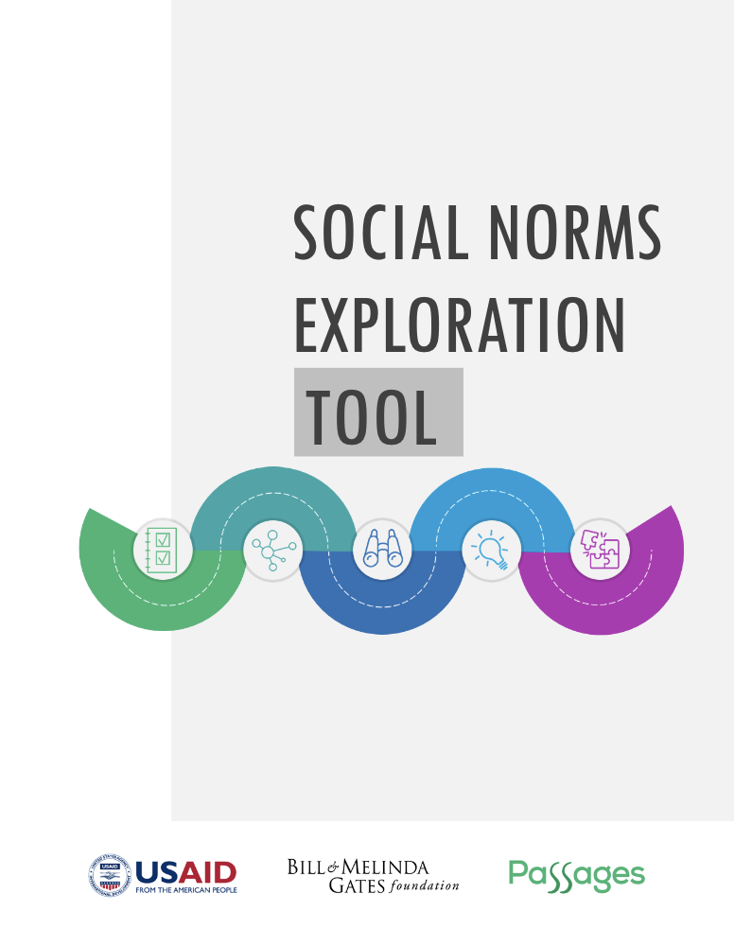

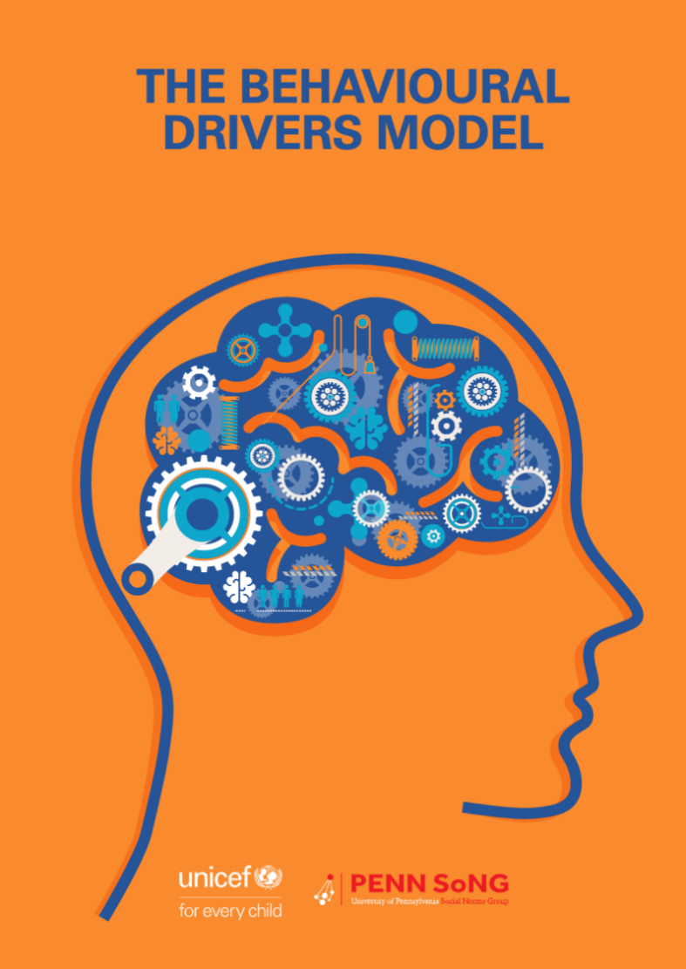
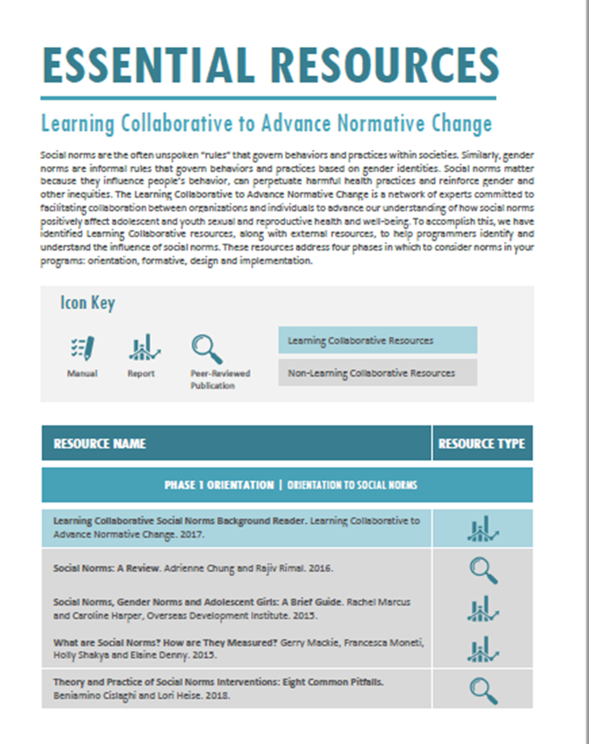
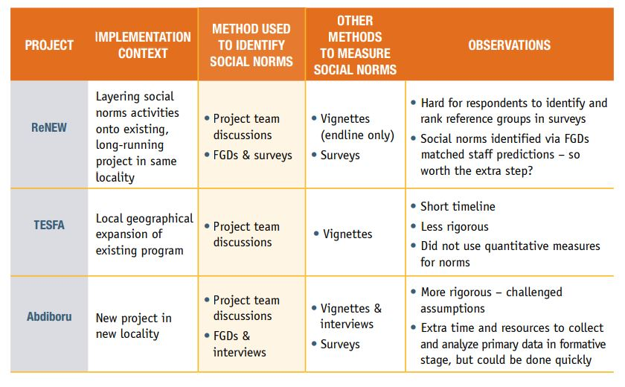
Existing Resources
to Inform Norms Assessments
Notes:
NOTES TO FACILITATOR: This is an animated slide. When you mention the name of a resource, click your mouse for the image of the resource to show on screen.
SPEAKER NOTES: Again, often these norms assessments are done by exploring and investigating norms through qualitative exercises (including vignettes) and analysis as well as through quantitative surveys—or through combinations of the both. That said, qualitative methodologies are most typically used. Innovative collaboratives, organizations, and projects are leading the way in thinking through the critical step of assessing norms at project outset. The Social Norms Learning Collaborative, CARE, UNICEF, Overseas Development Institute, PennSong/University of Pennsylvania, and others have developed manuals, guidance, and reports on project experiences assessing norms. Other projects apply norms assessments through existing formative research and have published their experiences.
A tool we’ll focus on later is the Social Norms Exploration Tool (or SNET), informed by the four questions in the previous section, which was developed as a community-based participatory tool to inform a norms assessment. The SNET filled a gap in 2016 by providing an applied, user-oriented tool to assess norms.
REFERENCES:
Passages Project and Learning Collaborative to Advance Normative Change, Social Norms Exploration Tool (Washington, DC: Institute for Reproductive Health, Georgetown University, 2020).
Cristina Bicchieri and Penn Social Norms Training and Consulting Group, Why People Do What They Do?: A Social Norms Manual for Viet Nam, Indonesia, and the Philippines (Florence, Italy: UNICEF Office of Research, 2016).
Leigh Stefanik and Theresa Hwang, Applying Theory to Practice: CARE’s Journey Piloting Social Norms Measures for Gender Programming (Geneva: Cooperative for Assistance and Relief Everywhere, Inc., 2016).
CARE International, Redefining Norms to Empower Women: Experiences and Lessons Learned (Colombo, Sri Lanka: CARE International Sri Lanka, 2016).
Ben Cislaghi and Lori Heise, Measuring Gender-Related Social Norms, Learning Report 1 (London: Learning Group on Social Norms and Gender-related Harmful Practices of the London School of Hygiene & Tropical Medicine, 2016).
Gerry Mackie et al., What Are Social Norms? How Are They Measured? (New York and San Diego: UNICEF and University of California San Diego).

Slide 26
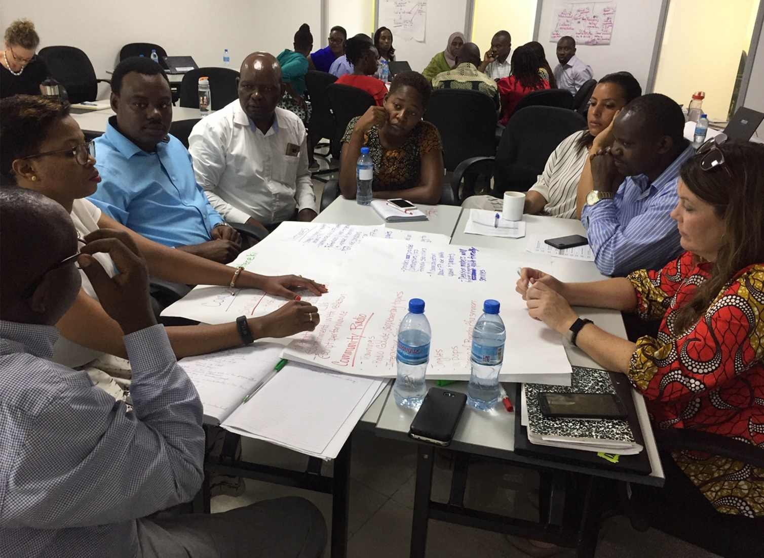
What Kinds of Activities Have You Used to Assess Norms?
PLENARY DISCUSSION
Have you ever used participatory approaches?
What kinds of approaches have you used?
If used, what do you find to be helpful about these approaches?
Photo credit: Institute for Reproductive Health
Notes:
NOTES TO FACILITATOR: After the previous slide is presented, engage the participants for two to five minutes discussing the questions on the slide here. Note that the questions are animated one by one. From the responses you can get an understanding of existing capacity. For example, some will call focus group discussions (FGDs) and in-depth interviews (IDIs) participatory (because there is interaction and they are participatory in this way), but what you want to know about are additional methods that are part of FGDs and IDIs, such as community mapping and body mapping. The aim of the question is to understand if they have moved beyond methods that extract info from people (classic IDI and FGD) to methods that engage people in sharing their knowledge/experience/analyses (PLA).
SPEAKER NOTES: After going through the previous slide, we’re now going to stop for a moment and reflect on the questions here in the context of your work.
Who among you have ever used participatory methods?
What kinds of approaches have you used?
What do or did you find helpful about these approaches?

Slide 27
Social Norms Exploration Tool
SECTION 3
A Participatory Learning Tool to Identify and assess Influence of Social Norms
Notes:
NOTES TO FACILITATOR: N/A
SPEAKER NOTES: For this section, we’re going to introduce you to a resource developed to assess norms to inform programs called the ‘Social Norms Exploration Tool’ or SNET.

Slide 28
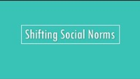
Notes:
NOTES TO FACILITATOR: This is an optional clip of the SNET Video. You can use this video to replace the “What Is the SNET?” and “Using the SNET” slides (the following two slides).
SPEAKER NOTES: This short video provides an overview of the SNET.

Slide 29
RESOURCE
What Is the SNET?
A participatory learning and action tool that guides a rapid “social norm exploration.”
Allows for rapid identification of reference groups and social norms that influence behaviors.
Offers guidance on how to use the information in program design, strategy adjustment, and evaluation.
Notes:
NOTES TO FACILITATOR: N/A
SPEAKER NOTES: So, what is the SNET? The Social Norms Exploration Tool or “SNET” is a participatory learning and action (PLA) tool that informs a social norms exploration process. The SNET is designed to be a rapid assessment tool, and as such, it is a team-based, qualitative process. The SNET as a tool provides the step-by-step guidance for users. Through conducting a social norms exploration using the SNET, programs are able to determine the relevant reference groups and norms and the way norms work and are held in place in each context, including through positive and negative sanctions. Programs can then use the information in program design, strategy adjustment, and evaluation.
REFERENCES:
Passages Project and Learning Collaborative to Advance Normative Change, Social Norms Exploration Tool (Washington, DC: Institute for Reproductive Health, Georgetown University, 2020).

Slide 30
SOCIAL NORMS EXPLORATION TOOL
Using the SNET
Who is it for? Project planners and implementers, especially those focused on community-based programming.
What does it include? Basic information and templates for guidance and use in social norm exploration.
When is it used? Easily integrated into different phases of new or existing programs.
Notes:
NOTES TO FACILITATOR: N/A
SPEAKER NOTES: Now who should use the SNET and how and when should they do so? The SNET is primarily for program planners and implementers with experience in community-based development programming. It is not necessary that you have technical expertise in social norms or participatory research. The SNET is ideally used before a program is implemented, to inform norms-shifting strategies to reach program objectives. The SNET can also be applied mid-program to make course corrections. We’ve found that the SNET has been applicable in a variety of settings and programs, though materials need to be modified to suit the context that your program is taking place in.
REFERENCES:
Passages Project and Learning Collaborative to Advance Normative Change, Social Norms Exploration Tool (Washington, DC: Institute for Reproductive Health, Georgetown University, 2020).

Slide 31
Learning Through Participation
The Social Norms Exploration Approach…
✓
✓
✓
Uses a variety of participatory and visual methods in interview and group discussion formats for learning about and engaging with communities.
Enables the sharing of insights with analysis providing a catalyst for the community to act on what is uncovered within a setting.
Provides the basis of the SNET from start to finish and builds capacity in staff as a result.
Notes:
NOTES TO FACILITATOR: This slide is animated. For each of the boxes, the text below will appear one at a time from left to right so that participants can focus on each point.
SPEAKER NOTES:
[Click for animation]
While a powerful consultation tool, the SNET offers the opportunity to go beyond mere consultation and promote the active participation by communities in the issues and interventions that shape their lives. Again, participatory approaches for learning are engaging with communities; the SNET combines an ever-growing toolkit of participatory and visual methods with natural interviewing methods and is intended to facilitate a process of collective analysis and learning.
[Click for animation]
A participatory tool, the SNET enables people in a given setting (i.e., a local context) to share their perceptions and identify, prioritize, and appraise social and other issues based on their knowledge of local conditions. More traditional, extractive research tends to “consult” communities and then take away the findings for analysis, with no assurance that they will be acted on.
[Click for animation]
In contrast, participatory tools combine the sharing of insights with analysis and, as such, provide a catalyst for the community itself (alongside the program staff) to act on what is uncovered.
REFERENCES:
Passages Project and Learning Collaborative to Advance Normative Change, Social Norms Exploration Tool (Washington, DC: Institute for Reproductive Health, Georgetown University, 2020).
Sarah Thomas, What is Participatory Learning and Action (PLA): An Introduction University of Wolverhampton, Centre for International Development and Training. http://idp-key-resources.org/documents/0000/d04267/000.pdf.

Slide 32
The SNET Assesses Norms in Two of the Five Phases
ASSESSMENT ACTIVITY | SNET ACTIVITIES | MAIN PURPOSE
IDENTIFY REFERENCE GROUPS | My Social Networks | Explore which people are influential by providing guidance, information, advice or support on a specific issue.
The Five Whys | Explore the social norms that influence the behavior of interest, learn which may be most influential, and understand the extent norms are influencing behaviors and consequences (sanctions) of not following a norm
Problem Tree Analysis | Same as above (the 5 Whys), but this exercise can identify both social and non-social causes of behavior in more specificity in real-time.
EXPLORE NORMS
Vignettes | Same as above (the 5 Whys and the Problem Tree), but this activity can also reveal more context and nuanced analysis with good probing
Notes:
NOTES TO FACILITATOR: Review this slide in advance to prepare the talking points. This is meant to be a quick summary of approaches included in the SNET, and facilitators should not dwell on this slide for long.
SPEAKER NOTES: The SNET comprises five phases; in two of them, norms are assessed at the community level. This table lays out the activities associated with the SNET’s two assessment purposes: to identify reference groups and explore social norms.
[CLICK SLIDE] For the two field-based phases; the first focuses on identifying references groups, for which one rapid exercise is provided. [Read table content]
[CLICK SLIDE] For the second field-based phase, the SNET provides three options for exploring norms within communities; user choose one. On the right-hand side you see the purpose and advantages of the exercises. As a program team, you plan and decide together which option(s) will work best for your setting. [Read remaining table content]
In the upcoming group activity, you’ll get the opportunity to try out either the Five Whys or Vignettes activities.
REFERENCES:
Passages Project and Learning Collaborative to Advance Normative Change, Social Norms Exploration Tool (Washington, DC: Institute for Reproductive Health, Georgetown University, 2020).

Slide 33
Let’s Try: Applying the Social Norms Exploration Tool
SECTION 4
GROUP WORK TO PRACTICE USING THE SOCIAL NORMS EXPLORATION TOOL.
Notes:
NOTES TO FACILITATOR: This slide marks the beginning of the group work section. It is critical that you review this section before facilitating. This is important for general flow and understanding but in particular because there are two options for group work, and you will need to choose in advance which to do.
Option 1 will be if this training is taking place with various people from different settings, projects, organizations. You will use a case study to help ground the activities.
Option 2 will be if this training is taking place with people from the same project. You will ask them to use their program to ground the activities.
Note that for either option you will run through the explanation for the exercise and then gather the group back together for a plenary reflection before closing this section.
Make sure to remove/hide the group work option you chose not to use.
SPEAKER NOTES: Now we’re going to try it by breaking into groups to conduct activities to inform a norms assessment together.
REFERENCES: N/A

Slide 34

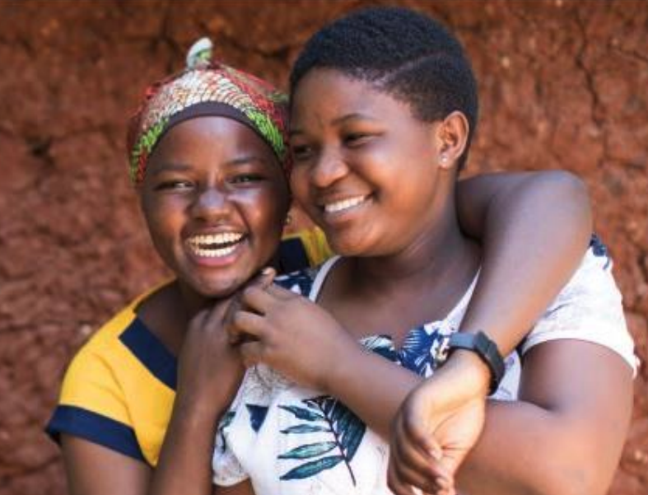
TULONGE AFYA, TANZANIA CASE STUDY
GROUP ACTIVITY
Social Norms Assessment Using SNET
Photo credit: USAID TULONGE AFYA – April, 2019
Notes:
NOTES TO FACILITATOR: You will only show the slides for this case study if you’re doing group work Option 1.
SPEAKER NOTES: In order to inform our activities together, I’m going to provide a case study so that we can use this program context to conduct our activities. To practice norms assessments, our case study today will be a project by USAID and FHI 360 that aims to improve health among women and youth in Tanzania called Tulonge Afya, which means “let’s talk about health” in Kiswahili.

Slide 35
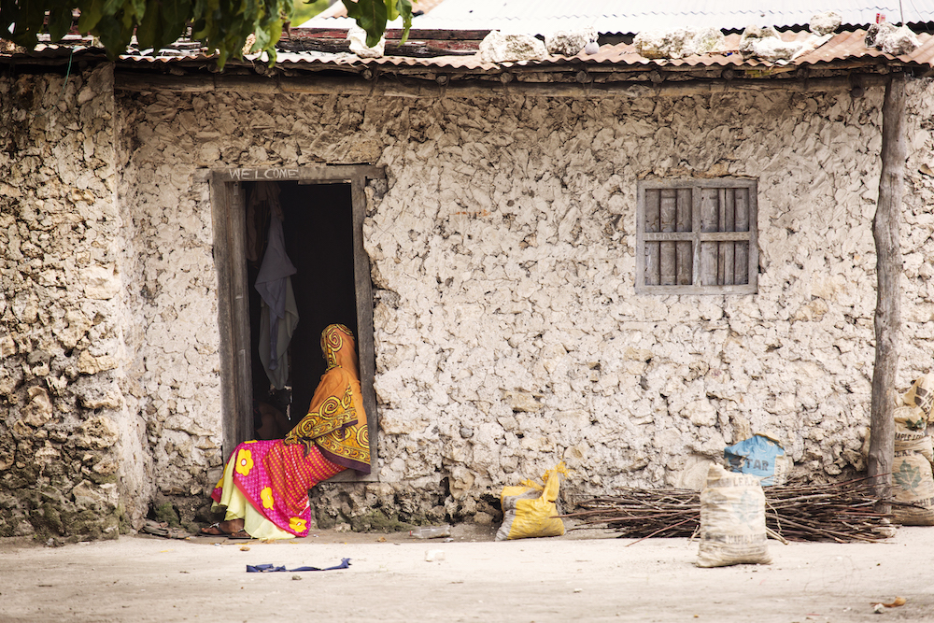
Program
Foundation
CASE STUDY
In Tanzania, health outcomes, including reproductive health, are disproportionately worse for women and youth…
Household decisionmaking, including for health decisions like family planning, is seen as the domain of men.
Married women are expected to have many children.
Unmarried men and women are not expected to be sexually active.
Family planning is seen as inappropriate for young, unmarried women to use.
Photo credit: danm/Getty Images
Notes:
SPEAKER NOTES: Read slide

Slide 36
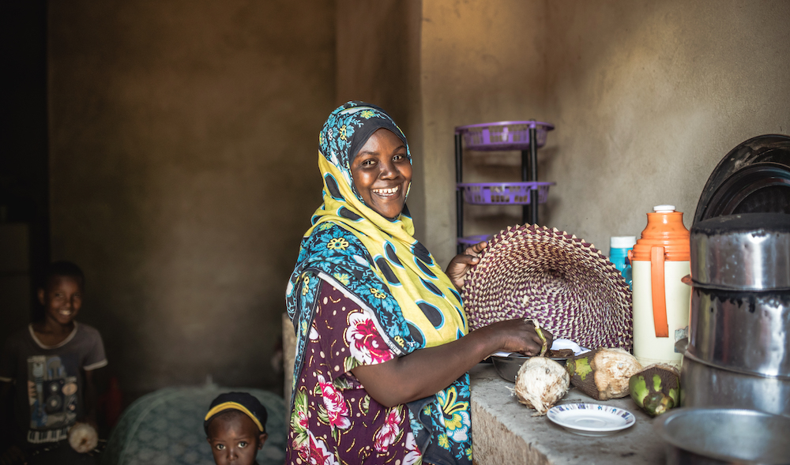
Intervention Components
CASE STUDY
The Tulonge Afya team developed two platforms—one for pregnant and caregiving adults (NAWEZA) and one for youth ages 15 to 24 (SITETEREKI)—that included a range of SBC activities and materials to reach key groups:
NAWEZA activities: radio shows, spots, social media, community radio, community theatre, small group dialogue, household and facility counselling, and supportive materials.
SITETEREKI activities: radio shows, spots, community radio, youth magnet theatre, small group dialogue, service referrals, household and facility counselling, supportive print materials, and message guides.
Photo credit: zeljkosantrac/Getty Images
Notes:
SPEAKER NOTES:
FHI-360’S Tulonge Afya Project catalyzes opportunities to improve health status, especially among women and youth, by transforming socio-cultural norms and supporting the adoption of healthier behaviors.
The Tulonge Afya staff followed the SNET process to identify the behaviors of interest and target populations, as well as establishing the goal and specific objectives of the activity.
Tulonge Afya included two platforms – one for pregnant and caregiving adults, called NAWEZA, and one for youth, ages15-24, called SITETEREKI, which includes a range of SBC activities and materials and activities to reach key groups:
NAWEZA activities include radio shows, spots, social media, community radio, community theatre, small group dialogue, household and facility counselling, supportive materials
SITETEREKI activities include radio shows, spots, community radio, youth magnet theatre, small group dialogue, service referrals, household and facility counselling, supportive print materials and message guides.
REFERENCES:
USAID Tulonge Afya FP Overview Presentation & USAID TULONGE AFYA PROJECT Fact Sheet.

Slide 37

Norms Exploration Scope
TULONGE AFYA
The key groups and behaviors explored by Tuloge Afya included:
1. Adults (NAWEZA) 18-49 years
Use of modern contraceptive methods.
Discussion of family planning with partners.
Seeking health care for postpartum family planning options.
Use of modern contraception post-live birth for 24 months.
2. Youth (SITETEREKI) 15-24 years
Use of modern contraceptive methods.
Delay first pregnancies and space future pregnancies.
Correct and consistent use of condoms.
3. Health workers
Family planning counselling on range of postpartum family planning options available.
Provide high-quality, confidential, and nonjudgmental reproductive health services to youth.
Photo credit: Jasmin Merdan/Getty Images
Notes:
NOTES TO FACILITATOR: N/A
SPEAKER NOTES:
The key groups and behaviors explored by Tuloge Afya included:
1. Adults (18-49 years) on the NAWEZA platform
- Use of modern contraceptive methods.
- Discussion of family planning with partners.
- Seeking health care for postpartum family planning options.
- Use of modern contraception post-live birth for 24 months.
2. Youth (15-24 years) on the SITETEREKI platform
- Use of modern contraceptive methods.
- Delay first pregnancies and space future pregnancies.
- Correct and consistent use of condoms.
3. Health workers
- FP Counselling on range of postpartum family planning options available.
Provide quality, confidential, and nonjudgmental reproductive health services to youth

Slide 38
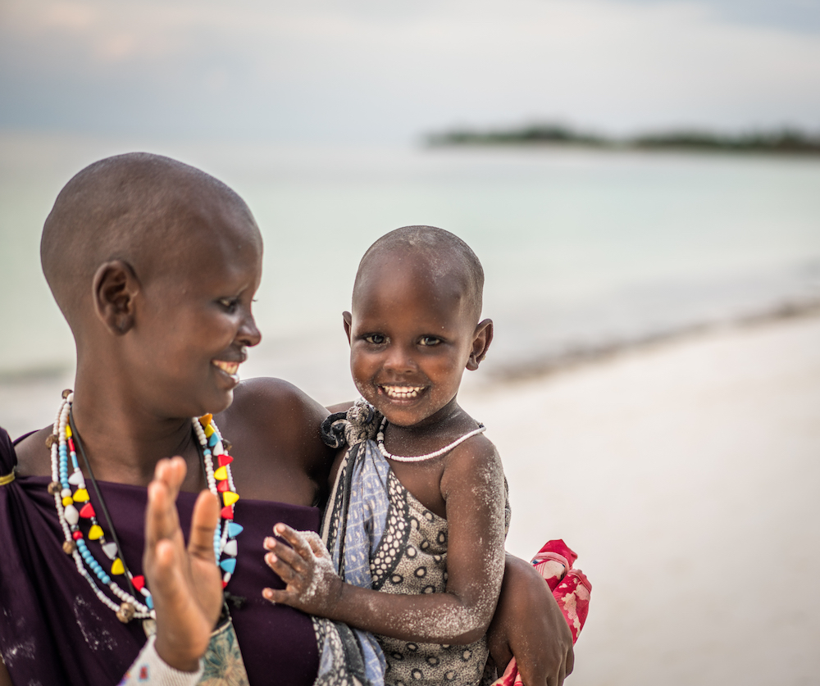
Using the SNET
TULONGE AFYA
The Tulonge Afya team used the SNET to unpack social norms preventing the uptake of family planning across priority regions.
Through the SNET process, the team gained insights into reference groups and family planning-related norms
The project now plans to adjust implementation and develop new approaches to address these norms.
Photo credit: Jasmin Merdan/Getty Images
Notes:
NOTES TO FACILITATOR: N/A
The Tulonge Afya team used the SNET to unpack social norms preventing the uptake of family planning across priority regions
Through the SNET process, the team gained important insights on reference groups and prevalent FP-related social norms for key groups in both adult and youth cohorts
The findings from the SNET enabled Tulonge Afya to identify social norms inhibiting uptake of priority FP behaviors
The project now plans to deepen its family planning implementation and develop new approaches and materials to address these norms
REFERENCES:
Passages Project and Learning Collaborative to Advance Normative Change, Social Norms Exploration Tool (Washington, DC: Institute for Reproductive Health, Georgetown University, 2020).

Slide 39
Group Work Options
OPTION ONE
OPTION TWO
Social Norms Exploration Tool exercises in practice with a sase study…
Problem tree
Vignettes
Five whys
Social Norms Exploration Tool exercises in practice for your program…
Problem tree
Vignettes
Five whys
Notes:
SPEAKER NOTES: Explain that participants will have one of two options to complete an upcoming exercise. They can rely on a case study that is described in their handouts, or they can use their own program as the example to complete the exercise.
Divide the participants into groups depending on their choice of the case study provided or their own program. Use the following slide to organize the groups. Once in their groups, participants have the option of working on a problem tree, a vignette, or the five whys exercise.

Slide 40
Social Norms Exploration Exercises
 | Problem Tree | Five Whys | Vignette
Option 1: Using a Case Study
Option 2: Using Your Program Intervention
Notes:
NOTES TO FACILITATOR: This slide is not meant to be shown; it’s to help you get organized. You could show this or imitate it on a flip chart if helpful.
SPEAKER NOTES: N/A
REFERENCES: N/A

Slide 41
Instructions
GROUP ACTIVITY
Select a behavior from Tulonge Afya.
Separate into groups.
Start with a short discussion to determine example reference groups for your chosen behavior.
Choose one exercise (five whys, problem tree, or vignette) and conduct an exploration.
Prepare a report out of results for plenary.
Photo credit: USAID TULONGE AFYA – April, 2019
Notes:
OPTION 1
NOTES TO FACILITATOR: This is only for group work Option 1. For this slide, you’ll read through the notes below and allow for any questions or clarifications to the process from participants.
SPEAKER NOTES: For this group work, the aim is to use the program case study to assess norms to inform programs, using an assessment tool, either a vignette or the five whys. Using a key behavior from the case study example, we will separate into equal groups and test out two different participatory activities to assess social norms. We’ll think creatively to test the approach and come up with illustrative results. To close, we’ll come back together and hear the results from each group as well as their experience using the activity. A few guiding questions will shape our discussion. Before we break out into our groups, let’s randomly assign the two types of exercises to the groups.
REFERENCES: N/A

Slide 42
Questions to Consider for Your Report Out
GROUP ACTIVITY
Describe your activity to the other groups (five whys, problem tree, or vignette).
To what extent did your formative assessment answer the four critical social norms exploration questions?
What reference groups were identified?
What social norms emerged?
What other factors emerged?
In general, was this easy, medium, or hard to complete?
Photo credit: USAID TULONGE AFYA – April, 2019
Notes:
OPTION 1
NOTES TO FACILITATOR: These questions should be asked across groups to report out. These form the basis of an open-ended discussion.
SPEAKER NOTES: Now we’re back together and before some final closing questions, I wanted to pause for a cross-group report out…
Describe your activity to the other groups (problem tree, five whys, or vignette).
To what extent did your formative assessment answer the four critical social norms exploration questions? What was covered and what was not well covered or missed?
What reference groups were identified?
What social norms emerged?
What other factors emerged?
In general, was this easy, medium, or hard to complete?
REFERENCES: N/A

Slide 43
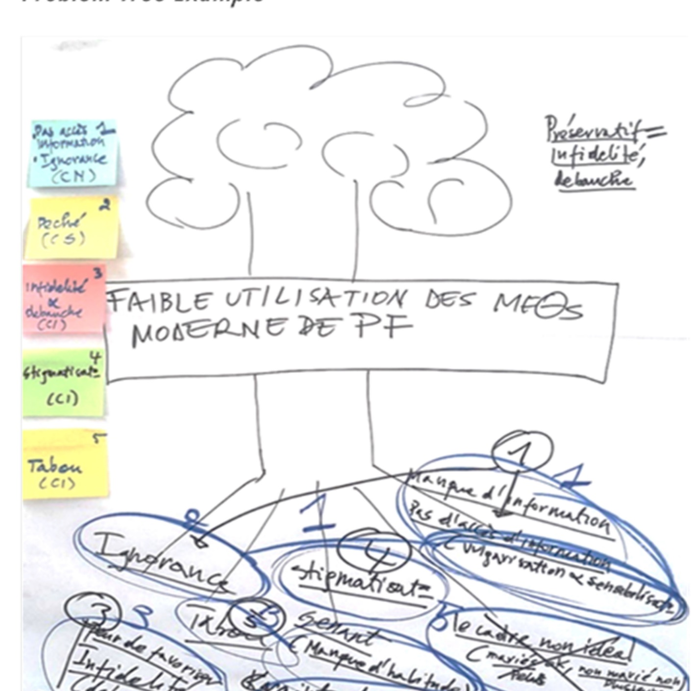
Problem Tree
GROUP ACTIVITY
In your group, select one of the behaviors of interest from Tulonge Afya.
Based on your selected behavior, draw a tree at the center of a flipchart. Under the tree (roots), list factors that may influence this behavior.
When done, label the factors by type: norms/social, individual, resources, or structural. Circle the norms factors.
Focus on the social norms-related root causes (now circled) and dive a bit deeper.
Discuss the types of norms that may be at play for each circled cause and write them next to the circles.
What are the benefits to following the norm? What are the consequences of not following the norm? (These are positive and negative sanctions.)
Notes:
OPTION 1, ACTIVITY 1
NOTES TO FACILITATOR: Read through this before allowing groups to break off. Provide groups with the corresponding handouts with these instructions for their use. These instructions are for the groups who chose to do the problem tree activity.
SPEAKER NOTES: Problem trees help identify the root causes, both social and non-social, and how they affect behavior(s) of interest. In your group, select one of the behaviors of interest from Tulonge Afya. Based on your selected behavior:
In your group, select one of the behaviors of interest from Tulonge Afya.
Based on your selected behavior, draw a tree at the center of a flipchart
Draw a tree at center of a flipchart. Under the tree (roots), list factors that may influence this behavior. When done, label the factors by type: norms/social, individual, resources, or structural. Circle the norms factors.
Focus on the social norms-related root causes (now circled) and dive a bit deeper. Discuss the types of norms that may be at play for each circled cause and write them next to the circles. What are the consequences of following or not following the norm? (These are positive or negative sanctions.)
REFERENCES:
Passages Project and Learning Collaborative to Advance Normative Change, Social Norms Exploration Tool (Washington, DC: Institute for Reproductive Health, Georgetown University, 2020).

Slide 44
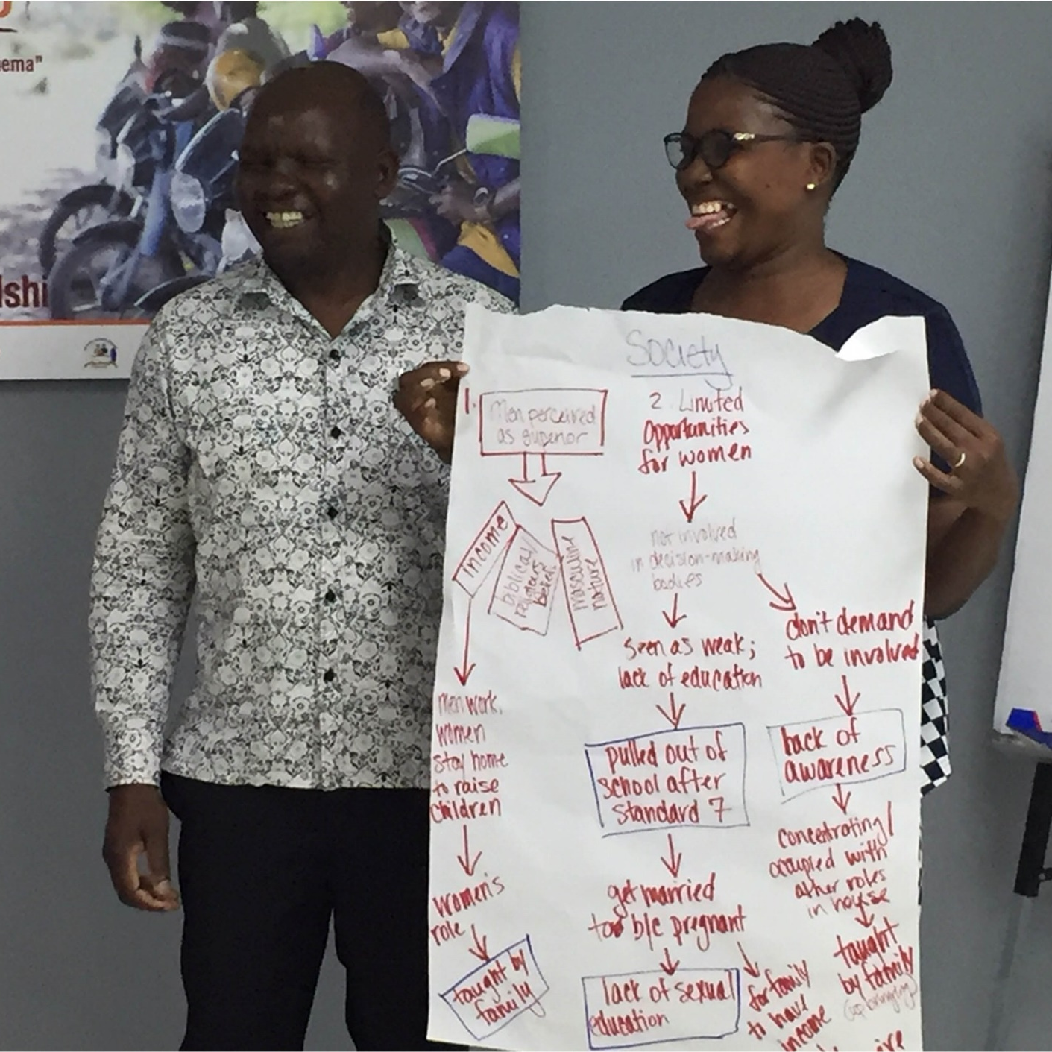
Five Whys
GROUP ACTIVITY
In your group, select one of the behaviors of interest from your program and ask, “why does this happen?”
For each explanation that emerges, ask “why?” again four times, diving deeper into each explanation given (you’ll do this for each “why?” you listed).
Examine the factors that emerged and circle any that are norms-focused.
Once selected, discuss each of the circled norms-focused factors. Why do these happen? Are there sanctions or rewards for complying?
Photo credit: Institute for Reproductive Health
Notes:
OPTION 1, ACTIVITY 2
NOTES TO FACILITATOR: Read through this before allowing groups to break off. Provide groups with the corresponding handouts with these instructions for their use. These instructions are for the groups that chose to do the five whys activity.
SPEAKER NOTES: The five whys help identify reasons (or root causes) of a behavior and prioritize the most important reasons. For the five whys, you’ll use the identified behavior of interest and use probing and digging techniques to focus in on why the behavior happens to uncover underlying factors. For each explanation that emerges, ask "why?” four more times, diving deeper into each explanation given (you’ll do this for each “why?” you first listed). Examine the factors that emerged and circle any that are norms-focused. Once selected, discuss of each of the circled norms-focused factors. Why do these happen? Are there positive or negative sanctions for complying or not complying?
REFERENCES:
Passages Project and Learning Collaborative to Advance Normative Change, Social Norms Exploration Tool (Washington, DC: Institute for Reproductive Health, Georgetown University, 2020).

Slide 45
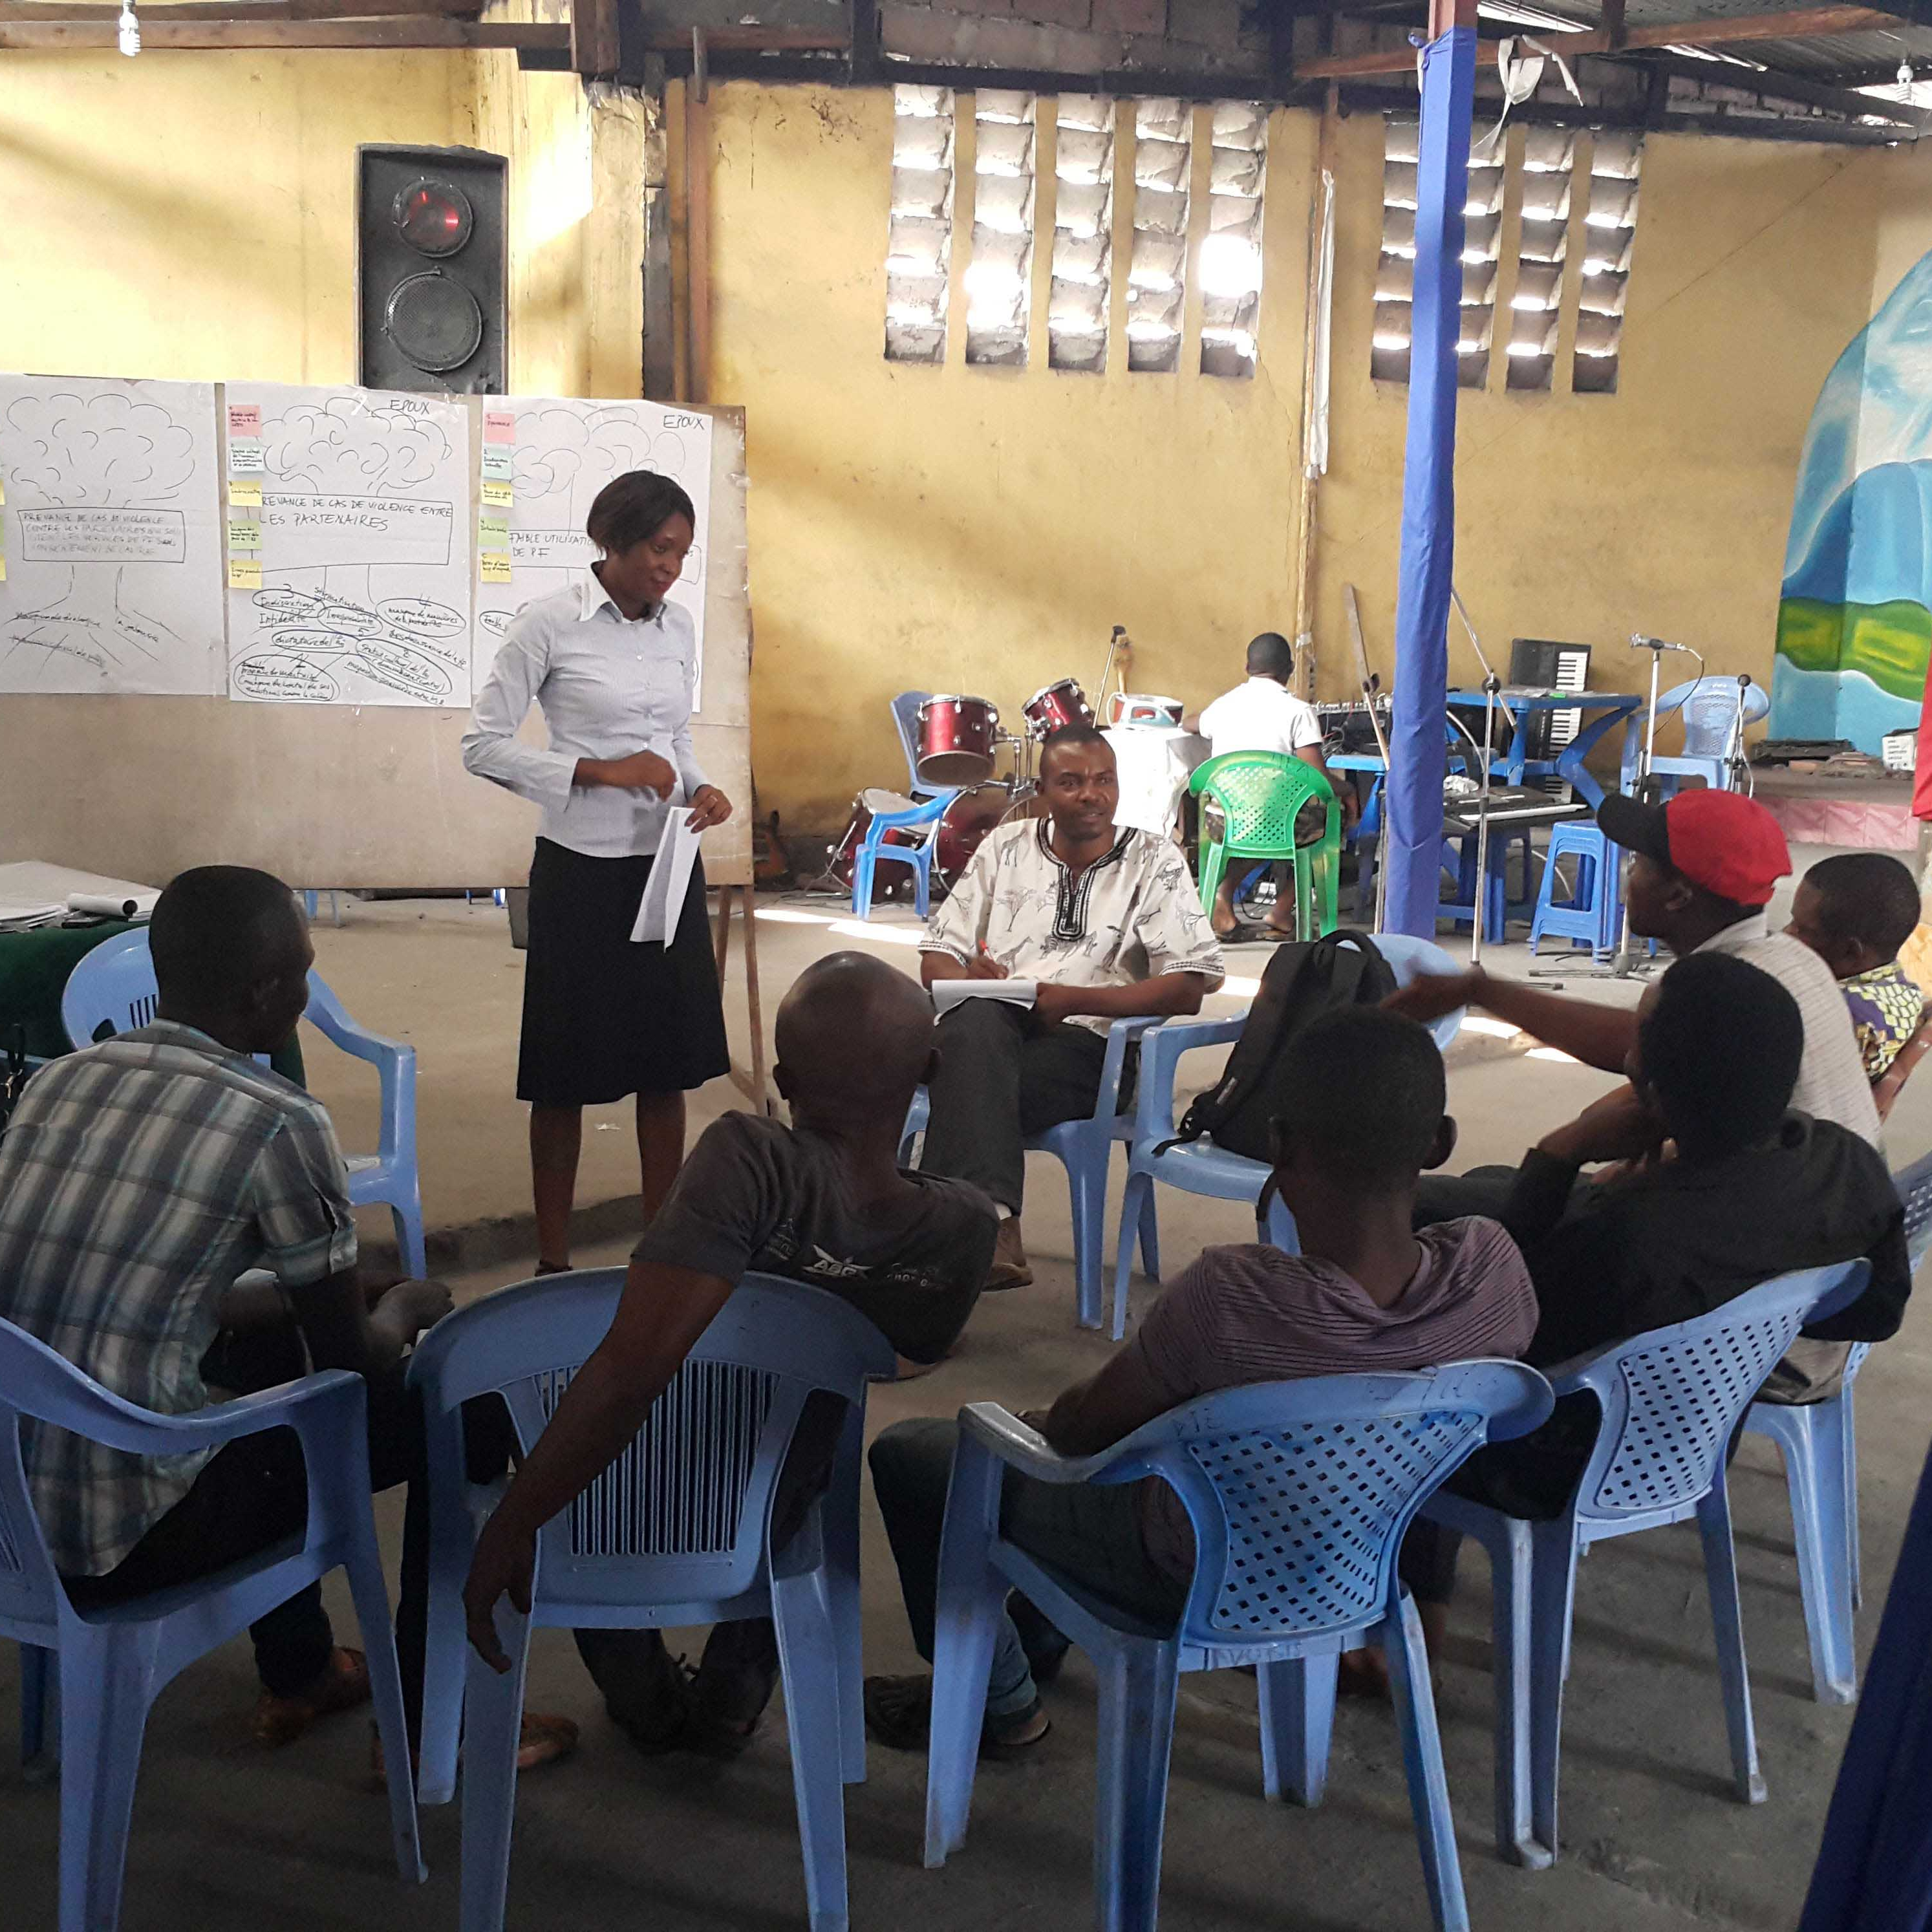
Vignettes
GROUP ACTIVITY
Using the case study, develop a vignette (short story) for group discussions that is focused on one behavior that you think would be contextually relevant.
Your vignette should be a story and have the following elements:
  An introduction to the context; be specific but simple.
  A situation about the behavior/absence of a behavior.
  A situation where a social norm is challenged or broken (and sanctions).
  Reference groups.
  Open-ended questions to engage with the story about norms.
Photo credit: Institute for Reproductive Health
Notes:
OPTION 1, ACTIVITY 3
NOTES TO FACILITATOR: Read through this before allowing groups to break off. Provide groups with the corresponding handouts with these instructions for their use. These instructions are for the groups who chose to do the vignettes activity.
SPEAKER NOTES: Vignettes are fictional stories that help explore the social norms that influence the behavior(s) of interest and understand the extent that norms and sanctions are influencing behaviors. You’ll develop a vignette (short story) for group discussions that is focused on one behavior that you think would be contextually relevant. Your vignette should be a story and have the following elements:
An introduction to the context; be specific but simple, present a situation about the behavior or absence of a behavior.
A situation where a social norm is challenged or broken (and sanctions).
Reference groups.
Open-ended questions to engage with the story about norms.
REFERENCES:
Passages Project and Learning Collaborative to Advance Normative Change, Social Norms Exploration Tool (Washington, DC: Institute for Reproductive Health, Georgetown University, 2020).

Slide 46
Report Out
Norms Assessment
PLENARY DISCUSSION
Describe your activity to the other groups (problem tree, five whys, or vignette).
Did your assessment answer the four critical social norms exploration questions?
What reference groups were identified?
What social norms emerged?
What other factors emerged?
In general, was this easy, medium, or hard to complete?
Photo credit: zeljkosantrac/Getty Images
Notes:
OPTION 1 REFLECTION
NOTES TO FACILITATOR: Bring the small groups back together and ask each group to present the results of their activity, following the five questions written on screen.

Slide 47
Final Reflection Questions…
PLENARY DISCUSSION
What surprised you about your work assessing norms? Any “aha” moments?
What do you see as different between these approaches and other formative assessments you may have done or be doing?
How might you integrate these approaches or norms-focused questions in your formative assessments?
Photo credit: Jasmin Merdan/Getty Images
Notes:
OPTION 1 REFLECTION
NOTES TO FACILITATOR: These are final questions again to be asked in plenary (time permitting, if it’s an issue—use your judgment to decide). These are more general reflections questions to create a bridge between the activities and the closing section to come.
SPEAKER NOTES: To close our norms exploration, some I wanted to take time to reflect on some final questions…
What surprised you about your work assessing norms? Any “aha” moments?
What do you see as different between these approaches and other formative assessments you may have done or may be doing?
How might you integrate these approaches or norms-focused questions in your formative assessments?
REFERENCES: N/A

Slide 48
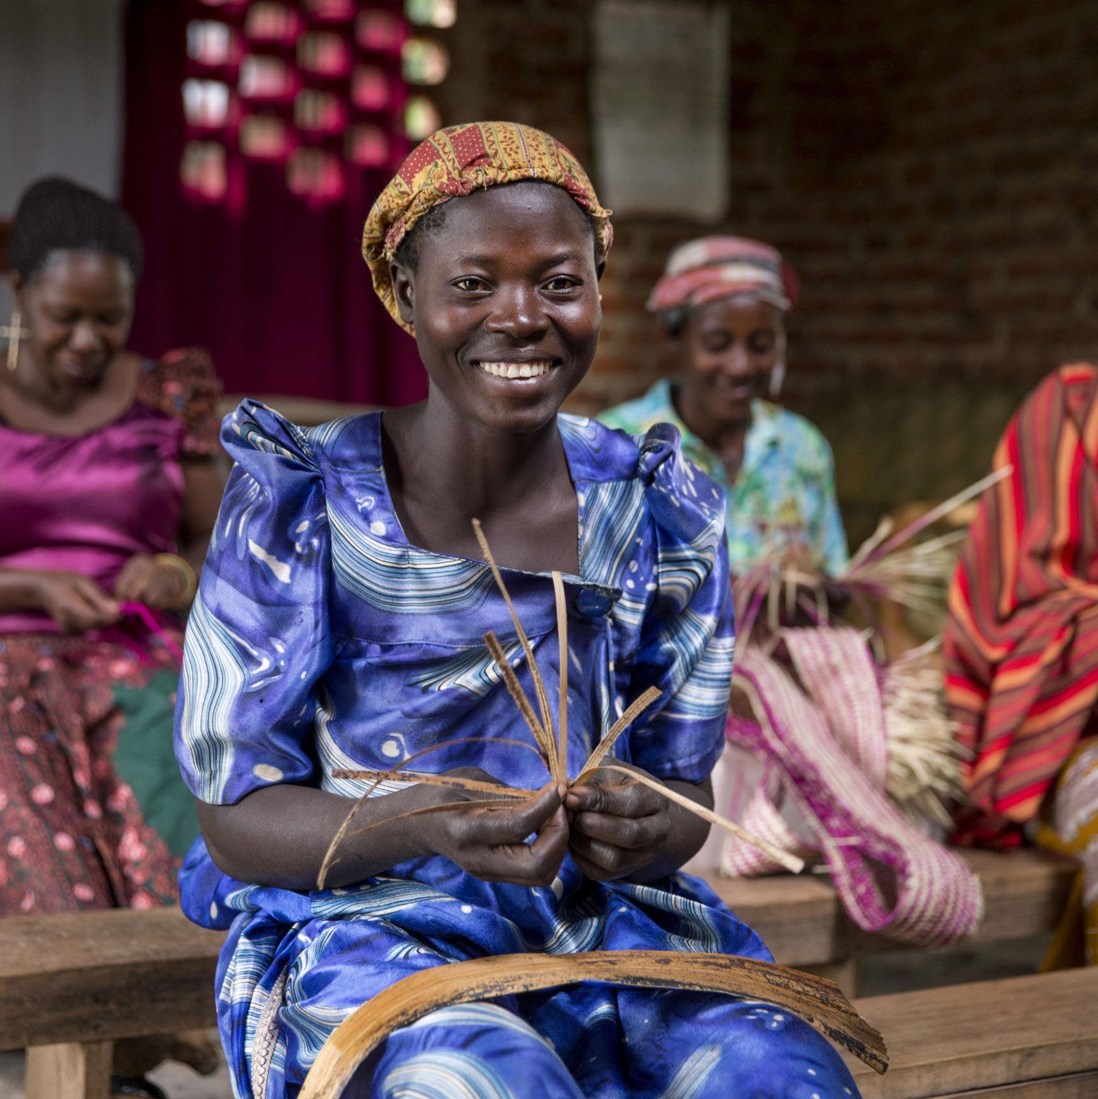
Using Your Program
GROUP ACTIVITY
Social Norms Assessment Using SNET
Photo credit: Jonathan Torgovnik/Getty Images/Images of Empowerment
Notes:
NOTES TO FACILITATOR: This is the introduction if you’ve chosen group work Option 2- using your program.
If relevant in advance of the training, you can organize such that you ask someone/a representative of the project you’ll be working with to provide 2-3 background/basic slides to present to get on the same page about the program before diving into the activity.
SPEAKER NOTES: Together, we’ll do activities within a social norms exploration to assess norms. We’ll be using your program as the context.
REFERENCES: N/A

Slide 49

Instructions
GROUP ACTIVITY
With your program in mind:
Select a behavior from your program.
Separate into groups.
Start with a short discussion to determine example reference groups for your behavior.
Each group will complete one exercise (problem tree, five whys, or vignette) and report back their results in plenary.
Photo credit: Jonathan Torgovnik/Getty Images/Images of Empowerment
Notes:
OPTION 2
NOTES TO FACILITATOR: This is only for group work option 2, the case study. For this slide, you’ll read through the notes below and allow for any questions or clarifications to the process from participants.
SPEAKER NOTES: The aim of this exercise is to use your program as the basis to assess norms. For the process, we will familiarize ourselves with the program setting and make sure we’re on the same page.
After together selecting a key behavior from the program, we will separate into groups and first have an open discussion around potential reference groups for the key population that is engaging in the behavior. Once that quick conversation is done, each group will decide to conduct the five whys, problem tree, or a problem tree activity. Once the activities are complete, the groups will come back together to share findings.
REFERENCES: N/A

Slide 50
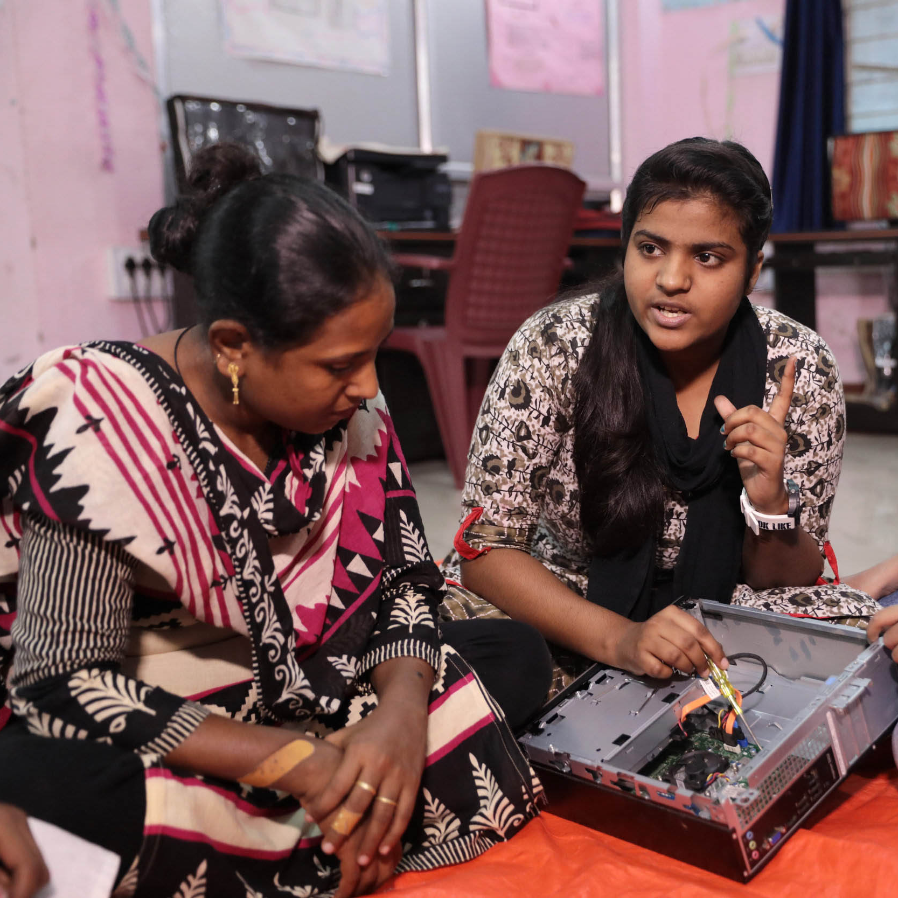
Questions to Consider for Your Report Out
GROUP ACTIVITY
Describe your activity to the other groups (problem tree, five whys, or vignette).
To what extent did your formative assessment answer the four critical social norms exploration questions?
What reference groups emerged?
What social norms emerged?
What other factors emerged?
In general, was this easy, medium, or hard to complete?
Photo credit: Paula Bronstein/Getty Images/Images of Empowerment
Notes:
OPTION 2
NOTES TO FACILITATOR: these questions should be asked across groups, once a report out is done. These form the basis of an open-ended discussion.
SPEAKER NOTES: Now we’re back together, and before some final closing questions, I wanted to pause for a cross-group report out…
Describe your activity to the other groups (problem tree, five whys, or vignette).
To what extent did your formative assessment answer the four critical social norms exploration questions? What was covered and what was not well covered or missed?
What social norms emerged?
What other factors emerged?
In general, was this easy, medium, or hard to complete?
REFERENCES: N/A

Slide 51
Problem Tree
GROUP ACTIVITY
In your group, select one of the behaviors of interest from your program.
Based on your selected behavior, draw a tree at the center of a flipchart. Under the tree (roots), list factors that may influence this behavior.
When done, label the factors by type: norms/social, individual, resources, or structural. Circle the norms factors.
Focus on just the social norms-related root causes (now circled) and dive a bit deeper.
Discuss the types of norms that may be at play for each circled cause and write them next to the circles.
What are the benefits to following the norm? What are the consequences of not following the norm? (These are positive or negative sanctions.)
Notes:
OPTION 2, ACTIVITY 1
NOTES TO FACILITATOR Read through this before allowing groups to break off. Provide groups with the corresponding handouts with these instructions for their use.
SPEAKER NOTES: Problem trees help identify the root causes, both social and non-social, and how they affect behavior(s) of interest.
In your group, select one of the behaviors of interest from your program. Based on your selected behavior, draw a tree at the center of a flipchart.
Under the tree (roots), list factors that may influence this behavior. When done, label the factors by type: norms/social, individual, resources, structural. Focus on just the social norms-related root causes (now circled) and dive a bit deeper.
Discuss the types of norms that may be at play for each circled cause and write them next to the circles. What are the consequences of following or not following the norm? (These are positive or negative sanctions.)
REFERENCES:
Passages Project and Learning Collaborative to Advance Normative Change, Social Norms Exploration Tool (Washington, DC: Institute for Reproductive Health, Georgetown University, 2020).

Slide 52
Five Whys
GROUP WORK OPTION TWO
In your group, select one of the behaviors of interest from your program and ask, “why does this happen?”
For each explanation that emerges, ask “why?” again four times, diving deeper into each explanation given (you’ll do this for each “why?” you first listed)
Examine the factors that emerged and circle any that are norms-focused.
Once selected, have a discussion of each of the circled norms-focused factors. Why do these happen? Are there sanctions or rewards for complying?
Photo credit: Institute for Reproductive Health
Notes:
OPTION 2, ACTIVITY 2
NOTES TO FACILITATOR: Read through this before allowing groups to break off. Provide groups with the corresponding handouts with these instructions for their use.
SPEAKER NOTES: The five whys help identify reasons (or root causes) of a behavior and prioritize the most important reasons. For the five whys, you’ll use the identified behavior of interest and use probing and digging techniques to focus in on why the behavior happens to uncover underlying factors. For each explanation that emerges, ask "why?” four more times, diving deeper into each explanation given (you’ll do this for each “why?” you first listed). Examine the factors that emerged and circle any that are norms-focused. Once selected, discuss of each of the circled norms-focused factors. Why do these happen? Are there positive or negative sanctions for complying or not complying?
REFERENCES:
Passages Project and Learning Collaborative to Advance Normative Change, Social Norms Exploration Tool (Washington, DC: Institute for Reproductive Health, Georgetown University, 2020).

Slide 53

Vignettes
GROUP WORK OPTION TWO
Using the case study, develop a vignette (short story) for group discussions focused on one behavior that you think would be contextually relevant.
Your vignette should be a story and have the following elements:
  An introduction to the context; be specific but simple.
  A situation about the behavior/absence of a behavior.
  A situation where a social norm is challenged or broken (and sanctions).
  Reference groups.
  Open-ended questions to engage with the story about norms.
Photo credit: Institute for Reproductive Health
Notes:
OPTION 2, ACTIVITY 3
NOTES TO FACILITATOR: Read through this before allowing groups to break off. Provide groups with the corresponding handouts with these instructions for their use.
SPEAKER NOTES: Vignettes are fictional stories that help explore the social norms that influence the behavior(s) of interest and understand the extent that norms and sanctions are influencing behaviors. You’ll develop a vignette (short story) for group discussions that is focused on one behavior that you think would be contextually relevant. Your vignette should be a story and have the following elements:
An introduction to the context; be specific but simple, present a situation about the behavior or absence of a behavior.
A situation where a social norm is challenged or broken (and sanctions).
Reference groups.
Open-ended questions to engage with the story about norms.
REFERENCES:
Passages Project and Learning Collaborative to Advance Normative Change, Social Norms Exploration Tool (Washington, DC: Institute for Reproductive Health, Georgetown University, 2020).

Slide 54
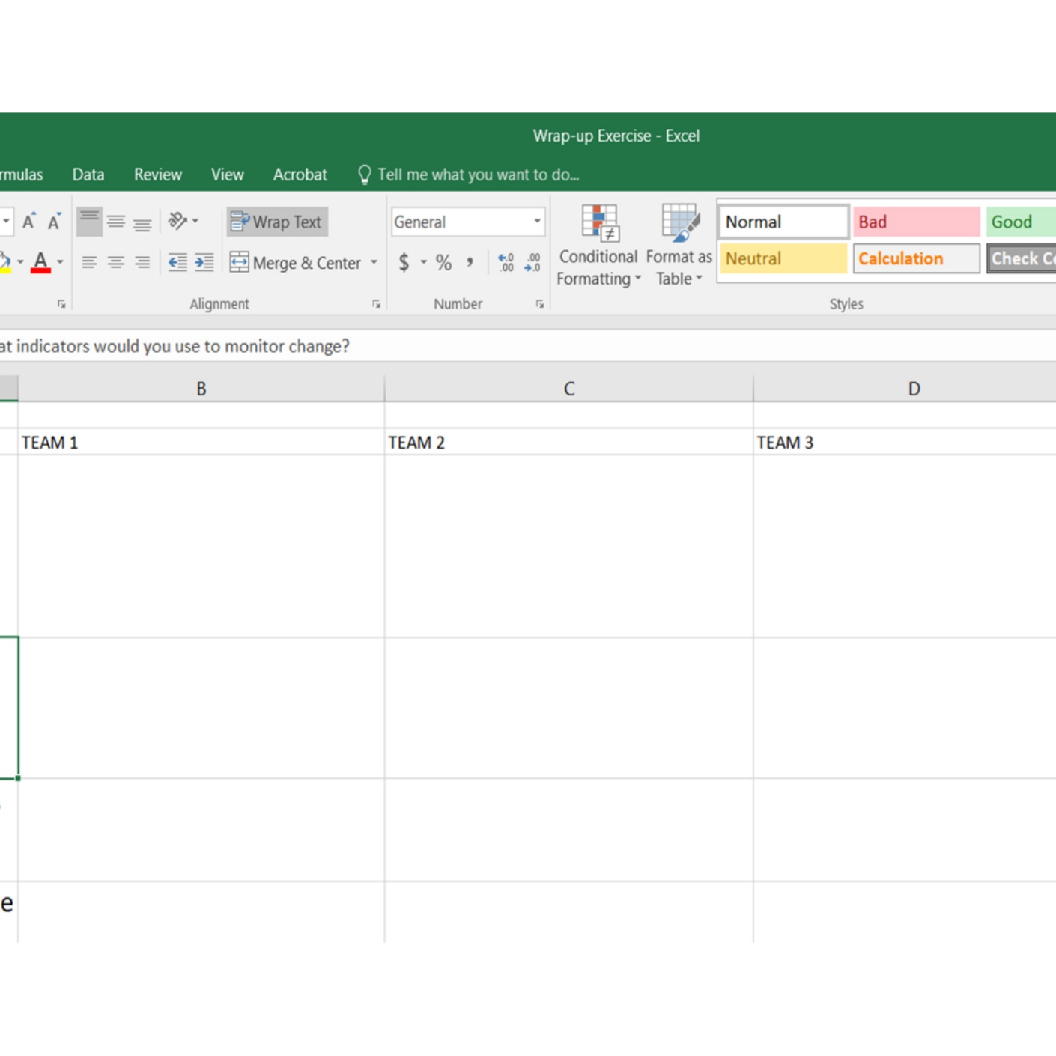
Report Out
Norms Assessment
PLENARY DISCUSSION
Describe your activity to the other groups (problem tree, five whys or vignette).
To what extent did your formative assessment answer the four critical social norms exploration questions?
What reference groups emerged?
What social norms emerged?
What other factors emerged?
In general, was this easy, medium, or hard to complete?
GOOGLE
SHEET
Notes:
OPTION 2
NOTES TO FACILITATOR: Bring the small groups back to the larger group and ask each group to present on the results of their activity, following the five questions written on screen.

Slide 55
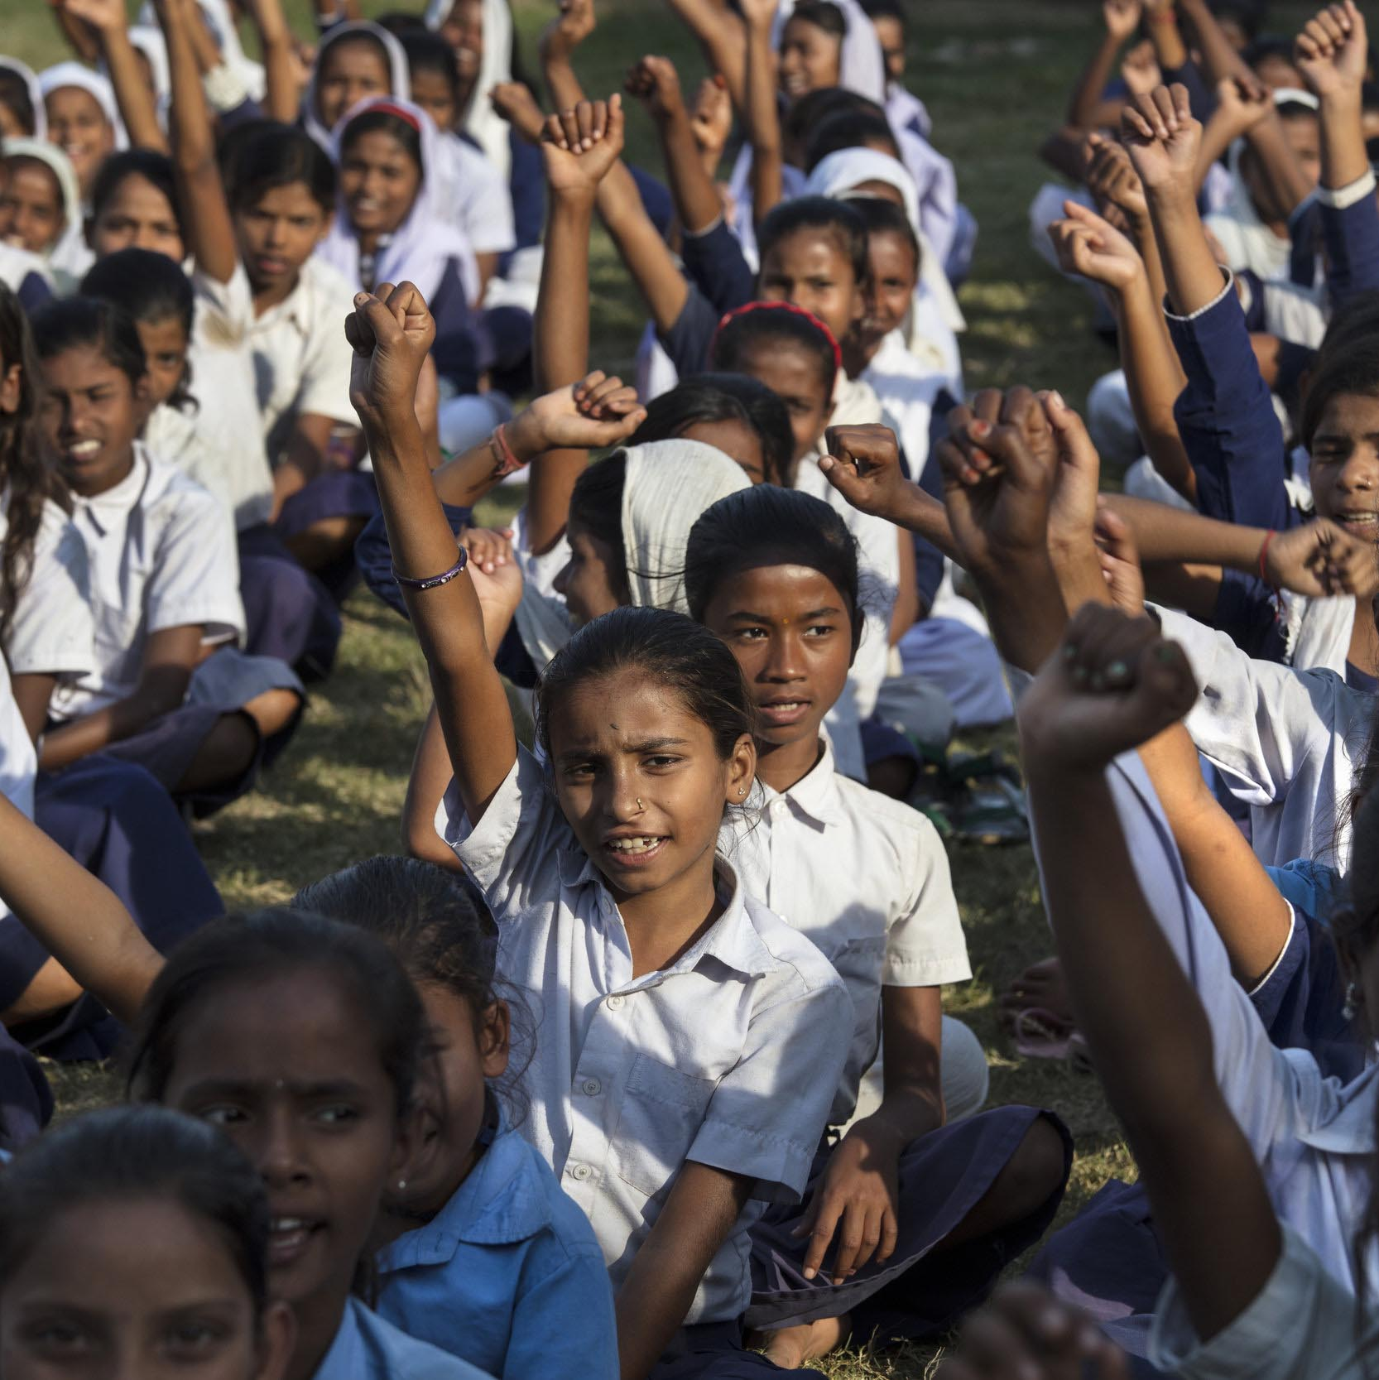
Final Reflection Questions…
PLENARY DISCUSSION
What surprised you about your work assessing norms? Any “aha” moments?
What do you see as different between these approaches and other formative assessments you may have done or may be doing?
How might you integrate these approaches or norms-focused questions in your formative assessments?
Photo credit: Paula Bronstein/Getty Images/Images of Empowerment
Notes:
OPTION 2
NOTES TO FACILITATOR: These are final questions again to be asked in plenary (time permitting, if it’s an issue—use your judgment to decide). These are more general reflections questions to create a bridge between the activities and the closing section to come.
SPEAKER NOTES: To close our norms exploration, I wanted to take time to reflect on some final questions:
What surprised you about your work assessing norms? Any “aha” moments?
What do you see as different between these approaches and other formative assessments you may have done or be doing?
How might you integrate these approaches or norms-focused questions in your formative assessments?
REFERENCES: N/A

Slide 56



What Happens Next in a Norms Assessment?
COMPILE
FOCUS
GENERATE
Compile your identified or generated information and review. If collecting primary data, you’ll want to identify similarities and differences across sites or groups of people.
Focus on the normative findings and factors. Unpack them to recognize types of norms or understand sanctions and rewards.
Generate a short list of findings (a short report) in your assessment to inform program action to come.
Notes:
NOTES TO FACILITATOR: This is the final slide in this section, before the closing section. This is meant to help close the group work out and act as a bridge to a few final summary slides about what is next. Before moving on to the final section, read through the points on this slide.
SPEAKER NOTES: Now that you’ve practiced some participatory activities from the SNET, we’re going to talk a little bit about what a program might do with them. Once they have findings in hand, programs need to make sense of the findings and take action. Regardless of the way in which you conducted an assessment (remember, these can be done at different time points and through different approaches), you’ll need to:
Compile your identified or generated information and review. If collecting primary data, you’ll want to identify similarities and differences across sites or groups of people.
Focus on the normative findings and factors. Unpack them to recognize types of norms or understand sanctions and rewards.
And generate a short list of findings (a short report) in your assessment to inform further program action to come.
REFERENCES: Passages Project and Learning Collaborative to Advance Normative Change, Social Norms Exploration Tool (Washington, DC: Institute for Reproductive Health, Georgetown University, 2020).

Slide 57
Using Assessment Findings to Take Action
SECTION 5
Applying Social Norms Assessment Findings for Design and Implementation
Notes:
NOTES TO FACILITATOR: Bring the group back together for the second-to-last section of this module—and a final plenary discussion of larger implications of these kinds of assessments.
SPEAKER NOTES: For this final section, I’m going to give a snapshot of how a program would take action using findings from their social norms assessments, before wrapping up with final reflections.
REFERENCES: N/A

Slide 58
What’s Next for Your Norms Assessment? Considerations Central to Adjusting Your Program
Consideration 1
Consideration 2
Consideration 3
Revisit your program objectives
Determine program adjustments that can be made based on the
norms assessment findings
Reflect on key findings gleaned from the norms assessment
Notes:
NOTES TO FACILITATOR: N/A
SPEAKER NOTES: Once you’ve conducted a norms assessment, you may ask, “what comes next?” As I summarized at the end of the group work, you’re conducting rapid analysis, compiling, reviewing, and finding out what the key information will be to inform your program.
In the SNET, we provide three central considerations to maintain focus:
It’s important to keep your initial objectives for the norms assessment in mind to be sure to use the findings.
Keep your key findings at the center of the actions to take.
And what might be feasible to achieve given objectives and findings?
REFERENCES:
Passages Project and Learning Collaborative to Advance Normative Change, Social Norms Exploration Tool (Washington, DC: Institute for Reproductive Health, Georgetown University, 2020).

Slide 59
Questions to Consider When Adjusting Your Program With Findings From a Norms Assessment
Program Design | Program Implementation | Program Monitoring | Program Evaluation
Does your program currently address the key factor (including social norms factors) that influence the behaviors of interest? If not: which factors (including social norms factors) are possible for your program to address? | Do intervention strategies or activities require adaptation to better address reference groups? Do intervention strategies or activities require adaptation to address social normative influences, including relevant reference groups, either to build on positive norms or address harmful norms? | Does the program’s logical framework need to be adjusted to include normative activities—inputs, outputs, effects? Is the monitoring system collecting the correct and relevant information on norms from 1) the primary program groups and 2) the relevant reference groups? | Do you need to make changes in your evaluation framework that mirror the change theory and strategy adjustments? Is the evaluation plan to collect correct and relevant information from not only the primary program groups, but also reference groups?
Notes:
NOTES TO FACILITATOR: Show this slide but focus on only the first row of considerations. You will first show the table, then read only the first question in each column. Read each one and then explain the other ones are focused on the different program consideration areas (design, monitoring, etc.). Explain that the full table is found in the SNET and is another tool to help programs reflect practically on the information gained from the exploration.
SPEAKER NOTES: Keeping the central considerations in mind, the SNET provides different ways to then guide a program to rapidly analyze and apply findings. This table is one such way. Another method is a matrix where findings can be applied by target groups and by program design. Depending on program needs, either path can be taken. Often, a helpful first step can be reflecting questions like these:
[Click] Does your program currently address the key factors (including social norms factors) that influence the behaviors of interest?
[Click] Do intervention strategies or activities require adaptation to better address reference groups?
[Click] Does the program logical framework need to be adjusted to include normative activities—inputs, outputs, effects?
[Click] Or do you need to make changes in your evaluation framework that mirror the change theory and strategy adjustments made in the other columns?
More questions for each can be found in the SNET.
REFERENCES:
Passages Project and Learning Collaborative to Advance Normative Change, Social Norms Exploration Tool (Washington, DC: Institute for Reproductive Health, Georgetown University, 2020).

Slide 60
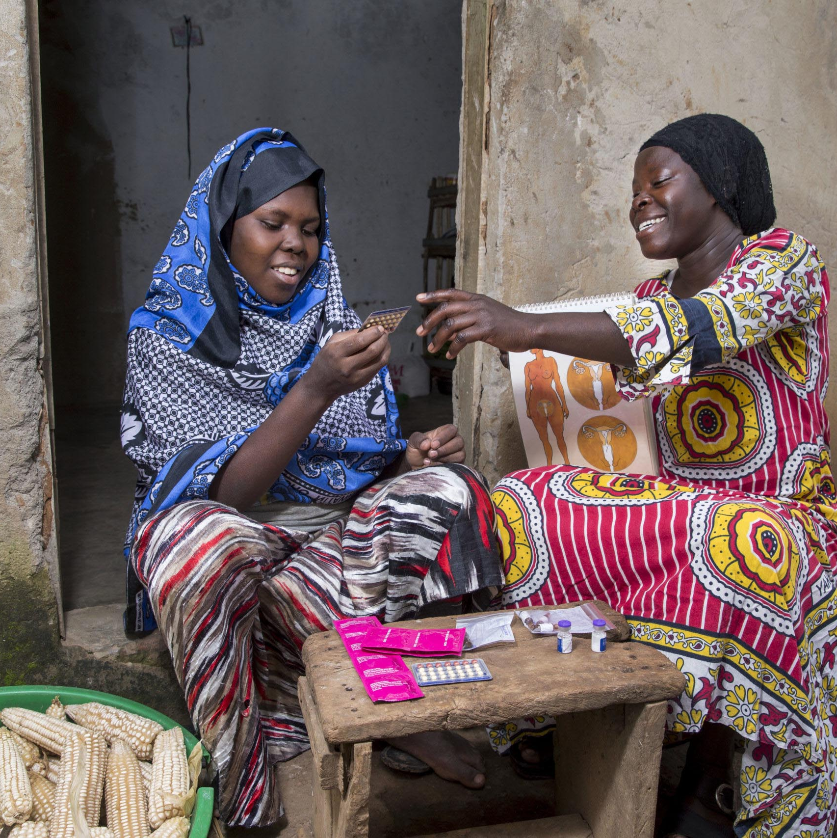
Norms Assessments Are Often Linked to Program Design, but Findings Can be Applied Throughout the Program Life Cycle
PLENARY DISCUSSION
What kinds of information are you already collecting in your program that you could leverage for norms-finding information?
How would such information be helpful to programmers and evaluators?
Could you integrate such questioning into evaluations you conduct and programs you design? How?
When could you use such analyses in the evaluation cycle?
How might you integrate learnings into existing theories of change, log frames, or work plans?
Photo credit: Jonathan Torgovnik/Getty Images/Images of Empowerment
Notes:
NOTES TO FACILITATOR: This is the final content-based slide. Next up are only reflections and then resources for further reading. When presenting this slide, consider the larger training curriculum and make linkages to the next session, on program design.
SPEAKER NOTES: To close, some final questions for you all. I’m interested in your insights into what kinds of adjustments might be made as a result of implementing this kind of a rapid assessment, or if you’re already doing this kind of work, how might you enrich it?
What kinds of information are you already collecting in your program that you could leverage for norms-finding information?
How would such information be helpful to programmers and evaluators?
Could you integrate such questioning into evaluations you conduct and programs you design? How?
When could you use such analyses in the evaluation cycle?
How might you integrate learnings into existing theories of change, log frames, or work plans?
REFERENCES: N/A

Slide 61
Key Takeaways
ASSESSING SOCIAL NORMS
Existing formative assessment approaches may overlook norms. If shifting norms is important to your program, completing a norms assessment is a must.
It’s important to understand how norms influence program behaviors.
Norms assessments answer, for as given context: (1) what the relevant norms are, (2) who the reference groups are, (3) why people comply with norms, and (4) which norms are the most important.
Not all norms assessments are perfect! It’s better to have some solid information than none at all. Do what you can but ensure findings are used.
A number of resources on norms assessments exist, including the Social Norms Exploration Tool.
Notes:
NOTES TO FACILITATOR: Read through the notes, allow any questions.
SPEAKER NOTES: In summary, we share several takeaways here:
Existing formative assessment approaches may overlook norms. If norms change is a goal, completing a norms assessment is a must.
It’s important to understand how norms influence program behaviors.
Norms assessments answer: (1) what norms are, (2) who the reference groups are, (3) why people comply with norms, and (4) which norms are the most important.
Not all norms assessments are perfect! It’s better to have some solid information than none at all. Do what you can but ensure findings are used.
A number of resources on norms assessments exist, including the Social Norms Exploration Tool.
REFERENCES: N/A

Slide 62
ASSESSING SOCIAL NORMS
Resources
Passages Project and Learning Collaborative to Advance Normative Change, Social Norms Exploration Tool (Washington, DC: Institute for Reproductive Health, Georgetown University, 2020).
Leigh Stefanik and Theresa Hwang, Applying Theory to Practice: CARE’s Journey Piloting Social Norms Measures for Gender Programming (Cooperative for Assistance and Relief Everywhere, Inc. (CARE), 2017).
Mackie, Gerry, Francesca Moneti, Holly Shakya, and Elaine Denny. What Are Social Norms? How Are They Measured? New York and San Diego: UNICEF and University of California San Diego, 2015.
Thomas, Sarah. What is Participatory Learning and Action (PLA): An Introduction. Sarah Thomas, 2002.
Cislaghi, Beniamino and Lori Heise. Measuring Gender-Related Social Norms, Learning Report 1. London: Learning Group on Social Norms and Gender-related Harmful Practices of the London School of Hygiene & Tropical Medicine, 2016.
Notes:
NOTES TO FACILITATOR: Read through the notes, allow any questions.
SPEAKER NOTES: Apart from the SNET, there is no other guided tool/toolkit available to explore and assess norms for programs. However, many project-specific resources are available online. As mentioned earlier in this module, CARE has many resources available. Further, there are reports from meetings and workshops on norms measurement, which often focus on identifying norms, what is needed to know, how to take action, or how other programs have done these things. And of course, I encourage you to review existing key resources before embarking on any of this work.
REFERENCES FOR THIS MODULE:
Passages Project and Learning Collaborative to Advance Normative Change, Social Norms Exploration Tool (Washington, DC: Institute for Reproductive Health, Georgetown University, 2020).
Leigh Stefanik and Theresa Hwang, Applying Theory to Practice: CARE’s Journey Piloting Social Norms Measures for Gender Programming (Cooperative for Assistance and Relief Everywhere, Inc. (CARE), 2017).
Desk review: Changing social norms: The development of a global M&E framework—Prepared for the social norms measurement meeting 15-16 December, 2016, UNICEF, New York.
Gerry Mackie et al., What Are Social Norms? How Are They Measured? (New York and San Diego: UNICEF and University of California San Diego).
Sarah Thomas, What is Participatory Learning and Action (PLA): An Introduction Sarah Thomas, http://idp-key-resources.org/documents/0000/d04267/000.pdf.
Ben Cislaghi and Lori Heise, Measuring Gender-Related Social Norms, Learning Report 1 (London: Learning Group on Social Norms and Gender-related Harmful Practices of the London School of Hygiene & Tropical Medicine, 2016).

Slide 63
Conclusion
Questions? Comments?
Add contact info here.

