Slide 1
Shifting Social Norms as Part of Social and Behavior Change
PRESENTER, ORGANIZATION
Notes:
NOTE TO FACILITATOR: Only use as starting slide if you are presenting all five modules or want to situate this module within the larger curriculum. If using this slide, make sure to reflect the presenter and organization name.

Slide 2
Overall Course Objectives
SHIFTING SOCIAL NORMS AS PART OF SOCIAL AND BEHAVIOR CHANGE
Discuss and explore advances in social norms programming, the relation of norms-shifting interventions to behavior change efforts, and the role of social norms in health and other sector programming.
Share design, implementation, and evaluation challenges and solutions for community-based social and behavior change (SBC) projects engaging in, expanding, or planning to expand normative change efforts.
Explore next steps to further collective learning about such promising interventions globally.
Notes:
NOTE TO FACILITATOR: These are the objectives for the social norms training that comprises several modules. Only use as starting slide if you are presenting all five modules or want to situate this module within the larger curriculum.
SPEAKER NOTE: Read slide content.

Slide 3
Shifting Social Norms as Part of SBC
1
2
3
4
5
INTRODUCTION | ASSESSMENT | DESIGN | MEASUREMENT | SCALE-UP
Why Social Norms Matter | Assessing Social Norms to Inform Program Design and Implementation Strategies | Designing Norms-Shifting Interventions | Measuring Normative Shifts in Complex Environments | Scaling Up Norms-Shifting Interventions Effectively and Ethically
Notes:
NOTE TO FACILITATOR:. Only use as starting slide if you are presenting all five modules or want to situate this module within the larger curriculum.
SPEAKER NOTES: This training is part of a 5-module course on norms-shifting interventions; as a note, when we say norms-shifting interventions, or NSIs, we mean those that may be standalone or may be activities integrated into a larger SBC intervention. The following modules cover the introduction, assessment, design, measurement, and scale-up of norms-shifting interventions.
Now, let’s get started on our introduction to social norms and why they matter for SBC efforts.

Slide 4
Welcome & Introductions
Notes:
NOTE TO FACILITATOR: Going around the room, ask participants to introduce themselves. Optional: Ask them to include one thing they hope to learn about social norms.

Slide 5


Why Social Norms Matter
MODULE ONE
A Conceptual Foundation for Norms-Shifting Interventions
NAME OF PRESENTER
ORGANIZATION
DATE
Notes:
FACILITOR NOTES: This is the title slide for this module. If you are not positioning this module within the larger curriculum, this slide should be #1.
Make sure to reflect the name of the training (i.e. the details of where and when the module is being used). For example, “Population Reference Bureau- Passages Training Febru.ary 2021”

Slide 6
Session I
Notes:
FACILITATOR NOTE: This slide is hidden and is only intended to be used if you chose to divide the training into two sessions if necessary.

Slide 7
Contents
1
Social norms and their relation to behavior.
Section
2
Why norms matter in social and behavior change efforts.
Section
3
Section
How social norms-shifting approaches fit into and bring additional value to social and behavior change programs.
4
Theories of how norms influence behaviors.
Section
5
Developing and using program theories of change.
Section
Notes:
FACILITOR NOTES: This is the title slide for this module. If you are not positioning this module within the larger curriculum, this slide should be #2. This slide presents the road map for this section of the training.
SPEAKER NOTES: This section sets the conceptual foundation for social norms, discusses how norms influence attitudes and behaviors, and establishes how norms are held in place by reference groups.
During this presentation, we’ll talk about norms-shifting interventions, which we’re defining based on Learning Collaborative work as “an intervention that seeks to improve an outcome or outcomes of interest, at least in part by transforming the social norms that prop up harmful related behaviors.” Such interventions utilize an analysis of social norms and are led by communities through a process of critical reflection, resulting in positive new norms rooted within the values of that group. Norms-shifting interventions complement other strategies to change behavior, such as transforming individual attitudes and addressing structural and material conditions.”
Looking toward norms-shifting interventions, the section offers an overview of theories on how norms influence behavior change. It also reviews the importance of articulating intermediate normative change effects to guide design, monitoring, and evaluation of norms-shifting interventions.

Slide 8
Learning Objectives
WHY SOCIAL NORMS MATTER
During this session, participants will:
Define social norms and distinguish norms from attitudes/beliefs and behaviors.
Identify the importance of normative influence between and within different layers of the socio-ecological framework for health and well-being.
Explain in practical terms how social norms influence health and other behaviors.
Understand how research-informed and program-defined program theories of change situate normative influence on behavior and are important tools for designing and evaluating norms-shifting interventions.
Notes:
NOTE TO FACILITATOR: After you’ve read through the notes for this slide when presenting, stop, and allow time for questions or clarifications from the group.
SPEAKER NOTES: This presentation will:
- Distinguish norms from attitudes/beliefs and behaviors.
- Identify the importance of normative influence between and within different layers of the socio-ecological framework for health and well-being.
- Explain in practical terms how social norms influence health behaviors.
- Understand how research-informed and program-defined program theories of change situate normative influence on behavior and are important tools for designing and evaluating NSI.

Slide 9


Social Norms in Real Time!
GROUP ACTIVITY
What just happened?
When did you notice this was happening?
What did you feel?
When and how did you learn this norm?
Where and how do you think this norm originated?
Photo credit: Jonathan Torgovnik/Getty Images/Images of Empowerment
Notes:
IN-PERSON ONLY SLIDE
NOTE TO FACILITATOR: This is an animated slide. Display the title first, then share slide questions to unpack the activity. This activity is intended as a discussion-starter to get people in the norms space and become more aware of how we are all influenced by norms. There are several options for this activity:
OPTION 1: The trainer can break a minor social norm before beginning the class, then ask students what they felt and noticed.
For example, you might wear something that isn’t the standard teacher or facilitator attire, or make a point of standing closer to others than you would otherwise, or put your feet up on your desk, hum loudly, etc.
After a few minutes of norm-breaking, ask the class about their reactions. What did they think about the trainer’s behavior? How did they feel when they saw the trainer acting outside of a normative boundary? What specific rule were he/she breaking? When and how did participants learn about that rule? How might it have originated, that is, what is the logic behind the rule?
OPTION 2: The trainer works with another facilitator or a participant to set up a norms-breaking scene. The facilitators start the session and then a second person takes a phone call, or pretends to be on one, and speaks really loudly for a few minutes so it disrupts the class. If it's a co facilitator or organizer of the event, then people may hesitate to reprimand them.
OPTION 3: [If using this option, change Activity Name/Bullet Points on Screen] Have people talk in pairs about a norm that they adhere to each day, make it personal, tie content to reality. Example below about breakfast is from an Advancing Nutrition workshop. At their tables, participants were asked to discuss a set of questions shown on a slide:
Breakfast time!
When you were six years old, what did you and your friends eat for breakfast?
How did your family make this decision?
If your family had decided to feed you something else, what would other people have thought or said?
What do you eat for breakfast now?
How do you make this decision?
If you decided to eat something else, what would other people think or say?
SPEAKER NOTES: This activity is intended as a discussion-starter to get people in the norms space and become more aware of how we are all influenced by norms. How has this changed over time?
[To close:] Are you convinced how norms influence you in different ways—your attitudes, beliefs, and actions/behaviors? Let’s move forward then.

Slide 10
Social Norms and Their Relation to Behavior
SECTION 1

Slide 11

Social Norms
PLENARY DISCUSSION
Unwritten rules about what is a “correct” behavior or way of acting within in a group.
Photo credit: Getty Images/hadynyah
Notes:
IN PERSON SLIDE
NOTES TO FACILITATOR: This is an animated slide for an exercise that is completed in plenary. The lack of title on the slide is intentional to avoid detracting from the exploration of the idea based on participants knowledge.
The aim of the exercise is to develop an initial definition of social norms.
Exercise process: First show the photo of women water carriers walking together and a lone boy water carrier walking apart. Then ask participants for their reposes to the following questions:
What do you see in this photo? What does this photo tell you about social norms?
If not discussed, bring in these ideas:
Women and girls are often water carriers but not boys. Why?
How do you think women see this young boy? What do they say about him?
Why is the young boy not walking with the women’s group? What is he thinking and feeling?
When he started carrying water, was he teased by women or men or other children? Why?)
To close, move the animation to share the definition of social norms and ask: Knowing this definition, what else can you say about the social norms being exhibited in this photo?
Exercise adaptation:
Alternatively, use a different photo that is characteristic of what participants may see in their typical home settings. The photo should allow discussion of norms that most people follow, by whom and why norms get broken, sanctions for not adhering, and (if it comes up) how it is not only norms that influence behavior but also economic conditions etc.

Slide 12
Social norms are the often implicit, informal rules that most people accept and abide by. They are influenced by belief systems, perceptions of what others expect and do, and sometimes by perceived rewards and sanctions.
Norms are embedded in formal and informal institutions and produced and reproduced through social interaction.
- ALIGN, Overseas Development Institute
Social
Norms
Notes:
NOTE TO FACILITATOR: This slide is animated.
SPEAKER NOTES: This is a more formal definition of social norms. It’s of note that norms can be embedded in formal institutions by codification into law, as well as institutional policies.
Sanctions are the consequences, negative or positive, of not adhering (or adhering) to a norm.
Animation 1: Refer back to the earlier exercise/slide reflection as an example. (Often not consciously done, norms are tacit
rules of behavior)
Animation 2: What does it mean that norms are embedded in institutions?
Some examples:
School policies towards unmarried girls who become pregnant, give birth, and then not allowed to return to finish studies. While boys who get the girl pregnant are not penalized in terms of finishing studies. What norms are operating here? Which are institutionalized?
Some healthcare settings require spouse permission for contraceptive services. What norms may be operating here? How have they been institutionalized?)

Slide 13
What people in a group believe is typical (what others do) and appropriate (what others expect me to do) behavior.
Social norms are different from individual attitudes or beliefs—not what I believe, rather what I think that others believe.
Social
Norms
Are…
Notes:
SPEAKER NOTES: Here is another way to think about social norms.
[Read two sentences on slide]

Slide 14
A type of social norm.
The expectations and perceived rules for how one should behave based on one’s biological sex and social perceptions of gender.
Gender Norms
Are…
Notes:
FACILITATOR NOTES: Read slide.

Slide 15

A group of people whose behavior and beliefs shape one’s own behaviors and beliefs.
Those who pass on and enforce social norms.
Reference
Groups
Are…
PARTNER
CELEBRITY
HEALTH OFFICIAL
RELIGIOUS LEADER
FAMILY ELDER
Notes:
SPEAKER NOTES: Having defined social norms, we will turn to enforcement of norms. Social norms are passed on and enforced by reference groups. A reference group is a group of people, a community—from a village to a broad religious community—for which these behaviors are relevant. Some define the reference group as a valued social group.
The important thing is that reference groups can exert a considerable amount of influence on behavior. We might not be particularly influenced by behavior of individuals that we do not interact with or whose approval we do not value.
These are individuals who:
A social group listens to.
Give information and advice.
Influence attitudes, behaviors, and decisions of a specific group
Can sanction or reward behavior.

Slide 16






Norms About…
OUTCOMES
Wash
Health
Education
Healthy timing and spacing of pregnancy
Livelihoods
Nutrition
INTERMEDIATE EFFECTS
Access
Social and economic capital
Reproductive intentions
Women’s participation in community decisionmaking
Couple communication and decisionmaking
Women’s
agency
NORMS
Girls’
education
Family
formation
Gender-based
violence
Masculine ideologies (authority, virility, son preference, paternity)
Feminine ideologies
(purity, chastity,
obedience, humility)
Power hierarchies related to social group
Notes:
SPEAKER NOTES: This slide shows in a more linear form how norms influence behaviors, actually how the same norms may influence a range of behavioral outcomes. While these norms have been broken out into different domains, many of
these may be linked—for example, norms of masculine ideology may be linked to norms that support gender-based violence.
Explanation:
- The outcomes show at the right reflect common sectors in global health projects, each with their behavior change goals.
- To obtain these outcomes are a range of intermediate effects (read them). These operate at different levels—individual, couple and household, and community level.
- Influencing the achievement of these intermediate effects and outcomes, are norms about many acceptable and correct ways of behaving. Like intermediate effects, norms operate at all levels.
Example - Thinking about education projects:
- Masculine and feminine ideologies – such as how a man should act as head of the family and community perspectives on girls and their future roles will influence whether girls go to school and whether they will finish school, or instead marry by age 15 and start a family. When we say that norms can influence many outcomes. The same norms operating around the acceptability of girls going to school will also affect future livelihoods and health.

Slide 17

What Is the Difference Between a Norm and an Attitude or Belief?
PLENARY DISCUSSION
Attitudes and beliefs are personal; they are individual and internally motivated.
Social norms are social or interdependent; they are collective and extrinsically motivated.
Attitudes and beliefs can conflict with social norms (but not always).
Photo credit: Juan Arredondo/Getty Images/Images of Empowerment
Notes:
IN PERSON SLIDE
NOTE TO FACILTATOR: Read the title question and ask the group to share their ideas to answer, then show the bullet points and finally show the example on the next slide.
SPEAKER NOTES: While their motivations differ, norms, attitudes, and beliefs all impact behavior. Our definitions of attitudes and beliefs come from the Passages Social Norms Lexicon and Learning Collaborative work.
Individual attitudes are personal evaluations about how the world should be. Although individually held, attitudes are not formed in isolation; they are influenced by social context and experience. A belief is an opinion, assumption, or conviction that a person holds to be true. Beliefs are internal perspectives formed from personal experiences and preferences, influence of social norms, and learning from others.

Slide 18
DEFINITION
Social norm
What a person perceives other people in his/her social reference group do, approve of, and expect others to do.
Behavior
What a person does (an action) and how often they do it.
Attitude/
belief
Attitude: A positive, negative, or neutral opinion that an individual has.
Belief: An internal feeling that something is true, whether the belief is proven or unproven.
Notes:
NOTE TO FACILITATOR: Acknowledge that we’ve already defined social norms but for the purposes of clarification have left it on the screen.
SPEAKER NOTES: [Read Behavior and Attitude/Belief definitions]

Slide 19
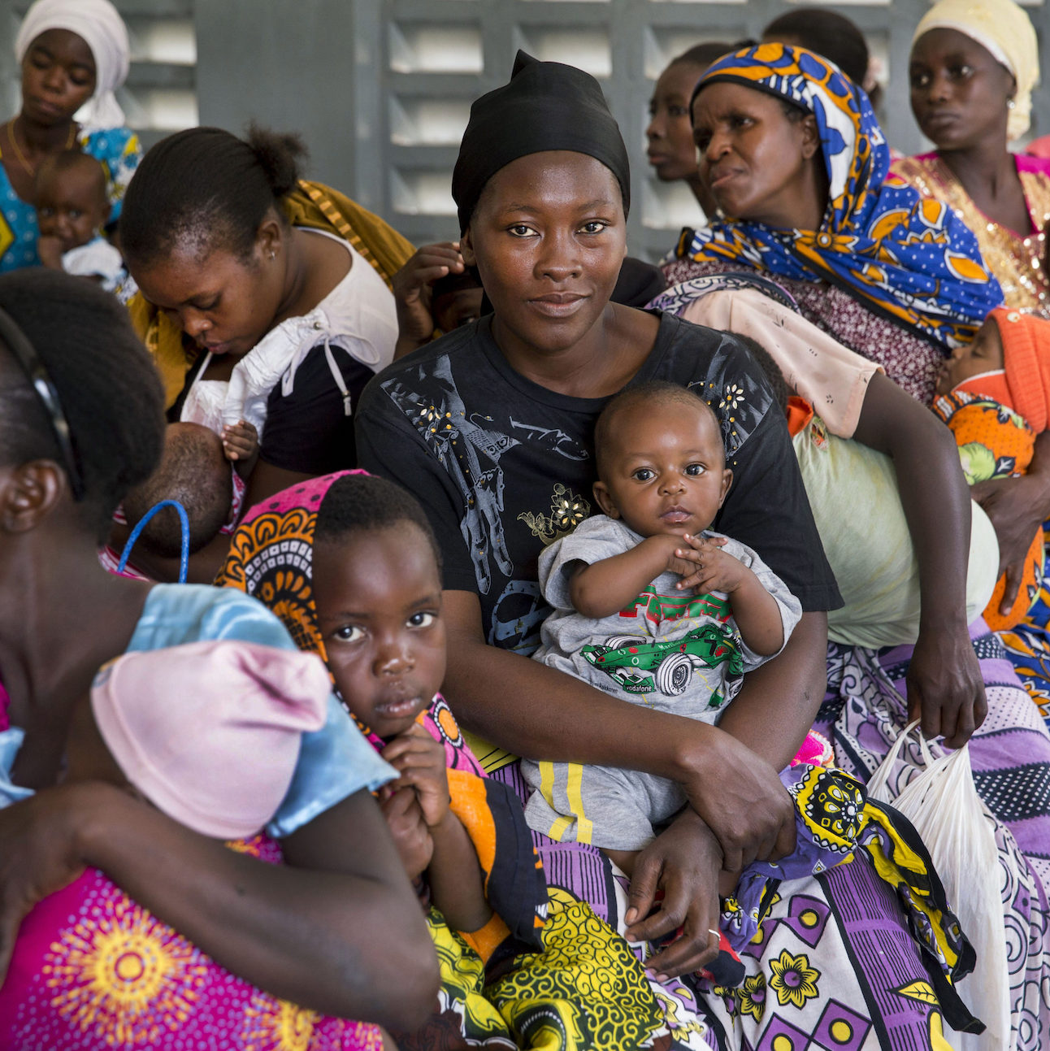
What Is the Difference Between a Norm and an Attitude or Belief?
A young married woman may believe it is better to plan to become pregnant after she finishes her education and is better equipped to provide for her child. But she does not use any birth control because her in-laws expect her to have a child.
Photo credit: Jonathan Torgovnik/Getty Images/Images of Empowerment
Notes:
NOTE TO FACILITATOR: Share this example.
SPEAKER NOTES: Now that we’ve talked about the differences between a norm and an attitude or belief, let’s look at a concrete example. [READ SLIDE CONTENT.]

Slide 20

Are These Norms or Attitudes/Beliefs?
PLENARY ACTIVITY
My mother and mother-in-law want me to have many children, so I do.
Not becoming pregnant until your last baby walks ensures a well-planned family, so I sleep separately from my husband until our last child is big enough to walk.
I use an implant to space births because my best friends space their births this way.
Women who practice family planning are smart, so I practice family planning.
If a woman has relations during her period, she cannot become pregnant, so I use this method to prevent pregnancy.
Photo credit: Jonathan Torgovnik/Getty Images/Images of Empowerment
Notes:
IN-PERSON ONLY SLIDE
NOTE TO FACILITATOR: The aim here is discerning differences.
SPEAKER NOTES: Process for this exercise:
Say that it is quiz time! Each statement is animated. [Answers below. N=Norm; A/B= Attitude/Belief]
- My mother and mother-in-law want me to have many children, so I do. (N)
- Not becoming pregnant until your last baby walks ensures a well-planned family, so I sleep separately from my husband until our last child is big enough to walk. (A/B)
- I use an implant to space births because my best friends space their births this way. (N)
- Women who practice family planning are smart, so I practice family planning. (A/B)
- If a woman has relations during her period, she cannot become pregnant, so I use this method to prevent pregnancy.(A/B)
If there’s time, add this complementary exercise:
Ask people to rework the statements, turning statements showing attitudes into statements showing norms and vice versa.
Closing: To close the activity say that there is very often confusion about the differences between norms and
attitudes/beliefs. It is important to recognize the difference because how you treat attitudes programmatically may be
different than how you treat norms programmatically. We’ll be coming back often to this distinction.

Slide 21


Types of Social Norms
DESCRIPTIVE NORMS
INJUNCTIVE NORMS
Perceptions of what others do.
Perceptions of what others expect me to do.
Photo credit: Getty Images/AfricaImages
Notes:
SPEAKER NOTES: There are two types of social norms we focus on during this course. Here’s a nice example of the two types of norms in action around the norm of always washing your hands before eating.
Ask participants:
- What do you see in each image? (What others do is a descriptive norm, represented in this case by children seeing others washing hands. What is considered appropriate behavior is an injunctive norm, in this case being told by your teacher or parent to leave the table and wash hands before rejoining.
- Think of yourself as a child. How did descriptive and injunctive norms about handwashing before eating influence your behavior?

Slide 22
Social Norms Influence Behavior if a Person Says They Do or Do Not Do Something for the Following Reasons:
DESCRIPTIVE NORMS
INJUNCTIVE NORMS
Because other people do it. A person does something because they believe many other people in their social group also do it.
Because other people expect me to do it. A person does something because other people in their social group expect them to or because they fear being sanctioned if they don’t.
“Most people in my community don’t wash their hands after coughing or sneezing.”
“If I don’t wash my hands before preparing food, my mother-in-law will criticize me.”
Notes:
NOTE TO FACILITATOR: Read the slide content. Ask participants if they have an example of a descriptive and an injunctive norm.

Slide 23
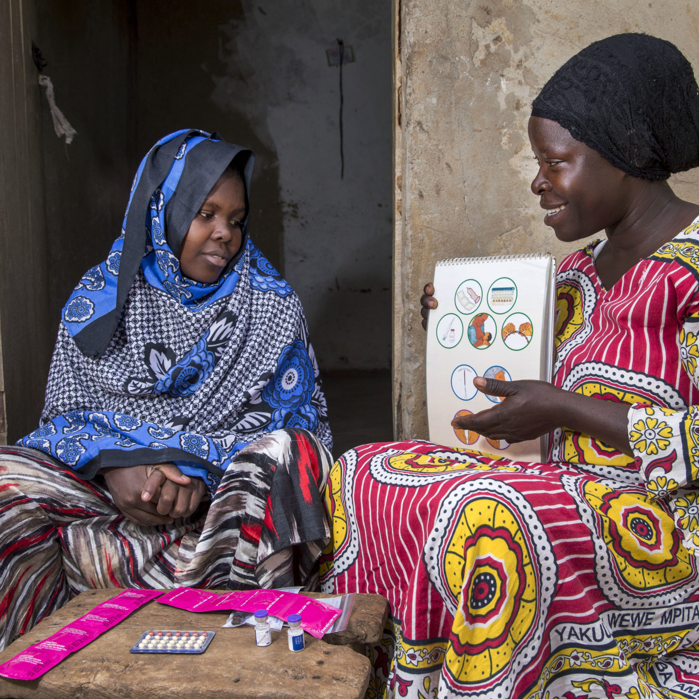
Descriptive or Injunctive Norm?
PLENARY ACTIVITY
A husband that does not beat his wife will be thought of as less manly.
Most husbands beat their wives in this community.
I don’t think it is right for a man to beat his wife.
Photo credit: Jonathan Torgovnik/Getty Images/Images of Empowerment
Notes:
IN PERSON ONLY SLIDE
NOTES TO FACILITATOR: Depending on the field of work of the participants, use this slide, which is focused on GVB, or the following slide, which is focused on FP use. This slide is animated, with one statement appearing at a time.
Answers
1-Is an Injunctive Norm: “A husband that does not beat his wife will be thought of as less manly.”
2-Is a Descriptive Norm: “Most husbands beat their wives in this community.”
3-Is an Attitude or Belief: “I don’t believe it is right for a man to beat his wife.” (Trick question ☺ )

Slide 24
Descriptive or Injunctive Norm?
PLENARY ACTIVITY
A husband who allows his wife to use family planning will be thought of as less manly.
Most men and their wives use traditional family planning methods in this community.
I don't believe that traditional methods work to space births.
Photo credit: Jonathan Torgovnik/Getty Images/Images of Empowerment
Notes:
IN PERSON ONLY SLIDE
NOTE TO FACILITATOR: This slide is animated, with one statement showing at a time.
Answers
1- Injunctive. A husband who allows his wife to use FP will be thought of as less manly.
2- Descriptive. Most men and their wives use traditional family planning methods in this community.
3. Trick question- it’s actually an attitude/belief. I don't believe that traditional methods work to space births.

Slide 25
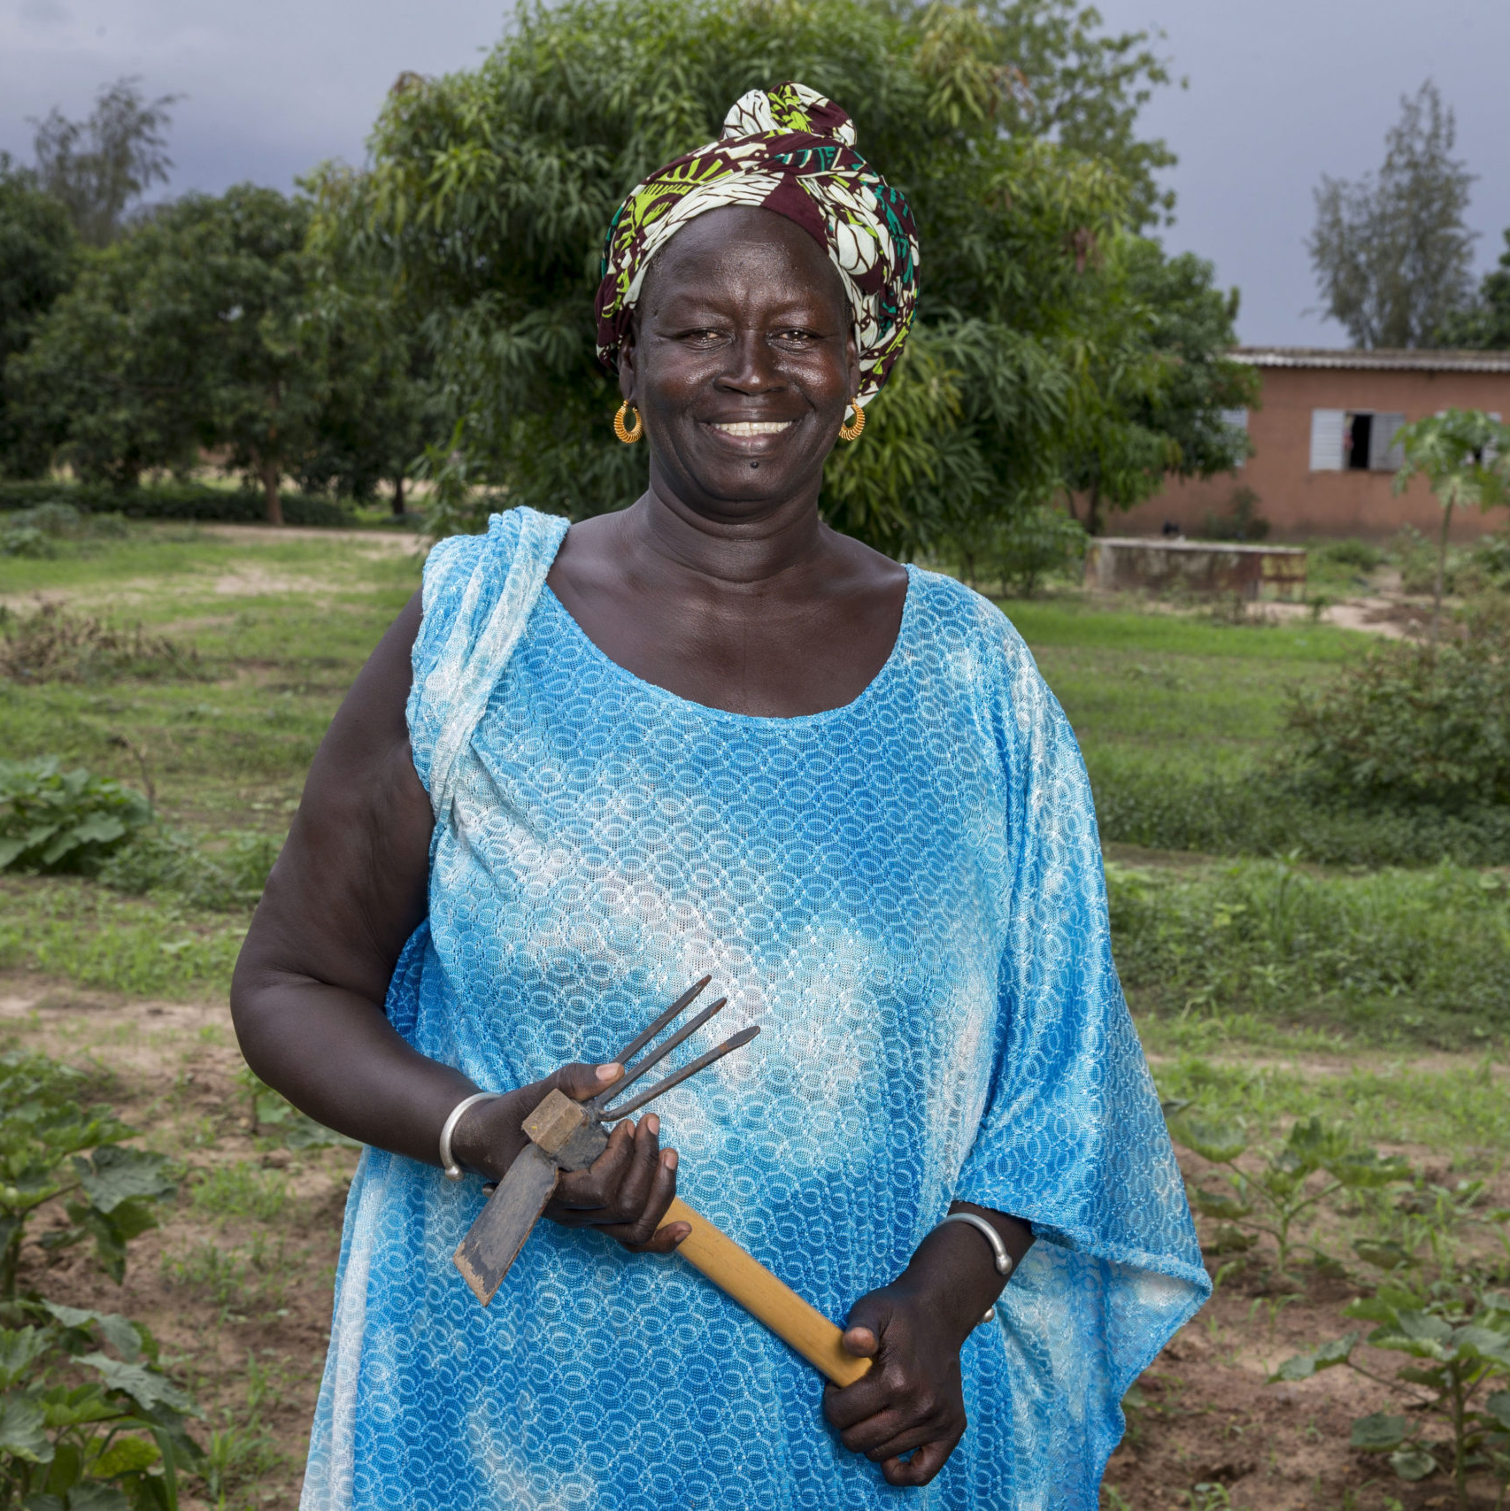
Reference Groups
PLENARY ACTIVITY
Who were the people you turned to for advice and information on the behavior?
Who were the people who most influenced your beliefs/attitudes or behaviors?
How might or did these people react if you took or did not take their advice?
How might these people react if you changed your behavior?
Photo credit: Jonathan Torgovnik/Getty Images/Images of Empowerment
Notes:
IN PERSON ONLY SLIDE
NOTES TO FACILITATOR: This is an individual exercise for participants to practice their knowledge/understanding of reference groups.
Ask each participant to think of a problematic behavior that they wanted to change in the past (or they could think of a behavior of a friend or family member or work colleague) and to answer the questions on the slide.
Who were the people you turned to for advice and information on the behavior?
Who were the people who most influenced your beliefs/attitudes or behaviors?
How might or did these people react if you took or did not take their advice?
How might these people react if you change your problematic behavior?
Ask one or two volunteers to share their thoughts on the questions.
Guide a reflection on how even for one behavior there may be different reference groups or the same reference group. How do reference groups reward behavior? How do they punish (sanction) behavior that is different from what is a shared behavior?

Slide 26

Putting It Together
Photo credit: Yagazie Emezi/Getty Images/Images of Empowerment

Slide 27
TERM |  | DEFINITION
Behavior |  | What I do.
Attitude or belief |  | What I prefer and what I know.
Social and gender norms | Descriptive norm | What I think others do.
 | Injunctive norm | What I think others will approve/disapprove of me doing.
Reference group |  | People whose opinions matter to me (for a particular behavior or context). People who reward or sanction me for my behavior.
Notes:
SPEAKER NOTES: Let’s take a step back and review the definitions we’ve covered so far. All can influence behavior, whether it is independent (beliefs, attitudes) or interdependent (social norms).
Reference: Adapted from CARE, 2017 & Chung & Rimal, 2016

Slide 28

Consider Norms as Well as Attitudes and Beliefs, as All Impact Behavior
GROUP ACTIVITY
Knowledge: Adam knows that breastfeeding protects the health of infants because it provides nutrients that help children grow.
Attitude: Adam thinks that it would be good for his wife to breastfeed their child.
Descriptive norm (what is perceived to be typical): Adam thinks that none of his friends’ wives breastfeed their children.
Injunctive norm (what is expected and enforced by others): Adam thinks that his mother would be very angry with him if she found out his wife breastfeeds their child.
Photo credit: Getty Images/powerofforever
Notes:
IN PERSON ONLY SLIDE
NOTE TO FACILITATOR: You can swap the photo with one that better reflects a typical couple in the participants’ context. In this activity, we’ll address norms as well as attitudes and beliefs—all impact behavior.
Activity Process:
Organize participants in small groups and explain that in this activity we’ll be thinking a bit deeper about knowledge, attitudes, and the two types of norms and how they might influence behavior differently.
After reading the slide, ask the group:
How important do you think these factors are in influencing Adam and his wife’s breastfeeding practice? Why do you think that?
If you were designing a program, how might distinguishing knowledge, attitudes/beliefs, and norms lead you to use a range of program strategies to achieve the behavioral goal of women breastfeeding their infants?
Close the activity by explaining that social norms perspectives bring in new elements to programs, meaning that participants will likely need to have new strategies that more explicitly address norms.
- Activity adaptation: Replace the picture and make the statements relevant to the participants’ program interests.

Slide 29
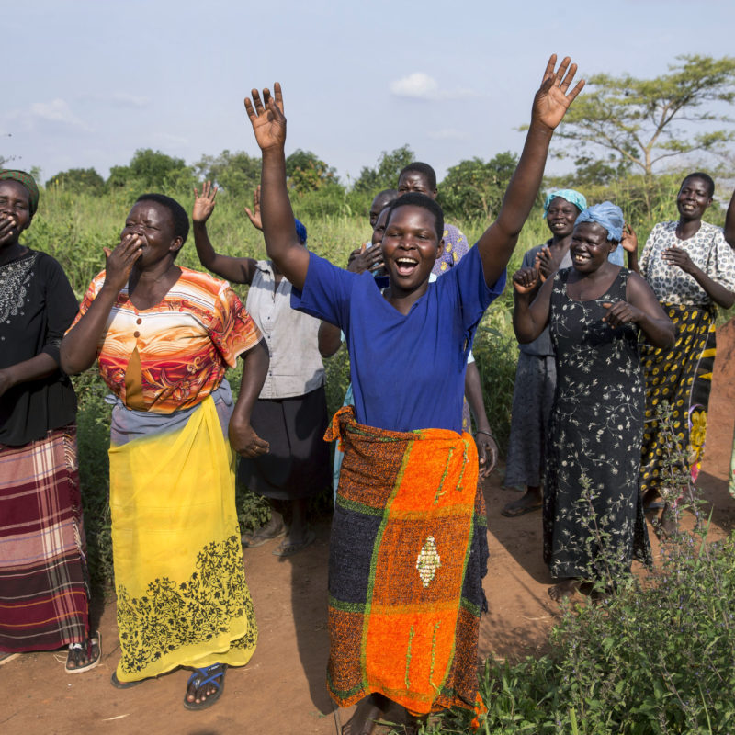
Distinguishing Attitudes, Behaviors, and Norms
GROUP ACTIVITY
YOUR GROUP’S TASKS | EXAMPLE
Select a specific behavior your program is seeking to address. | Breastfeeding.
Describe the context in two words. | Urban Kinshasa.
Articulate an attitude/belief, injunctive norm, and descriptive norm related to this behavior. | Women who breastfeed are good mothers (attitude). My mother and mother-in-law want me to breastfeed my baby, so I do (injunctive norm). I feed my baby formula because my best friends give formula to their babies (descriptive norm).
Identify who might be the reference group for this behavior. | Mother. Mother-in-law.
Name one or two sanctions that might enforce this norm. | Gossip. Respect.
Photo credit: Jonathan Torgovnik/Getty Images/Images of Empowerment
Notes:
IN PERSON ONLY SLIDE
NOTES TO FACILITATOR: We will be looking at behaviors in relation to norms and distinguishing attitudes from norms.
Activity Process (20 minutes, including debrief):
Organize participants into small groups.
Say that we will be putting together everything we’ve learned now and apply the social norms concepts to your own program experiences. See example at right.
Ask participants in their small groups to choose one project they know well and work through the five concepts at left. They can use the example on the right as guidance.
After 15 minutes, ask volunteers to share their examples.
To close, clarify if there is confusion in the participant responses.

Slide 30
Distinguishing Attitudes, Behaviors, and Norms
GROUP ACTIVITY
YOUR GROUP’S TASKS | EXAMPLE
Select a specific behavior your program is seeking to address.
Describe the context in two words.
Articulate an attitude/belief, injunctive norm, and descriptive norm related to this behavior.
Identify who might be the reference group for this behavior.
Name one or two sanctions that might enforce this norm.
Photo credit: Jonathan Torgovnik/Getty Images/Images of Empowerment
Notes:
IN PERSON ONLY SLIDE
NOTE TO FACILITATOR: This is the handout that participants will use to complete the exercise.

Slide 31
Distinguishing attitudes, behaviors, and norms
GROUP ACTIVITY
YOUR GROUP’S TASKS | EXAMPLE
Select a specific behavior your program is seeking to address.
Describe the context in two words.
Articulate an attitude and/or belief, injunctive norm, and descriptive norm related to this behavior.
Identify who might be the reference group for this behavior.
Name one or two sanctions that might enforce this norm.
Photo credit: Jonathan Torgovnik/Getty Images/Images of Empowerment
Notes:
IN PERSON ONLY SLIDE
NOTE TO FACILITATOR: This is the handout that participants will use to complete the exercise.

Slide 32
Why Do People Comply With Norms, Even if They Disagree?
PLENARY DISCUSSION
Norms are often hidden and unexamined.
Desire to conform to their sense of social identity.
Enforcement by the reference group.
Insufficient power to resist.
Photo credit: Getty Images/hadynyah
Notes:
IN PERSON ONLY SLIDE
NOTE TO FACILITATOR: This is an animated slide.
SPEAKER NOTES: As we close this section one final thought. We know that norms do not control everything, including specific behaviors. So here is a question:
Animation 1: [Show picture and question.] Let’s return to this image and look at the group of women carrying water in the background. Why do people (these women) comply with norm (only women carry water), even if they disagree?
Animation 2: Show possible answers.
ALTERNATIVE EXERCISE: Use a clip from Grease or a Bollywood or Nollywood clip that shows gender norms at play. Use a similar line of questioning to unpack gender norms (in this case).
ALTERNATIVE EXERCISE: Use a different photo that is typical of what participants may see in their typical home settings, one that allows discussion of norms that most people follow, by whom and why norms get broken, sanctions for not adhering, and (if it comes up) how not only norms influence behavior but also economic conditions, etc.

Slide 33

CAUTION!
Not everything is a norm and not every norm influences behavior.
Social norms operate in complex social systems and are therefore situational, contextual, and fluid.
Social norms are often important, but other factors can drive behavior.
One single factor rarely drives behavior and influences can act at different levels.
Photo credit: Getty Images/Granger Wootz
Notes:
SPEAKER NOTES: Read slide content and comment that people live their lives within a social context. Their attitudes/beliefs influence norms norms. Norms influence attitudes and beliefs. Yet all influence behaviors.
It’s complex, and the first thing to do is to be able to distinguish different influences, as that allows us to build better programs focused on social and behavior change

Slide 34

CAUTION!
Norm, attitudes, sanctions… it’s complex.
I think no one should use violence (attitude), but if I don’t, other parents will think I don’t know how to educate or control my children (sanction), so I slap my children (norm).
I don’t like to smoke (attitude), but my peers approve of me smoking (injunctive norm).
I would like to report a parent who hits their child (attitude), but everyone hits their children (descriptive norm), and I am worried it would cause problems for me if I make a complaint (injunctive norm).
Photo credit: Getty Images/Eva-Katalin
Notes:
SPEAKER NOTES: Here are some examples of the interplay between norms, attitudes, and sanctions. The first example, the behavior of slapping children, is influenced by attitudes, sanctions, and norms that all interact.
[Read slide.]

Slide 35
Why Norms Matter in Social and Behavior Change Efforts
SECTION 2

Slide 36
Norms About…
OUTCOMES
Wash
Health
Education
Healthy timing and spacing of pregnancy
Livelihoods
Nutrition
INTERMEDIATE EFFECTS
Access
Social and economic capital
Reproductive intentions
Women’s participation in community decisionmaking
Couple communication and decisionmaking
Women’s
agency
NORMS
Girls’
education
Family
formation
Gender-based
violence
Masculine ideologies (authority, virility, son preference, paternity)
Feminine ideologies
(purity, chastity,
obedience, humility)
Power hierarchies related to social group
Notes:
SPEAKER NOTES: This is a repeat of the earlier slide, to remind us how norms influence behaviors, actually as a range of behavioral outcomes.

Slide 37
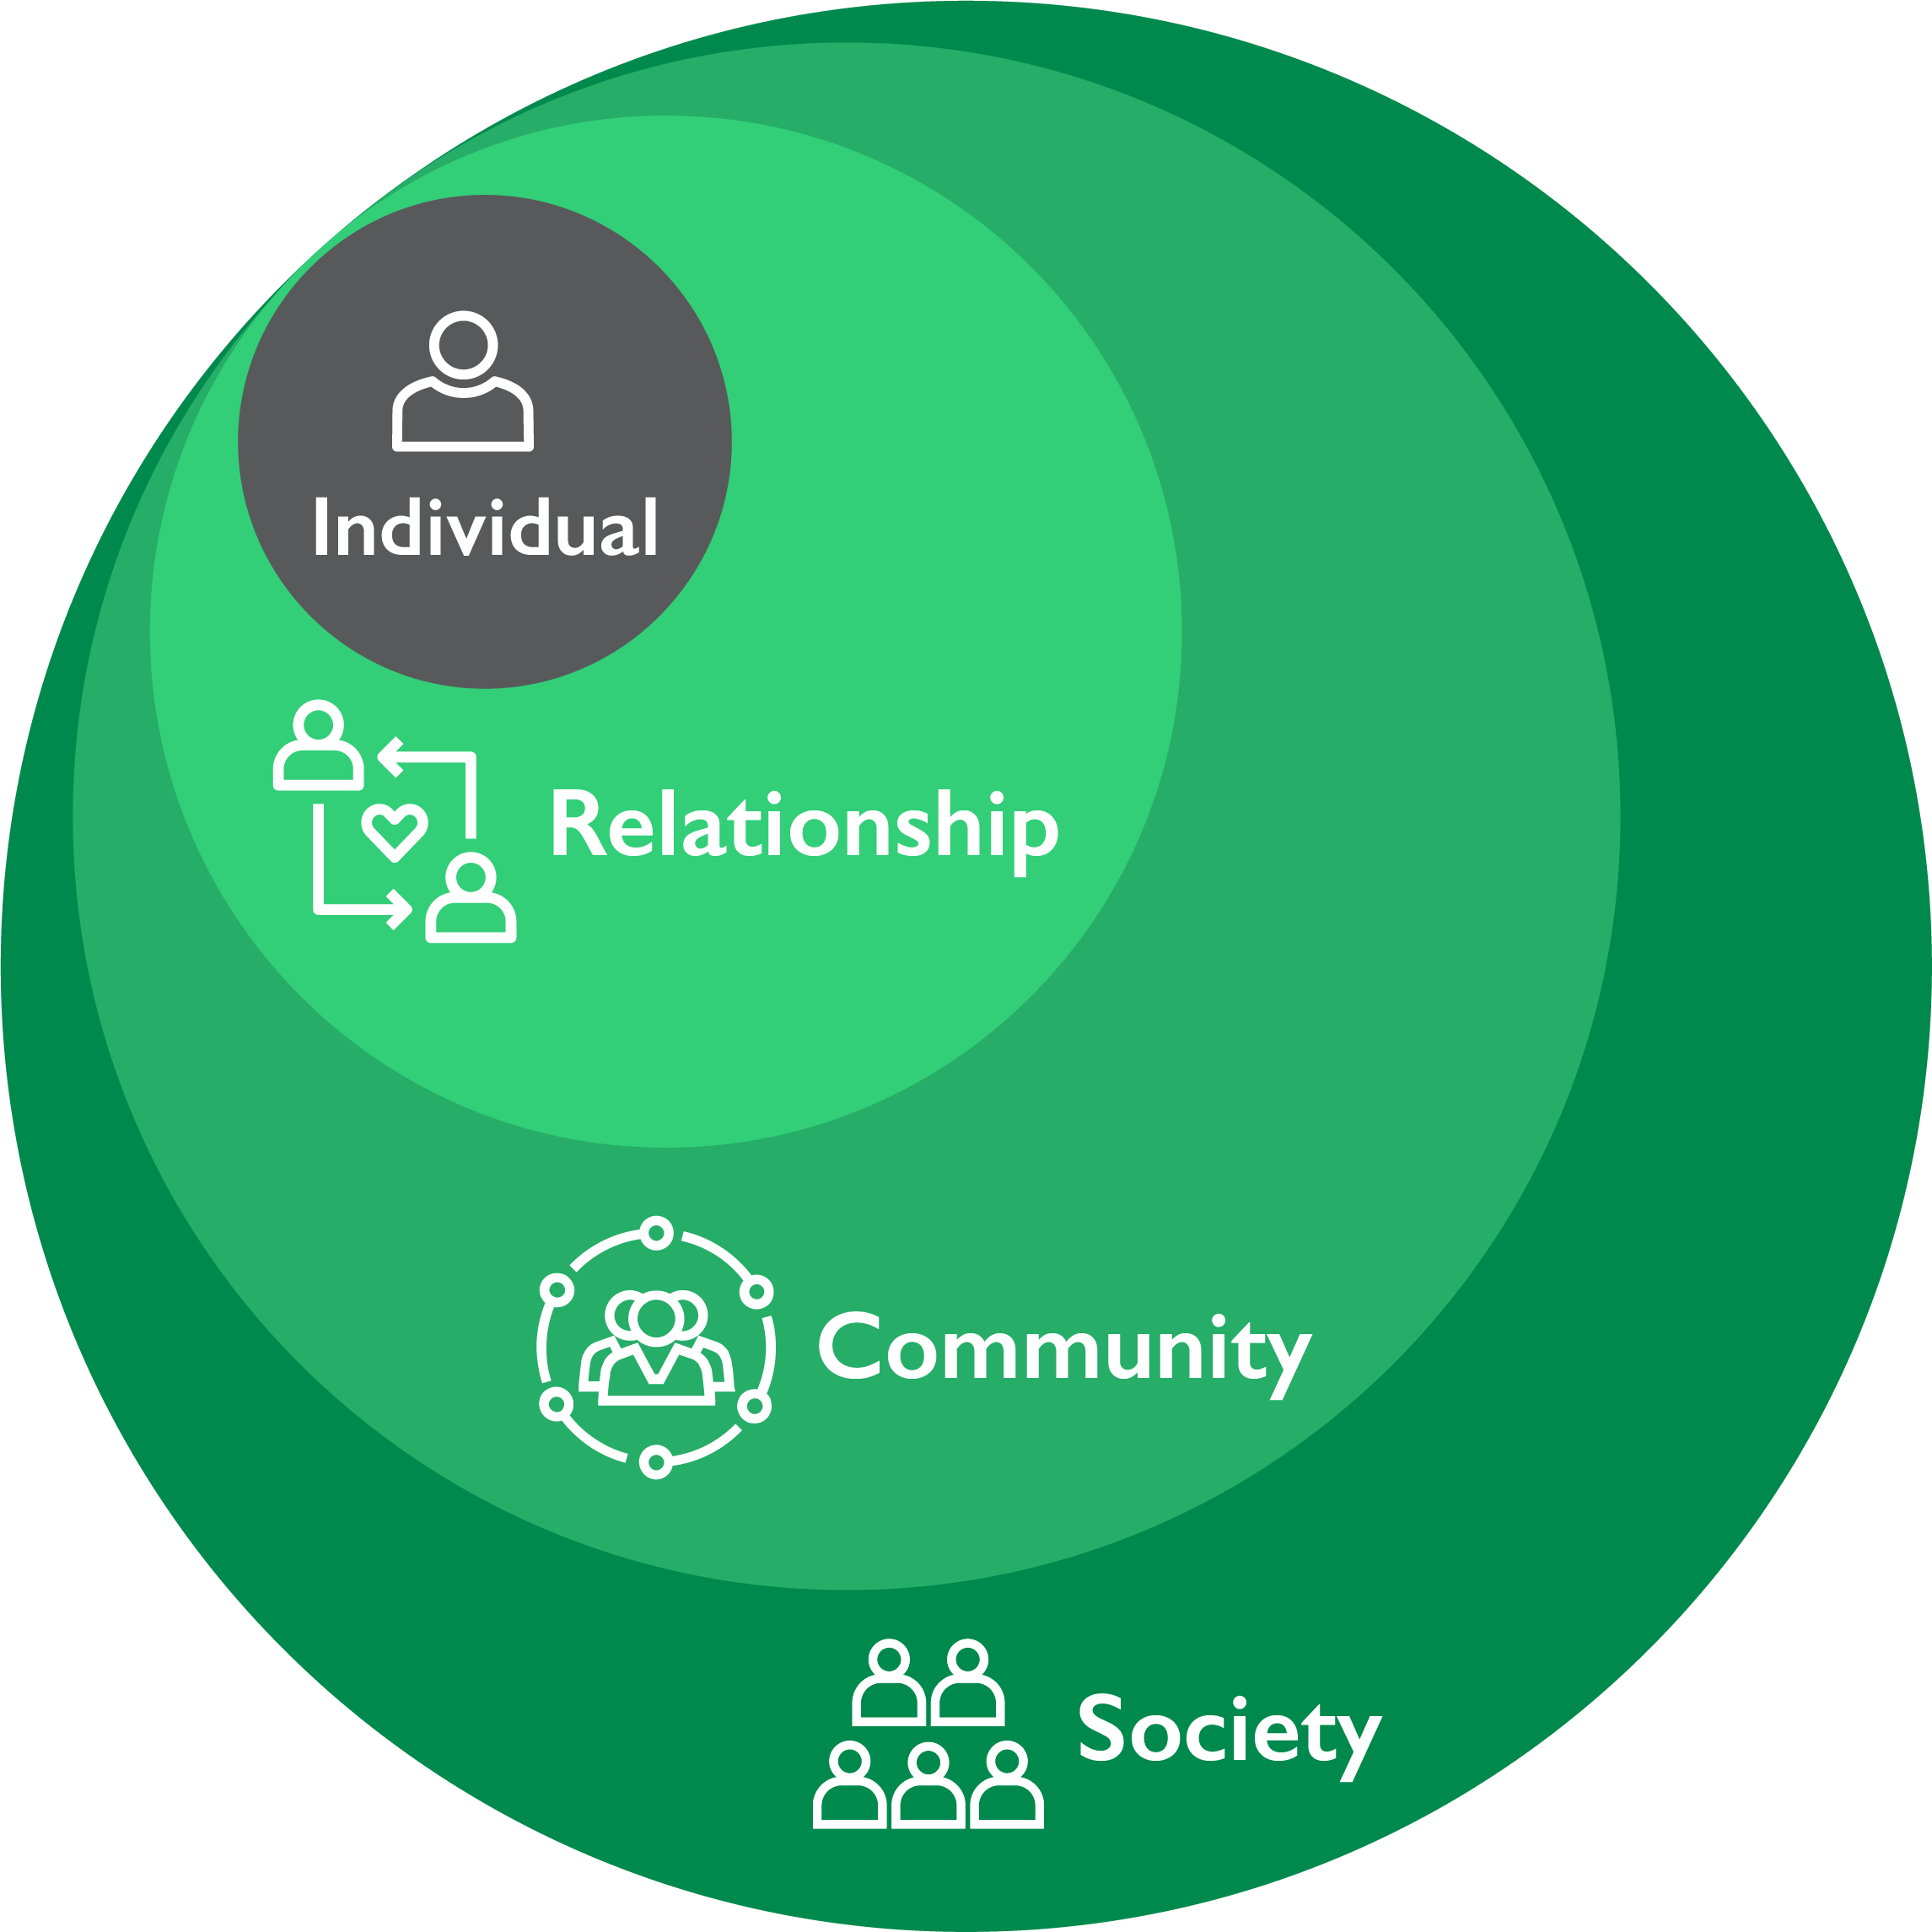
Social Norms Permeate All Levels of Society and Societal Structures
Notes:
NOTE TO FACILITATOR: This diagram shows a general socioecological model, with the speaker notes providing examples related to GBV. Speaker note text can be swapped with other examples relevant to the participants.
SPEAKER NOTES:
To think about the norms within the socioecological model, this visual illustrates how social norms permeate all levels of society. Let's walk through the socioecological model using violence prevention as an example.
At the individual level, you see attitudes and beliefs related to violence.
At the relationship level are expectations related to appropriate sexual behavior among peers or physical violence in the household.
At the community level there are normative expectations that tolerate or oppose sexual violence under certain conditions and that also play out in responses by kinship networks, religious leaders, police, or legal systems.
At the social level underlying inequalities based on gender, religious beliefs, or economic policies all play a role in encouraging or preventing violence.

Slide 38
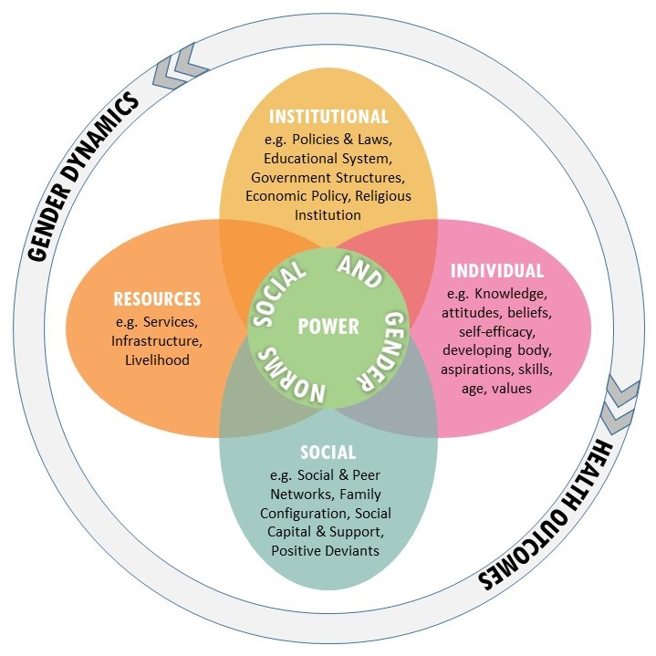
The Flower
Integrating normative influence and change.
Adapted from Cislaghi and Heise by the Learning Collaborative. London, 2017
Notes:
SPEAKER NOTES: This bring us to The Flower.
A sort of inversion of the social ecological model, the Flower visual more clearly defines power and social and gender norms at the heart of the ecosystem. Power and social norms are manifested in the different petals—at individual, institutional, services/resources, and society levels.
Social norms reinforce power status (often power-holders are defined by gender, age, ethnic group).
When projects aim to shift norms, they are essentially changing the balance of power or, more precisely, the power of current power holders. This may result in push back or unexpected consequences.
Because power is at the center, one can assume power holders are operating within and between petals.

Slide 39








Features of Social Norms
Harmful & Protective Norms
Structural Factors Upholding Norms
Strength & Influence of Norm
Alignment of Norms & Attitudes
+
Influential Reference Group
Power Holders Support or Resist Change
Agreement & Compliance Vary
Agency Can Support Healthy & Harmful Behavior
Notes:
NOTE TO FACILITATOR: Distribute the handout of the eight features brief.
SPEAKER NOTES: What does a norm look and feel like? On the slide are eight features of norms, which probably play out differently for different behaviors. They are important to understand to bring clarity as you design programs.
Feature 1. Norms related to the behavior(s) of interest can be both harmful and protective.
Feature 2. Norms are embedded in a system of structural drivers that intersect and sustain the behavior(s). This includes
access to resources; for example, access to healthcare is important to programs that seek to increase healthy behaviors.
Feature 3. Not all norms have the same strength.
Feature 4. Norms can be aligned or misaligned with attitudes.
Feature 5. Norms are sustained by several reference groups with different influence.
Feature 6 . Power-holders may resist—or support—change.
Feature 7. Some people agree and comply with norms, while others do not.
Feature 8. Agency—an individual’s ability to make their own choices—can work in both healthy and unhealthy directions.

Slide 40
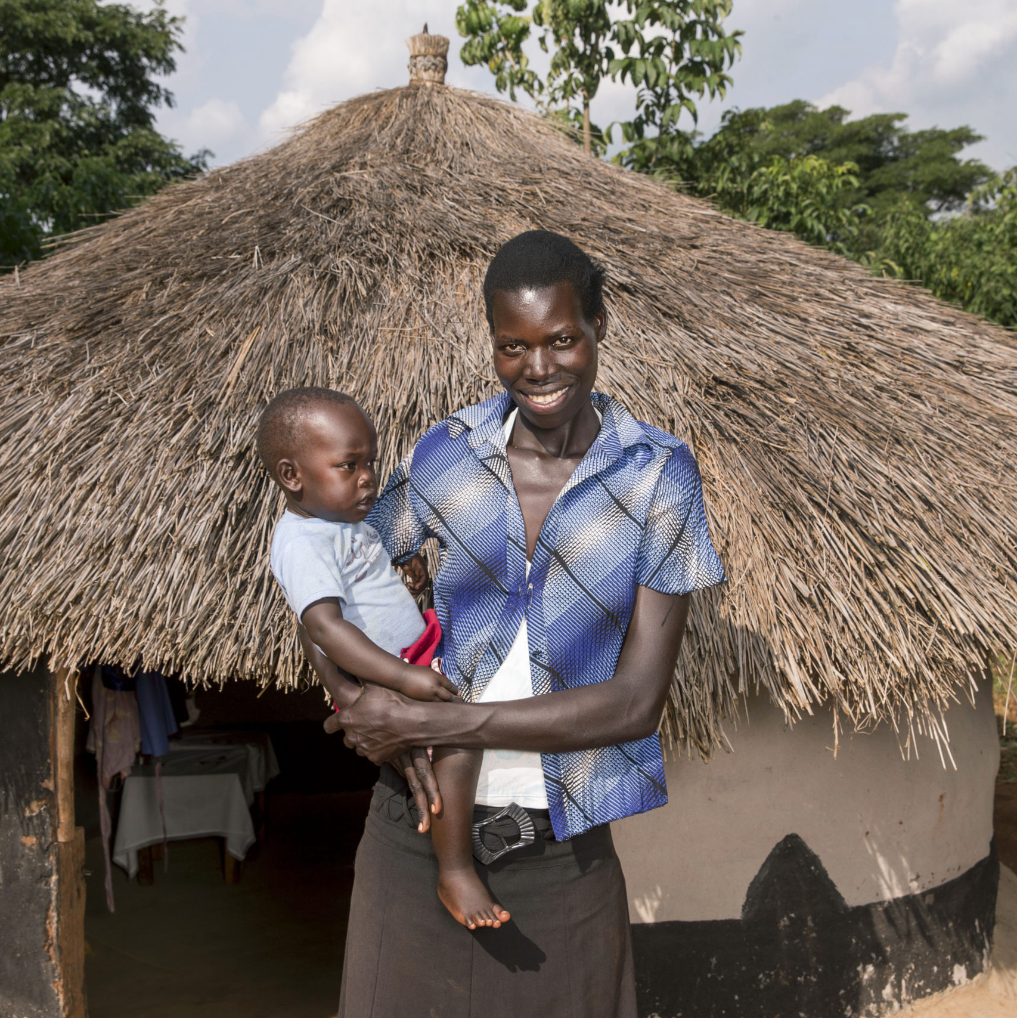
Eight Features
GROUP ACTIVITY
Select a norm your project is addressing or wants to address more specifically.
Using the table in your handout, explore how the eight features can be applied. (20 min)
Share your small group work. (10 min)
Photo credit: Jonathan Torgovnik/Getty Images/Images of Empowerment
Notes:
IN PERSON ONLY SLIDE
NOTE TO FACILITATOR: This is a small group exercise. The aim is to help participants to internalize the eight features vis-à-vis a range of behaviors.
People may continue to work on earlier project applications done earlier. Or ask them to select one norm and its relation to behaviors that the UPWARD project is aiming to shift and ask people to work on it. (See next slide on WASH).
Process:
Organize participants in small groups to explore ways they can apply the eight features of social norms in their program contexts.
Indicate that they have 20 minutes to discuss in their groups
Invite volunteers to share the work in their small groups. Spend 10 minutes on this debriefing.
Ask if participants found this activity clear. Was there ambiguity?
To close, ask how understanding these eight features might influence developing and implementing programs that aim to address the normative environment and foster behavior change.

Slide 41
Eight Features
GROUP ACTIVITY
Choose a social norm related to WASH behaviors to work with:
Women should fetch water.
Men should not perform “women’s roles” in the home.
Men alone are responsible for household decisions.
Women should not attend (or speak up in) community meetings.
Women and men should not mix in spaces.
Women should be controlled.
Men should be given priority to eat the better food before women and children.
Women are responsible for taking children to the clinic.
Photo credit: Jonathan Torgovnik/Getty Images/Images of Empowerment
Notes:
IN PERSON ONLY SLIDE – Remove from slide deck if participants will be working on norms within their own projects.
SPEAKER NOTES: The norms on the slide were identified during formative assessments for the Uplifting Women’s Participation in Water-Related Decision-Making (UPWARD) Project in Tanzania. UPWARD aimed to shift gendered social norms regarding women’s participation in water decisions by working with community leaders and women’s groups. In addition, local government authority and WASH governance institutions were the site of trainings and reflective discussions on the importance of including women’s voices to empower women with water resources management capabilities and encouraging greater participation in decisionmaking.
You can use this information, which is also in your handouts, as reference when working in your small groups.

Slide 42
Eight Features
GROUP ACTIVITY HANDOUT
Harmful and protective norms – Are there protective norms that could be leveraged?
Influential reference groups – Who enforces the norm? How are they doing it?
Structural factors upholding norms – Are there structural factors that enforce the norm?
Power holders resisting change – To what extent will power holders support or resist change?
Strength and influence of norms – Is the behavior visible? Do people think they can change it?
Agreement and compliance vary – Does everyone uphold the norm? Do some people deviate? Why?
Alignment of norms and attitudes – Are personal attitudes in sync with this norm?
Agency – Is agency furthering healthy or unhealthy behaviors?
Photo credit: Jonathan Torgovnik/Getty Images/Images of Empowerment
Notes:
IN PERSON ONLY SLIDE
NOTE TO FACILITATOR: This is a handout.

Slide 43
How Social Norms-Shifting Approaches Fit Into And Bring Additional Value to SBC
SECTION 3

Slide 44



An Increased Focus on Social Norms Can Help Improve Development Impact by…
Creating an environment that sustains and spreads behavior change over time.
Addressing norms that drive multiple behaviors.
Providing a common avenue of collaboration for projects across sectors/divisions.
Notes:
SPEAKER NOTES: Before delving into specific examples, let’s identify the important benefits of adding a social norms focus into SBC programs.
An enabling environment will support sustained change at scale.
The same norms often drive behaviors within and across sectors.
A social norms focus provides opportunities for collaboration across sectors and allows leveraging of resources that can increase program efficiency.
We’ll talk about each of these in more detail, starting with different techniques.

Slide 45


TÉKPONON JIKUAGOU CASE STUDY
Photo credit: Institute for Reproductive Health
Notes:
SPEAKER NOTES:
Here’s a quick introduction to Tekponon Jikuagou, or TJ, a USAID-funded norms-shifting intervention to address low modern family planning uptake in Benin. TJ was implemented by IRH with CARE International and Plan International between 2010-2017.

Slide 46
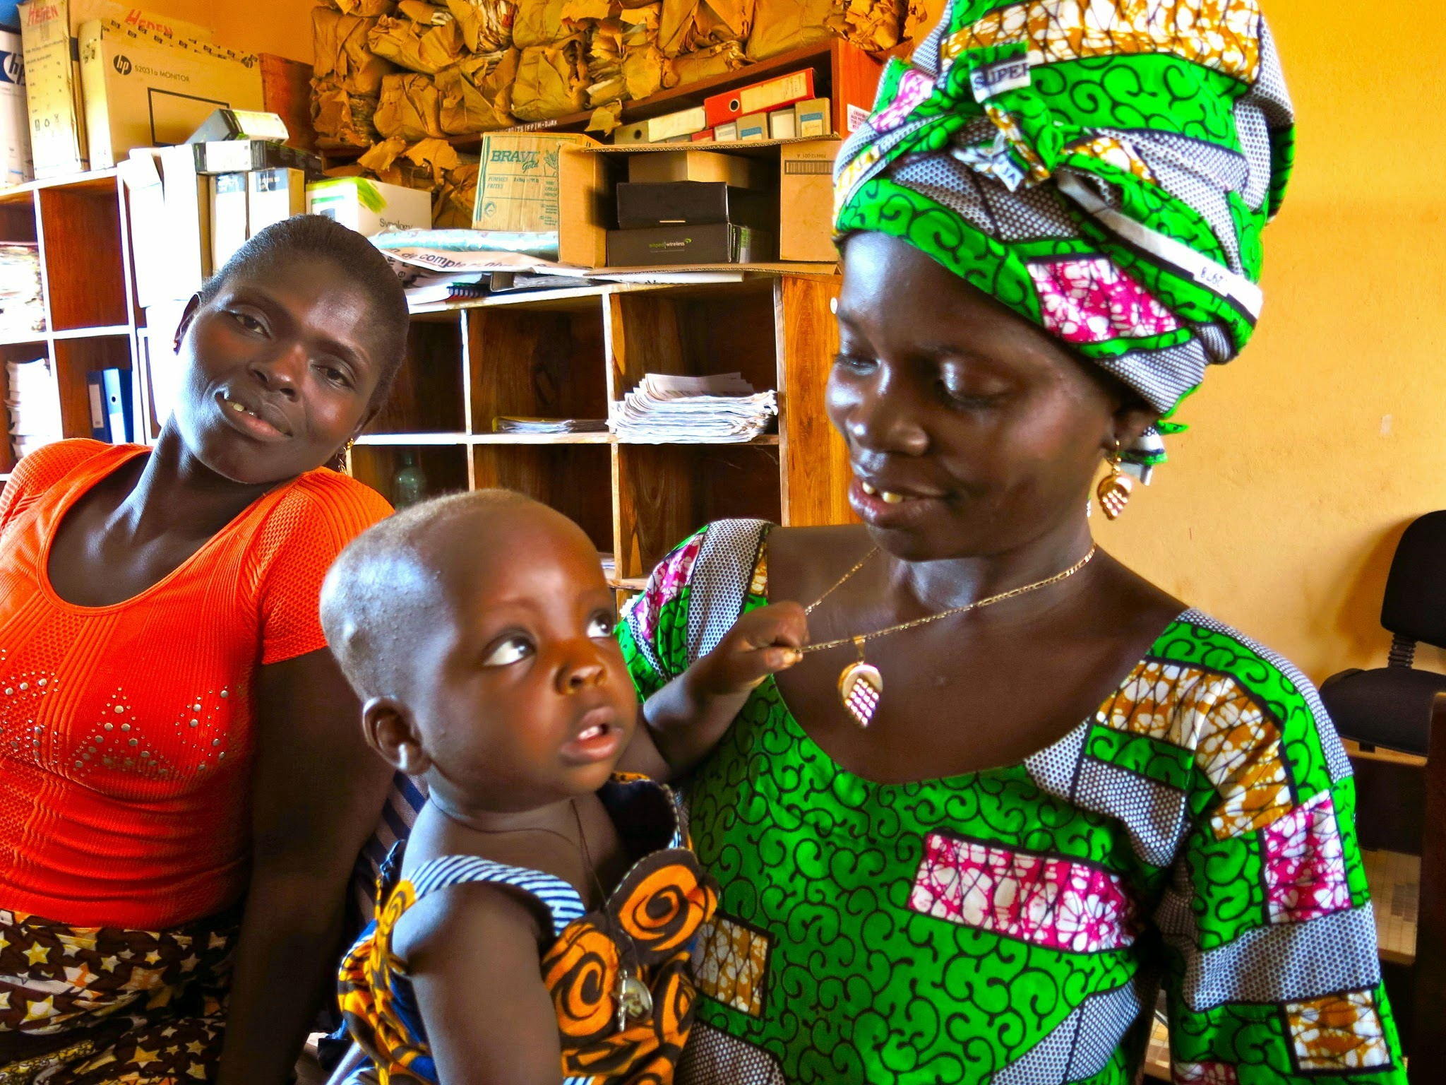
TJ Overview
Location: Benin.
Aim: Address low rates of uptake of modern family planning methods.
Norms focus: Reduce normative barriers by breaking communication taboos and shift reproductive health-related gender roles.
Value add: TJ’s integration into non-family planning projects had cross-sectoral benefits.
Photo credit: Institute for Reproductive Health
Notes:
SPEAKER NOTES:
The norms focus of TJ was to reduce normative barriers by breaking communication taboos and shifting reproductive health-related gender roles. The value-add of the TJ norms focus was both in family planning outcomes, as well as cross-sectoral benefits from TJ’s integration into non-family planning projects.

Slide 47
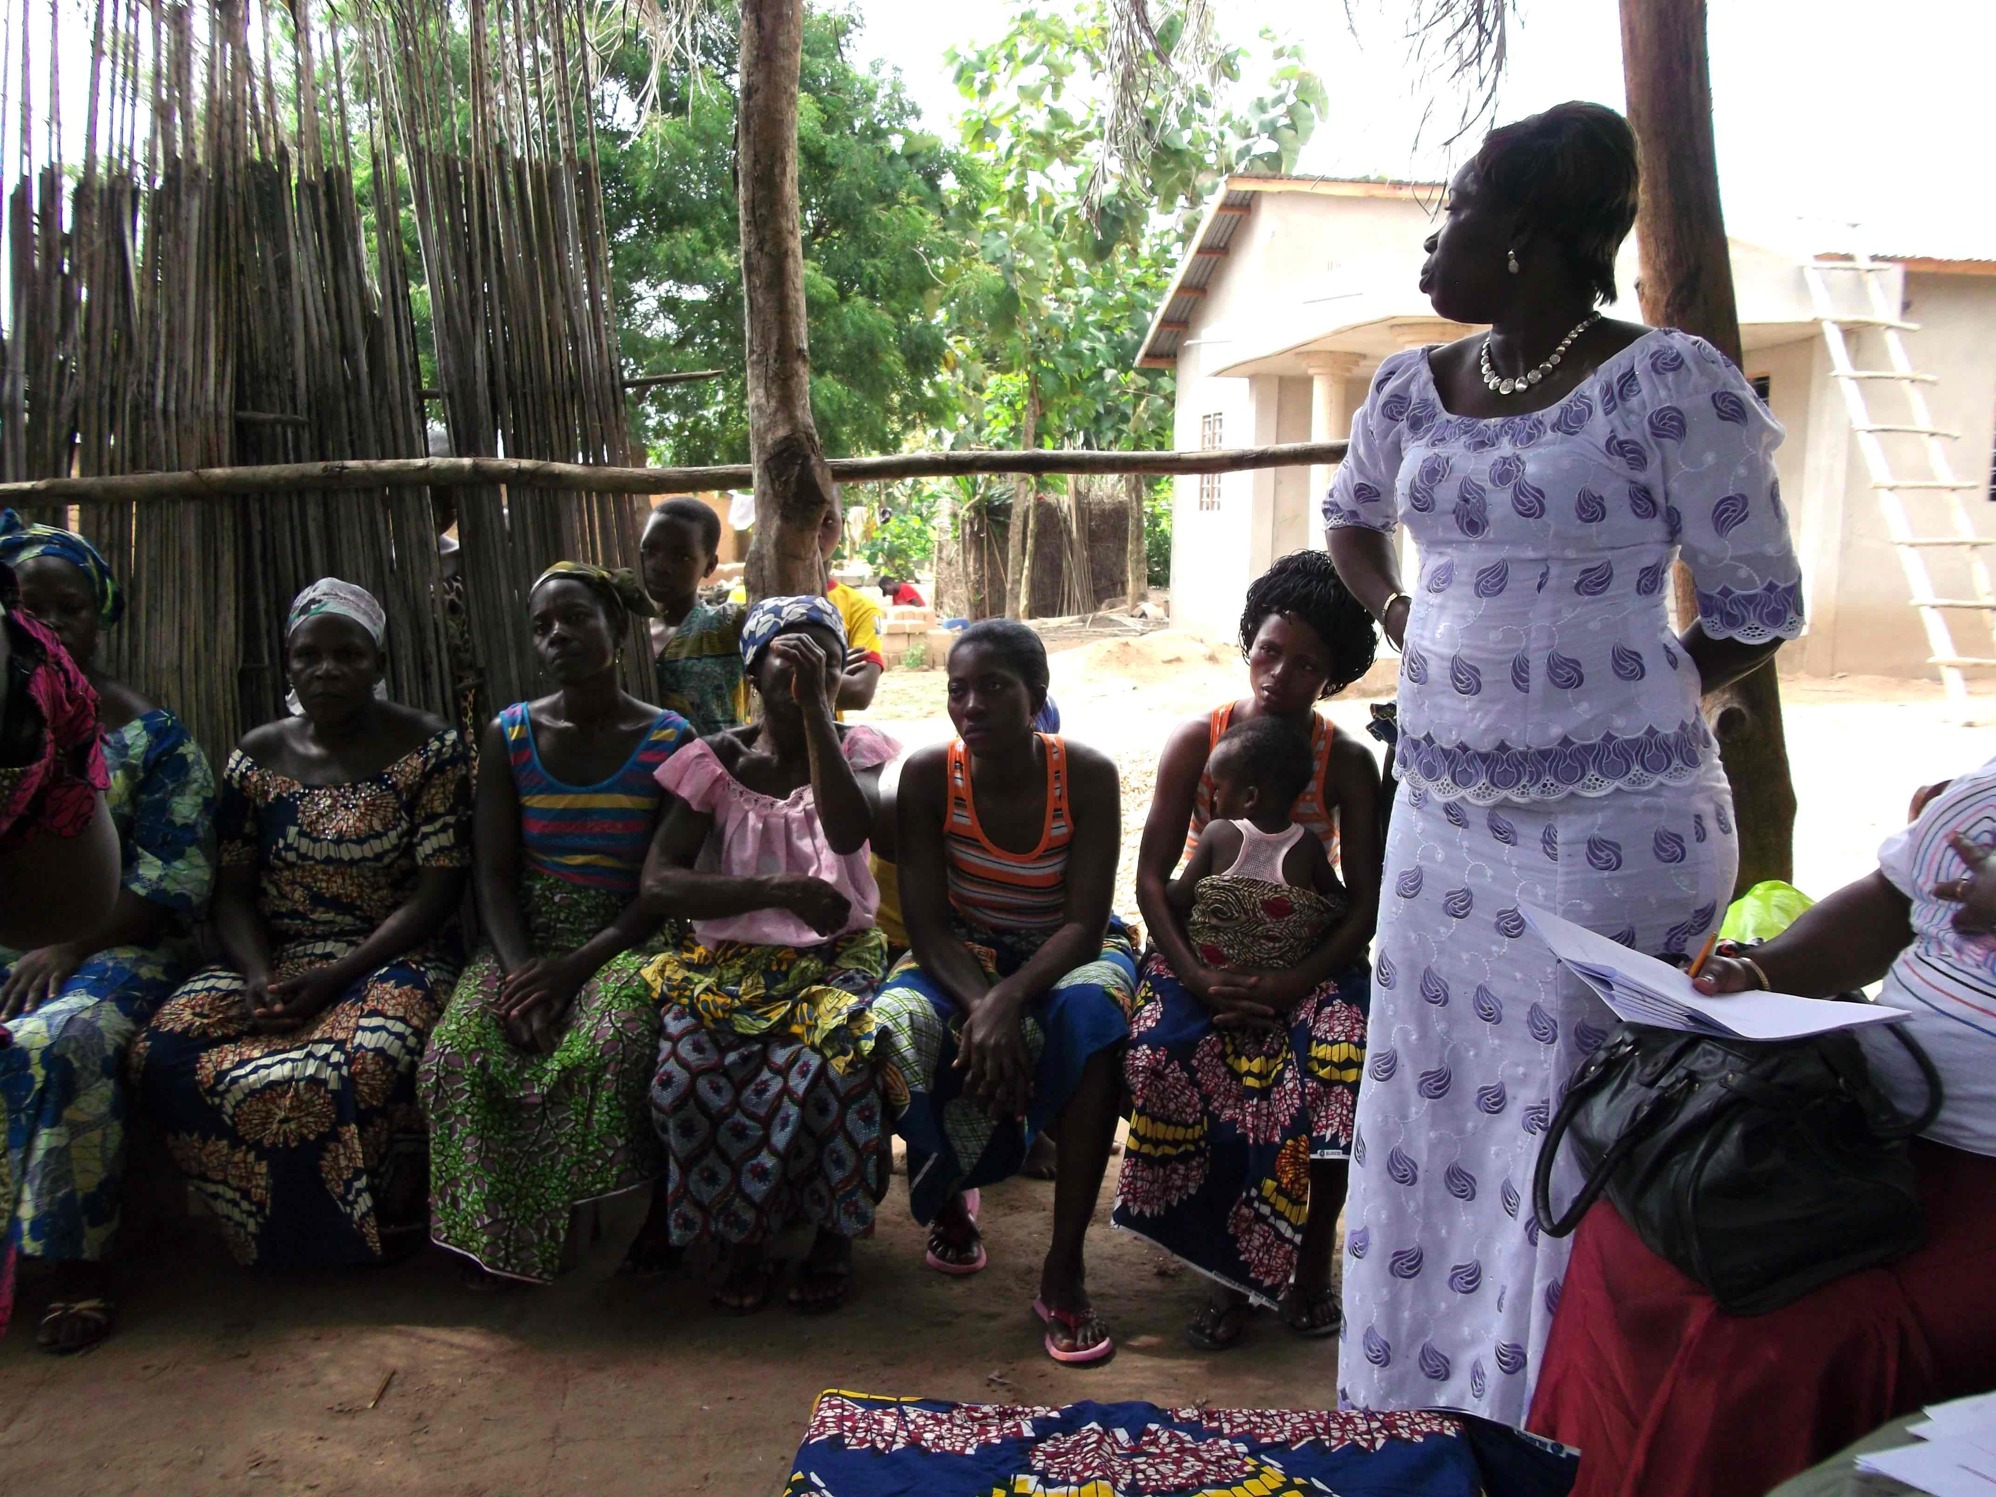
TJ Approaches
Leveraging social connections to decrease gender and other socio-normative barriers to act on unmet need.
Intervention Components:
  Engage communities in social mapping.
  Support influential groups in critical dialogue.
  Encourage influential individuals to act.
  Link family planning providers with influential groups.
  Use radio to expand reach and build an enabling environment.
Photo credit: IRH
Photo credit: Institute for Reproductive Health
Notes:
SPEAKER NOTES:
TJ worked through social connections to reduce the barriers that lead to unmet need. Many demand-creation efforts focus on improving knowledge and attitudes, forgetting the social barriers to people acting on their desire to space births using modern methods. For TJ, formative research had identified and found the importance of gender and social norms related to gender roles that underlay the high unmet need in TJ communities.
The goal of TJ was to create a social environment that enabled married couples to achieve their fertility desires, including by using modern methods of family planning. It was implemented by four local NGOs interested in integrating family planning into their work. The components of the intervention that helped accomplish this were:
Social mapping with communities, to identify highly influential social groups for family planning behaviors through which to implement intervention activities
Support influential groups in critical and reflective dialogue about social and gender norm barriers and taboos related to family planning
Encourage influential individuals to diffuse new ideas about family planning, share information about barriers to family planning, and mobilize ongoing public dialogue
Link family planning providers with influential groups, allowing correct information about methods and services to flow through influential networks, and encourage their communities to seek information and services
Use radio to expand reach of these new ideas, and build an broader enabling normative environment.

Slide 48
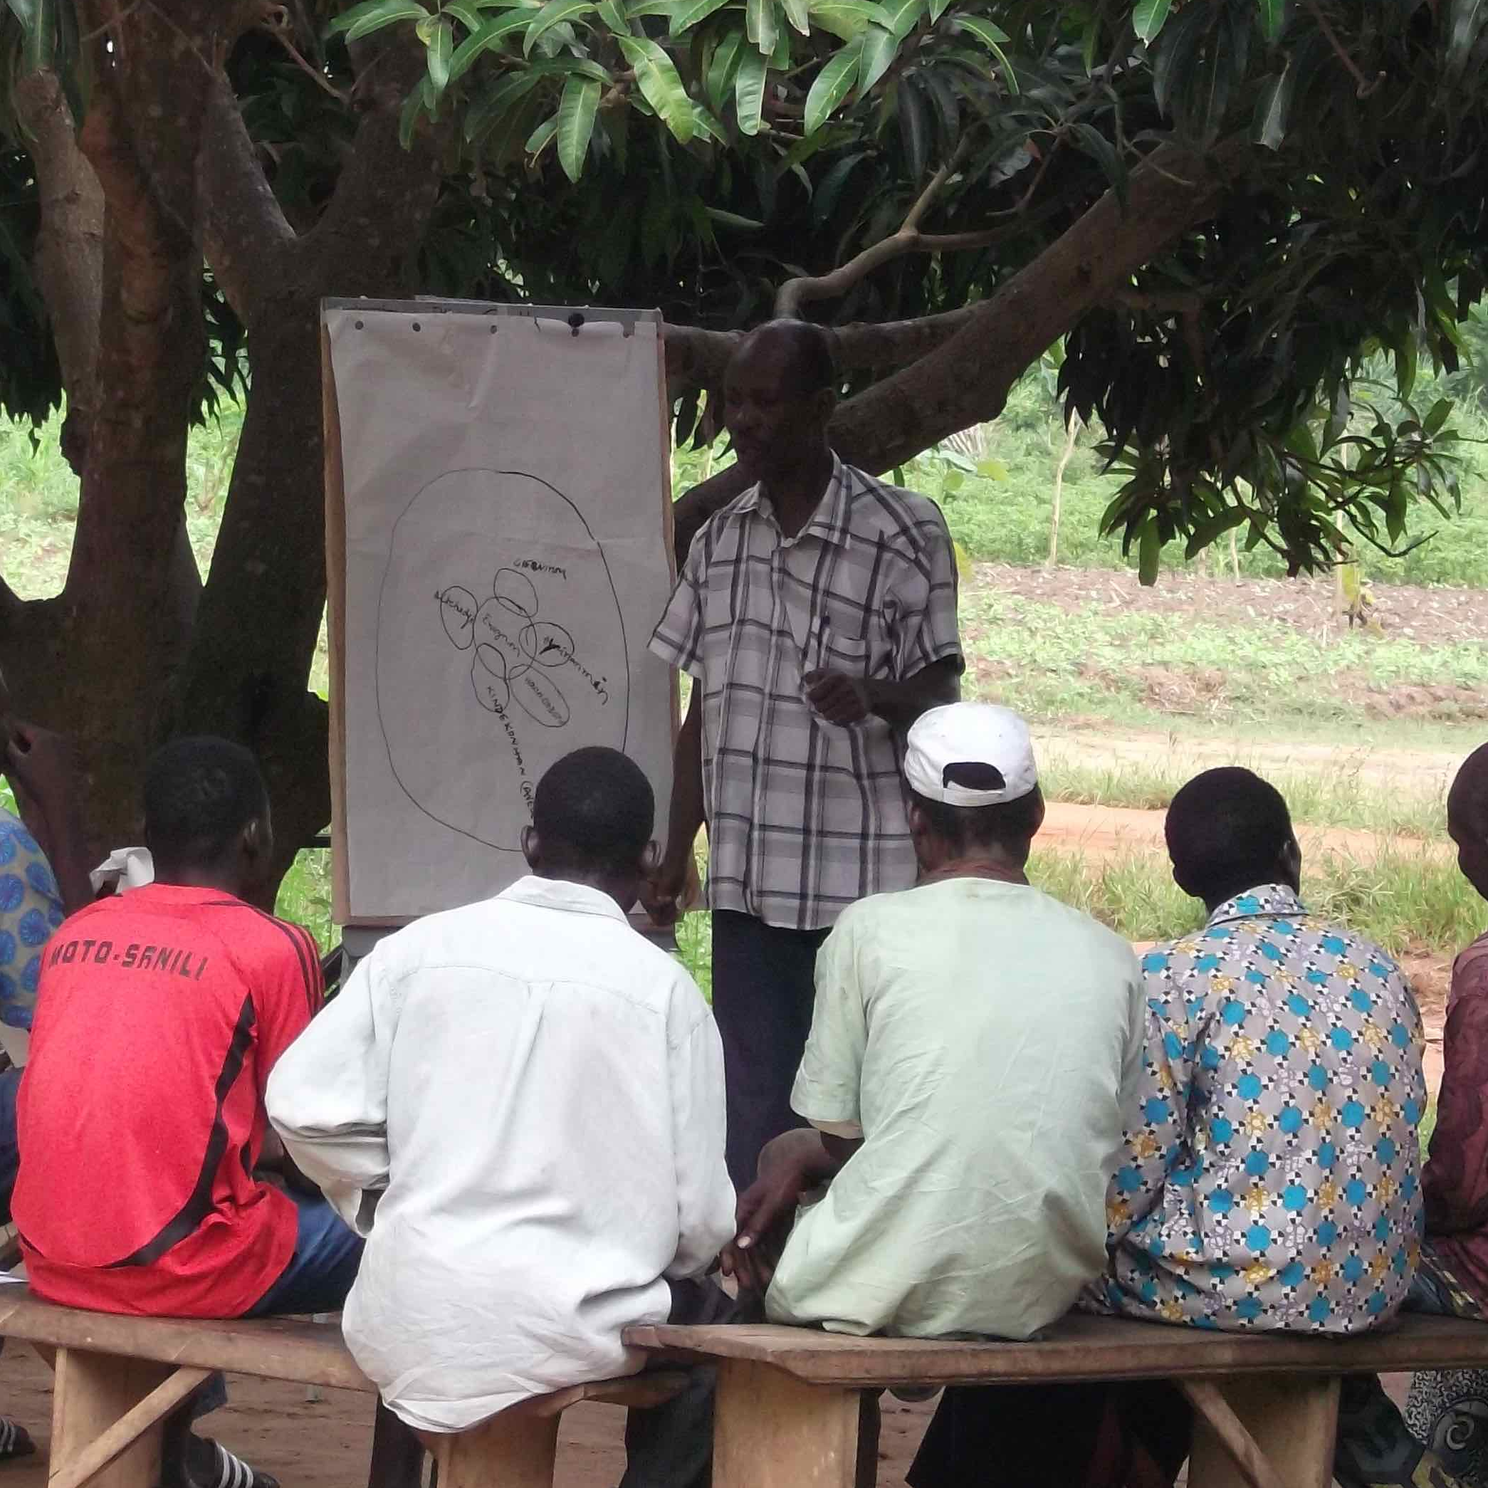
TJ Community Social Realities
“I don’t know what my wife thinks about family planning; we have never talked about it. In our culture, men and women should not talk about these things—this is the reason I have never discussed family planning with my wife.”
Husband
“There is not one single person in any of my networks who can give me positive information on family planning—they are all against it.”
- Wife
Photo credit: Institute for Reproductive Health
Notes:
SPEAKER NOTES:
On this slide, we share quotes from TJ participants explaining the social norms that prevented couple communication about, and use of, family planning.
A husband interviewed said, “I don’t know what my wife thinks about family planning; we have never talked about it. In our culture, men and women should not talk about these things—this is the reason I have never discussed family planning with my wife.”
A wife interviewed said, “There is not one single person in any of my networks who can give me positive information on family planning—they are all against it.”
These quotes capture the difficulty in this normative environment both of discussing and seeking family planning.

Slide 49

TJ Norms-Shifting
TJ Addressed Demand By:
Improving family planning (FP) knowledge and attitudes and breaking normative barriers.
Reducing peer stigma about talking of FP in public.
Reducing peer sanctions relating to FP use, for example what others say about someone using or talking about FP.
Giving permission to men to engage in dialogue on what is/what could be.
Impact: Women’s and men’s FP use almost doubled in less than a year.
Photo credit: IRH
Photo credit: Institute for Reproductive Health
Notes:
SPEAKER NOTES :
As those quotes illustrated, norms were influencing people to NOT act on their intentions.
In this situation, two of the norms at play were: “in this community, couples do not discuss FP” and “people in this community think that if a husband allows his spouse to use family planning, he is not ‘controlling’ his wife”
The result was that people felt there was peer stigma to talking about family planning as well as to using family planning. By reducing that stigma, and opening space for men to engage in dialogue about their and their partners current and future family planning, TJ helped to address this unmet demand.
The impact was that men’s and women’s family planning use almost doubled in less than a year.

Slide 50
TJ Connections Between Sectors
The social norms emphasis created multi-sector connection.
TJ was integrated into nutrition, literacy training, and WASH projects.
The four NGOs wanted to add family planning to increase their development impact.
Impact:
Greater community participation in
other-sector activities.
Gender norms shifting via male engagement led to male support for other-sector health and development efforts.
TJ: Change in gender inequality & FP taboo norms and behaviors
Water and sanitation/ hygiene
Adult literacy training
Infant and
child nutrition
Notes:
NOTE TO FACILITATOR:
As we look at this slide, I want you to remember the slide we presented earlier, that showed how a single norm can impact multiple outcomes. This concept was at play in the multi-sectoral impact of TJ. Because norms, including, for example, those about couples’ communication have relevance in multiple sectors, shifting one norm had implications for outcomes in other sectors.
TJ was integrated into nutrition, literacy training, and water, sanitation, and hygiene projects by four NGOs that aimed to increase their development impact by adding a family planning component.
The addition of TJ had the impact of greater community participation in activities in these other sectors. and the gender norms shifting from male engagement in TJ lead to greater male support for efforts in these other sectors. This diagram shows how the TJ social norms focus lead to shifting in gender inequality and family planning taboo norms that had implications for behaviors in other sectors.

Slide 51


SALEEMA
CASE STUDY
Photo credit: UNICEF Sudan/Omer

Slide 52

Saleema Overview
Location: Sudan.
Aim: Address socially-condoned practice of female genital mutilation and cutting (FGM/C).
Norms focus: Replace norms to cut with new norms NOT to cut.
Value add: Saleema’s FGM/C norms-replacement effort could also reduce the related harmful practices of early marriage and pregnancy.
Photo credit: UNICEF/Sari Omer
Notes:
SPEAKER NOTES: I’m going to introduce the Saleema project, a norms-shifting intervention to stop female genital cutting in Sudan.
[Read the slide content.]

Slide 53

Saleema Approaches
Leveraging media to change how communities talk about female genital cutting, to establish positive norms around NOT cutting.
Intervention Components
Mass media and social marketing campaigns.
Community and inter-generational dialogues.
Photo credit: UNICEF Sudan
Notes:
SPEAKER NOTES: The aim of this project was to help participants understand how a norms focus can improve project impact, creating an environment that sustains and spreads behavior change over time, in this case by promoting collective abandonment of the practice of FGMC
This case example shows how it is possible to establish a new norm, at scale, using a mix of mass media and community-based reflective dialogue and messaging of the “brand” Saleema.
Bringing new language to re-brand normative drivers of girl child well-being to establish a new, beneficial norm.

Slide 54

Saleema Community Social Realities
Community beliefs:
Cutting girls early will ensure they follow community traditions (and be available for early marriage).
If they go to school uncut, they will be “influenced” by others’ views and practices.
Language reflecting beliefs:
Traditionally, FGC is “tahoor,” which means “pure” and therefore cut women are pure.
Women and girls who do not undergo FGC are called “ghalfaa,” which means “impure” and “obscene.”
Photo credit: UNICEF Sudan/Omer
Notes:
SPEAKER NOTES: Existing norms around cutting include: Girls are cut to keep them chaste and ensure their virginity until marriage. Cutting also bestows honor on the family as evidence they are raising their girl children well.
Saleema is a word that means pristine, whole, in a God-given condition.
The broad objective of Saleema is to change the way that people talk about female genital cutting by promoting, at the community level, wide usage of new positive terminology to describe the natural bodies of girls and women.
Saleema built on an existing cultural value that had not been applied to cutting. Providing a new way to talk about not cutting—versus talking about the many negative health and other consequences of the most severe form of cutting that is practiced in the Sudan—provided a way to move towards a new norm of not cutting.

Slide 55
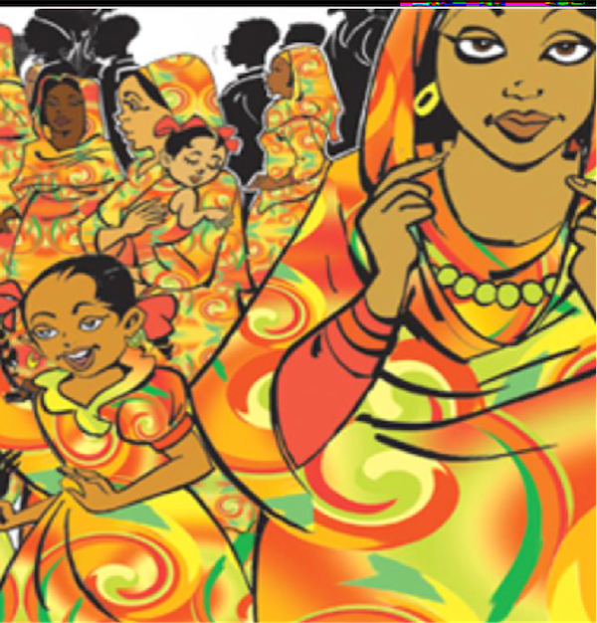
Saleema Norms-Shifting
Saleema addresses FGC with information but also:
Shifts community perceptions by changing the way that people talk about cutting.
Promote at scale the establishment of a new norm of desirability of uncut girls through branding and social dialogue.
Impact:
Women participating in Saleema are six times more likely to believe that FGC should be discontinued.
The project saw a reduction in normative beliefs to continue cutting across 18 states.
Photo credit:: UNICEF Sudan
Notes:
SPEAKER NOTES: Read the slide content.

Slide 56
Session II
Notes:
FACILITATOR NOTE: This slide is hidden and is only intended to be used if you chose to divide the training into two sessions if necessary.

Slide 57
Theories of How Norms Influence Behaviors
SECTION 4
Research-Informed Theories on How Norms Influence Behavior Change
Notes:
SPEAKER NOTES: Many theories of behavior change are created by researchers and theorists who draw from existing research to develop causal explanations around how norms and other factors influence behavior change. These are usually high-level and useful as you begin to think about designing a program and what others have learned from research.

Slide 58
PROGRAM THEORIES OF CHANGE
Norms and Behavior Change Theories Come From Different Disciplines and Perspectives
  Community Psychology: Norms are a social phenomenon consisting of informal understandings that govern the behavior of members of a society. As norms change so can behavior.
  Communication: Norms are a social phenomenon transmitted within a social system through communication. Communication can shape perception and influence behavior.
  Systems and Complexity: The interconnectedness of social systems create synergy for newly-emerging behavior. Changing one part usually affects other parts and the whole system, with predictable patterns of behavior.
Notes:
SPEAKER NOTES:
Thinking about theory helps in project design. The theories that underpin social norms and behavior change work draw from multiple disciplines.
Across disciplines, these are the key foundations for social norms work. Read the slide content.

Slide 59
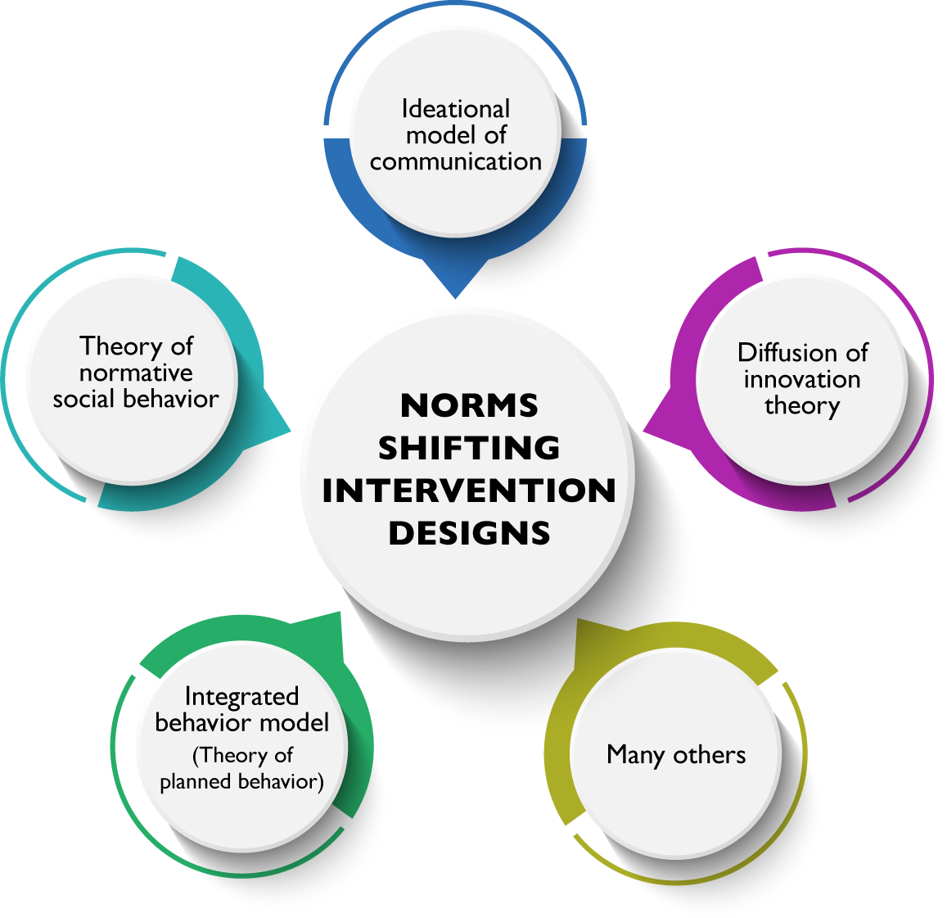
Prominent Norms and Behavior
Change
Theories
Notes:
FACILTATOR NOTE: Supplemental slides on different research-informed behavior change theories and an exercise are included at the end for groups that are interested in more in-depth look a TOCs. If you are using the supplemental theory slides, insert them after this slide.
SPEAKER NOTES:
By one estimate there are over 80 SBC theories, but only a handful are regularly referenced, including those cited in the slide. These are: the theory of planned behavior, social cognitive theory, information-motivation-behavior skills (IBMS) model, trans-theoretical model of change.
If you are NOT using the supplemental theory slides: This is just a tiny introduction to these theories. If you are interested in additional slides and resources detailing these theories, please follow up directly with your facilitator.
If you are using the supplemental theory slides: The aim of the next set of slides it to quickly share some of the TOCs and think about how they are useful in thinking about NSI programs.

Slide 60
Across Theories: Consensus on Factors That Foster Norms Shifting
Multiple norms influence a specific behavior.
Key norm types: descriptive and injunctive.
Role of meta-norms.
Group identity.
Importance of reference groups and social networks in influencing individuals to adopt new behaviors, attitudes, beliefs.
New ideas/ideation diffuse outward.
Diffusion of ideas/ideation: social networks; norm change tipping points.
Intentions predict behaviors.
Dynamic interplay of complexity and systems with individuals’ behaviors.
Notes:
SPEAKER NOTES:
One area of consensus, as we’ve talked about in earlier slides, is that multiple norms influence a specific behavior. Of these norms, the key types are our now-familiar friends descriptive and injunctive norms. There’s also agreement that meta-norms, or the foundational norms that are broadly shared across settings, (for example, difference in land inheritance by gender) are key to address in norms-shifting interventions.
A second area of consensus is the importance of group identity in norms-shifting interventions, including the importance of reference groups and social networks in influencing individuals to adopt new behaviors, norms, attitudes, and beliefs.
A third area of agreement is that new ideas and ideation diffuse outward through social networks, and may operate on a tipping point model, where there is a critical mass among a community who adopt new norms that leads to wide-spread change.
Finally, there is consensus that intentions predict behaviors. Intention to engage in a behavior is underpinned by an interplay of complexity and systems, and norms are a key part of this.

Slide 61
Implications for SBC Projects Working in the Normative Space
Be relational, not linear, in your approach.
Assess the number and types of norms influencing a specific behavior.
Assess the extent that norms are driving a behavior versus other factors.
Assess norms’ influence in relation to structural, individual, and other factors.
Intervention focus.
Individuals, but also influential reference groups.
Not just knowledge, attitudes, behaviors, but also perceptions about how others think, believe, and act.
Systems approach.
Monitoring emerging change, unexpected change, expecting and mitigating pushback.
Notes:
SPEAKER NOTES: Thinking about theory does help in project design. Looking across the more prevalent TOCs, certain
“good practices” repeat themselves and are shared here.
We look across theories and these are the things we find are important. These are tips for projects based on theory.

Slide 62
Developing and Using Program Theories of Change
SECTION 5
Program-Specific Theory of How Norms Influence Behavior Change
Notes:
SPEAKER NOTES: Theories of change (distinct from behavior theories) are more cyclical and interactional and include dynamic, non-linear (changing over time) behavior change processes.
TOCs offer explanations of how a behavior change intervention might work to achieve its aims. It provides an organized framework for how program components and external factors relate to each other and allow programs to predict and then measure outcomes.
How many of your current projects have a program TOC or are guided by a research-driven theory of behavior change?

Slide 63
How Is a Theory of Change Different From a Logical Framework and a Conceptual Framework?
THEORIES OF CHANGE
(TOCs) are more flexible and a complete picture of the program. They capture the complicated and real-world nature of programs. They define how program elements act independently and together to achieve change.
LOGICAL FRAMEWORK
delineate a linear map of objectives, goals, and project activities that contribute to the achievement of those goals.
CONCEPTUAL FRAMEWORKS
illustrate established theoretical understandings of factors that influence behavior. They can be in a diagram or narrative and often take a wider view of the various factors that relate to outcomes than just one program.
Notes:
SPEAKER NOTES: So, how are Theories of Change different from other ways we conceptualize change in interventions? [Read slide]

Slide 64
PROGRAM THEORIES OF CHANGE
Value of Explicit Norms Change Theory Within Programs
Research-informed theory is important.
A check on important factors to consider in norms-focused SBC project design.
Yet some high-level concepts may not be easy or even possible to operationalize in practice.
Program-informed theory provides a counterpoint.
Program change theory is based on real-life implementation experience and related program studies.
When done as a participatory TOC development exercise, implementers and other stakeholders can articulate and see how norms shifting occurs.
Notes:
SPEAKER NOTES:
Programs don’t often use theory in their design, yet some theory is truly useful to designing and evaluating NSI.
The issue is that if NSI is without theory on how norms shift, then how can relevant NSI strategies be defined? And if not defined, it is very unlikely that specific norms-shifting strategies will be defined or measured at the end of the project.
Interventions are often designed without reference to theory (Davies et al 2010, Prestwich et al 2013). Davis et al’s 2015 study of 235 intervention research found less than one-quarter—22.5%—explicitly used a theory of behavior.
Source: Rachel Davis et al., “Theories of Behaviour and Behavior Change Across the Social and Behavioural Sciences: A Scoping Review,” Journal of Health Psychology Review vol. 9,3 (2015): 323-44.

Slide 65
PROGRAM THEORIES OF CHANGE
UNFPA Niger’s Husbands’ Schools: Initial TOC
Augmentation Utilization Services SR par les femmes
Env
Changement Environnement plus favorable a l’utilisation services SR (changements normatives – roles des hommes.)
Individu
Changements de Comportements et Attitudes H/F
Comportement – Chercher/Util. Serv.
Qualité de services SR augmente
Diffusion
Les Fs ne cachent plus
Plus de leaders approvent la SR.
Nouveau roles pour les H en SR
Discussion entre les couples
Donner envie de devenir Mari-Model
Femmes decident de freq. les CSI
Maris defendant plus le SR
Avec meilleur structure prestataires plus motives
La communautaire voie les maris-models s’occupent de SR
H et F diffusion
Mari-models ont plus de confiance dans la CSI
Plus de discussion communautaire
Discussions entre H.
Amelioration de discussion inter-generationale
Indiv changement son comportement
Autres viennent pour les parler
Les F ecoutent
CSI percoit EdM bien augmente collab.
Nouvelles idées jouillent sur utlise services SR
Susiter l’interets aux autres H. ecoutent
Brise a l’honte de parler entre générations
La communauté voie les maris-models s’occupant de SR
Ouverture discussion entre couples
Prise de consequences de maris
H n’acceptant pas d’ecouter
Commun voie les m. models s’occupent de SR
Leadership augmente
Groupe
-Decisions sur les actions a mener
-Resolutions de conflits
Fierté de mari-models
Hommes acceptant d’ecounter
Augmente notorité de EdM aux villages
Confiance
Motivation des membres
Prise m. models confiances
Chargement d’attitude
Plus de connaissances SR
Outreach:
VAD: H timides, H opposés
Seances EdM
- Discussions – Planification activités etre membres
Outreach – Travaux publiques
Eg, Disposition vehicules-urgencies, amelioriation infrst CSI
Outreach: Sensibilisation
Discussions entre H sur les themes SR.
Notes:
SPEAKER NOTES: The Passages Project is using participatory approaches to create program theories of change with implementers and stakeholders.
Here’s an example of a participatorily developed TOC, developed by program implementers. It shows the change pathways emanating from project activities (bottom boxes) to reach the goal (top box). As you can see, it’s quite messy! But this TOC reflects real-life in how implementers think change is happening, including normative changes.

Slide 66
PROGRAM THEORIES OF CHANGE
UNFPA Niger’s Husbands’ Schools: Refined TOC
Mediating/Enabling Effects
Behavioral/Normative Shifts
Outreach to other husbands about RH
Shifting men’s attitudes about RH for women
Individual
More RH-supportive attitudes & behaviors of men and women
Changed attitudes and behaviors of men and women about their roles/communication in improved RH
Environment
Greater collaboration and trust between men and RH service structure
Changed gender role expectations for RH and services use by men and women
Shifting men’s relationships with wives and RH needs
Building community trust & confidence in Model Husbands
Increase in RH services use by women
Husbands’ Schools Sensitization & Leadership Sessions for Model Husbands
Outreach to reserved/opposed husbands
Public/private discussion about RH between men
Diffusion to community of new ideas, expectations, visible model behaviors of men and women vis-à-vis RH and gender roles
Husbands’ Schools Intervention
Increasing RH knowledge for men
Public service for health centers and the community
Increasing men’s approval of RH services
Improving men’s linkage to SRH services
Notes:
SPEAKER NOTES: This is what the same TOC looks like when it is refined.
Not shown in these TOC examples are the program assumptions underlying the change theory, such as minimal civil disruptions (pandemic, MOH, or teacher strikes). Assumptions are important to check at the beginning, midpoint, and end of a project as they can influence expected intermediate effects and outcomes.
An interesting story about the Husbands’ Schools: Because their early change theory was focused on the services use outcome, earlier program evaluations focused on measuring that change, ignoring systematic inquiry about how processes, including gender roles, attitudes, and practices, influenced services outcomes. A big gap!

Slide 67
CONCEPTS (norms vs. attitudes/beliefs)
THEORIES of how norms influence behaviors
CROSS-CUTTING the social ecology
Foundations for Norms-Shifting Interventions
Notes:
SPEAKER NOTES: The foundations for norms-shifting interventions have many components. These include theories of how norms influence behavior change; definitions of concepts including norms, attitudes, and beliefs; and sense of how the socio-ecological structure affects all of these.

Slide 68
Shifting Social Norms as Part of SBC
1
YOU
ARE HERE
2
3
4
5
INTRODUCTION | ASSESSMENT | DESIGN | MEAUREMENT | SCALE-UP
Why Social Norms Matter | Assessing Social Norms to Inform Program Design and Implementation Strategies | Designing Norms-Shifting Interventions | Measuring Normative Shifts in Complex Environments | Scaling Up Norms-Shifting Interventions Effectively and Ethically
Notes:
NOTE TO FACILITATOR:. Only use as starting slide if you are presenting all five modules or want to situate this module within the larger curriculum.
SPEAKER NOTES: Going back to our training roadmap, you can see where we are and where we’re going. We’ve now concluded the introduction to social norms and why they matter for social and behavior change. The next module will delve into assessing social norms to inform program design and implementation strategies.

Slide 69
Key Takeaways
WHY SOCIAL NORMS MATTER
Why norms matter:
Norms, which are distinct from but influence attitudes and behaviors, are important drivers of behaviors.
Norms are sustained and enforced by reference groups, which are different for different contexts and behaviors.
Norms cut across the socio-ecological model and across sectors.
A focus on social norms can improve SBC project outcomes and lead to sustained behavioral shifts.
Notes:
NOTE TO FACILITATOR: Read the slide content.

Slide 70
Key Takeaways
WHY SOCIAL NORMS MATTER
Why norms theory is important for project design, implementation, and measuring change:
Social science theory and program change theory can inform and help explain how norms influence behaviors.
Norms-shifting activities should be articulated when mapping program change theories for an SBC project, so they do not get “lost.”
Notes:
NOTE TO FACILITATOR: Read the slide content.

Slide 71
Resources
Social Norms Learning Collaborative Resources
The Social Norms Learning Collaborative. Social Norms Background Reader. Washington, DC: Institute for Reproductive Health (IRH), Georgetown University, 2016.
The Social Norms Learning Collaborative. The Flower for Sustained Health: An Integrated Socioecological Framework for Normative Influence and Change: A Working Paper. Washington, DC: IRH, Georgetown University, 2019.
The Social Norms Learning Collaborative. Top 20 Resources on Social Norms. Washington, DC: IRH, Georgetown University, 2019.
The Social Norms Learning Collaborative. Social Norms and AYSRH: Building a Bridge from Theory to Program Design. Washington, D.C.: IRH, Georgetown University, 2019.
Cislaghi, Beniamino. “What Are Social Norms and Why Do They Matter for Adolescents?” Learning Collaborative Blog Series, Nov. 26, 2018.
The Social Norms Learning Collaborative. Social Norms Atlas: Understanding Global Social Norms and Related Concepts. Washington, DC: Institute for Reproductive Health, Georgetown University, 2021.
Notes:
Social Norms Background Reader: https://www.alignplatform.org/resources/social-norms-background-reader-0
The Flower For Sustained Health: An Integrated Socio-ecological Framework For Normative Influence And Change
Top 20 Resources On Social Norms: https://www.alignplatform.org/resources/flower-sustained-health-integrated-socio-ecological-framework-normative-influence-and
The Learning Collaborative to Advance Normative Change, Social Norms and AYSRH: Building a Bridge from Theory to Program Design (Washington, D.C.: Institute for Reproductive Health, Georgetown University, 2019).
Ben Cislaghi, “What Are Social Norms and Why Do They Matter for Adolescents?” Learning Collaborative Blog Series, Nov. 26, 2018, https://irh.org/measurement_1/.
Rachel Davis et al., “Theories of Behaviour and Behavior Change Across the Social and Behavioural Sciences: A Scoping Review,” Journal of Health Psychology Review vol. 9,3 (2015): 323-44, http://dx.doi.org/10.1080/17437199.2014.941722.

Slide 72
Resources
Behavior change theories and social norms
Davis, Rachel, Rona Campbell, Zoe Hildon, Lorna Hobbs, and Susan Michie. “Theories of Behaviour and Behavior Change Across the Social and Behavioural Sciences: A Scoping Review.” Journal of Health Psychology Review 9, no. 3 (2015): 323-44.
Health Communication Capacity Collaborative. “Social and Behavior Change Communication.” Urban Adolescent Sexual and Reproductive Health Social and Behavior Change Communication Implementation Kit. Last modified 2016.
Valters, Craig. Theories of Change: Time for a Radical Approach to Learning in Development. London: Overseas Development Institute, 2015.
Fishbein, Martin and Icek Ajzen. Predicting and Changing Behavior: The Reasoned Action Approach. New York, New York: Routledge, 2009.
Rimal, Rajiv N. and Kevin Real. "How Behaviors Are Influenced by Perceived Norms: A Test of the Theory of Normative Social Behavior." Communication Research 32, no. 3 (2005): 389-414.
Kincaid, D. Lawrence, Maria Elena Figueroa, Douglas Storey and Carol R. Underwood. “Communication, Ideation, and Contraceptive Use: The Relationships Observed in Five Countries.” Paper presented at the World Congress on Communication for Development. Rome, Italy: 2006.
Kincaid, D. Lawrence. “From Innovation to Social Norm: Bounded Normative Influence.” Journal of Health Communication 9, sup. 1 (2004): 37-57. DOI: 10.1080/10810730490271511.
Diffusion of innovation
Rogers, Everett M. Diffusion of Innovation, 4th ed. New York: Simon and Schuster, 1995.
Rogers, Everett M. and D. Lawrence Kincaid. Communication Networks: Toward a New Paradigm for Research. New York: Free Press, 1981.
Notes:
Health Communication Capacity Collaborative, “Social and Behavior Change Communication Theory,” https://sbccimplementationkits.org/urban-youth/urban-youth/part-1-context-and-justification/social-and-behavior-change-communication-theory/.
Craig Valters, Theories of Change: Time for a Radical Approach to Learning in Development (London: Overseas Development Institute, 2015), https://usaidlearninglab.org/sites/default/files/resource/files/theories_of_change_odi_2015.pdf.
Psychology and behavior. Fishbein & Ajzen. 2012
Communication theory and health promotion:
Rimal, Lapinski, Cook, and Real. 2005: https://journals.sagepub.com/doi/pdf/10.1177/0093650205275385?casa_token=shbGF-Aag6UAAAAA:p2mzTz13JXCuW_YzfXgmqxBuzXBY-53JOfx0Fg0FbfVsp1cKkKh44ZwUWV6TVtxK3rJwxc7_LD0gfw
D. Lawrence Kincaid et al., Communication, Ideation, and Contraceptive Use: The Relationships Observed in Five Countries, paper presented at the World Congress on Communication for Development, Rome, Italy, 2006.
Kincaid, 2004: Kincaid DL. From innovation to social norm: bounded normative influence. J Health Commun. 2004;9 Suppl 1:37-57. doi: 10.1080/10810730490271511. PMID: 14960403.: https://pubmed.ncbi.nlm.nih.gov/14960403
Diffusion of innovation:
Rogers, Everett M. Diffusion of Innovations. 4th ed. New York, NY: Simon and Schuster, 1995.
Systems theory and health promotion:
Naaldenberg et al 2016

Slide 73
Conclusion
Questions? Comments?
Add contact info here.

Slide 74

Introductions
PLENARY DISCUSSION
Think back to when you were a child…
Take a moment to reflect on how social norms influenced decisions about your well-being and the well-being of your family
While you are thinking, we’ll go around and introduce ourselves, and I’ll call on some of you to share your reflections…
Photo credit: Yagazie Emezi/Getty Images/Images of Empowerment
Notes:
FACILITATOR NOTE: Prepare an example of a norm that affected you in childhood.
I would like to start with a very short exercise. I’m sure we all are familiar in some way with the term social norms, or norms.
So for a moment, I’d like you to READ the slide, and think about an example of this in your life.
While you’re thinking, I’ll offer an example ….

Slide 75
Introductions
PLENARY DISCUSSION
How did you feel?
When and how did your family learn this norm?
Where and how do you think this norm originated?
Photo credit: Yagazie Emezi/Getty Images/Images of Empowerment
Notes:
NOTE TO FACILITATOR: This is an opportunity for participants to reflect on the results of their discussion.

Slide 76


Let’s Try It!
HOMEWORK ACTIVITY
The next time you are in a public space, try doing the opposite of what is expected.
Note your reaction, as well as others’ reactions. We’ll share experiences in a later session.
Photo credit: Yagazie Emezi/Getty Images/Images of Empowerment
Notes:
HOMEWORK ASSIGNMENT!
Finally, ask each group member to select a minor social norm and publicly violate it before the next class. Encourage them to be bold, but also to be considerate of others and not take unnecessary risks. Remind them that they don’t need to be offensive or rude to generate responses by breaking a social norm; indeed, the most interesting results often happen when the rule seems trivial and yet generates reactions from others.
For example, although there is little or no reason to do so, virtually everyone faces the door when riding in an elevator. Students could take an elevator and face the back or side walls in a shared elevator. Even this minor social transgression is likely to produce stares and comments. Ask students to note others’ reactions as well as their own thoughts and feelings and then report back to the class.
Let participants decide their norms-breaking experiment and ask them to talk about it the next day.
If a one-day session, ask participants to try this experiment out during break times.

Slide 77
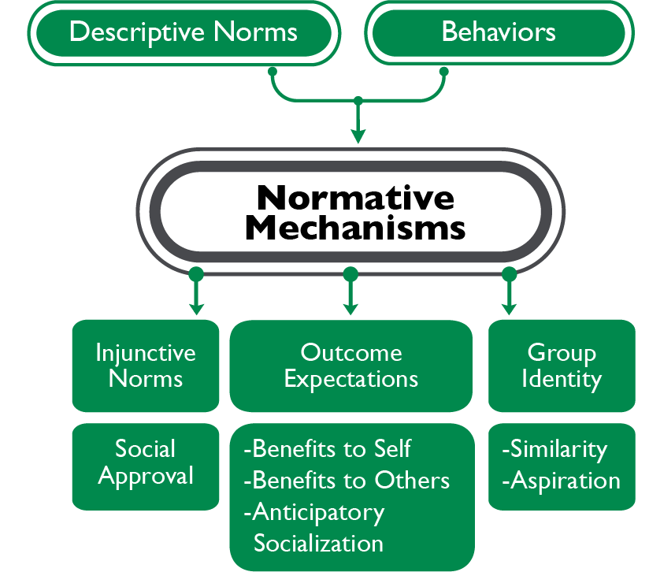
RESEARCH-DRIVEN THEORIES OF CHANGE
Theory of Normative
Social Behavior
Both descriptive and injunctive norms matter.
Descriptive norms (what people perceive as common) have a direct influence.
But injunctive norms (what people should be doing), group identity (belonging), and perceived benefits of conforming also influence behavior.
These factors should be part of norms-shifting interventions.
Notes:
SPEAKER NOTES: The theory of normative social behavior lays out the ways that behavior is influenced by both descriptive social norms and by injunctive social norms. Under this theory, descriptive norms hold a direct influence over behavior, as people are more likely to engage in a behavior they perceive to be common. But injunctive norms are also an important component, the theory holds that injunctive norms, along with group identity, and the perceived benefits or detriments of engaging in a behavior (also called sanctions) moderate the influence of descriptive norms over behavior. For example, if not a lot of men in a community share property legally with their wives, but sanctions are not severe, and it’s not important to group identify, men might be more likely to engage in this behavior. If sanctions are severe and it’s important to group identity, men might be less likely to do this.

Slide 78
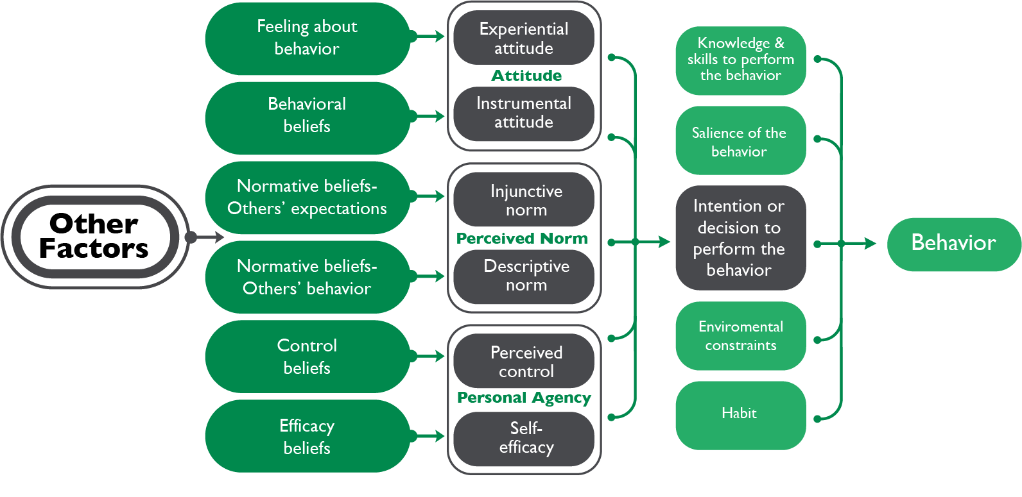
RESEARCH-DRIVEN THEORIES OF CHANGE
Integrated Behavior Model
Notes:
SPEAKER NOTES:
In the integrated behavior model, there are five components that directly affect behavior. Similar to the theory of reasoned action and theory of planned behavior, the most important component is intention. Without the intention to do so, an individual is unlikely to carry out a behavior. Behavioral intention is determined by attitude, perceived norms, and personal agency (or self-efficacy). Under this theory:
Intentions predict behavior.
In turn, attitudes, perceived social norms, and perceived agency influence intention.
Both descriptive and injunctive norms are key underpinnings of intention.
While intention is key, other determinants of behavior exist, including:
Environmental and structural constraints.
Individual’s knowledge and skills to perform the behavior
The relevance of the behavior to an individual’s life
An individual’s habits, or their experience performing the behavior
For example, if a man’s attitudes, perceived injunctive and descriptive social norms, and agency all give him the intention to make his wife co-owner of his property, but he doesn’t know how to go about this, and the relevant government offices aren’t willing to help, he won’t be able to carry out this behavior.

Slide 79
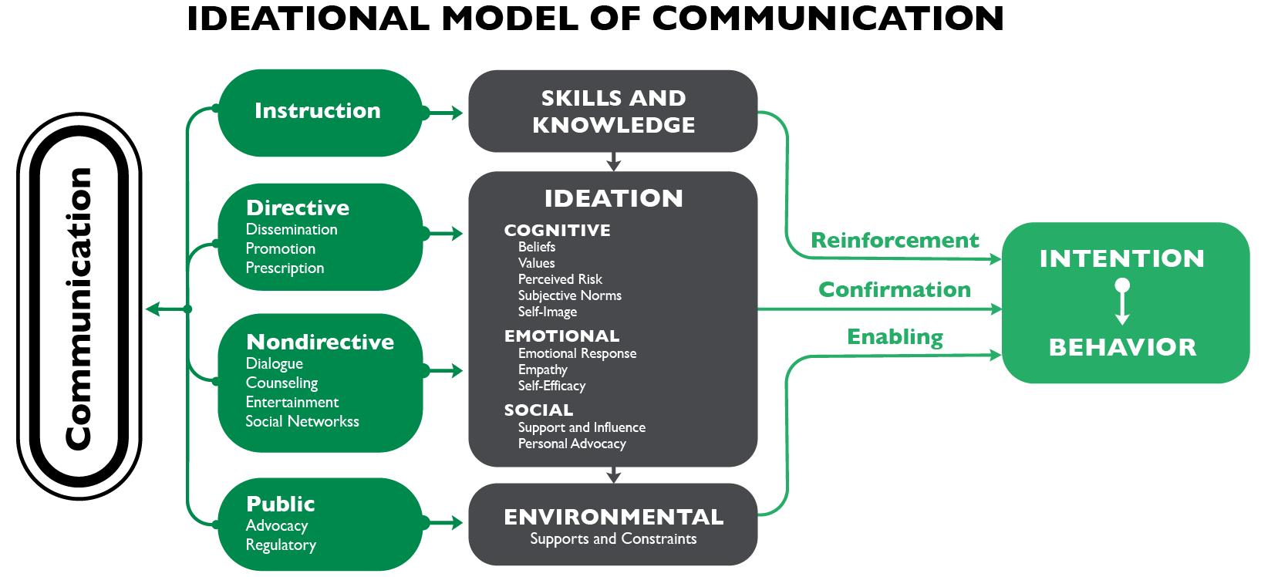
RESEARCH-DRIVEN THEORIES OF CHANGE
Ideational Model of Communication
Notes:
SPEAKER NOTES:
The ideational model of communication refers to how ideation, or new ways of thinking and new behaviors, are diffused through a community. In this theory, individual ideation is closely linked to the intention to perform a behavior, along with having the necessary knowledge, and a supportive environment, to perform the behavior. Ideation is divided into three factors, cognitive, emotional, and social. Norms are part of ideation, and particularly influence a person’s cognitive subjective interpretation of the communication of an idea related to a new behavior. Norms may also influence the social support and influence that will determine the likelihood of a person engaging in a new behavior. For example, if non-directive communication including dialogue and communication through social networks share with men the idea of making their wives co-owners of their property, this will influence the emotional and social domains of ideation, where men feel they have self-efficacy to do so, and social supports (or injunctive norms), and be more likely to engage in this behavior.

Slide 80
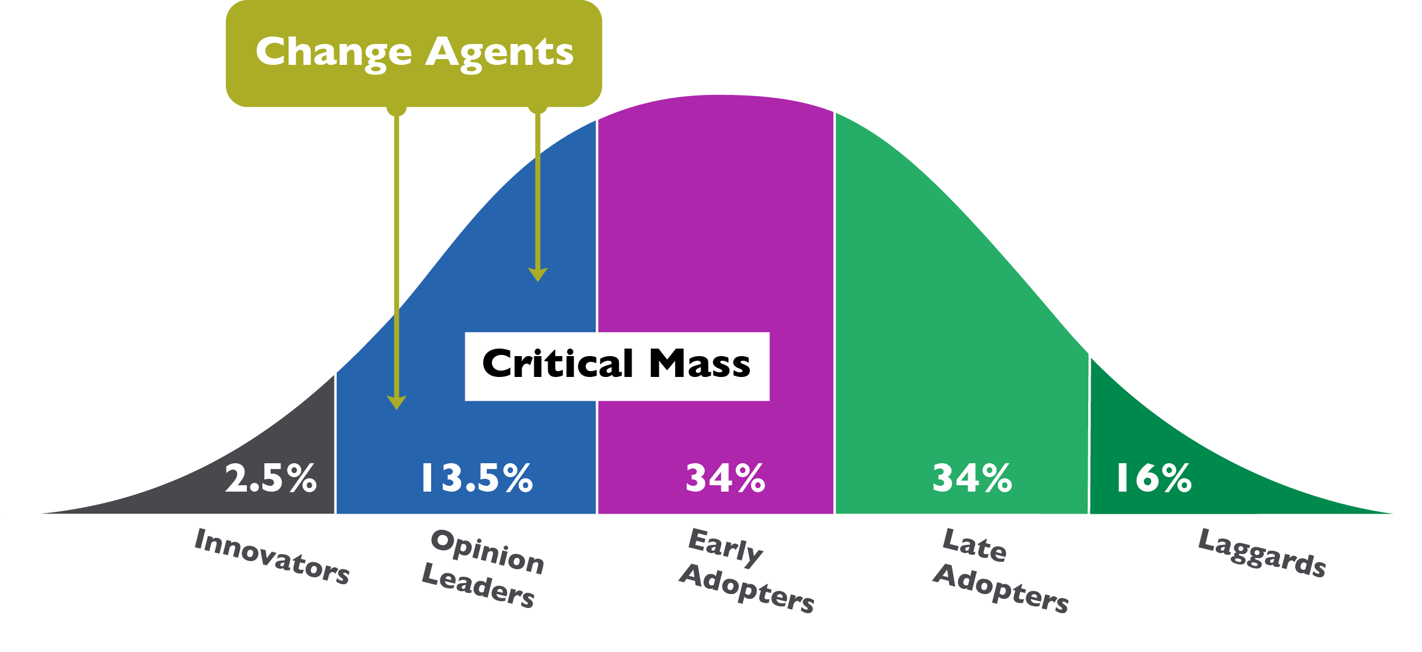
RESEARCH-DRIVEN THEORIES OF CHANGE
Diffusion of Innovation Theory
Notes:
SPEAKER NOTES:
Diffusion of innovation theory lays out a model for how a behavior spreads from a small group to a larger group or population – it looks at adoption of a new behavior over time. In this model, innovation (normative shifts in the case of norms-shifting interventions) should become self-sustaining after a critical mass or tipping point is reached. It’s important to note that in norms-shifting interventions, as with other interventions, 100% of a population is rarely/never reached. In our property co-ownership example, we would communicate the innovation of property co-ownership, through change agents and other strategies, and people in the community might change their mind in stages, reaching a tipping point where change becomes self-sustaining, as the normative and structural environment become more amenable to this – yet some people will never adopt this new behavior. It’s also key to note that the tipping point concept doesn’t hold for all behaviors.

