Slide 1
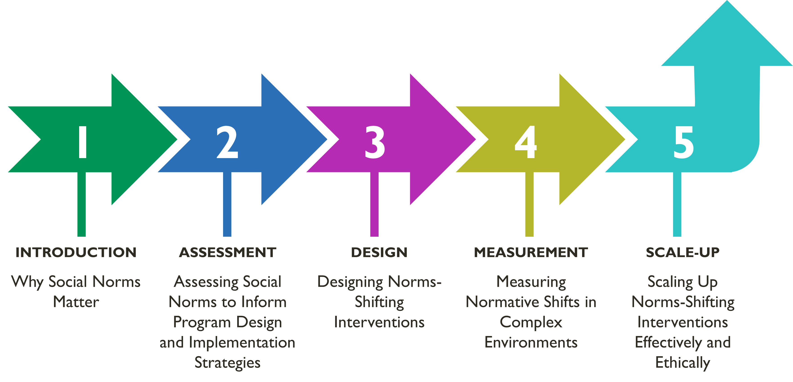
MODULE 3 | DESIGNING NORMS SHIFTING INTERVENTIONS
Overall Course Objectives
Discuss and explore advances in social norms programming, the relation of NSI to behavior change efforts, and their role in health and other-sector programming.
Share challenges and solutions in the design, implementation, and evaluation of community-based SBC projects engaging in, expanding, or planning to expand normative change efforts.
Explore next steps to further collective learning about such promising interventions globally.
Shifting Social Norms as Part of SBC

Slide 2
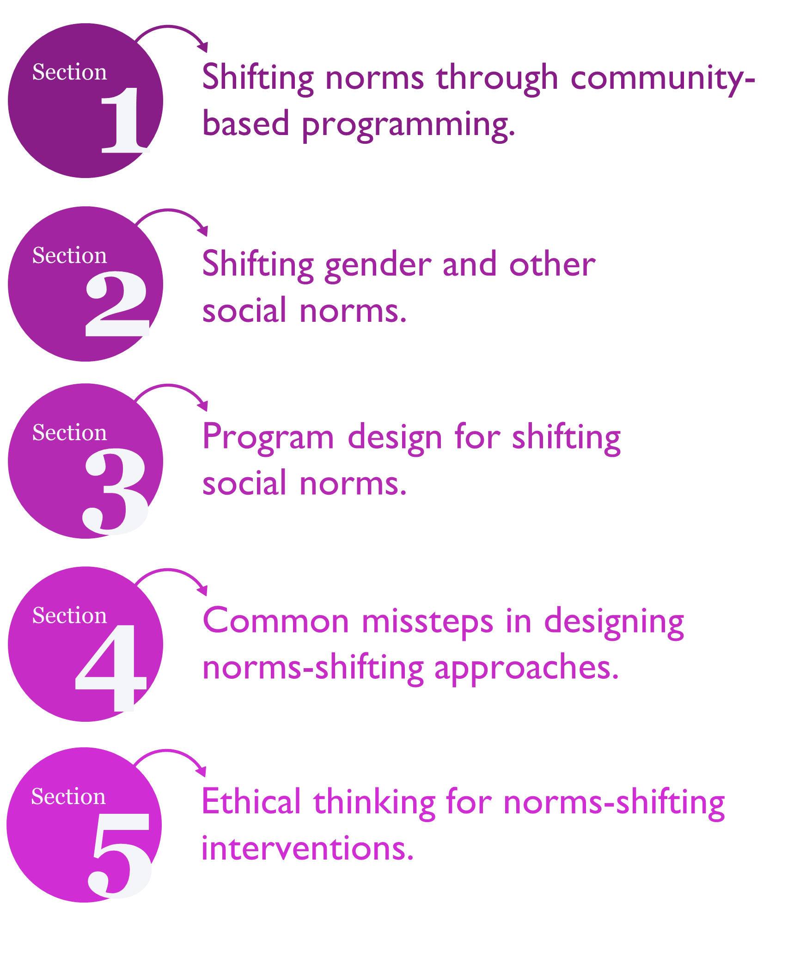
MODULE 3 | DESIGNING NORMS SHIFTING INTERVENTIONS
Overview: Designing Norms-Shifting Interventions
Learning Objectives
During this session, participants will:
Identify the differences between norms-shifting interventions (NSI) and other social behavior change interventions.
Recognize common characteristics of a community-based NSI.
Be aware of ethical considerations for NSI design and implementation.
Discuss strategies to integrate social norms shifting into project design.

Slide 3
MODULE 3 | DESIGNING NORMS SHIFTING INTERVENTIONS
PLENARY ACTIVITY
What makes interventions norm shifting?
Think about the SBC projects that you know.
Do they address the social factors that influence behavior? How?
How do they decrease socio-normative barriers to behavior change
Defining Community-Based NSI
Who | Individual and community as a locus of change.
What | Uses mix of media channels and social spaces to foster critical reflection rooted in cultural values. Works at different levels of social ecology. Based on social norms assessment and identification of relevant norms, planned diffusion of new ideas.
How | Behavior change strategies address normative perceptions and expectations; new, alternative behaviors.
Aim | Seeks to redistribute power and social influence that support individuals’ health behaviors and service use.

Slide 4
MODULE 3 | DESIGNING NORMS SHIFTING INTERVENTIONS
Common Attributes of Community NSI
x
Seeks community-level change
Engages people at multiple levels
Corrects misperceptions around harmful behavior
=
Confronts power imbalances, particularly related to gender
Creates safe spaces for critical reflection by community members
Roots the issue within the community’s own value systems
+
Accurately assesses norms
Uses “organized diffusion”
Creates positive new norms

Slide 5
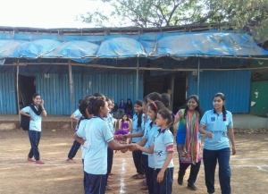
MODULE 3 | DESIGNING NORMS SHIFTING INTERVENTIONS
Case Study - Parivartan for Girls
A sports and mentoring programming
Program Foundation
A sports and mentoring program, Parivartan for Girls, aims to increase adolescent girls’ self-esteem, self-confidence and educational aspirations. In a context where gender norms act as structural barriers to their health, development and wellbeing, Parivartan provides adolescent girls in slum communities of Mumbai with better opportunities. Over 15-months, young women coach the traditional Indian contact sport of Kabaddi. The Mentors guide groups of girls aged 12 to 16. (The original Parivartan program reached adolescent boys and used cricket and other sports to address violence against women by “coaching boys into men.”)
The program empowers adolescent girls to be active in ways that have not previously been considered ‘appropriate’ for them, allowing them to:
Engage in team-based sports with all its mental and physical benefits
Occupy public spaces safely.
Discuss sensitive topics from life skills, aspirations, and reproductive health, to gender, violence and sexual harassment

Slide 6
MODULE 3 | DESIGNING NORMS SHIFTING INTERVENTIONS
Case Study: Parivartan for Girls
Program Formative Research
Initial discussions the program partners and later formative research on norms and other social factors indicated that when adolescent girls reach puberty, their carers restrict them from spending time in public spaces. Girls are expected to be home and do chores for their parents and siblings and learn skills to be a good future wife. In some families, girls stop going to school or go less frequently after puberty to protect them from harassment by men and boys in the community. When people in the community see girls in public settings, they keep an eye on them, scold them, tell their parents, and consider them not to be ‘good girls,’ especially at times when girls are outside instead of helping at home or are talking to boys. When neighbors see girls misbehaving, they start to believe that the family is not raising their children correctly, and the families social respect declines. As a result, girls are allowed to socialize at family events or celebrations, when they walk home from school or run errands for the family. They do not take part in sports, which research shows can build self-esteem and confidence in girls.
Family values, family support and relationships are significant. Girls have close bonds with their mothers and sisters. They have respectful and kind relationships with their brothers and fathers. With older brothers and their fathers, girls will help support their needs at home, such as cleaning clothes, bringing food. Therefore, speaking up in front of these family members when her opinions differ can be hard. In more liberal families, some girls are more willing to initiate and work within their networks to achieve their goals.

Slide 7
MODULE 3 | DESIGNING NORMS SHIFTING INTERVENTIONS
Case Study: Parivartan for Girls
Program Strategies
Apanalaya with the International Center for Research on Women-India designed an intervention that includes:
Mentors. Young women are trained as Mentors. They are relatively progressive and come from the same community.
Gender curriculum. Once a week for 15 weeks, girls and their mentors have group discussions that use prepared cards and reflection questions. The curriculum covers topics including dealing with emotions, goal setting, gender equality, puberty and responding to violence.
Kabaddi sports events. Each week girls play Kabaddi, coached by a Mentor. Girls play at the local school which has enclosed grounds rather than on public sports field. They walk together to and from the sports field, and their neighborhoods and people see the girls moving about and are aware of their sports events.
Parents and Community Reflections. Once each month, mothers and fathers attend reflection sessions with other couples. Topics include communication skills, the value of girls and girl's education, benefits of delayed marriage, issues around sexual harassment.
Parivartan Community Advisory Board guides program design and supports implementation, which shows the value of the program and legitimizing its efforts at a community level.

Slide 8
MODULE 3 | DESIGNING NORMS SHIFTING INTERVENTIONS
Case Study: Parivartan for Girls
Program Evaluation
The Parivartan program evaluation has several lessons for how to design and implement a norms program. These lessons are also supported by similar learning in other community based norms programs.
1. Sports with reflective sessions for girls and parents can be transformative.
There has been debate about whether sports can be transformative. Yet Parivartan shows that when sports are implemented in ways that build comradery and confidence, and conducted in ways that are acceptable while building parent and community support, transformative change can occur (or be a part of it).
2. Build and implement programs with trusted, local and community-embedded partners.
Parivartan was a partnership with INGO and local NGO partners. They designed the program collaboratively, allowing respect for community structures and expectations while being strategic about how to facilitate norms shift for girls opportunity and well being.
3. Invest in those in the community most ready for change.
The program engaged girls and families that were more likely to be supportive, who wanted to participate, who were excited or interested in the program. Implementers did not reach the most conservative families that would not have favored this. The idea was not to leave those girls out, but instead to reach those likely to change first, leading to shifting expectations from fathers and mothers and behaviors from girls – showing support for their opportunity, education, and confidence while indirectly demonstrating that girls could participate and still be respected.

Slide 9
MODULE 3 | DESIGNING NORMS SHIFTING INTERVENTIONS
Case Study: Parivartan for Girls
Program Evaluation (cont.)
4. Foster collective agency in order to cultivate individual agency.
Girls developed networks, worked together on teams and during discussions, and built relationships with mentors. Parents and community participated in discussion groups so they could bring each other along.
5. Ensure that program strategies are culturally appropriate.
The strategies were structured to be acceptable while still providing varied spaces for girls to interact. Concurrent activities for parents and community helped to bring them along with the program. A Community Advisory Board guided the structure. Girls sports and group discussions were held in schools, which were a safe and acceptable space, rather than in public spaces.
6. Make change visible in day-to-day interactions.
The program structured change so that it was visible. Implementers wanted to bring the community along with them and reveal over time that girls could participate in the program, challenge social expectations and still maintain safety and respect. They did this by having Mentors and girls walk together to schools where Kabaddi was played and group discussions were held. When walking to school, they avoided spaces with groups of men. The Mentors were role models to the girls and community on what was possible. Seeing girls and Mentors move around became normal over time. Mentors gained in their reputation by working with a trusted NGO, Apanalaya, modeling good behavior and acting as mentors to young girls. Parents formed relationships with Mentors, which deepened their trust the program. A public sports day provided a way to where community and family could publicly celebrate the girls..

Slide 10
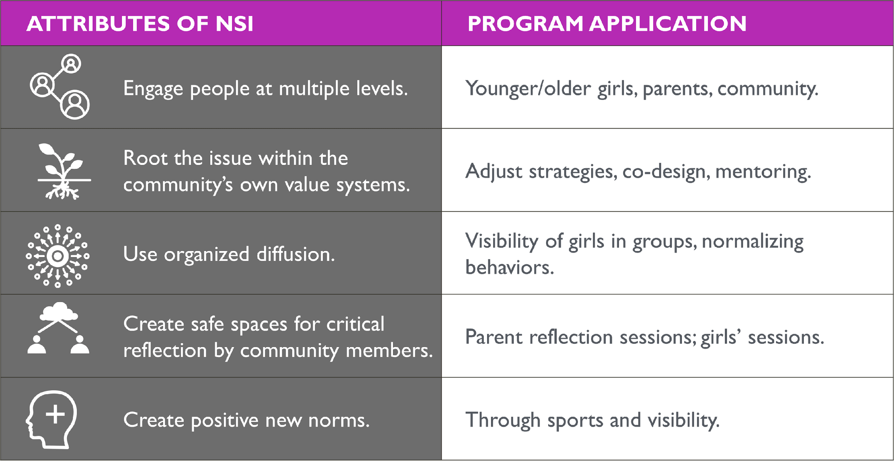
MODULE 3 | DESIGNING NORMS SHIFTING INTERVENTIONS
Case Study: Parivartan for Girls
Program Evaluation
Key Program Learnings
Sports with reflective sessions for girls and parents can be transformative.
Build & implement with a trusted, local, community-embedded partner.
Invest in those in the community most ready to change.
Foster collective agency as a basis to cultivate individual agency.
Ensure that program strategies are culturally appropriate.
Make change visible in day-to-day interactions.
Attributes of Parivartan

Slide 11
MODULE 3 | DESIGNING NORMS SHIFTING INTERVENTIONS
GROUP ACTIVITY
Case Study: Parivartan for Girls
Using the Parivartan case example, identify:
1.The behavior(s) the project seeks to influence.
2.The norm(s) the project seeks to shift.
3. The reference groups for these norms/behaviors and the powerholders.
4. Which strategies address norms and how they do this.
5. Share your discussions with the large group. (10 minutes)

Slide 12
MODULE 3 | DESIGNING NORMS SHIFTING INTERVENTIONS
Common Design Pitfalls
Conflating social norms and personal attitudes
Focusing only on discordant norms and attitudes; overlooking protective norms
Confusing how common is a norm with how important it is for behavior change
Publicizing the wide prevalence of a harmful social norm
GROUP ACTIVITY
Digging Deeper into the Pitfalls
Reflecting on the Parivartan case study, circulate by the four ‘pitfall posters’ on the wall to answer these two questions per pitfall:
Discuss where the four pitfalls might occur during formative assessment and design phases.
Then take a few minutes to reflect on
How you might avoid the pitfalls in your SBC program designs.
How a program could go wrong if we don’t keep these pitfalls in mind.

Slide 13
MODULE 3 | DESIGNING NORMS SHIFTING INTERVENTIONS
Ethical Thinking Case Study: Bell Bajao!
Program Strategies
Goal: To prevent domestic violence by making domestic violence unacceptable in communities and encourage men and boys to take action (ring a bell) when they suspect domestic violence
Organization: Breakthrough-India
Pilot between 2008-2010 (2 years) in India
Adapted and scaled in Bangladesh, Malaysia, Nepal, Pakistan and South Africa
Formative Assessment
People had a surface level understanding of what constitutes domestic violence
Men have power over their spouses and be heads of their families
Men are expected to be macho
Domestic violence was considered a private matter
Intervening in domestic violence will create new problems and result in personal harm

Slide 14
MODULE 3 | DESIGNING NORMS SHIFTING INTERVENTIONS
Ethical Thinking Case Study: Bell Bajao!
Program Overview
Approach: Cultural, organizing and media campaign
Messages: Reach whole communities with a focus on changing men and boys behavior
Strategies:
Interactive website
Online presence (e.g., Facebook, Twitter, YouTube)
Media campaign: television, radio and print PSA’s inspired by true stories
Community mobilization: Leadership training, mass outreach, video vans, face-to-face educational and conversational events
Celebrity support
Program Achievements
Reach: PSAs reached more than 130 million people over 2 years
Increased knowledge about domestic violence
Changed individual and community attitudes towards domestic violence
Domestic violence normalized in conversation
Increase in laws and women seeking justice

Slide 15
MODULE 3 | DESIGNING NORMS SHIFTING INTERVENTIONS
GROUP ACTIVITY
Case Study: Bell Bajao!
Read the case study.
Make note of the values Breakthrough India applied.
Reflect and discuss:
1. What values were considered in program design?
2. How did the values influence program design?
3. Do you think ethical thinking made a difference in program design decisions? Why or why not?
Report out highlights with a focus on question 3.
PLENARY DISCUSSION
Case Study: Discussion in Plenary
Share reflections from group work.
Make note of the values Breakthrough India applied.
Reflect and discuss your group’s takeaways.

Slide 16
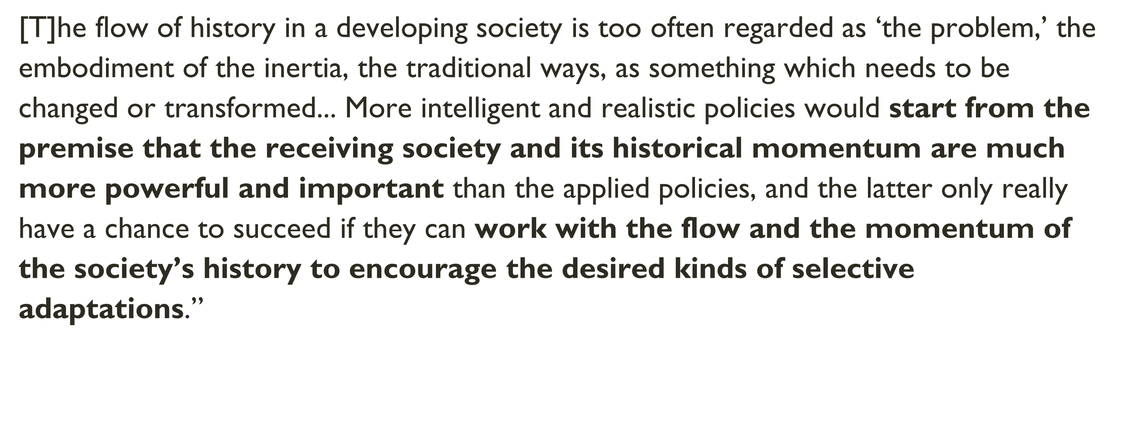
MODULE 3 | DESIGNING NORMS SHIFTING INTERVENTIONS
Norms Exist in a Historical and
Social Context
Social and gender norms are rooted in belief systems.
Norms may outlive their function.
Early adopters change behaviors in a social and structural environment.
Norms change can be exciting, vulnerable, and risky.

Slide 17
MODULE 3 | DESIGNING NORMS SHIFTING INTERVENTIONS
Key Takeaways
Social norms shifting can be complex.
Design processes led by data and co-design will help identify strategies.
Watch out for common pitfalls that can mislead program design.
Ground your work in values and ethics.
Plan for, monitor, and respond to pushback.
Build in flexibility to allow for positive change as it emerges.
Know that one program alone cannot do everything.
Resources
Passages Project. Social Norms Key to Development Programming: Landscaping Finds Their Influence on Behaviors across Sectors. Washington, DC: Institute for Reproductive Health, Georgetown University, 2020. http://irh.org/resource-library/social-norms-landscaping-brief/
The Social Norms Learning Collaborative. Social Norms and AYSRH: Building a Bridge from Theory to Program Design. Washington, D.C.: IRH, Georgetown University, 2019. https://www.alignplatform.org/resources/social-norms-and-aysrh-building-bridge-theory-program-design
The Social Norms Learning Collaborative. Community-Based, Norms-Shifting Interventions: Definitions and Attributes. Washington, DC: Institute for Reproductive Health, Georgetown University, 2019. https://www.alignplatform.org/resources/community-based-norms-shifting-interventions-definitions-and-attributes
The Social Norms Learning Collaborative. Identifying and Describing Approaches and Attributes of Norms-Shifting Interventions. Washington, DC: Institute for Reproductive Health, Georgetown University, 2017. https://www.alignplatform.org/resources/identifying-and-describing-approaches-and-attributes-norms-shifting-interventions

