Slide 1
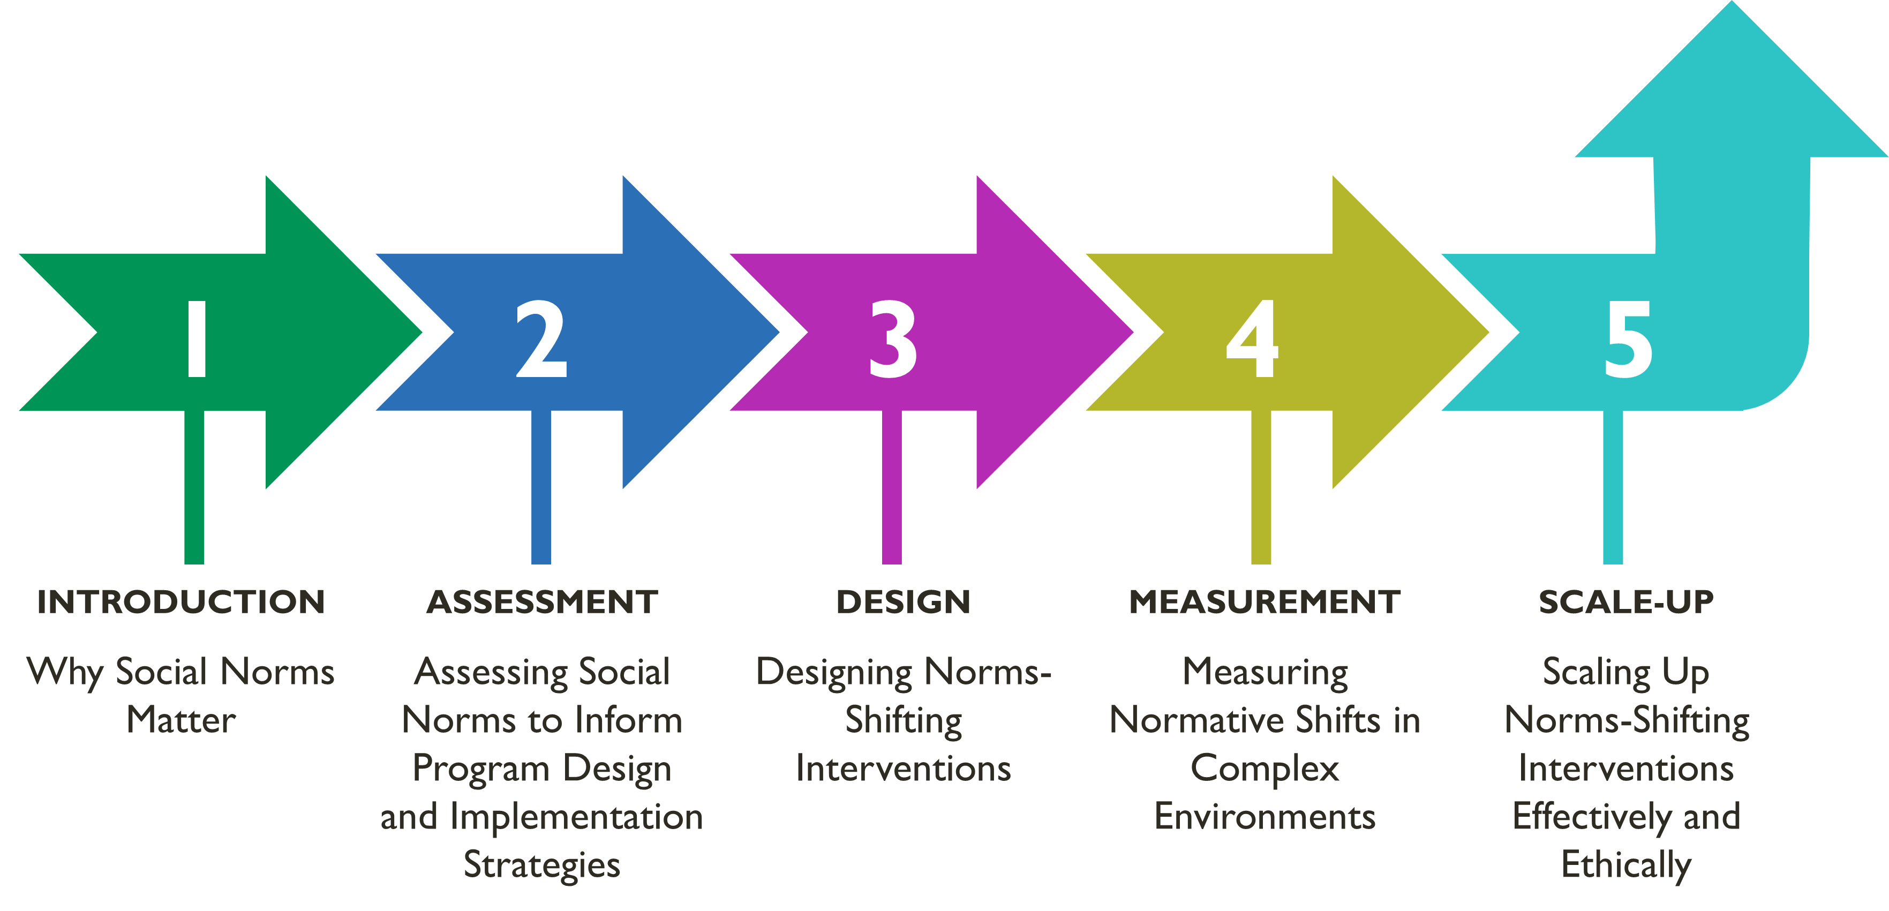
MODULE 2 | ASSESSING SOCIAL NORMS
Overall Course Objectives
Discuss and explore advances in social norms programming, the relation of norms-shifting interventions to behavior change efforts, and the role of social norms in health and other sector programming.
Share design, implementation, and evaluation challenges and solutions for community-based social and behavior change (SBC) projects engaging in, expanding, or planning to expand normative change efforts.
Explore next steps to further collective learning about such promising interventions globally.
Shifting Social Norms as Part of SBC

Slide 2
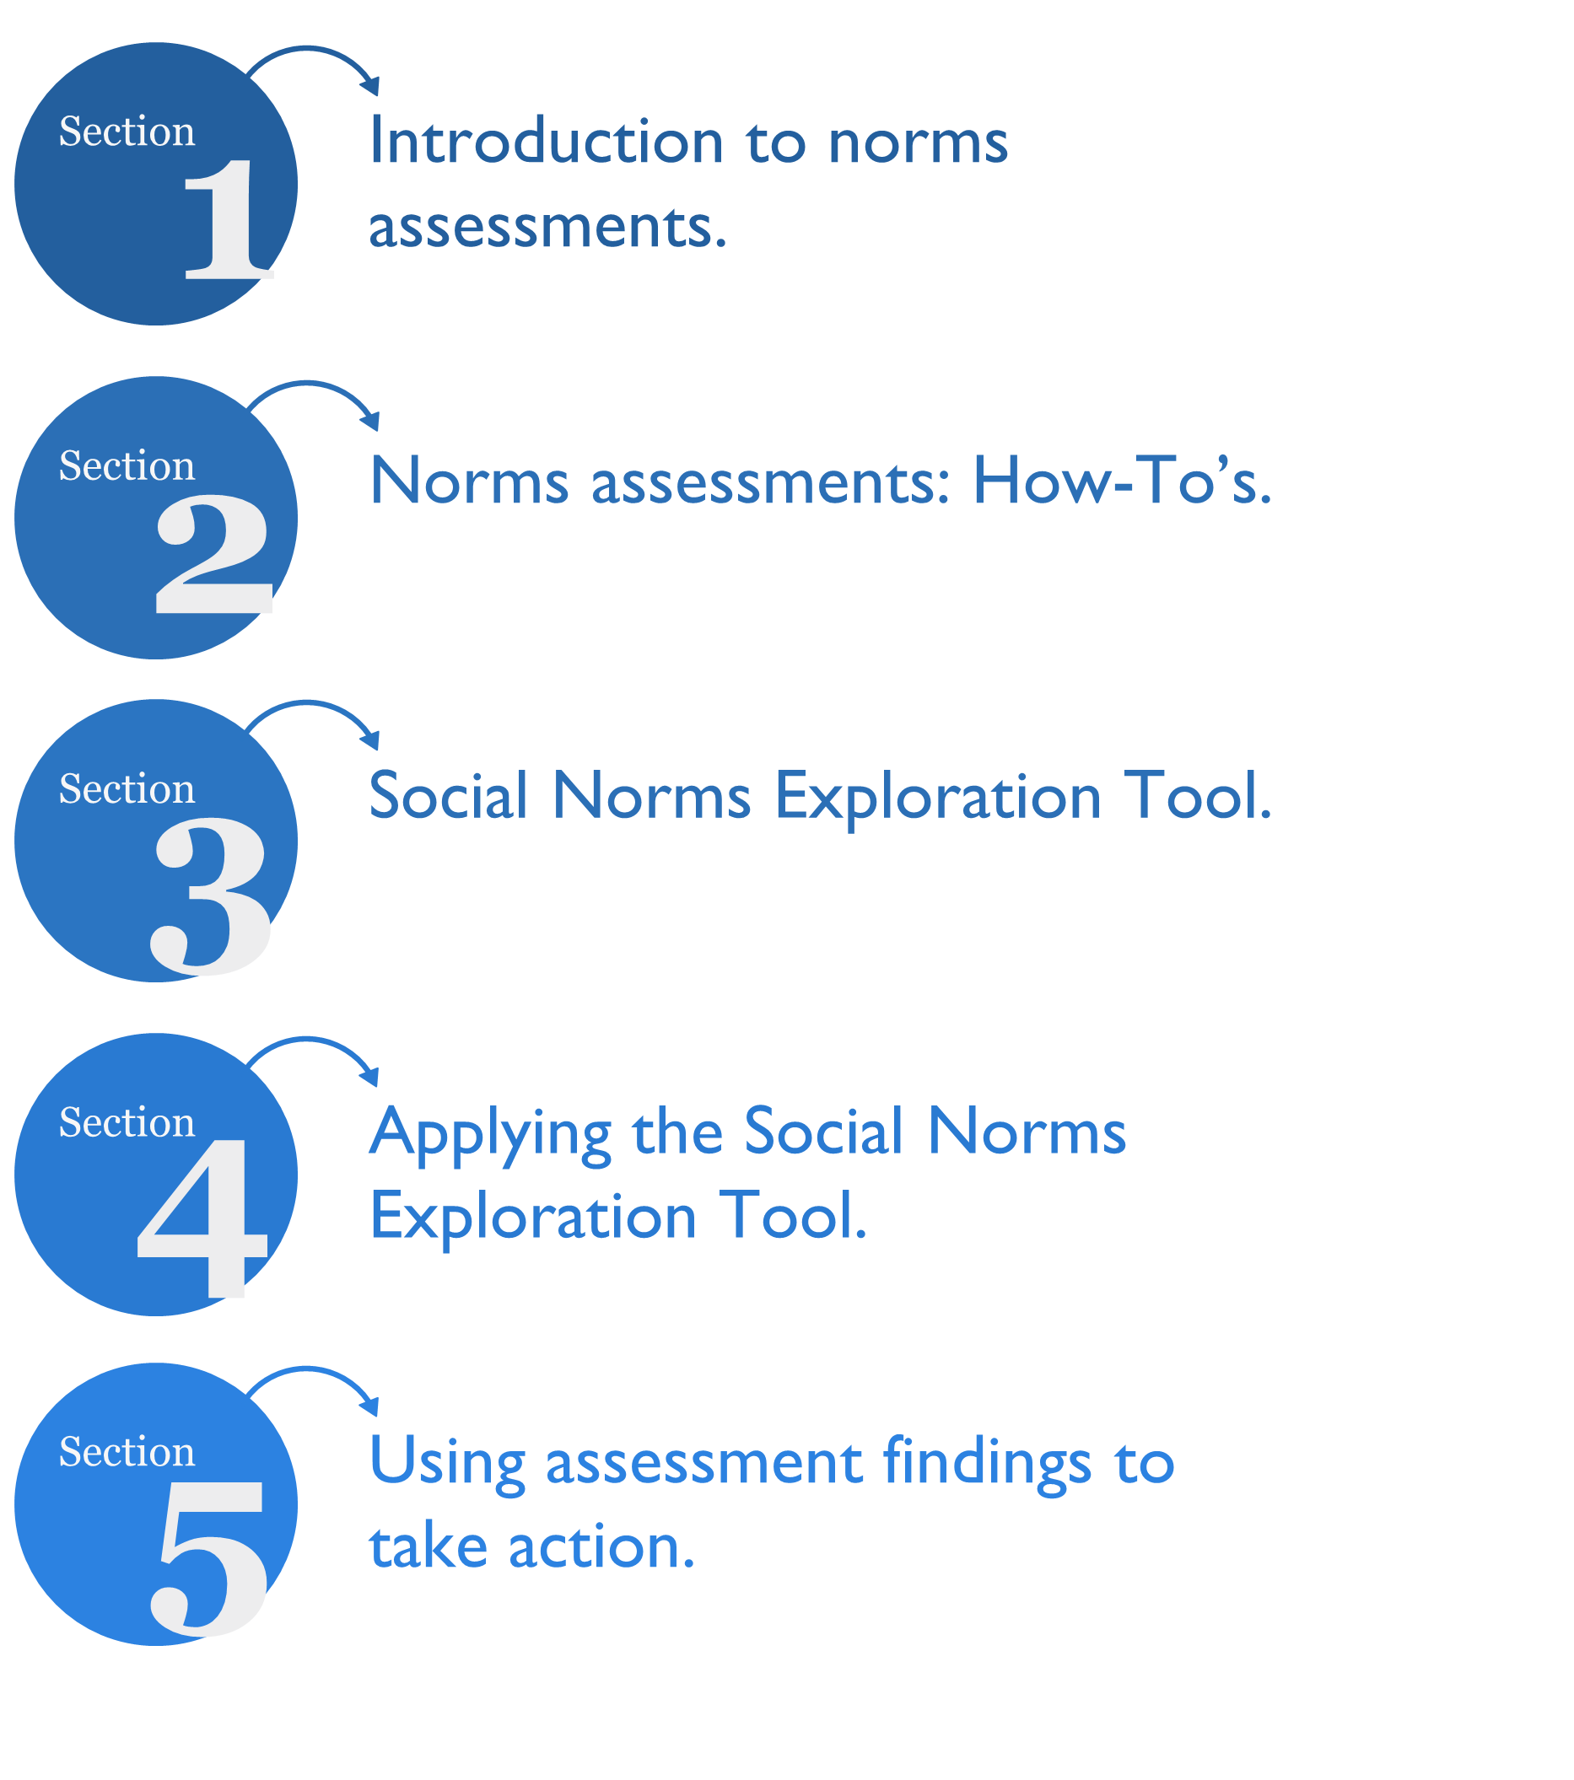
Overview: Assessing Social Norms
Learning Objectives
During this session, participants will:
Identify the value of norms assessments for informing program design and implementation strategies.
Strengthen their understanding of the extent to which norms influence behaviors in key populations and reference groups in their settings and context.
Practice using participatory methods for gathering community-level information to identify reference groups and assess norms that influence behaviors.
Reflect briefly on how to integrate norms assessment findings into new or ongoing projects.

Slide 3
Through a Norms Assessment, You Should Be Able To Answer:
Questions: | Why you want to answer them from a program perspective:
1.Who are the reference groups that influence the behavior? | Identifying reference groups that do or do not support a behavior helps programs include the right people in interventions and evaluations.
2.What are the social norms that influence this behavior? | Identifying the root causes of an issue—including social norms—ensures your program articulates and addresses the range of determinants of behaviors.
3.Why do people comply with social norms? Why not? | Identifying reasons people comply will help unpack the “black box” (or unknowns) in your program. (Maybe it’s because norms are hidden, or people have a strong desire to conform, or they gain social benefits for conforming, or fear sanctions for not conforming.)
4.What are the social norms that influence this behavior the most? | Discussing, analyzing, and prioritizing normative factors (and taking other factors into account) allows more strategic focus of interventions.
Where Do Norms Fit in Current Formative Assessments?
Assessments to understand the drivers of behaviors may not include an explicit focus on norms.
Common formative assessments (like gender analyses) may explore norms but not unpack them enough to take action.

Slide 4
The SNET Assesses Norms in Two Phases
ASSESSMENT ACTIVITY | SNET ACTIVITIES | MAIN PURPOSE
IDENTIFY REFERENCE GROUPS | My Social Networks | Explore which people are influential by providing guidance, information, advice or support on a specific issue.
The Five Whys | Explore the social norms that influence the behavior of interest, learn which may be most influential, and understand the extent norms are influencing behaviors and consequences (sanctions) of not following a norm
EXPLORE NORMS
Problem Tree Analysis | Same as above (the 5 Whys), but this exercise can identify both social and non-social causes of behavior in more specificity in real-time.
Vignettes | Same as above (the 5 Whys and the Problem Tree), but this activity can also reveal more context and nuanced analysis with good probing

Slide 5
CASE STUDY
TULONGE AFYA, TANZANIA
CASE STUDY
Social Norms Assessment Using SNET
Program Foundation
In Tanzania, health outcomes, including reproductive health, are disproportionately worse for women and youth…
Household decisionmaking, including for health decisions like family planning, is seen as the domain of men.
Married women are expected to have many children.
Unmarried men and women are not expected to be sexually active.
Family planning is seen as inappropriate for young, unmarried women to use.
Intervention Components
The Tulonge Afya team developed two platforms—one for pregnant and caregiving adults (NAWEZA) and one for youth ages 15 to 24 (SITETEREKI)—that included a range of SBC activities and materials to reach key groups:
NAWEZA activities: radio shows, spots, social media, community radio, community theatre, small group dialogue, household and facility counselling, and supportive materials.
SITETEREKI activities: radio shows, spots, community radio, youth magnet theatre, small group dialogue, service referrals, household and facility counselling, supportive print materials, and message guides.

Slide 6
CASE STUDY
TULONGE AFYA, TANZANIA
Norms Exploration Scope
The key groups and behaviors explored by Tuloge Afya included:
1. Adults (NAWEZA) 18-49 years
Use of modern contraceptive methods.
Discussion of family planning with partners.
Seeking health care for postpartum family planning options.
Use of modern contraception post-live birth for 24 months.
2. Youth (SITETEREKI) 15-24 years
Use of modern contraceptive methods.
Delay first pregnancies and space future pregnancies.
Correct and consistent use of condoms.
3. Health workers
Family planning counselling on range of postpartum family planning options available.
Provide high-quality, confidential, and nonjudgmental reproductive health services to youth.
Using the SNET
The Tulonge Afya team used the SNET to unpack social norms preventing the uptake of family planning across priority regions.
Through the SNET process, the team gained insights into reference groups and family planning-related norms
The project now plans to adjust implementation and develop new approaches to address these norms.

Slide 7
GROUP ACTIVITY
Instructions
1. In your breakout room, review the case study information again.
2. Review your “assigned” SNET exercise (either vignettes or five whys).
3. Discuss to rapidly determine reference groups. Complete the exercise for the tool you selected and record your work on the Google sheet.
4. Prepare to share the results of your group work using Handout 4C.
GROUP WORK
Five Why’s
1. In your group, select one of the behaviors of interest from the case study and ask, “why does this happen?”
2. For each explanation that emerges, ask “why?’ again four more times, diving deeper into each explanation given (you’ll do this for each “why” you listed at first).
3. Examine the factors that emerged and circle any that are norms-focused.
4. Once selected, discuss of each of the circled norms-focused factors. Why do these happen? Are there positive or negative sanctions for complying?

Slide 8
GROUP WORK
Vignettes
Using the case study, develop a vignette (short story) for group discussions that focuses on one behavior that you think would be contextually relevant.
Your vignette should be a story and have the following elements:
An introduction to the context; be specific but simple.
A situation about the behavior/absence of a behavior.
A situation where a social norm is challenged or broken (and sanctions).
Reference groups.
Open-ended questions to engage with the story about norms.
Questions to Consider When Adjusting Your Program With Findings From a Norms Assessment
Program Design | Program Implementation | Program Monitoring | Program Evaluation
Does your program currently address the key factor (including social norms factors) that influence the behaviors of interest? If not: which factors (including social norms factors) are possible for your program to address? | Do intervention strategies or activities require adaptation to better address reference groups? Do intervention strategies or activities require adaptation to address social normative influences, including relevant reference groups, either to build on positive norms or address harmful norms? | Does the program’s logical framework need to be adjusted to include normative activities—inputs, outputs, effects? Is the monitoring system collecting the correct and relevant information on norms from 1) the primary program groups and 2) the relevant reference groups? | Do you need to make changes in your evaluation framework that mirror the change theory and strategy adjustments? Is the evaluation plan to collect correct and relevant information from not only the primary program groups, but also reference groups?

Slide 9
Key Takeaways
Existing formative assessment approaches may overlook norms. If shifting norms is important to your program, completing a norms assessment is a must.
It’s important to understand how norms influence program behaviors.
Norms assessments answer, for as given context: (1) what the relevant norms are, (2) who the reference groups are, (3) why people comply with norms, and (4) which norms are the most important.
Not all norms assessments are perfect! It’s better to have some solid information than none at all. Do what you can but ensure findings are used.
A number of resources on norms assessments exist, including the Social Norms Exploration Tool.
Resources
Passages Project and the Social Norms Learning Collaborative. Social Norms Exploration Tool. Washington, DC: Institute for Reproductive Health, Georgetown University, 2020. https://irh.org/social-norms-exploration/
Stefanik, Leigh and Theresa Hwang. Applying Theory to Practice: CARE’s Journey Piloting Social Norms Measures for Gender Programming. Cooperative for Assistance and Relief Everywhere, Inc. (CARE), 2017. https://prevention-collaborative.org/wp-content/uploads/2021/08/CARE_2017_Applying-Social-Norms-Theory-to-Practice-CARE_s-Journey-1.pdf
Mackie, Gerry, Francesca Moneti, Holly Shakya, and Elaine Denny. What Are Social Norms? How Are They Measured? New York and San Diego: UNICEF and University of California San Diego, 2015. https://www.alignplatform.org/resources/what-are-social-norms-how-are-they-measured
Thomas, Sarah. What is Participatory Learning and Action (PLA): An Introduction. Sarah Thomas, 2002. http://idp-key-resources.org/documents/0000/d04267/000.pdf
Cislaghi, Beniamino and Lori Heise. Measuring Gender-Related Social Norms, Learning Report 1. London: Learning Group on Social Norms and Gender-related Harmful Practices of the London School of Hygiene & Tropical Medicine, 2016. http://strive.lshtm.ac.uk/system/files/attachments/STRIVE%20Norms%20Report%201.pdf

