Slide 1
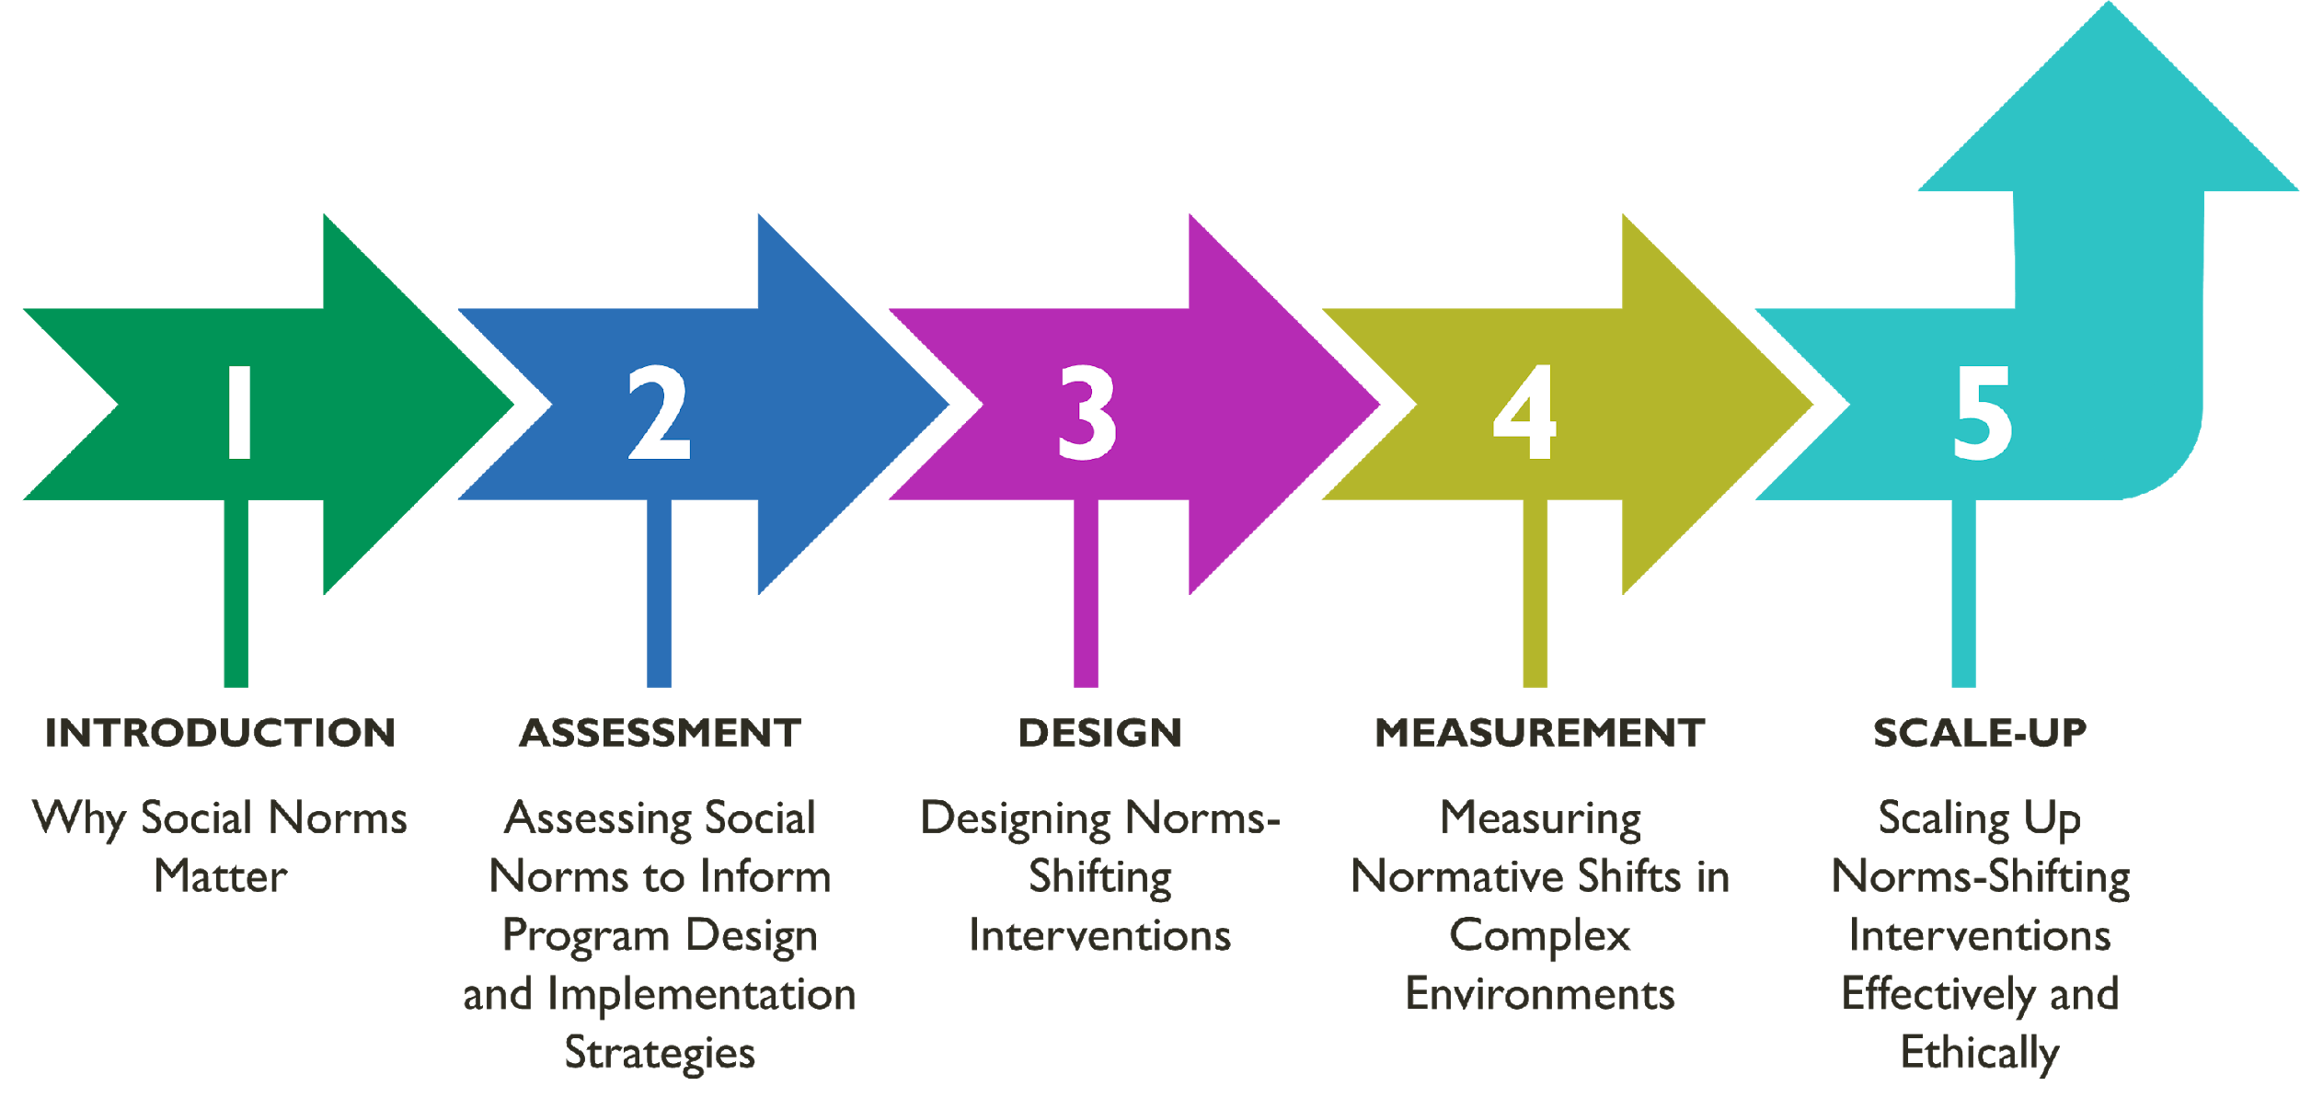
MODULE 1 | WHY SOCIAL NORMS MATTER
Overall Course Objectives
1. Discuss and explore advances in social norms programming, the relation of norms-shifting interventions to behavior change efforts, and the role of social norms in health and other sector programming.
2. Share design, implementation, and evaluation challenges and solutions for community-based social and behavior change (SBC) projects engaging in, expanding, or planning to expand normative change efforts.
3. Explore next steps to further collective learning about such promising interventions globally.
Shifting Social Norms as Part of SBC

Slide 2
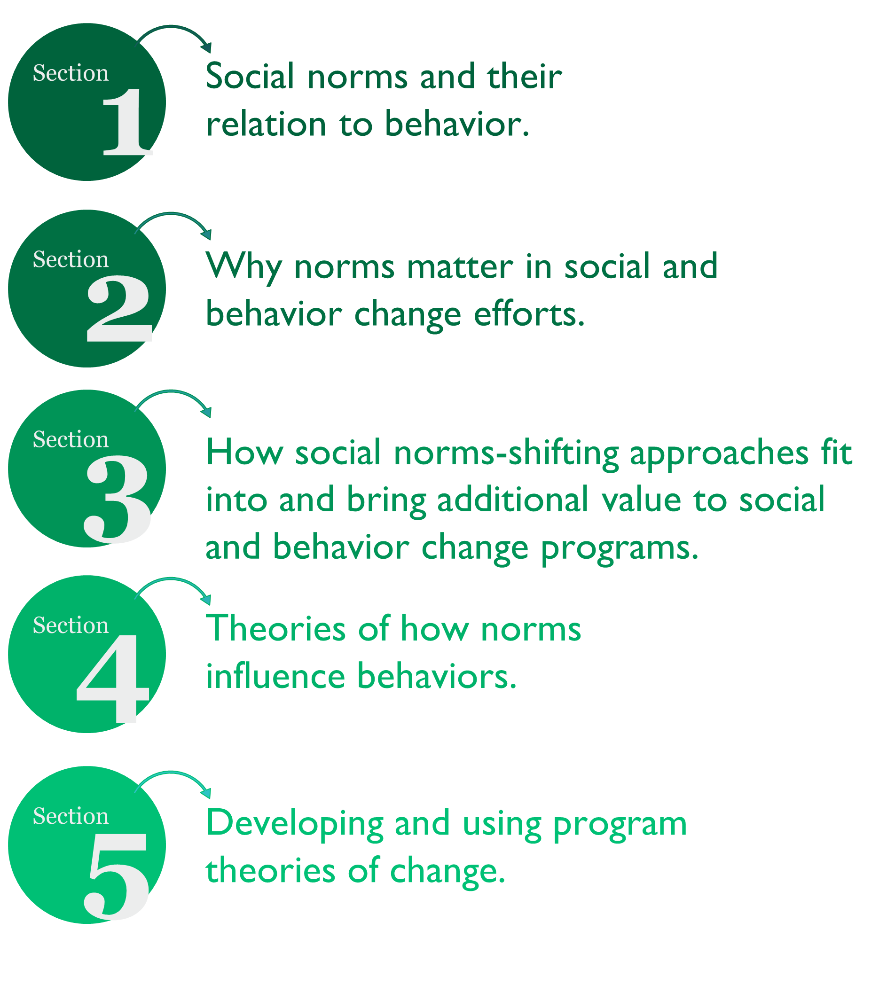
Overview:
Social Norms and their relation to behavior
WHY SOCIAL NORMS MATTER
Learning Objectives
During this session, participants will:
1.Define social norms and distinguish norms from attitudes/beliefs and behaviors.
2. Identify the importance of normative influence between and within different layers of the socio-ecological framework for health and well-being.
3. Explain in practical terms how social norms influence health and other behaviors.
4. Understand how research-informed and program-defined program theories of change situate normative influence on behavior and are important tools for designing and evaluating norms-shifting interventions.

Slide 3
MODULE 1 | WHY SOCIAL NORMS MATTER
Putting it Together
TERM |  | DEFINITION
Behavior |  | What I do.
Attitude or belief |  | What I prefer and what I know.
Social and gender norms | Descriptive norm | What I think others do.
 | Injunctive norm | What I think others will approve/disapprove of me doing.
Reference group |  | People whose opinions matter to me (for a particular behavior or context). People who reward or sanction me for my behavior.
GROUP ACTIVITY
Reference Groups
1. Who were the people you turned to for advice and information on the behavior?
2. Who were the people who most influenced your beliefs/attitudes or behaviors?
3. How might or did these people react if you took or did not take their advice?
4. How might these people react if you changed your behavior?

Slide 4
MODULE 1 | WHY SOCIAL NORMS MATTER
GROUP ACTIVITY
Distinguishing Attitudes, Behaviors, and Norms
YOUR GROUP’S TASKS | EXAMPLE
Select a specific behavior your program is seeking to address. | Breastfeeding.
Describe the context in two words. | Urban Kinshasa.
Articulate an attitude/belief, injunctive norm, and descriptive norm related to this behavior. | Women who breastfeed are good mothers (attitude). My mother and mother-in-law want me to breastfeed my baby, so I do (injunctive norm). I feed my baby formula because my best friends give formula to their babies (descriptive norm).
Identify who might be the reference group for this behavior. | Mother. Mother-in-law.
Name one or two sanctions that might enforce this norm. | Gossip. Respect.
GROUP ACTIVITY
Putting It Into Practice
Your group’s tasks:
Select a specific behavior your program is seeking to address.
Describe the context briefly (for example, urban Kinshasa).
Articulate an attitude and/or belief, injunctive norm, and descriptive norm related to this behavior.
Identify who might be the reference group for this behavior.
Name one or two sanctions that might enforce this norm.

Slide 5
MODULE 1 | WHY SOCIAL NORMS MATTER
GROUP ACTIVITY
Eight Features: Part 1
Instructions
1. In your small group explore how the eight features can be applied. (X min)
2. Use the description of the eight features as reference.
3. Two options to apply the eight features:
Select a norm your project is addressing or wants to address more specifically.
Use the WASH case example provided.
4. Share your small group work. (Y min)
GROUP ACTIVITY
Eight Features: Part 2
Instructions
Choose a social norm related to WASH behaviors to work with:
Women should fetch water
Men should not perform ‘women’s roles’ in the home
Men alone are responsible for household decisions
Women should not attend, or speak up, in community meetings
Women and men should not mix in spaces
Women should be controlled
Men should be given priority to eat the better food before women and children
Women are responsible for taking children to the clinic

Slide 6
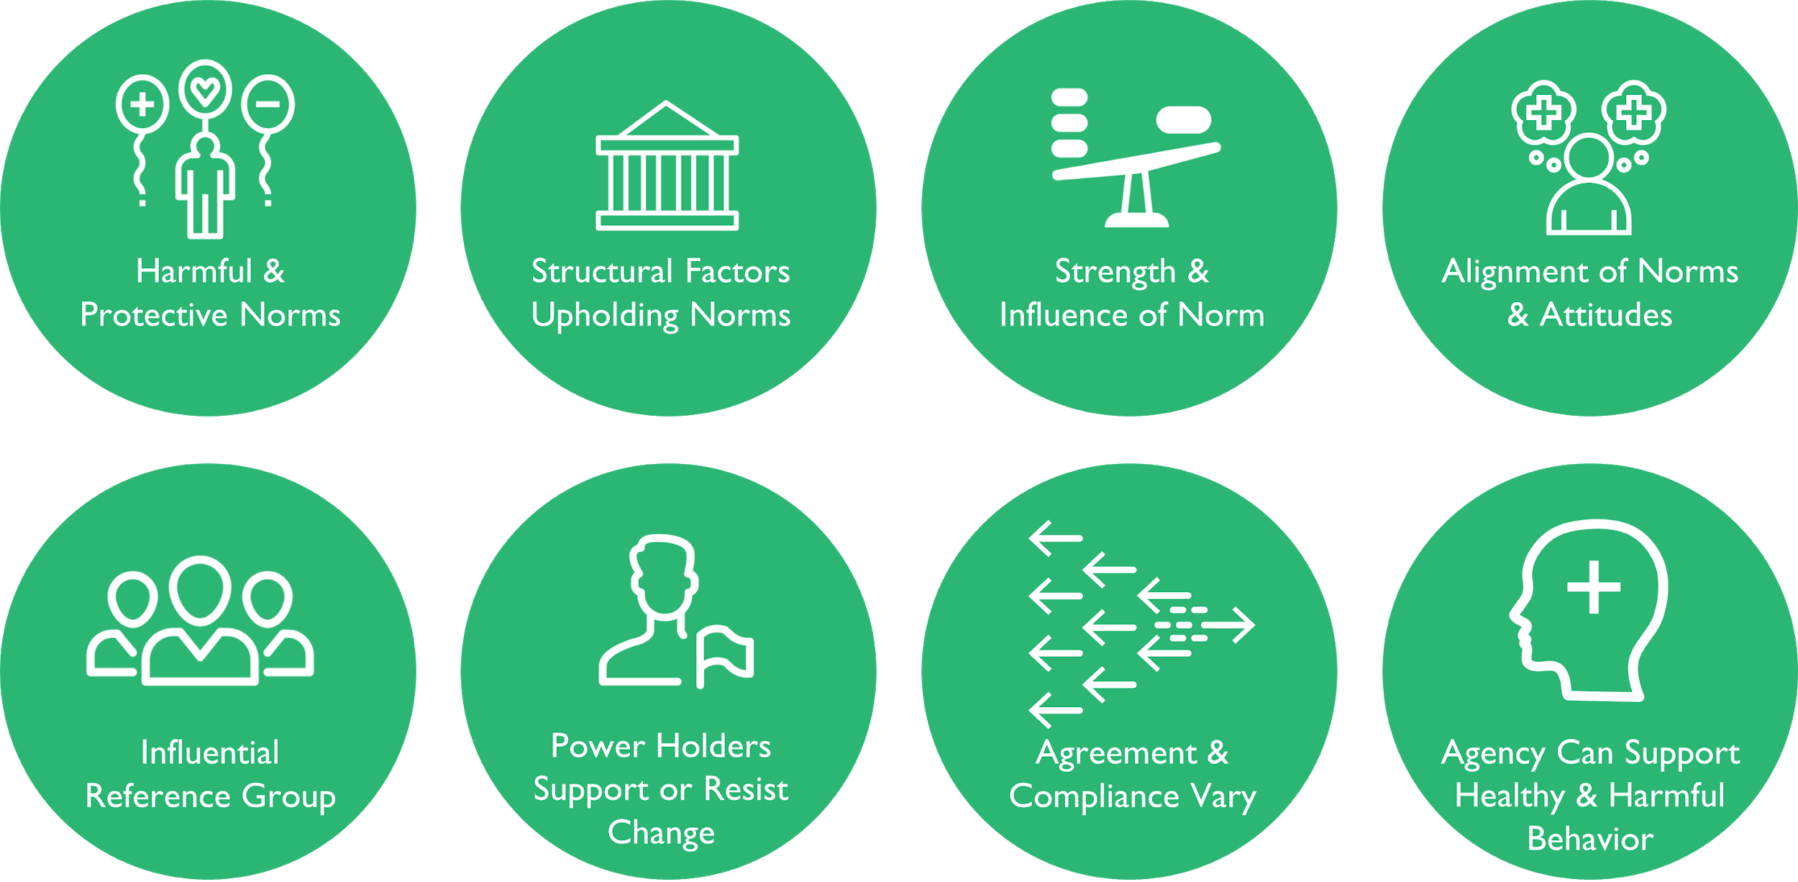
MODULE 1 | WHY SOCIAL NORMS MATTER
Features of Social Norms
GROUP ACTIVITY HANDOUT
Eight Features
Harmful and protective norms - Are there protective norms that could be leveraged?
Influential reference groups - Who enforces the norm? How are they doing it?
Structural factors upholding norms - Are there structural factors that enforce the norm?
Power holders resisting change - To what extent will power holders support or resist change?
Strength and influence of norms - Is the behavior visible? Do people think they can change it?
Agreement and compliance vary - Does everyone uphold the norm? Do some people deviate? Why?
Alignment of norms and attitudes - Are personal attitudes in sync with this norm?

Slide 7
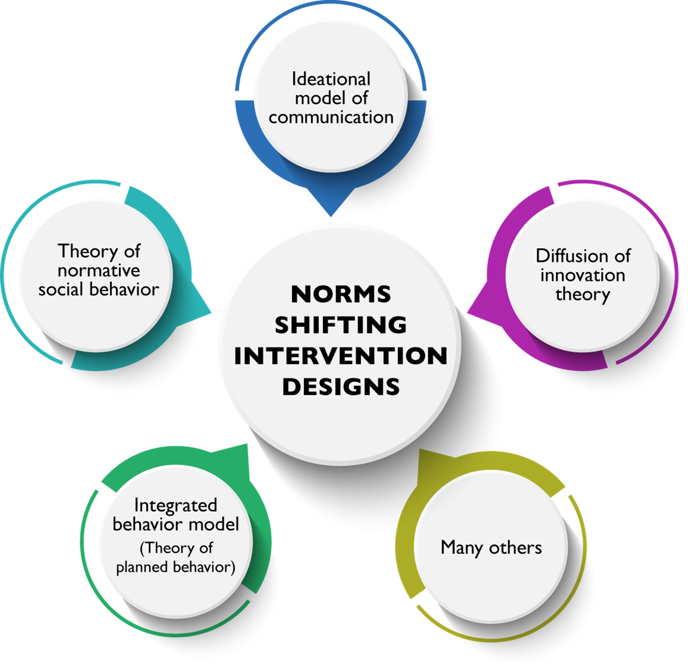
MODULE 1 | WHY SOCIAL NORMS MATTER
PROGRAM THEORIES OF CHANGE
Norms and Behavior Change Theories Come From Different Disciplines and Perspectives
Community Psychology: Norms are a social phenomenon consisting of informal understandings that govern the behavior of members of a society. As norms change so can behavior.
Communication: Norms are a social phenomenon transmitted within a social system through communication. Communication can shape perception and influence behavior.
Systems and Complexity: The interconnectedness of social systems create synergy for newly-emerging behavior. Changing one part usually affects other parts and the whole system, with predictable patterns of behavior.
Prominent Norms and Behavior
Change
Theories

Slide 8
MODULE 1 | WHY SOCIAL NORMS MATTER
Across Theories: Consensus on Factors That Foster Norms Shifting
Multiple norms influence a specific behavior.
Key norm types: descriptive and injunctive.
Role of meta-norms.
Group identity.
Importance of reference groups and social networks in influencing individuals to adopt new behaviors, attitudes, beliefs.
New ideas/ideation diffuse outward.
Diffusion of ideas/ideation: social networks; norm change tipping points.
Intentions predict behaviors.
Dynamic interplay of complexity and systems with individuals’ behaviors.
Implications for SBC Projects Working in the Normative Space
Be relational, not linear, in your approach.
Assess the number and types of norms influencing a specific behavior.
Assess the extent that norms are driving a behavior versus other factors.
Assess norms’ influence in relation to structural, individual, and other factors.
Intervention focus.
Individuals, but also influential reference groups.
Not just knowledge, attitudes, behaviors, but also perceptions about how others think, believe, and act.
Systems approach.
Monitoring emerging change, unexpected change, expecting and mitigating pushback.

Slide 9
MODULE 1 | WHY SOCIAL NORMS MATTER
Key Takeaways
Why norms matter:
Norms, which are distinct from but influence attitudes and behaviors, are important drivers of behaviors.
Norms are sustained and enforced by reference groups, which are different for different contexts and behaviors.
Norms cut across the socio-ecological model and across sectors.
A focus on social norms can improve SBC project outcomes and lead to sustained behavioral shifts.
Why norms theory is important for project design, implementation, and measuring change:
Social science theory and program change theory can inform and help explain how norms influence behaviors.
Norms-shifting activities should be articulated when mapping program change theories for an SBC project, so they do not get “lost.”
Resources
Social Norms Learning Collaborative Resources – Social Norms Concepts
Learning Collaborative to Advance Normative Change, Social Norms Background Reader (Washington, DC: Institute for Reproductive Health (IRH), Georgetown University, 2016).
Learning Collaborative to Advance Normative Change, The Flower for Sustained Health: An Integrated Socioecological Framework for Normative Influence and Change: A Working Paper (Washington, DC: IRH, Georgetown University, 2019).
The Social Norms Learning Collaborative. Social Norms Background Reader. Washington, DC: Institute for Reproductive Health (IRH), Georgetown University, 2016. https://www.alignplatform.org/resources/social-norms-background-reader-0.
The Social Norms Learning Collaborative. The Flower for Sustained Health: An Integrated Socioecological Framework for Normative Influence and Change: A Working Paper. Washington, DC: IRH, Georgetown University, 2019. https://www.alignplatform.org/resources/flower-sustained-health-integrated-socio-ecological-framework-normative-influence-and

Slide 10
MODULE 1 | WHY SOCIAL NORMS MATTER
Resources
Social Norms Learning Collaborative Resources – Social Norms Concepts (cont.)
The Social Norms Learning Collaborative. Top 20 Resources on Social Norms. Washington, DC: IRH, Georgetown University, 2019. https://www.alignplatform.org/resources/learning-collaborative-top-20-resources
The Social Norms Learning Collaborative. Social Norms and AYSRH: Building a Bridge from Theory to Program Design. Washington, D.C.: IRH, Georgetown University, 2019. https://www.alignplatform.org/resources/social-norms-and-aysrh-building-bridge-theory-program-design
Cislaghi, Beniamino. “What Are Social Norms and Why Do They Matter for Adolescents?” Learning Collaborative Blog Series, Nov. 26, 2018. https://irh.org/measurement_1/.
The Social Norms Learning Collaborative. Social Norms Atlas: Understanding Global Social Norms and Related Concepts. Washington, DC: Institute for Reproductive Health, Georgetown University, 2021. https://www.alignplatform.org/resources/social-norms-atlas-understanding-global-social-norms-and-related-concepts
Behavior change theories and social norms
Davis, Rachel, Rona Campbell, Zoe Hildon, Lorna Hobbs, and Susan Michie. “Theories of Behaviour and Behavior Change Across the Social and Behavioural Sciences: A Scoping Review.” Journal of Health Psychology Review 9, no. 3 (2015): 323-44.
Health Communication Capacity Collaborative. “Social and Behavior Change Communication.” Urban Adolescent Sexual and Reproductive Health Social and Behavior Change Communication Implementation Kit. Last modified 2016. https://sbccimplementationkits.org/urban-youth/urban-youth/part-1-context-and-justification/social-and-behavior-change-communication-and-theory/
Valters, Craig. Theories of Change: Time for a Radical Approach to Learning in Development. London: Overseas Development Institute, 2015. https://odi.org/en/publications/theories-of-change-time-for-a-radical-approach-to-learning-in-development/
Fishbein, Martin and Icek Ajzen. Predicting and Changing Behavior: The Reasoned Action Approach. New York, New York: Routledge, 2009.
Rimal, Rajiv N. and Kevin Real. "How Behaviors Are Influenced by Perceived Norms: A Test of the Theory of Normative Social Behavior." Communication Research 32, no. 3 (2005): 389-414.
Kincaid, D. Lawrence, Maria Elena Figueroa, Douglas Storey and Carol R. Underwood. “Communication, Ideation, and Contraceptive Use: The Relationships Observed in Five Countries.” Paper presented at the World Congress on Communication for Development. Rome, Italy: 2006.
Kincaid, D. Lawrence. “From Innovation to Social Norm: Bounded Normative Influence.” Journal of Health Communication 9, sup. 1 (2004): 37-57. DOI: 10.1080/10810730490271511.
Diffusion of innovation
Rogers, Everett M. Diffusion of Innovation, 4th ed. New York: Simon and Schuster, 1995.
Rogers, Everett M. and D. Lawrence Kincaid. Communication Networks: Toward a New Paradigm for Research. New York: Free Press, 1981.

