Slide 1


Tékponon Jikuagou ORIENTATION (DAY 1)
USING SOCIAL NETWORKS TO ADDRESS UNMET NEED FOR FAMILY PLANNING

Slide 2
ORIENTATION TO KEY CONCEPTS
Unmet need, including the influence of social factors that prevent people who want to space births from acting
Social Norms
Gender
2. Social Networks
3. Reflective dialogues

Slide 3
UNMET NEED

Slide 4
UNMET NEED
What does unmet need mean?
How could social barriers influence people to act (or not) on their unmet need?
Notes:
Modeste & J.B’s advice.: Let at least two people per question answer
Bintou and Mariam’s advice: Let at least two people per question answer and / or allow a minimum time for the debate.
The definition of unmet need includes 'people who are not pregnant and do not want to have a child during the next two years, but do not use FP.‘ There are two aspects of unmet needs:
1) Either I wish or do not wish to have a child, and the factors influencing this desire:
In Benin, people tend to favor a large family, and therefore do not want to limit or space births. Why?
(Answers: Not yet given birth to a son, pressure from in-laws, pressure from the husband, pressure to get pregnant immediately after marriage)
2) Or, I do not wish to have a child, but I do not use FP
In Benin, a variety of reasons may determine why a person might not want to have a child, but does not use FP: household decision-maker (this person may want to have more children than the number desired by the woman); if the woman already has given birth to a son; fear of side effects and infertility
Implications:
Men and women BOTH may experience unmet need
People can have an excellent knowledge of FP and still feel unmet need
Unmet need id not the same as demand for FP - although I do not want to have a child, there may be other barriers (social) to the use of FP

Slide 5

Social Barriers
Barriers arise when social norms hinder people’s ability to discuss, seek and use FP methods - or indeed, understand their need for FP. Social norms are all factors (acceptance, inclusion, stigma, exclusion) which adhere to, or diverge from a specific social value.
Notes:
Example 1: A woman who has just had her first child. She hasn’t yet spoken about FP with her husband because she knows her family will not agree. Her mother-in-law told her before the wedding that she wants lots of children, and the woman wants to please her husband's family because she lives far away from his parents now ...
Example 2: A man who sees that his wife is suffering after the birth of their third child within 4 years of their marriage. He thinks she will agree to use a family planning method to avoid another pregnancy, but he is afraid that his friends will make fun of him. They will say that he is not the village chief and that his wife has all the power.
Example 3: A religious leader who is well respected in the village began to believe that FP is a very good thing. He has seen that people are more free and happy when they use implants to space births, but he feels that the majority of the village are not of that opinion. Moreover, he knows that it is not considered proper to talk about these things in public ...

Slide 6
Social Barriers
How might social barriers influence someone who wants to space births to prevent him or her from acting?
How do social barriers differ between men and women?

Slide 7

GENDER
Social, cultural and economic attributes, as well as opportunities that society confers as a result of being a man or woman.

Slide 8
GENDER
How could gender influence someone who wants to space births and prevent him or her from acting?
How does the influence of gender differ between men and women?

Slide 9
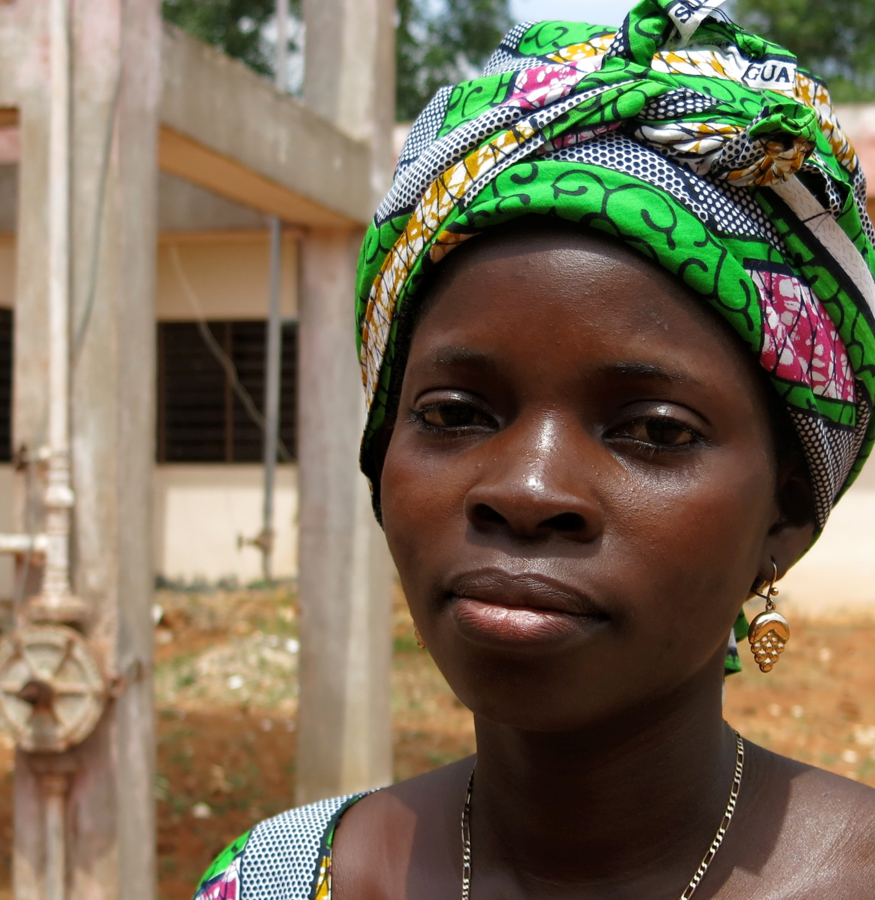
UNMET
NEED DEFINED:
A woman who…
Is not pregnant
Wishes to avoid or delay pregnancy
Perceives she is at risk of becoming pregnant
Uses no method of contraception (modern or traditional)
Notes:
All four conditions are not necessary for a woman or a man to be deemed in a situation of unmet need. It is important to emphasize the last condition.
This is the defintion of perceived unmet need. In the context of TJ, the person must satisfy all four criteria to be considered as having perceived unmet need. Unperceived unmet need is taken into account in no perceived need.

Slide 10
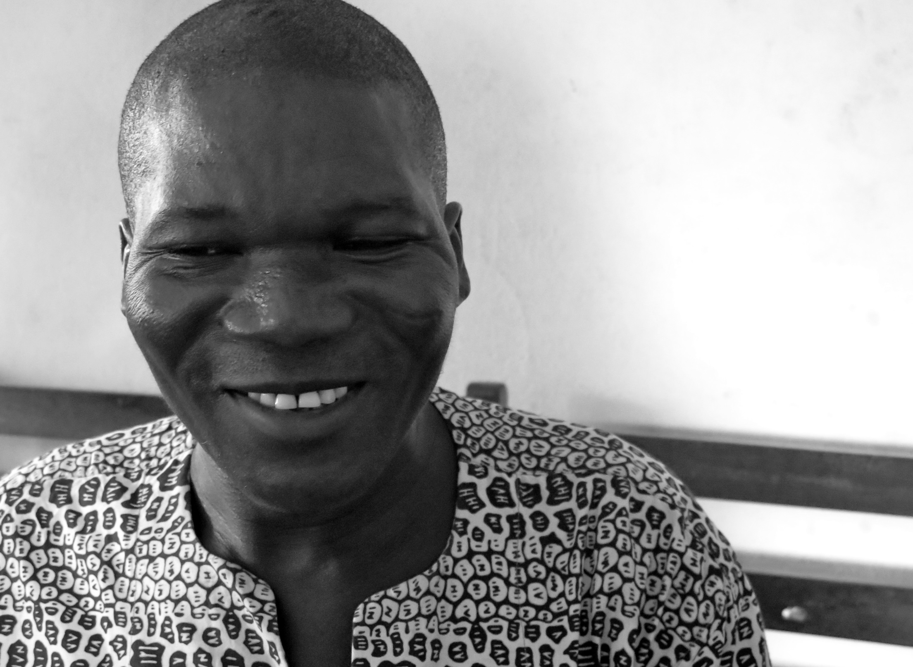
UNMET
NEED DEFINED:
A man who…
Does not have a pregnant wife
Wishes to avoid or delay pregnancy
Perceives that his wife may become pregnant
Uses no method of contraception (modern or traditional)

Slide 11
Categories of unmet need
Married women of reproductive age
Met need, real or perceived
No need
real or perceived
Perceived unmet need
Using a modern method
= MET NEED
Not using a method:
Pregnant
Desires a child now
Not having sex
Menopausal
Had hysterectomy
= NO NEED
Not using a method and does not meet the criteria of "no need“ criteria
= UNMET NEED
Using a traditional method
= PERCEIVED MET NEED
Not using a method:
Infrequent sex
Thinks she is not fertile, or
Thinks husband is not fertile
Gave “breastfeeding” as a reason for not using a method, or
Gave “postpartum amenorrhea” as a reason for not using a method
= PERCIEVED NO NEED
Notes:
DEFINITIONS OF FAMILY PLANNING NEED
As the ultimate goal of Tékponon Jikuagou is to reduce unmet need for FP, it is important to have a clear definition of unmet need. Many definitions of unmet need for FP exist. Our definition differs from those commonly used because it focuses on the perceptions of the individual as follows:
MET NEED: Individuals who use any FP method, modern or traditional. We believe that every person taking measures to prevent or delay pregnancy, regardless of the actual effectiveness of the method, considers that their FP needs are met.
NO NEED : Individuals currently desiring children, pregnant women, menopausal women, or those who are not sexually active and believe they are protected from pregnancy (this perception may be correct or incorrect) and individuals who think they have no need for FP for other reasons.
UNMET: Individuals who do not desire pregnancy, but are sexually active and are not using a family planning method. In other words, any individual not within the "unmet need" or in "no need" categories.

Slide 12
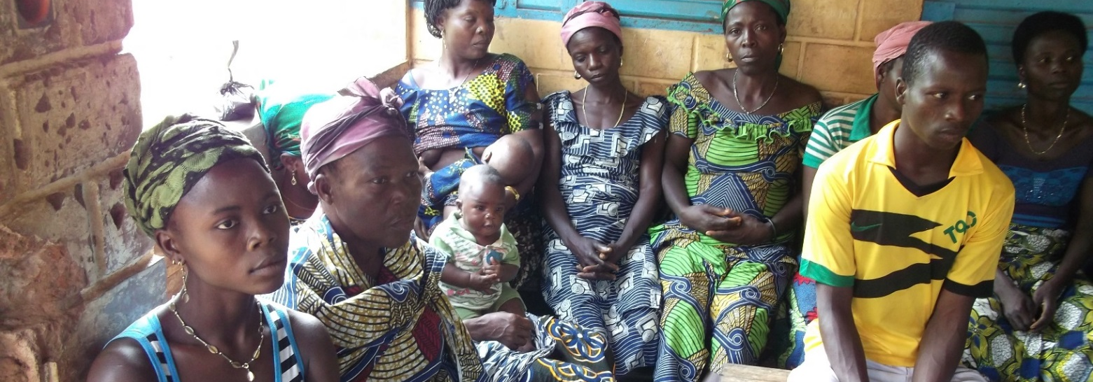
KEY FINDINGS:
UNMET NEED
Segmentation of programs to meet the needs of those who have unmet need AND perceived unmet need
Meeting the needs of users of traditional methods
Helping women and men correctly assess the risk of pregnancy
Notes:
Note: This is important because it shows why we categorize the different need statuses.
In fact, we segment categories of unmet need in the TJ program to address the categories of unperceived needs.

Slide 13
SOCIAL NETWORKS

Slide 14
Why a social Network approach?
Research shows that social barriers are the main factors contributing to unmet need for FP
People talk with, learn from, and receive information from others
  Therefore, social networks can influence and support the diffusion of information and new ideas about FP

Slide 15
SOCIAL NETWORKS influence Diffusion THROUGH ...
Social Influence
Network members serve as "guardians" of social norms to ensure authorization and avoid conflict
    Social Learning
    Network members exchange ideas and information; they assess the advantages and disadvantages of an innovation
Notes:
Men and women can receive correct information on reproductive health from established health institutions, but they also make decisions on the basis of narratives circulating in their informal social networks, and they find additional information from service providers from informal conversations. By observing, discussing, criticizing, and evaluating, people pass information from one to another and from public sources to groups.
Communications follow inter-personal channels, as well as multiple other media channels, provide information on the existence of new behaviors, reduce uncertainty regarding the consequences of new choices, and reduce the cost of innovation by changing social norms.

Slide 16
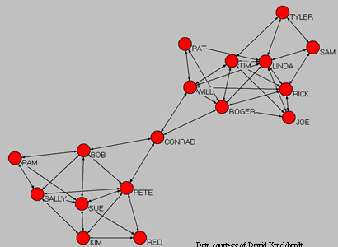
ConnectOrs & influencers
Influencers are the most designated individuals in a network. They have a direct influence on more people.
Connectors are the quickest path towards others. They are the doormen, the brokers, who control the movement and establish links between cliques.

Slide 17


How networks support the diffusion of information and ideas on FP
Person with unmet need for FP
Other users of FP
Social Influence
Social Learning
Social Support
Notes:
N.B.: A person with an unmet need for FP is able to satisfy this need through social influence, social learning and social support from network members

Slide 18
Orientation on Key concepts: reflective AND participatory DIALOGUES

Slide 19
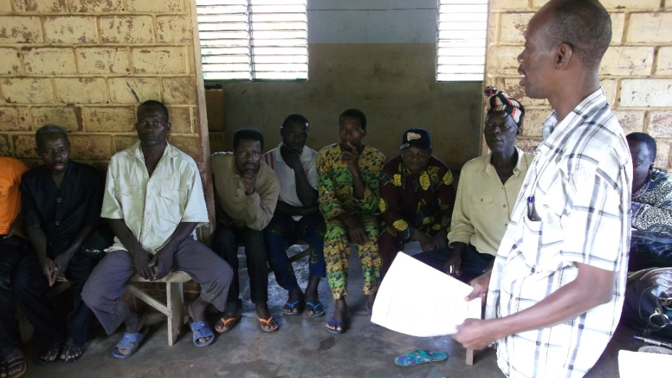
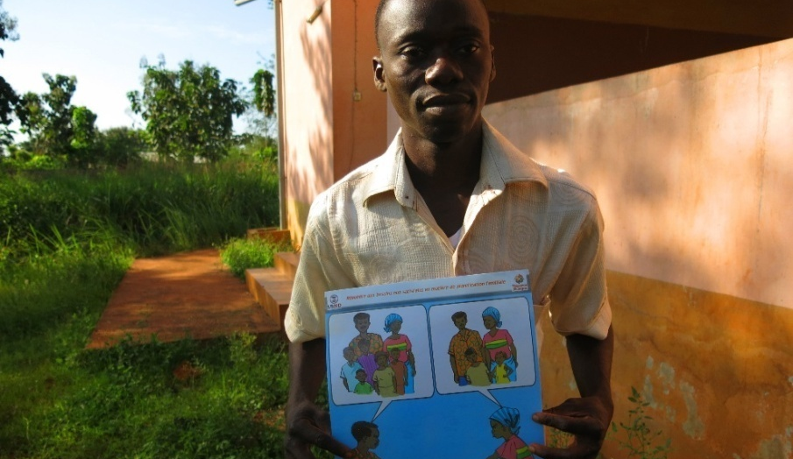
Why the approach of reflective and participatory dialogues?
Most causes of unmet need relate to social norms and gender:
Couple communication and decision-making
Social and community stigma related to the use of FP
Women may have no control over fertility choices

Slide 20
Why the approach of reflective and participatory dialogues?
  Individual behavior is often determined by social norms
  Social norm change depends on opportunities to reflect personally and with others on these norms, which can be beneficial for all
Notes:
Note: Careful! Networks can be just a much a source of problems as of solutions.

Slide 21

Reflective and Participatory Dialogues
Create "safe" spaces for dialogue so that men and women may reflect on social factors relating to important decisions in their lives, such as discussions between couples about family planning and the power dynamics between men and women and their role in these decisions.
Notes:
Also called communication for change our social mobilization
Allows communities to identify and address the social, economic and cultural factors that influence health.
Goes beyond the traditional "communication for behavioral change”, to address "social change".
Explores alternative ways of thinking, feeling and being.

Slide 22
TWO COMPLEMENTARY
APPROACHES
Social Network Approach
Reflective & Participatory Dialogue Approach
Using men’s and women’s interpersonal connections to disseminate new ideas and influence
Assures that the flow of ideas contain attitudes, values and norms that support the use of FP by individuals who want it

Slide 23
?
WHAT CHARACTERIZES THE TJ APPROACH COMPARED TO CONVENTIONAL DEVELOPMENT OR IEC PROJECTS?
Notes:
General discussion - how is it this different from a normal community development project? How do these approaches differ from the IEC approach?

Slide 24
YOUR CURRENT PROJECTS
Do they address social barriers? Which ones? How?
Do they incorporate a gender approach? How?
Do they use social network approaches? How?
Notes:
General discussion - how is it this different from a normal community development project? How do these approaches differ from the IEC approach?

Slide 25
WHAT DIFFERENTIATES THE TJ APPROACH FROM OTHER CONVENTIONAL DEVELOPMENTS OR IEC PROJECTS?
TJ | CLASSICAL PROJECTS
Aims to change the flow of information and social influence | Focuses on the behavior of individuals
Uses groups to reach leaders AND connectors with information | Prioritizes improving the quality and availability of services
Uses reflection and critical dialogue to alter mindsets and achieve change | Uses messages and information to convince people to adopt expected behaviors
Includes men too | Often focuses exclusively on women of childbearing age
Notes:
As you can see, there are key differences

Slide 26


EXERCISE:
AGREE / DON’T AGREE

Slide 27
THE TJ APPROACH

Slide 28
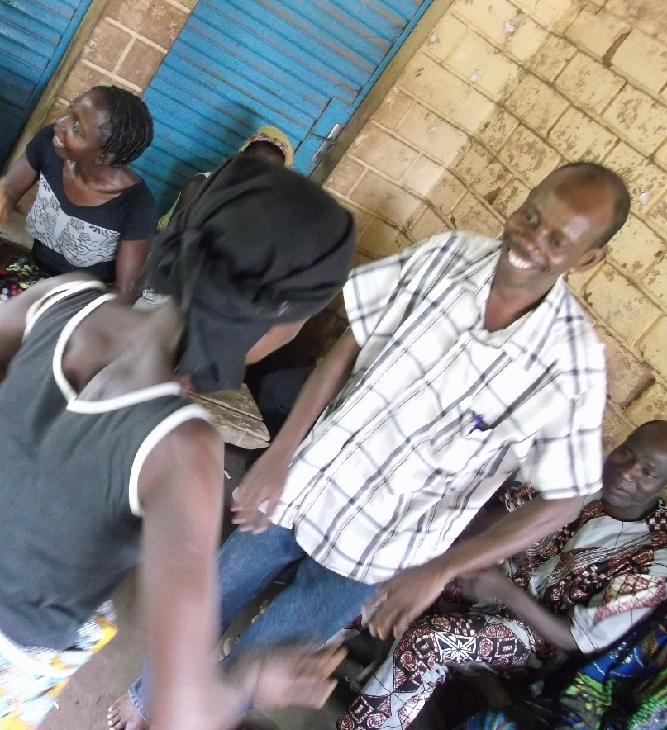
PROJECT OBJECTIVES
Apply a social network analysis framework to assess the influence of social groups.
Develop and test interventions with the goal of activating key players in the social network.
Expand interventions to other communities (if they prove successful)
Notes:
We finished # 1 and # 2 with the pilot project. We focus now on # 3, and the documentation of the application of these approaches in different contexts.
In addition, social network analysis is an advanced methodology that is receiving increasing attention. It has been applied in the US by the military (see examples later), and is becoming increasingly common. This project represents a pioneering application of this methodology in public health issues and specifically FP.

Slide 29
Macro Result:
Increased proportion of women and men reporting equitable attitudes about roles within the couple related to fertility and family planning.
Primary Results: Individual
Increased proportion of women and men desiring to use FP
Increased proportion of women and men approving of FP methods
Increased perception that spouse approves of FP use
Increased proportion of women and men saying they definitely could obtain a contraceptive method should they need one
Increased proportion of women and men saying they could use FP consistently if they did not want to get pregnant
Increased proportion of women and men who correctly perceive the risk of pregnancy during the postpartum and breastfeeding period
Intermediate
Result 1
Increased communication between couples about fertility desires and FP use
Tékponon Jikuagou Results Framework
Goal
Reduce unmet need for FP
Strategic Objective
Decreased proportion of women and men of reproductive age with unmet need for FP
Ultimate Result 2
Increased use of contraception
Ultimate Result 1
Increased use of FP services
Intermediate
Result 2
Increased proportion of women and men planning to use FP
Primary Results: Network
Increased proportion of people in women’s and men’s’ social networks believed to approve of FP
Increased perception of community approval for child spacing and FP use
Increased perception that discussion of FP is accepted/appropriate
Decreased perception of stigma associated with FP use
Intermediate
Result 3
Increased
proportion
of women and men taking steps to obtain FP
Last revised 15 February 2013

Slide 30
KEY RESULTS: PILOT PHASE
Diffusion of dialogue through social networks
Men and women are engaged in discussions and may disseminate ideas about FP
Elimination of barriers to talking about FP and unmet need
Awakens interest in couple communications
Creates a demand for FP services

Slide 31
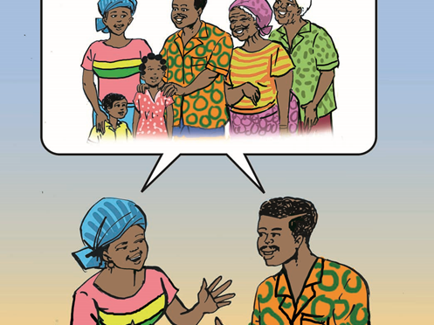
Tékponon Jikuagou INTERVENTION PACKAGE

Slide 32
SOCIAL NETWORK APPROACH
Encourage Critical Reflection and Dialogue
Strategically targeted groups
Leaders of established groups
Snowball effect
Opinion leaders
Reconfiguration of links
Source: Valente 2010

Slide 33
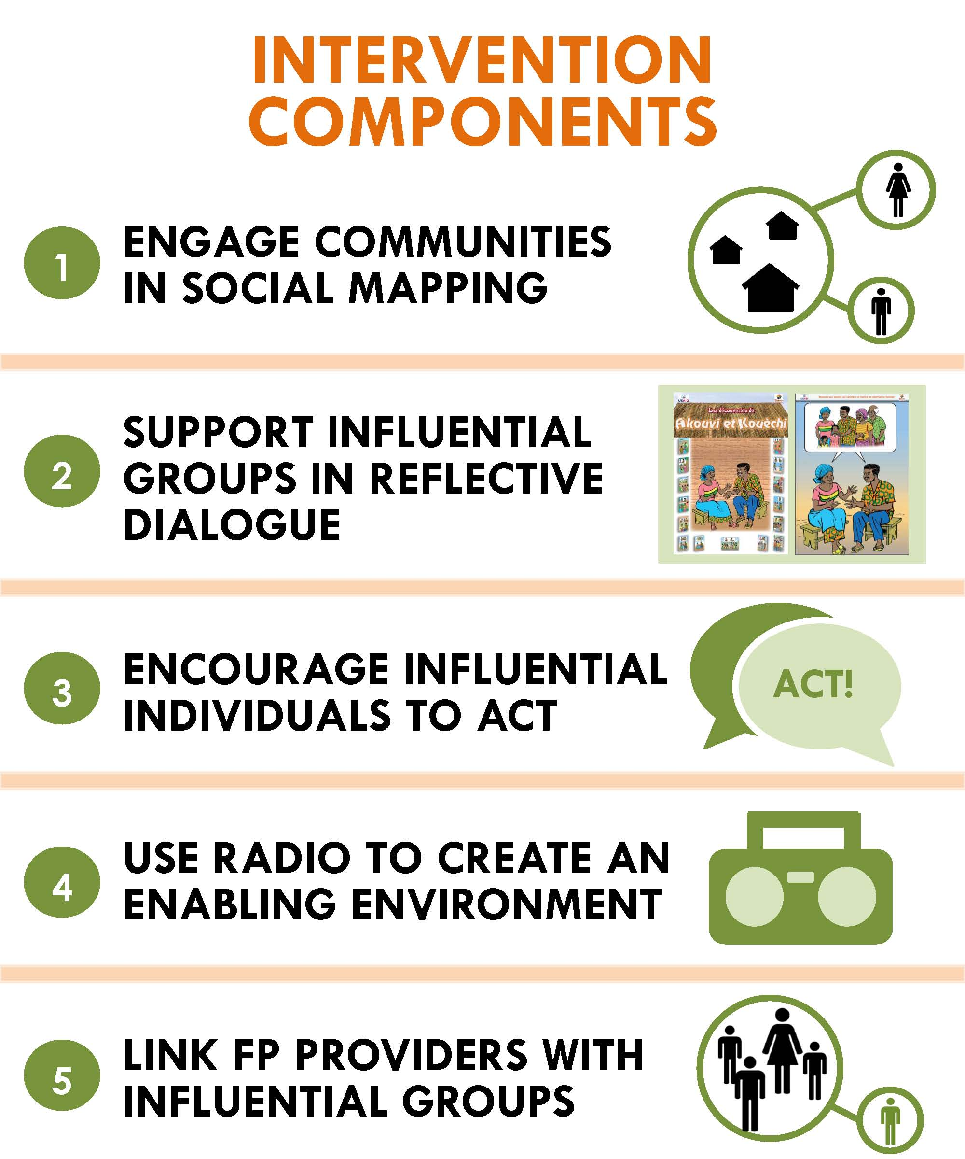

Slide 34
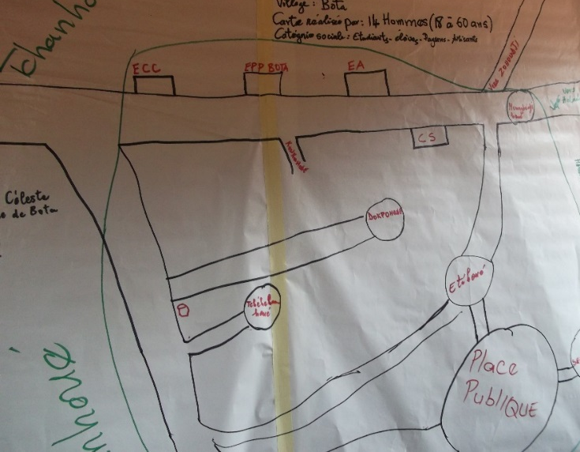
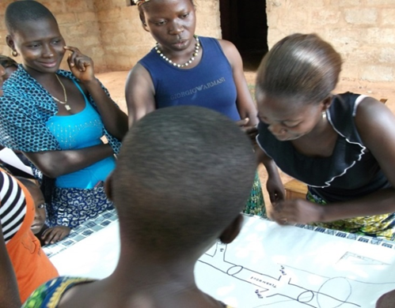
1
ENGAGE COMMUNITIES IN SOCIAL MAPPING
Participatory tools to identify influential groups / individuals
Through participation, groups and influentials become catalyzers for discussion and change

Slide 35
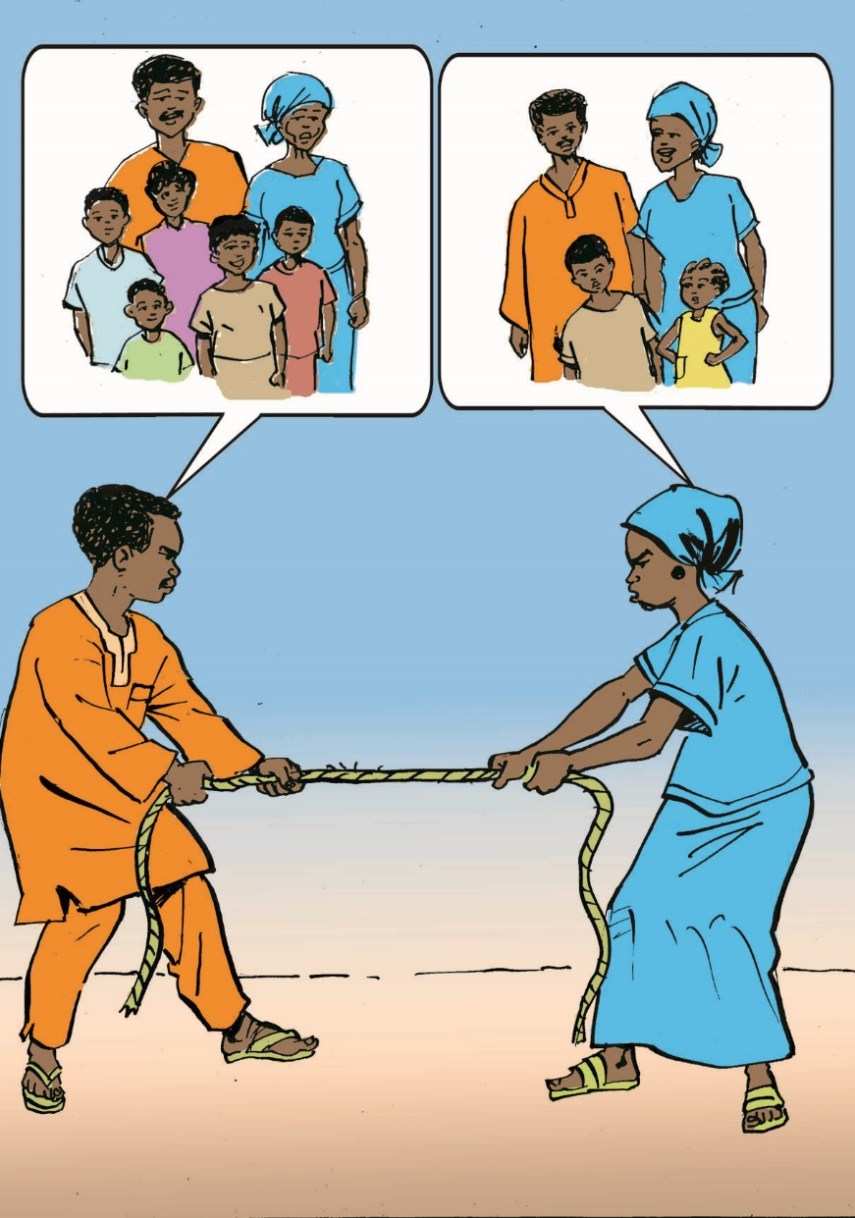
2
SUPPORT INFLUENTIAL GROUPS IN REFLECTIVE DIALOGUE

Slide 36
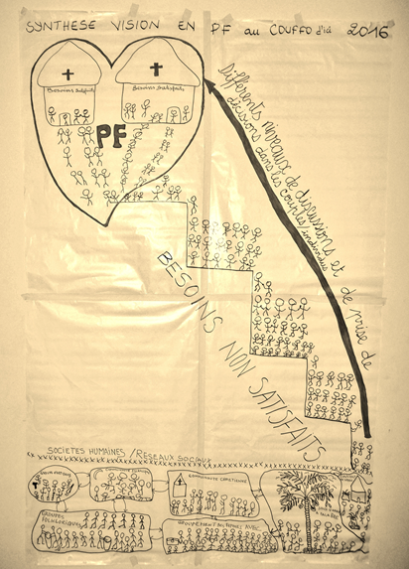
3
ENCOURAGE INFLUENTIAL INDIVIDUALS TO ACT
  INFLUENTIALS ORIENTATION:
  FP in your community
  Vision - obstacles to the use of FP
  Update on activities
  Gaps and challenges: how can you help?

Slide 37



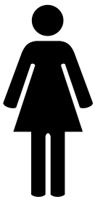

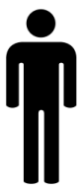
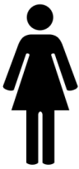
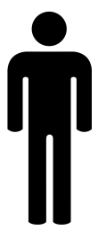
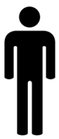
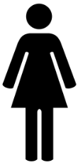
INFOGRAPHIC ON
THE ROLE OF INFLUENTIALS
Au cours des trois derniers mois,
1 personne (femme ou homme) sur 10…
Example of an infographic
which shows the lack of community discussion about FP by community leaders
WHY?
…a entendu un leader parlé de la planification familiale

Slide 38
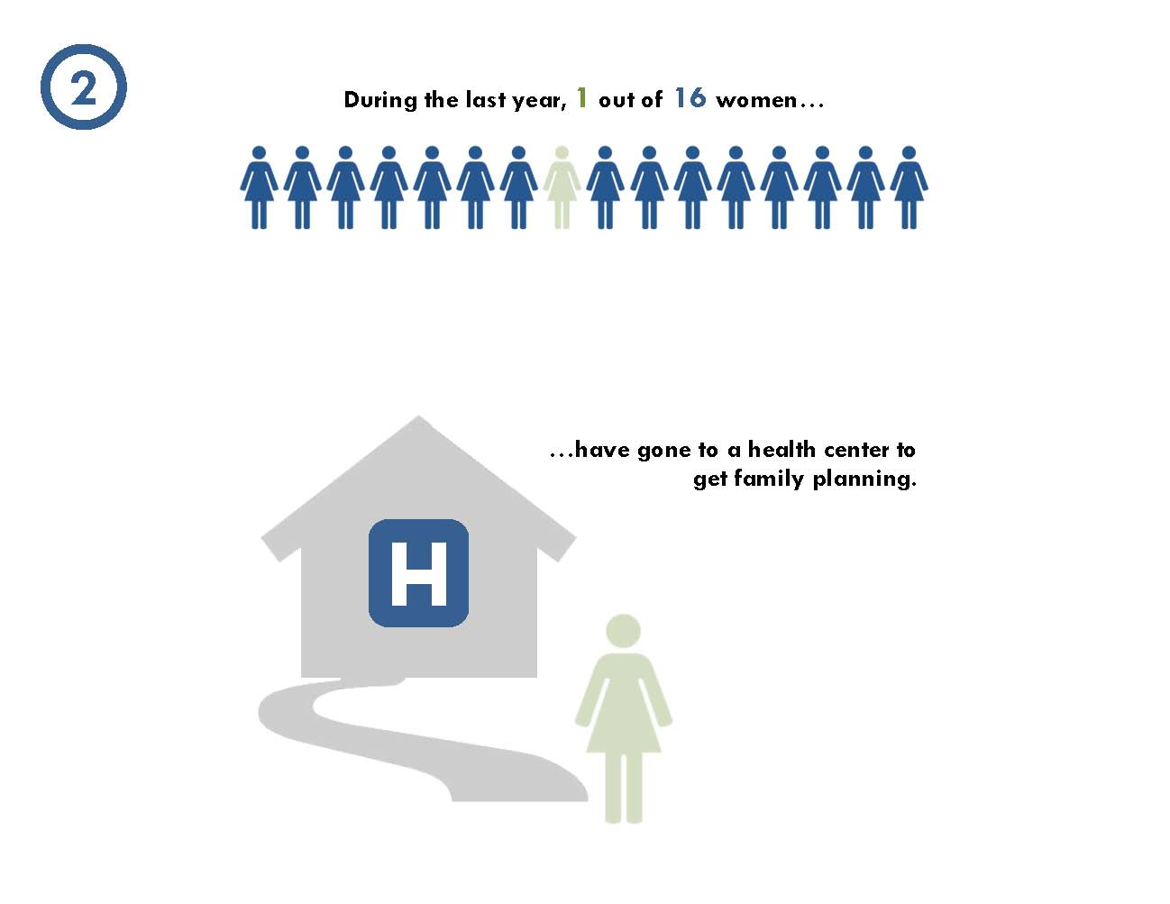
4
USE RADIO TO CREATE AN ENABLING ENVIRONMENT

Slide 39
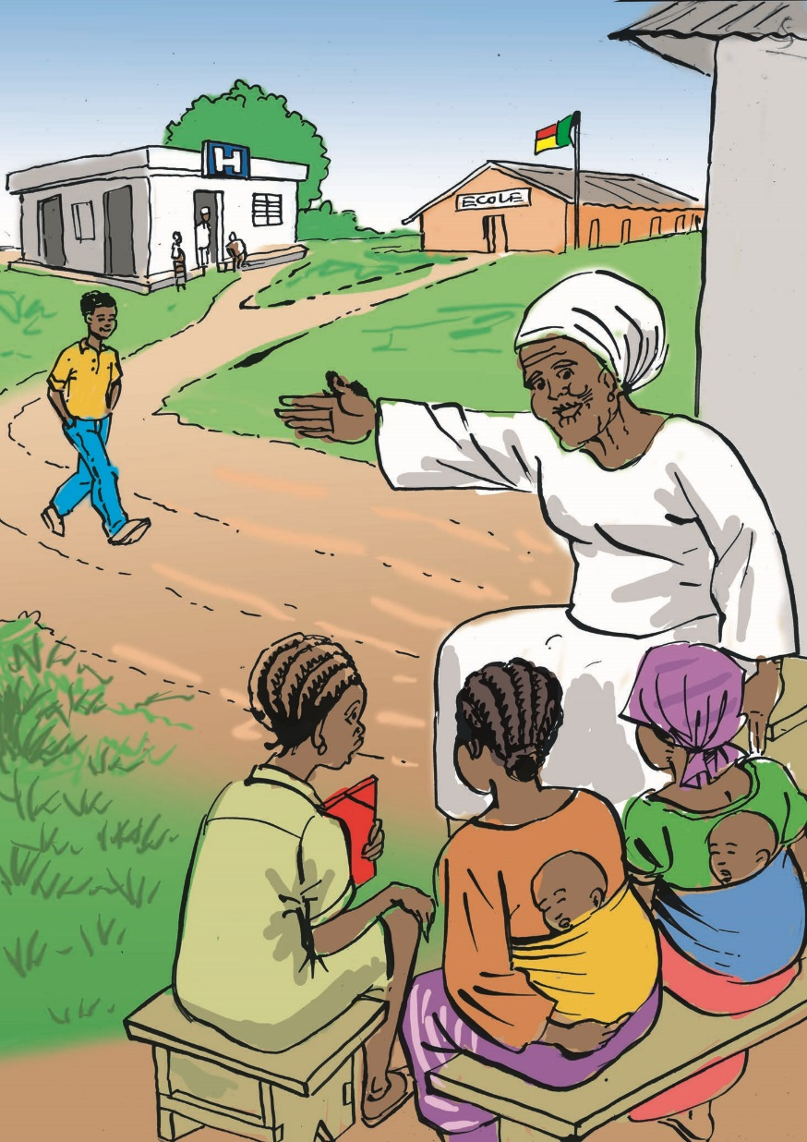
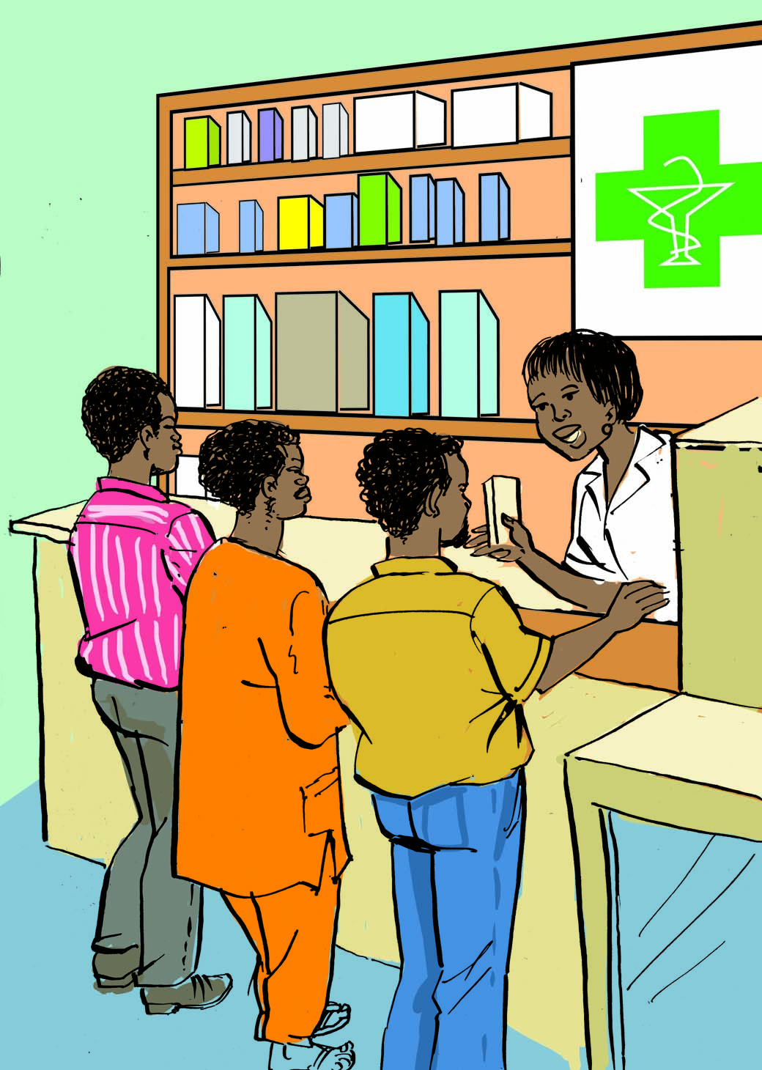
5
LINK FP PROVIDERS WITH INFLUENTIAL GROUPS

Slide 40
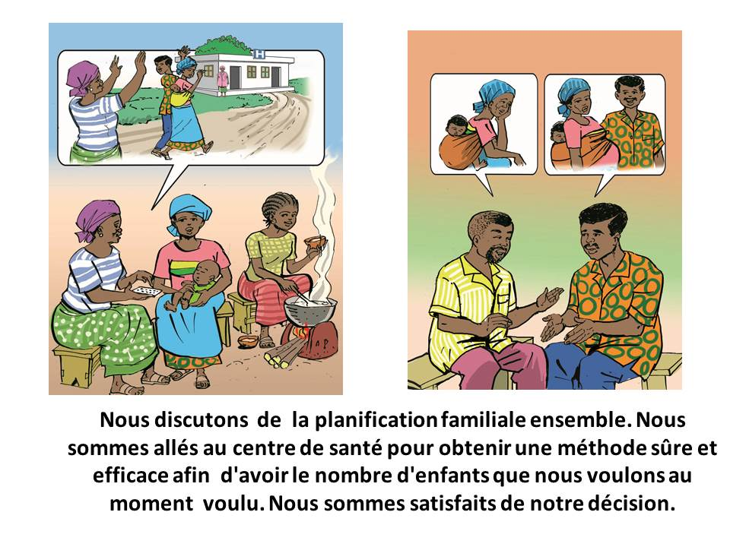

EACH ONE INVITES 3 CAMPAIGN
Invitation cards are given to group members, community health workers, and Influentials.
These people begin discussions with friends and relatives who do not use FP.
These same people offer the invitation cards to friends and relatives and encourage them to go to the health center.
We discuss family planning together. We went to the health center to obtain a safe and effective method to have the number of children that we want, when we want them. We are satisfied with our decision.
You are invited to the health center to get more
information about family planning
Pill
Injectable pill
IUD
Contraceptive
implant
CycleBeads
Condom

Slide 41
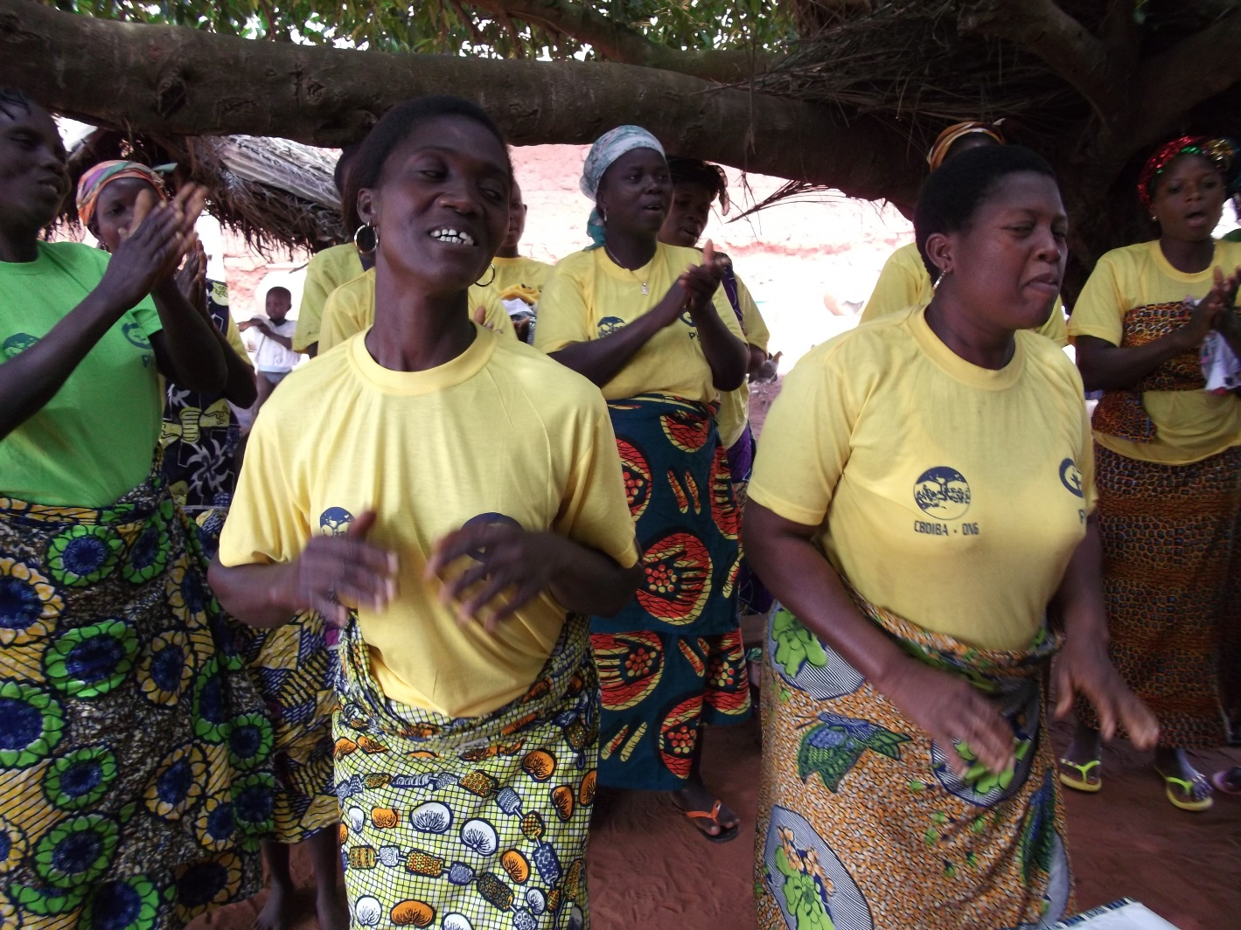
THANK YOU!

