Slide 1


TÉKPONON JIKUAGOU ORIENTATION (DAY 3)
RE-EXAMINING GENDER

Slide 2
Macro Result:
Increased proportion of women and men reporting equitable attitudes about roles within the couple related to fertility and family planning.
.
Primary Results: Individual
Increased proportion of women and men desiring to use FP
Increased proportion of women and men approving of FP methods
Increased perception that spouse approves of FP use
Increased proportion of women and men saying they definitely could obtain a contraceptive method should they need one
Increased proportion of women and men saying they could use FP consistently if they did not want to get pregnant
Increased proportion of women and men who correctly perceive the risk of pregnancy during the postpartum and breastfeeding period
Tékponon Jikuagou
Results Framework
Intermediate
Result 1
Increased communication between couples about fertility desires and FP use
Goal
Reduce unmet need for FP
Strategic Objective
Decreased proportion of women and men of reproductive age with unmet need for FP
Ultimate Result 2
Increased use of contraception
Ultimate Result 1
Increased use of FP services
Intermediate
Result 2
Increased proportion of women and men planning to use FP
Primary Results: Network
Increased proportion of people in women’s and men’s’ social networks believed to approve of FP
Increased perception of community approval for child spacing and FP use
Increased perception that discussion of FP is accepted/appropriate
Decreased perception of stigma associated with FP use
Intermediate
Result 3
Increased
proportion
of women and men taking steps to obtain FP
Last revised 15February2013
Notes:
WE ARE WORKING ON GENDER BECAUSE OF THE INTERMEDIATE RESULTS #1 AND THE OVERARCHING GOAL.

Slide 3

Brainstorming
What gender norms in OUR communities influence these variables?

Slide 4
Gender Barriers
that Influence Use of Family Planning (according to TJ research)
8% women
17% men
Believe that women who use FP have multiple sexual partners
Believe that a woman must have her husband’s approval to use FP
Believe that it is a woman’s responsibility to bring up the subject of FP with her husband
Believe that if a husband discovers that a woman is secretly using FP, he will beat her
47% women
72% men
89% women
78% men
25% women
27% men
Notes:
TJ baseline research

Slide 5
OTHER GENDER BARRIERS: BELIEFS
Men who allow their wives to use FP are weak/ controlled by their wives.
Men are not concerned with obtaining information about FP.
Health providers must have the husband’s permission before giving a woman a FP method.
A man must have many children to be respected within the community.
Notes:
Other:
Men decide the number of children to have, and when.

Slide 6
Brainstorming
WHAT MOTIVATES WOMEN TO USE
FAMILY PLANNING?

Slide 7

GENDER FACTORS SUPPORTING FAMILY PLANNING - WOMEN
Women who uses FP have more time to pursue revenue-generating activities.
Women talk easily about FP with other women in their social network.
A woman who uses FP has better health and can take better care of her children.
Notes:
Other:
Mothers-in-law are obligated to work more when their daughters-in-law are sick or pregnant

Slide 8
Brainstorming
WHAT MOTIVATES MEN TO USE FAMILY PLANNING?

Slide 9

GENDER FACTORS SUPPORTING FAMILY PLANNING - MEN
The family’s financial well-being.
Better availability of the woman for the family.
Greater availability of the woman for sexual relations.

Slide 10
IMPLICATIONS FOR TJ?
With the gender-synchronized programs,
we try to create less rigid and more diverse norms, so that each person can become the person that he or she wishes to be.

Slide 11
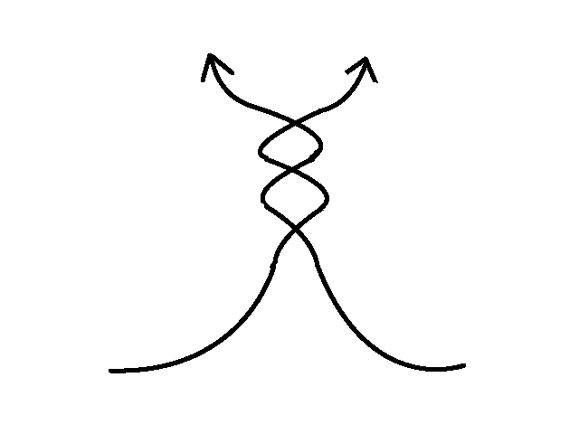
Gender-synchronized approaches
Gender equality
Gender-synchronized approaches
Work with men and boys
Empowerment of women and girls

Slide 12
ELEMENTS OF GENDER EQUALITY
FLEXIBLE GENDER ROLES
Promote mutual understanding of the two sexes in an intentional manner
Equality in the balance of power and the pursuit of gender justice
Freedom from violence
Human rights for women and men
Notes:
In monitoring & evaluation: gender equality as a measure of program success.

Slide 13
DISCUSSION IN TWO GROUPS
Group A – Engagement of Men
List a few barriers to engaging men in FP.
List a few ideas to overcome these barriers, and reach a « gender synchronized » approach.
i. Who should we target and how can we involve them?
ii. How can we change the environment to make it more favorable?
  Group B – Empowerment of women in reproductive health
List a few barriers to empowering woman in FP.
List a few ideas to overcome these barriers, and reach a « gender synchronized » approach.
i. Who should we target and how can we involve them?
ii. How can we change the environment to make it more favorable?

Slide 14
INTRODUCTION TO COMMUNITY SOCIAL MAPPING

Slide 15
COMMUNITY SOCIAL MAPPING – DATA COLLECTION
Participatory identification of key social organizations and community resources, and identification and ranking of influential groups and individuals
Analytical and identification activities meant to ensure multiple social perspectives:
Women
Men
Youth, socially marginalized individuals

Slide 16
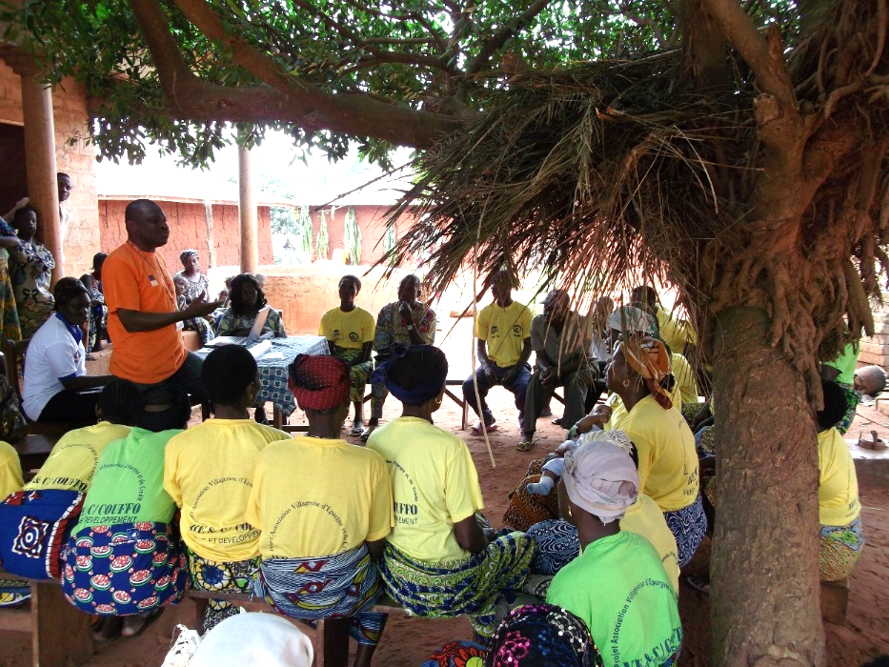
GENERATE QUALITY INFORMATION TO GUIDE SELECTION OF PEOPLE TO WORK WITH:
Get informed on informal leaders
Gain understanding of the community’s social organization
Identify the most connected and respected groups and individuals

Slide 17
COMMUNITY SOCIAL MAPPING PROVIDES A PRACTICAL INTERPRETATION OF CLASSIC SOCIAL NETWORK MAPPING
SOCIAL NETWORKS ➔ Influential Social Groups
OPINION LEADERS ➔ Influentials
CONNECTERS & INFLUENCERS ➔ Among identified influential individuals and grops
!
Need for practical tools to quickly identify groups and people for approaches based on social networks

Slide 18
5 STEPS OF THE MAPPING PROCESS

Slide 19
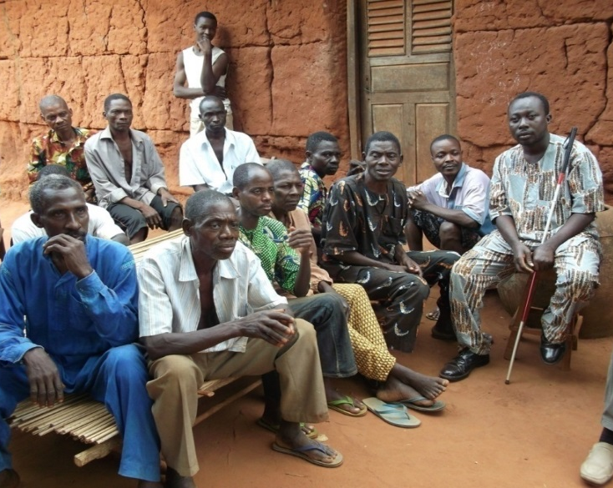
1
COMMUNITY INTRODUCTION
Meeting local officials to present the project, manage expectations (no compensation) and inspire initial participation
Prepare for mapping activities
Notes:
It is necessary to manage community expectations (for example, that no compensation is provided for participation) and to ensure that Facilitators know that this part of their work.

Slide 20
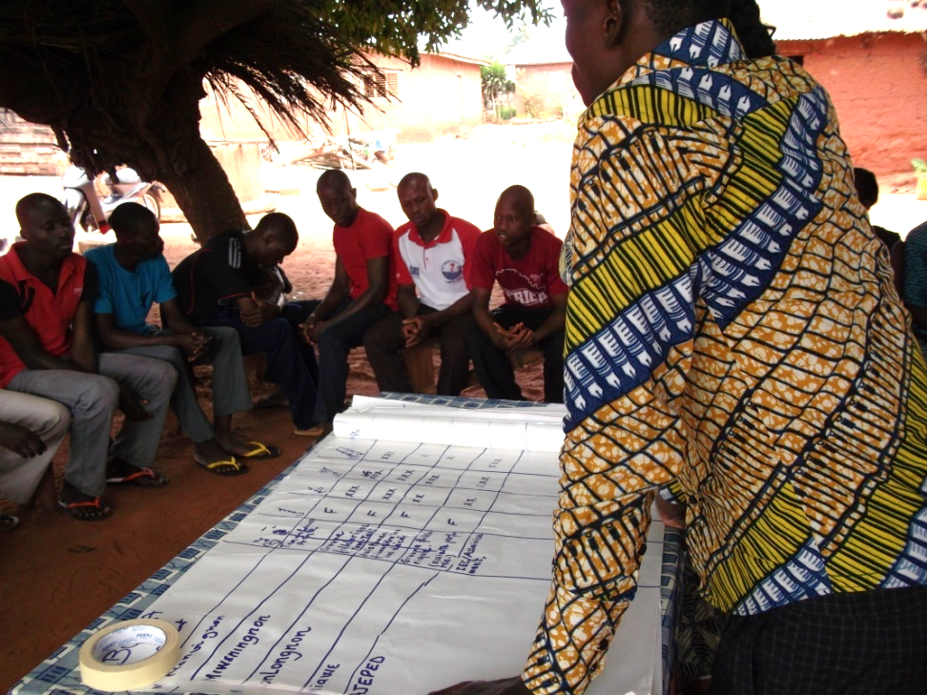
2
COMMUNITY IDENTIFICATION OF INFLUENTIAL GROUPS
Name
Type of activity
Gender
Age group
Size
Meeting frequency
Links with other groups
Influence

Slide 21
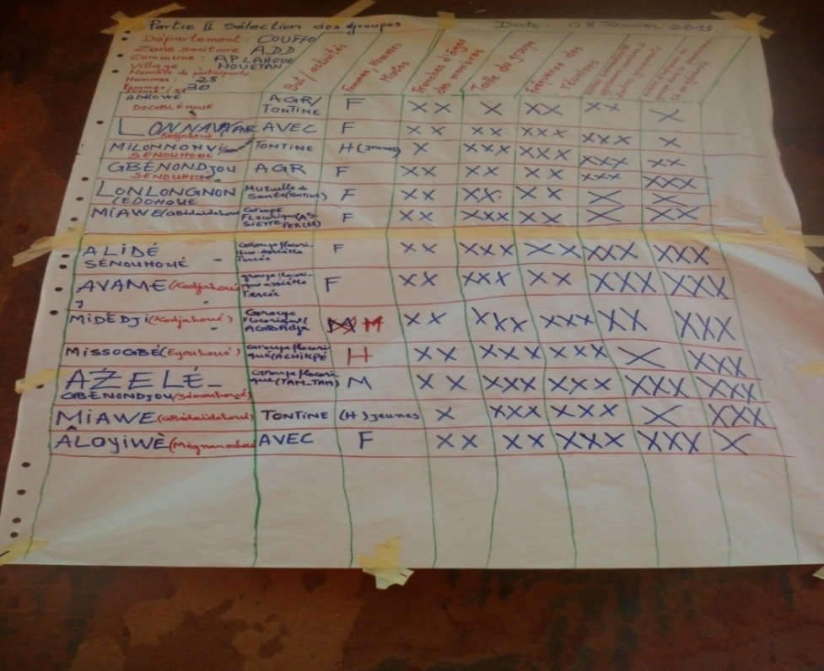
SELECTION OF GROUPS WITH DIFFUSION OF POTENTIAL BASED ON COMMUNITY ANALYSIS
Participants review criteria to select potential women’s, men’s, and mixed groups to participate in TJ
3
Notes:
Criteria:
Influence
Connectivity
Meeting frequency
Size
Age group

Slide 22
GROUP CHARACTERISTICS
SOCIAL NETWORKS – GROUPS AND REFLECTIVE DIALOGUE
Work with a limited number of strategically selected groups (3 – 6 / Village)
2. The group moderator (Catalyzer) selected by members (no compensation)
3. Focus on reflective dialogue with expected diffusion outside of the main themes
4. The project follows the timing of the group’s regular meetings and activities

Slide 23
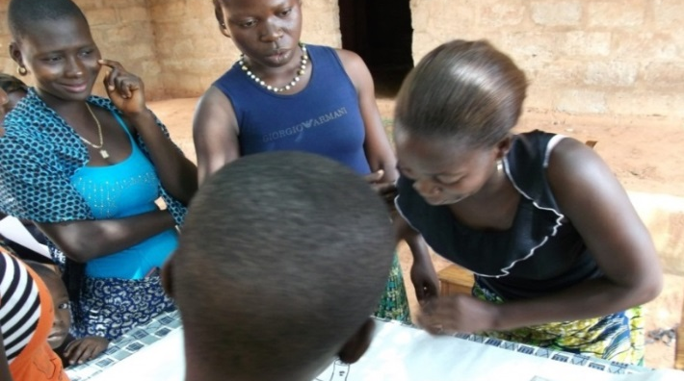
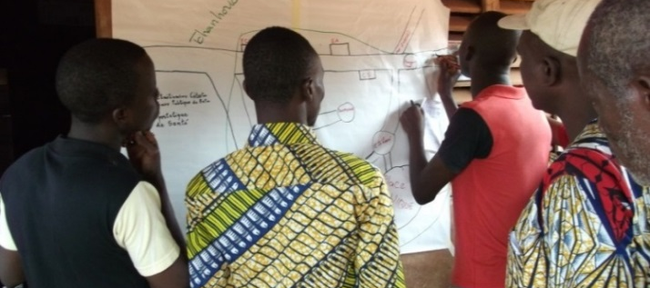
COMMUNITY DEVELOPMENT OF THE SOCIAL MAP AND LISTING OF INFLUENTIALS
4
Learn about community dynamics and social organization
Identify socially influential individuals, particularly in the fields of health and social welfare

Slide 24
INFLUENTIALS CHARACTERISTICS
SOCIAL NETWORK – INFLUENTIALS AND COMMITMENTS TO ACTION
Work with a limited number (approximately 5-10 per village) of Influentials identified by the community (formal and informal)
Authorize Influentials to identify their own actions and commitments to address issues relating to unmet need for family planning

Slide 25
5
VALIDATION
Staff meeting with selected influential groups
Evaluate family planning behaviors using a series of questions
Confirm influence in the community through a participatory Venn diagram
Ensure interest in work on issues relating to unmet need and family planning
G₁
G
G₃
G₂
G1: Inforgmation exchange within group.
G2: Shared decision-making
G3: Agreement with shared decision-making

Slide 26
GROUP DISCUSSION QUESTIONS –
COMMUNITY MAPPING
Do you think the groups and individuals with whom you currently work will be recognized as influential groups during the validation process? Why or why not?
Detail out the next 2 or 3 steps for implementation of community mapping

