Slide 1


TÉKPONON JIKUAGOU ORIENTATION (DAY 2)
RE-EXAMINING UNMET NEED, SOCIAL NETWORKS AND SOCIAL DIALOGUE

Slide 2


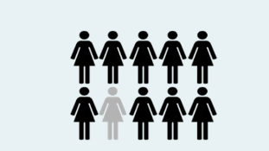
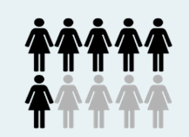
5 in 10 women are at risk of an unwanted pregnancy.
Why are they at risk?
…because only 1 woman out of 10 doesn’t use any method of family planning, despite her desire to do so
… because 4 out of 10 believe that they cannot fall pregnant, even though they can, and doesn‘t recognize the risk…
Notes:
Why do women who which to avoid pregnancy not use FP?
Cost, location, quality and social access (lack of couple communication, no decision-making power)
Why would women think they are unlikely to get pregnant even though it is a possibility?
Using traditional/ineffective method, breastfeeding, infrequent sex

Slide 3

UNMET
NEED DEFINED:
A woman who…
Is not pregnant
Wishes to avoid or delay pregnancy
Perceives she is at risk of becoming pregnant
Uses no method of contraception (modern or traditional)
Notes:
All four conditions are not necessary for a woman or a man to be deemed in a situation of unmet need. It is important to emphasize the last condition.
This is the defintion of perceived unmet need. In the context of TJ, the person must satisfy all four criteria to be considered as having perceived unmet need. Unperceived unmet need is taken into account in no perceived need.

Slide 4
DIFFERENT CATEGORIES OF UNMET NEED
She admits she would like to use family planning to avoid pregnancy but has no access
      Social barriers
      Stigma
      Availability of services
      Cost
  She does not want to get pregnant but thinks she is not at risk
      Ineffective methods, including breastfeeding
      Infrequent sexual activity
  Previous bad experience with family planning
      Wishes to avoid pregnancy but does not see an alternative
Notes:
What are some examples of interventions that address these barriers?

Slide 5
REMINDER – TWO COMPLEMENTARY APPROACHES
Social network approach: dissemination channels and influence
Dialogue and reflection approach: Ensure that the "content" represents the attitudes, values and norms that support family planning use for those who want it

Slide 6

PARTICIPATORY AND REFLECTIVE DIALOGUE
Create spaces for iterative dialogue to express alternative ways of thinking, being and feeling about sexual and reproductive health, gender and power dynamics
Facilitate community member efforts to initiate and support thinking and acting on issues and norms that affect them and their communities by recognizing different opinions.
Notes:
Also called social and behavior change communication or social mobilization
Allows communities to identify and address the social, economic and cultural factors that influence health.
Goes beyond the traditional “behavior change communication” (BCC), to address "social change“.
Explores alternative ways of thinking, feeling and being.

Slide 7
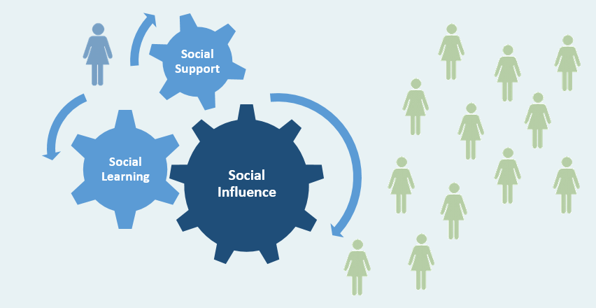
How networks support the diffusion of information and ideas on FP
Person with unmet need for FP
Other users of FP
Notes:
N.B.: A person with an unmet need for FP is able to satisfy this need through social influence, social learning and social support from network members

Slide 8
EXERCISE - TRIADs
In your own life:
Think of an example of behavior in your own life that might diverge from existing social norms
Think about WHO in your life might inflence you and HOW
    This could help you not to deviate from norms, or encourage you to act on your own belief despite the norm.
Think about how you might influence or mobilize your network to support changing norms against which you struggle.
Notes:
Example for # 1 - working women, the way we treat our girls and our boys differently from gender roles, the way we diverge from traditional gender roles in our marriage
Examples for # 2 could include friends, in-laws, spouses

Slide 9
HOW CAN PROGRAMS USE SOCIAL NETWORKS FOR THE LEARNING AND INFLUENCE?
?

Slide 10
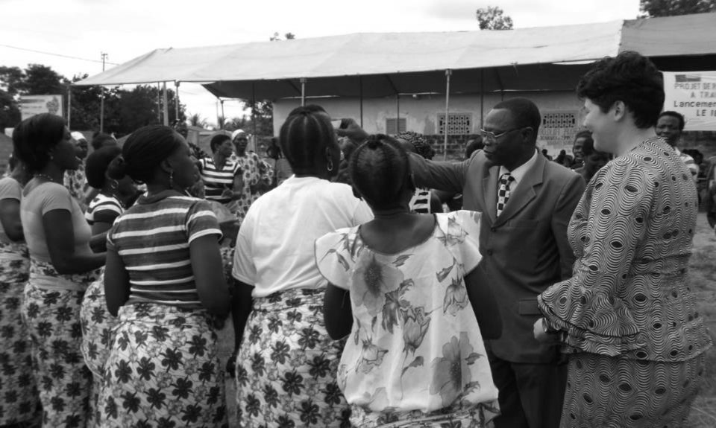
ENGAGE WITH OPINION LEADERS
1
Notes:
These can be formal leaders such as religious leaders or chiefs, but they can also be informal leaders who impact the acceptability of attitudes or judgements within the community.

Slide 11
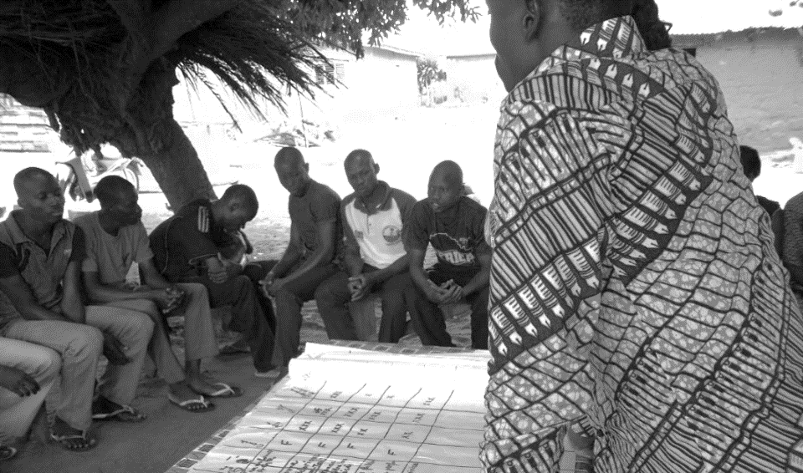
2
WORK WITH STRATEGICALLY TARGETED GROUPS
Notes:
This can be traditional or informal groups within the community ..

Slide 12
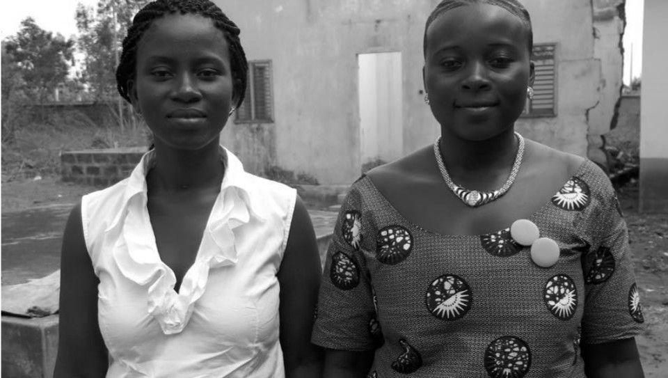
3
WORK WITH LEADERS OF ESTABLISHED GROUPS (CATALYZERS)
Notes:
Group leaders are often also influential people. They may be connectors and influencers within the community.

Slide 13
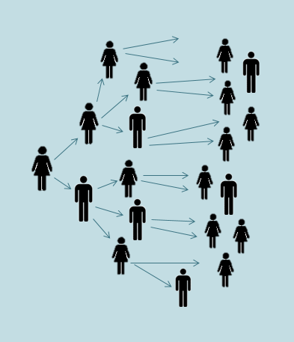
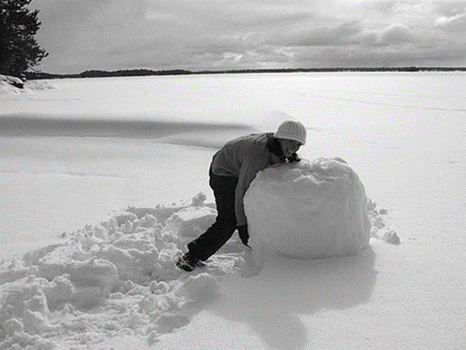
4
EACH PERSON INVITES OTHERS “SNOWBALL EFFECT”

Slide 14
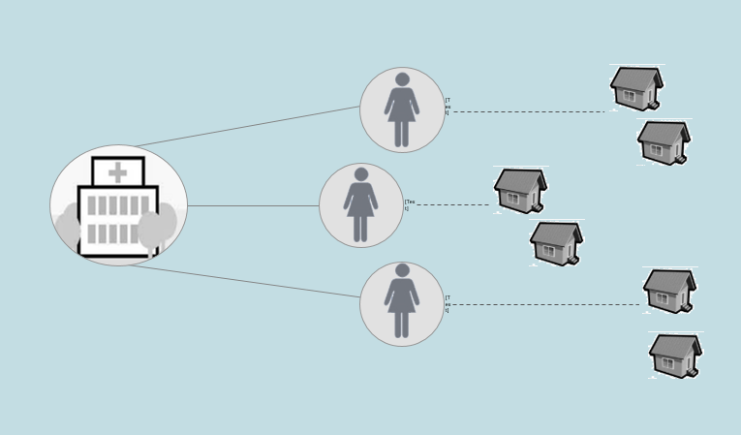
5
RECONFIGURATION OF LINKS
Notes:
If we can influence links between people, we can influence the diffusion of learning or norms. Through TJ, we try to strengthen ties between health workers and groups within the community.

Slide 15
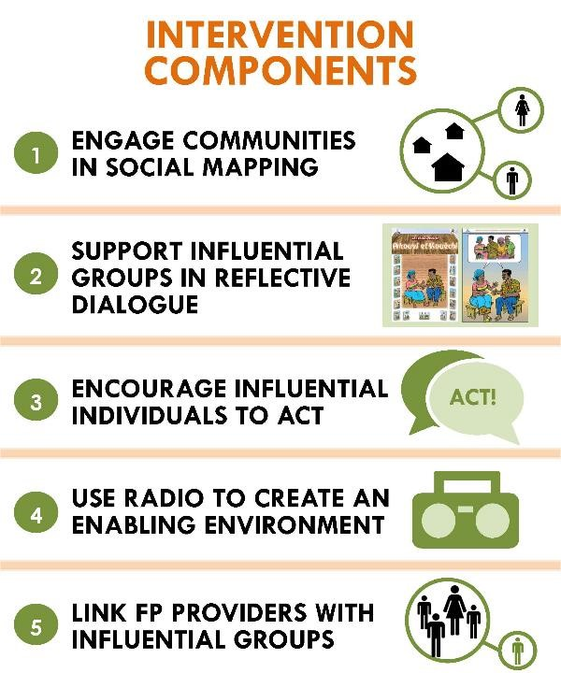

Slide 16
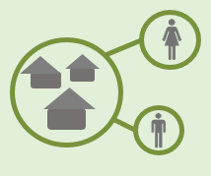
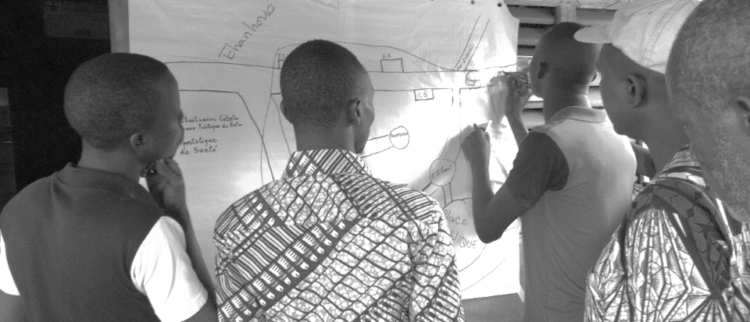
SOCIAL MAPPING
Participatory approach WITH the community to identify influential groups, group leaders and opinion leaders within the community.
Notes:
These groups or leaders may or may not be the same groups and individuals with whom the project are already working with - the essential here is that they are INFLUENTIAL.

Slide 17
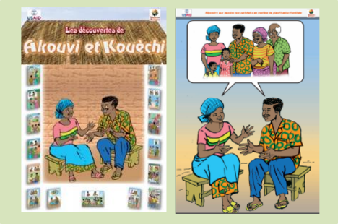
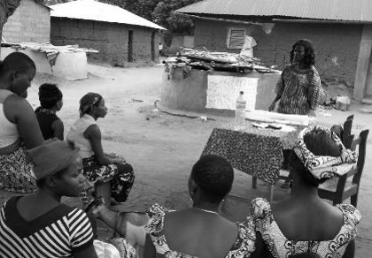
INFLUENTIAL GROUPS AND GROUP LEADERS
Leaders of influential groups (Catalyzers) facilitate critical reflection and dialogue within their groups using TJ materials.
Project Facilitators guide and coach these Catalyzers to become true moderators of dialogue.

Slide 18
INFLUENTIALS
Influentials recognize the problems associated with unmet need for family planning, and undertake to facilitate change within their communities according to their spheres of influence.
Project Facilitators work with Influentials to orient them and encourage action.
Notes:
The actions of Influentials are informally defined and depend on how a leader believes he or she can best use his or her influence. They do not develop specific action plans.

Slide 19

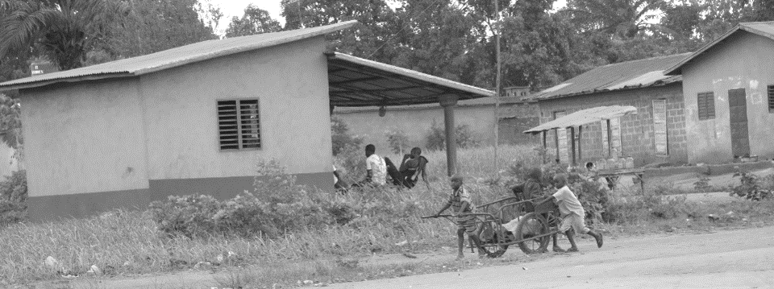
RADIO
Radio programs are developed using TJ stories as discussion materials. In this way, radio discussions reinforce group discussions.
Notes:
These programs are followed by many more people than group discussions, but discussion topics are reinforced as they use the same materials.

Slide 20
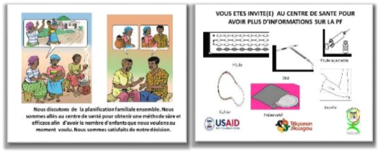
LINKS WITH
HEALTH SERVICES
The project encourages links between health workers and Influentials within the community through:
The “Each One Invites Three” campaign which encourages people to seek advice on family planning in health centers.
Encouraging contact with health workers when they are in the community.
Participation of health workers at the Catalyzers and Influentials orientations.

