Slide 1
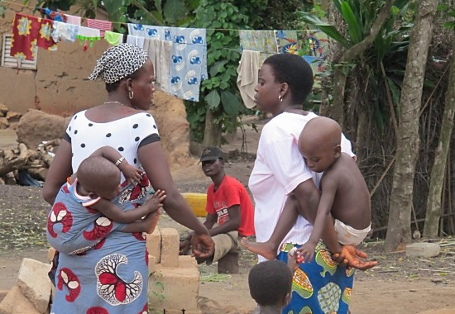


“Each One Invites 3”
Hello! Do you have time to talk?

Slide 2
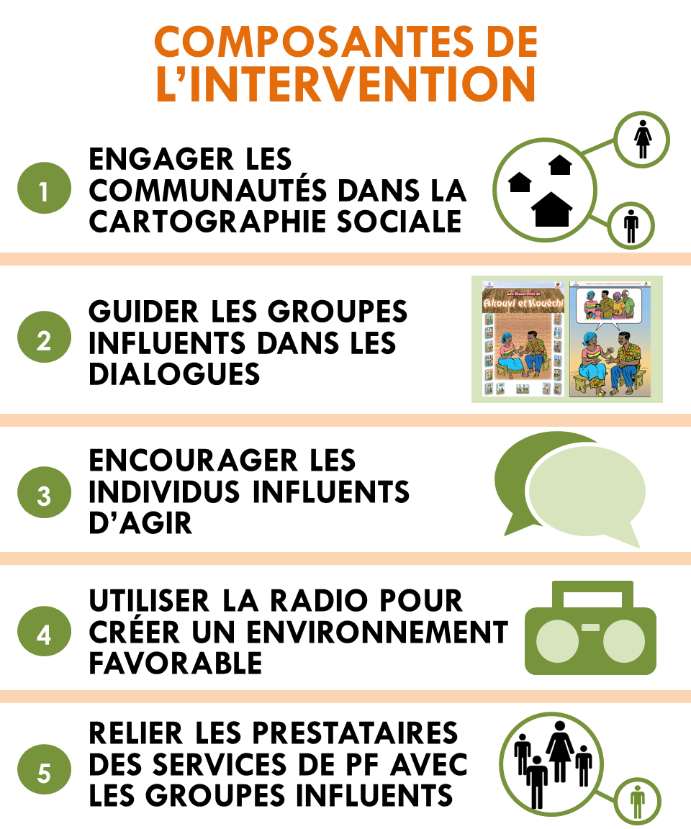
Components of the intervention
Engage communities
in social mapping
The « Each One Invites 3 » campaign can reinforce the links between health providers and the community
Guide Influential Groups in dialogue
Encourage Influential Individuals to act
Create a supportive environment with radio
Link family planning providers with Influential Groups

Slide 3



Q:
How can « Each One Invites 3 » link FP health providers with men and women in the village who want to space children but who are not using any modern contraceptive method?
People satisfied with FP speak to at least 3 friends. They share their experiences with FP and ask friends to seek information from a health provider at a health center.
The invitation card allows the person who is satisfied with FP to broach the subject with family and friends.
The card encourages the person who receives it to visit a health center to seek more information about FP.
HC
A:
Notes:
This is the core idea that was used in Rwanda (and earlier in Madagascar)
DIAGRAM
Gold person signifies CHW/ project person
He/she gives 3 invitation cards each to orange people – who represent satisifed FP users or people who are pro-FP, but not necessarily users.
Each pro-FP pserons talks to three friends who they think or know are not using FP and gives them a card at the end of the exchange.
The idea of permission to talk – about satisfaction with your own method and to engage a friend or neighbor or family member in discussion of methods that they might like to use – is the core diffusion concept.
Social learning
People exchange ideas and information with their friends/within their social networks; and evaluate the relative benefits of innovation
Social influence
People follow norms of gatekeepers to gain approval and avoid conflict.

Slide 4
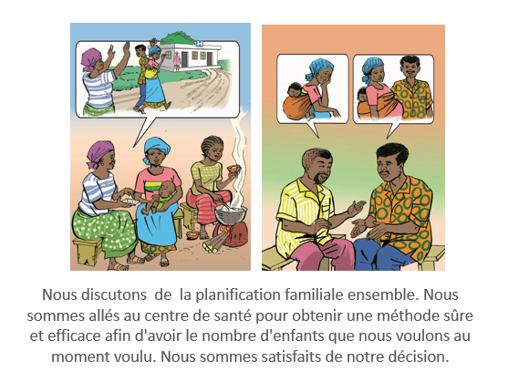

The approach
The invitation cards are given to group members (Community Health Workers and Influentials depending on context).
These people initiate a discussion with friends and family who do not use FP.
These same people give invitation cards to friends and family, encouraging them to seek information at health centers.
We discuss family planning together. We went to the health center to obtain a safe and effective method to have the number of children that we want, when we want them. We are satisfied with our decision.
You are invited to the health center to get more information about family planning
Notes:
This campaign mostly involves groups who are engaged in TJ reflective dialogues and activities. Depending on local context, relais and influents could join in. But this is optiional.
Why? Groups members have been most exposed to TJ ideas and discussions and so most likely to share their positive experiences vis-à-vis FP communication and talking with others. Remember, group members do NOT need to be FP users in order to distribute cards.

Slide 5
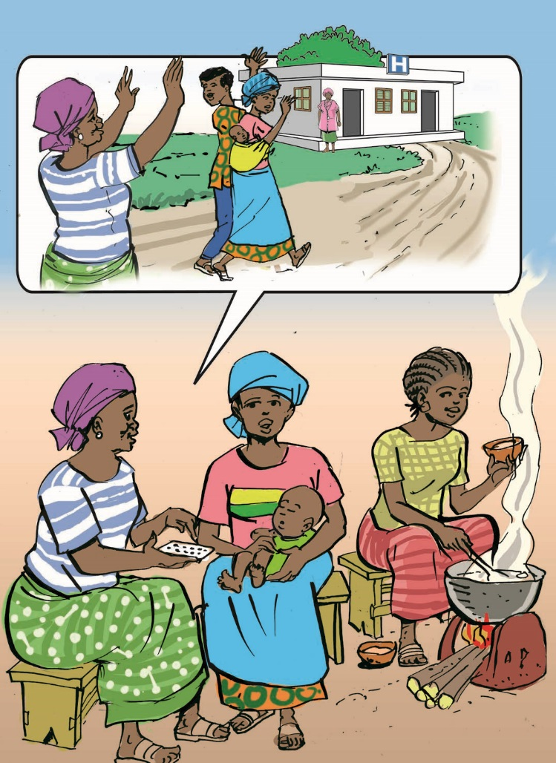
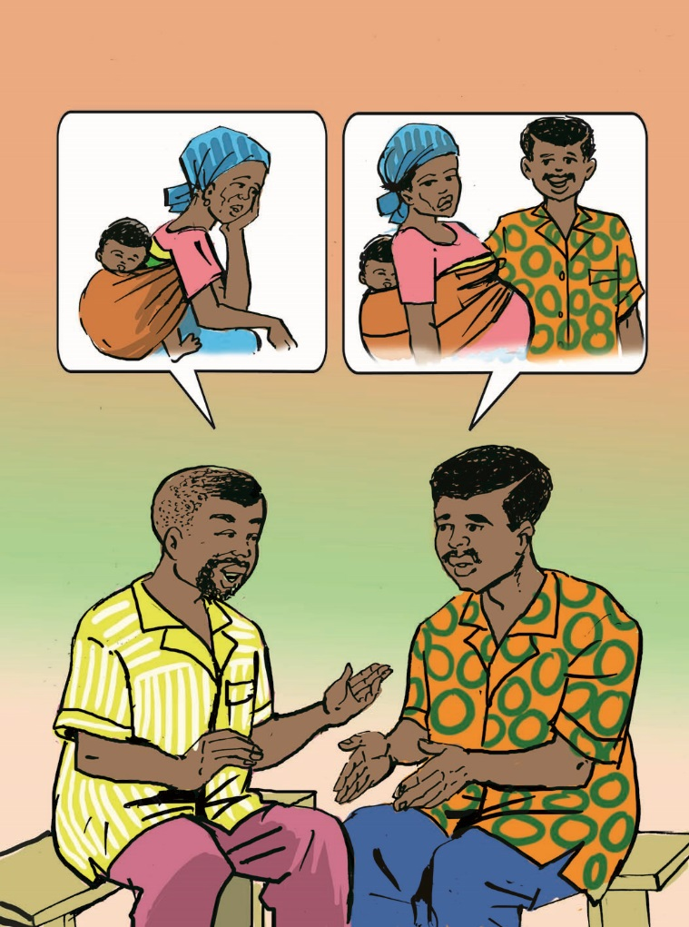
We discuss family planning together. We went to the health center to obtain a safe and effective method so we can have the number of children that we want, when we want. We are satisfied with our decision.
Notes:
This is the FP invitation card. Side 1. It is a card that can be used with both women and men to talk about one’s FP experiences.

Slide 6
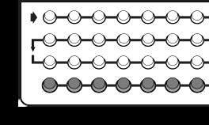
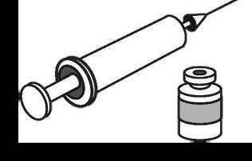
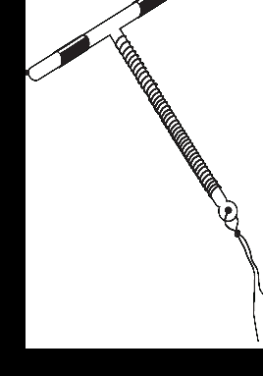
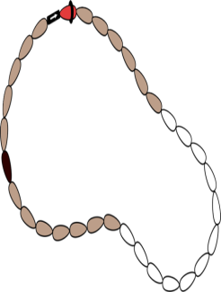

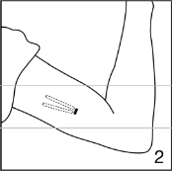


VISIT THE HEALTH CENTER FOR MORE INFORMATION ABOUT FAMILY PLANNING
Pill
Injectable pill
IUD
Condom
CycleBeads
Contraceptive implant
Notes:
Second side of the FP invitation card.

Slide 7

Process – distribution of the invitation cards
HC
Facilitator hands out cards to the various groups.
Each group member with cards engages 3 to 5 friends and family members who are not using FP in discussion to share their positive experiences with FP.
They offer a card to each friend/ family member that they speak to.
They encourage them to seek information at health centers.
Each group member + Influential who are interested takes 3 to 5 cards.
Notes:
Facilitator gives to the group.

Slide 8
Steps – Planning and Implementation of the Campaign
Preparation – one or two months before the start of the campaign
Obtain approval of departmental and district authority.
Warn local village and district authorities.
Talk to health providers about their roles and responsibilities in the campaign.
Broadcast radio spots that advertise the invitation cards and the campaign. (one month prior to the start of the campaign)
Start Campaign Activities
Orient groups + Influentials + community health workers on their roles in the campaign.
Give these individuals cards. Ask them to talk to friends and family members about FP and distribute all of their cards in the next month.
Monitor Implementation (3 to 6 months) - Follow-up on all of the people implicated in the EOI3 campaign to ensure that implementation is going according to plan.
Wrap-up of Campaign - by the date pre-established by the project

Slide 9
Role-play in groups of three
    You are a Facilitator in charge of distributing the cards to Catalyzers and Influentials.
How would you explain to EOI3 process? What information is critical?
How would you make sure that the message was well received?
Your only tools: invitation cards + flip chart
You are a Catalyzer in charge of distributing the cards to members of your group who are interested in participating in the EOI3 campaign.
How would you explain to EOI3 process? What information is critical?
How would you make sure that the message was well received?
Your only tool: invitation cards
1
2
Notes:
During the orientation of points focaux and facilitators, you can do both role plays, to help people understand the process.
During the orientation of catalysers, you can do the second role play only.

Slide 10
?
QUESTIONS?

