Slide 1
The « EACH ONE INVITES THREE» APPROACH
Using social diffusion approaches to increase family planning use in Rwanda:

Slide 2
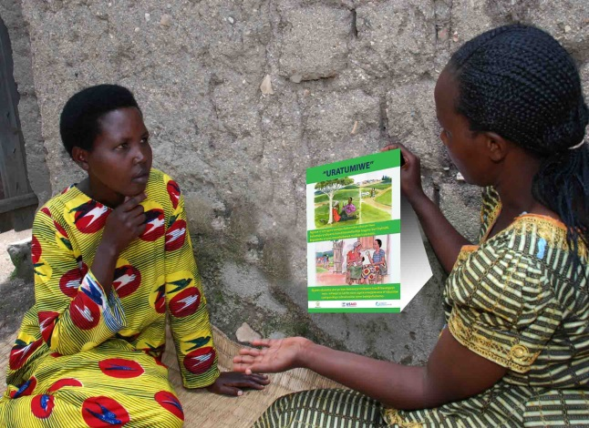
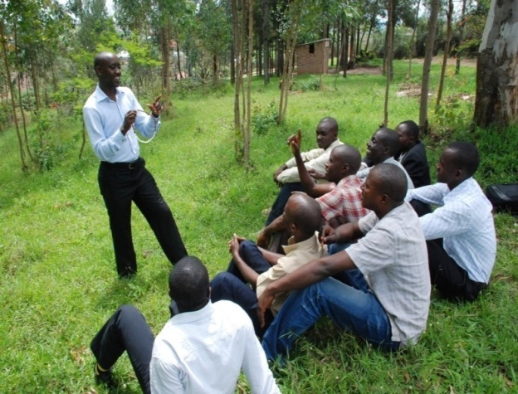
What is social diffusion?
Diffusion is the process in which an innovation is communicated through certain channels over time among the members of a social system.”
Diffusion of Innovations (2003) by Everett M. Rogers
Notes:
Everett M. Rogers really brought the notion of Diffusion of Innovations to the forefront. Read the definition of Diffusion of innovations. This set the theoretical framework for IRH in approaching how to increase family planning use, particularly the Standard Days Method, in targeted regions.

Slide 3
Applying social diffusion to family planning demand
‘Satisfied FP Users Gives Invitation Cards to Friends and Peers who are not using FP
Permission to talk about using FP - why friend is happy with his/her method – and encourage friend to try a method
Person receiving card invited to seek info & services from health provider
Social Influence
Social Leaning
Notes:
Context: For the past five years, IRH has been working with the MOH to scale up the Standard Days Method of family planning in Rwanda.
Background: Performance Based Financing statistics indicate very low FP service use (2%) in areas where Community-Based Provision of FP is occurring. Other assessments indicate that CHWs are overworked, which is particularly disadvantageous given that CHWs now play roles as FP community mobilizers. A recent assessment of the scale-up process in Rwanda indicated there is a need for more community discussion on SDM vis-à-vis other methods. Since SDM is disadvantaged compared to other methods of family planning, a social diffusion approach was hypothesized to help reduce this gap, particularly because it occurs at a community level.

Slide 4
Background of Each One Invites Three (EOI3) Approach in Rwanda
Relies on family planning (FP) users as community mobilizers to discuss FP with non-users, maximizing use of satisfied user testimonies
Invitation cards are given to friends and peers during discussions with mobilizers
Invitations cards will increase FP awareness and encourage people to talk with their provider
Use of satisfied clients as community mobilizers help the target population form a positive view of FP and health services
Distributing invitations allows people to talk about their FP experience, helping to break social norms about the secretive nature of FP.
Because the person distributing the invitation card is familiar with the person receiving the card, the message is accepted with greater confidence.
Notes:
The EOI3 approach was adapted for the Rwandan context based on a successful increase in family planning uptake (45%) in Madagascar under the SantéNet project (http://www.jhuccp.org/hcp/countries/madagascar_samia.html).
Structured similarly, EOI3 in Rwanda involves community associations ad community mobilizers reaching out to their peers to engage them in conversations about family planning, and inviting them to talk to their health care provider with the EOI3 invitation card. The hypothesis is that community members are more willing to discuss the topic openly knowing positive experiences from their friends families and neighbors.

Slide 5
How does EOI3 work? What tools are needed?
The community mobilizer, or Imboni uses 2 tools:
His/her testimonial of a positive family planning experience (how he/she chose a method, what are the advantages experienced).
The invitation card which helps the mobilizer begin the conversation with his/her peer. The invitation card says with the person you invite which reminds him/her of the discussion, and encourages him/her to talk to the family planning provider for more information.
Notes:
EOI3 identifies associations and select members, as well as satisfied users to be “Imboni”. Imboni reach out to their communities to share their positive family planning (FP) experience and distribute the invitation to people encoraging them to discuss FP with their health care provider.
You will see a little bit later how Imboni are selected and trained. It is also covered in the EOI3 Guidelines for Implementation.

Slide 6
Postcard size, the Invitation Card depicts…
Same-sex discussions on FP
Seeking info and services of
Community mobilizers
Notes:
The EOI3 Invitation card is ‘post-card size’ (10cm x 14cm). The sample used in Rwanda is available in English and Kinyarwanda, and can be adapted for other contexts. In the invitation card, images depict men talking about FP with each other and women discussing FP with each other. The other side shows community workers prepared to discuss all family planning methods available in country.
The images and corresponding messages help to begin discussing family planning with some one who is not as familiar with the advantages of FP.

Slide 7
Who is invited?
Who Invites?
Community mobilizers, or imboni, identified by participating associations, as well as satisfied family planning users in the community interested in participating.
Anyone who is in need of FP method or more information about family planning.
Notes:
EOI3 is an inclusive approach. It engages members of the community to discuss family planning in a way that is has not in the past.
While the implementing organization and its partner associations identify imboni to help implement the approach, all positive family planning experiences can contribute. Members of the community interested in helping to invite non-users to talk with their health care providers should talk to a participating association to get involved.
Those who are not using family planning, or are not familiar with the benefits or the variety of methods available should be given the invitation card, hear the positive experience from the Imboni, and visit their health care professional for more information. In some cases, people might have negative perspectives that can be influenced by the positive experience of a familiar person in the community. This is the power of social diffusion.

Slide 8
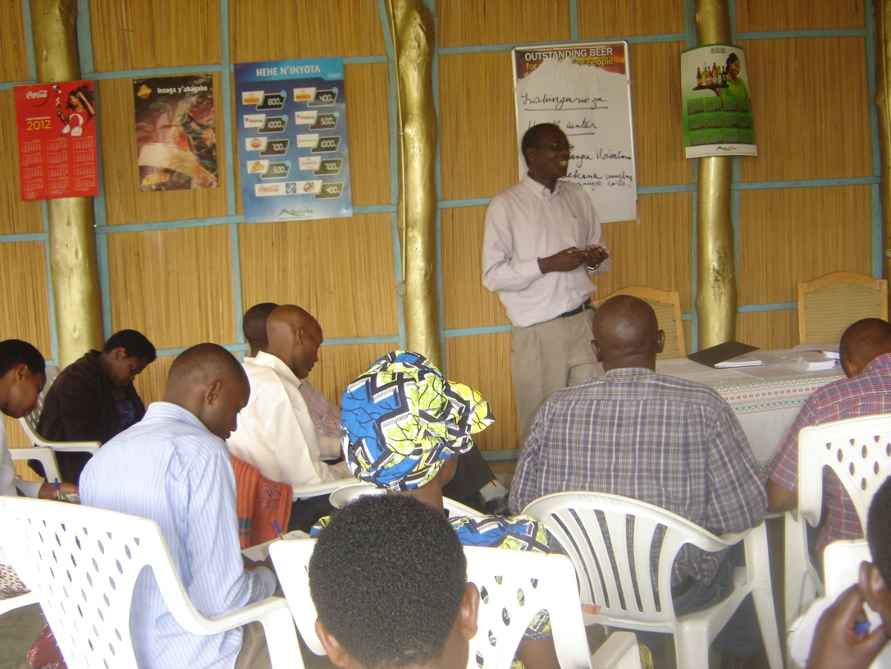
EOI3 Implementation in Rwanda
Identify of associations of community actors
Orient community leaders, service providers, and community health supervisors
Cascade training of associations
Radio broadcasts and community meetings
Monitor intervention districts
Notes:
In Rwanda, EOI3 was implemented in 4 districts. In those districts, 5 women’s associations, 43 community health worker associations, 2 men’s associations, and 1 couples association became implementation partners. Cascade training was used to orient the large group of participating community mobilizers at each level.
A radio campaign and community meeting discussions contributed to the success of EOI3. The radio spot and community discussions focused on the invitation card and the positive family planning messages conveyed. This created awareness of the campaign within the community, and familiarity with what the mobilizers were doing. Spreading the word of the campaign was essntial to the effectiveness of the approach.

Slide 9
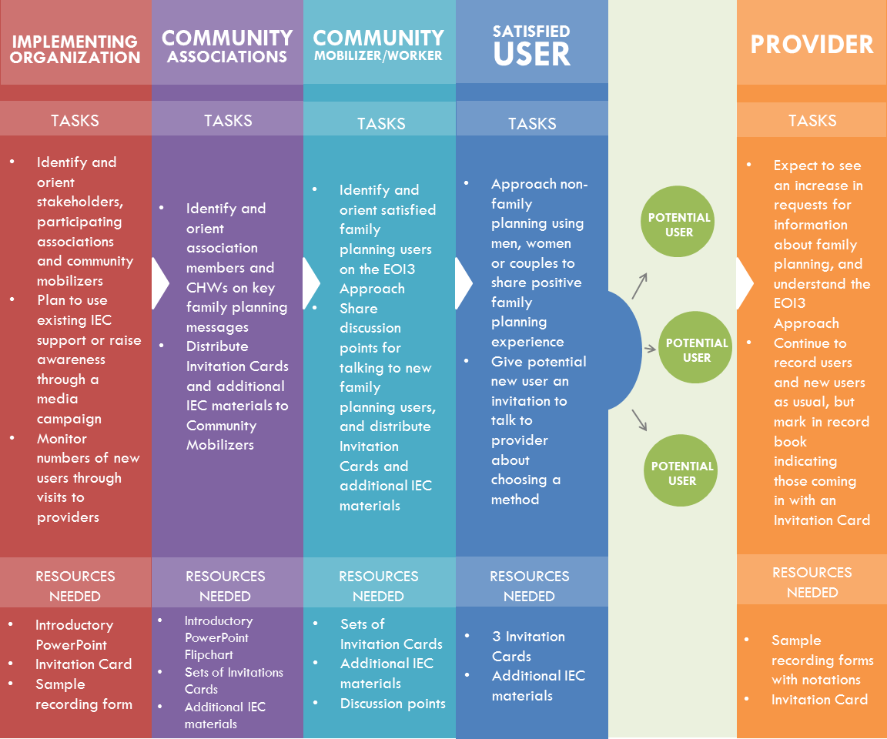
Implementation Players and their Roles
Notes:
The implementing organization must organize the key stakeholders involved in implementing EOI3. At the initial stakeholder meeting, all participants must be oriented in the approach and communities and community associations can be selected to participate.
Community associations are oriented, and repsonsible for identifying additional community mobilizers and orienting them as well. These community mobilizers also identify the satisfied users that will join them in reaching out to non-users with in the community.
All mobilizers will be provided with talking points and the invitation card to begin discussions with and give to others in the community who would benefit from family planning.
It is important for service providers to also be prepared to recieve new patients interested in family planning, prepared to discuss all family planning methods, and to have the necessary stock of methods available.

Slide 10
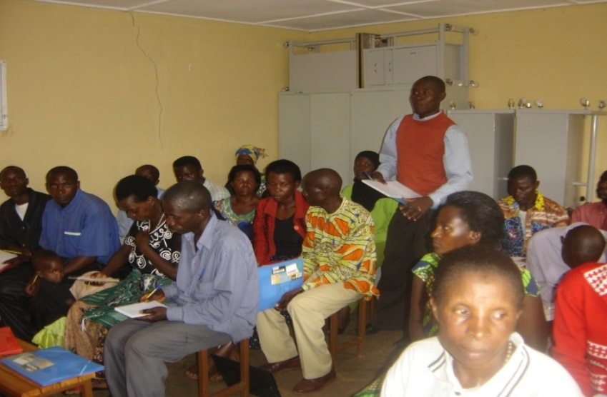
What is expected from Community Association leaders
first to be trained in the EOI3 approach
help to monitor the implementation of the approach
Identify additional mobilizers and are orient them in the EOI3 approach
Help to identify satisfied users who will share share their positive FP experience and distribute invitation cards
Distribute the stock of invitation cards to mobilizers and satisfied users
Sensitize the community to the EOI3 approach and the importance of FP
Submit a monthly monitoring report to the health center
Notes:
This slide should be used when orienting Community Association Leaders
Community Association leaders play an important role organizing association members and other participating EOI3 community mobilizers. They are responsible for sensitizing the community mobilizers and satisfied users to the approach, managing the stock of invitation cards, reporting to the health center and sensitizing the community to the approach.

Slide 11
Group work – Role play for invitation card distribution FP
In pairs, take10 minutes to prepare and present the role-play scenario assigned to your team.
Do you think you convinced the invitee of the benefits of family planning? Do you think s/he will visit her provider for more information?
Why is the invitee not currently using a family planning method? Did s/he take the invitation card and promise to discuss it with her partner?
What were some of the messages you used to convince the invitee that they should be using a family planning method?
Notes:
Use the role-play and discussion points found in the Guidelines for Implementation to help facilitate this session.

Slide 12
Results from EOI3 In Rwanda
EOI3 was tested in four districts in Rwanda: Gatsibo, Karongi, Rusizi and Rulindo.
Results from the pilot;
Rumors about family planning decreased;
Dialogue between husbands and wives about family planning increased;
Adherence to family planning services increased;
A relationship of trust developed between community mobilizers doing the inviting and the invited person;
Male involvement in family planning increased
Assessing the Each One Invites 3 Social Diffusion Approach: to Increase Family Planning Use – Including Standard Days Method – in Rwanda. Institute for Reproductive Health 2013, Draft
Notes:
EOI3 in Rwanda also showed an increase of 39% of new family planning users and referrals in targeted districts. Over 10,000 invitation cards were distributed, and near half were brought to health care providers for more information about family planning. Seventy-seven percent of users left with a method of their choice.

Slide 13
THANK YOU MURAKOZE

